Slide 1
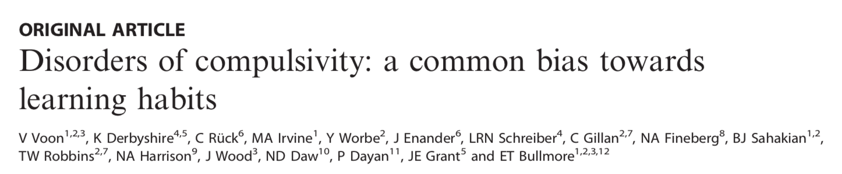
3

Slide 2
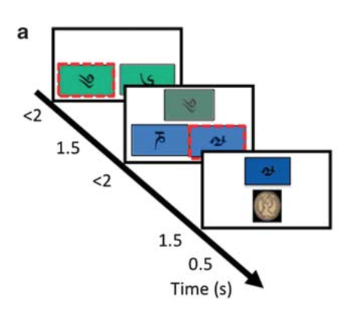
Experimental setting

Slide 3
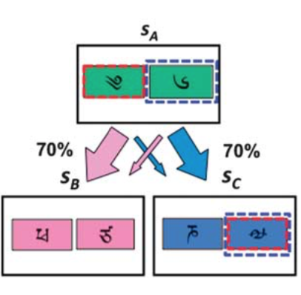
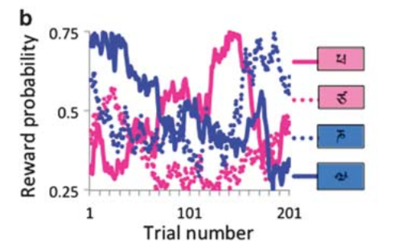
Experimental setting
Reward
Non-Reward

Slide 4
Experimental setting
Counterbalanced????
One choice is reward very high?
Reward
Non-Reward

Slide 5
List all the possible Q values

Slide 6
In the present study,
Model-free temporal difference algorithm
= habit behavior
= SARSA(State-action-reward-state-action) temporal difference algorithm
Model-based reinforcement learning algorithm
= goal-directed behavior

Slide 7
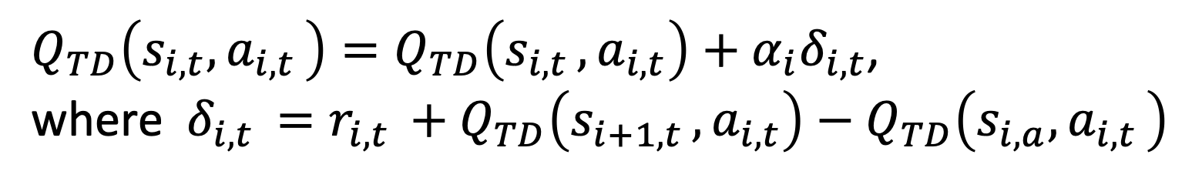
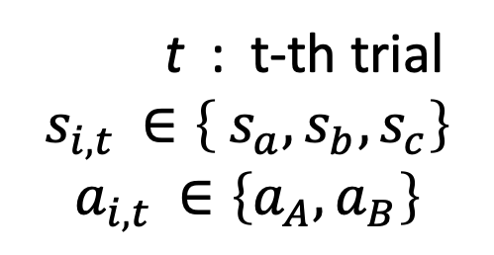
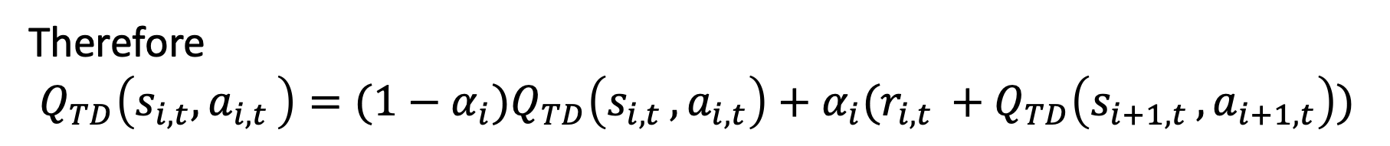
< Model-free temporal difference algorithm >
$Q_{TD}\left(s_{i,t},a_{i,t }\right)=Q_{TD}\left(s_{i,t }, a_{i,t}\right)+α_{i}δ_{i,t}$,
where $δ_{i,t }=r_{i,t }+Q_{TD}\left(s_{i+1,t },a_{i,t}\right)−Q_{TD}\left(s_{i,a},a_{i,t }\right)$
Therefore
$Q_{TD}\left(s_{i,t},a_{i,t }\right)={(1−α_{i})Q}_{TD}\left(s_{i,t }, a_{i,t}\right)+α_{i}(r_{i,t }+Q_{TD}\left(s_{i+1,t },a_{i+1,t}\right))$
t : t-th trial
$$s_{i,t }∈\left\{ s_{a},s_{b},s_{c}\right\}$$
$$a_{i,t }∈\left\{a_{A},a_{B}\right\}$$
Note

Slide 8
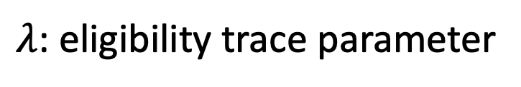
< Model-free temporal difference algorithm >
Updating procedure
*black, red and green color indicates old, updated and re-updated value.
Stage-1
$Q_{TD}\left(s_{A},a_{1,t }\right)={(1−α_{1})Q}_{TD}\left(s_{A }, a_{1,t}\right)+α_{1}(0+Q_{TD}\left(s_{2,t },a_{2,t}\right))$
Stage-2
$Q_{TD}\left(s_{2,t},a_{2,t }\right)={(1−α_{2})Q}_{TD}\left(s_{2,t }, a_{2,t}\right)+α_{2}(r_{2,t}+0)$
Re-update Stage-1
$Q_{TD}\left(s_{A},a_{1,t }\right)=Q_{TD}\left(s_{A }, a_{1,t}\right)+α_{1}λ(r_{2,t }+0−Q_{TD}\left(s_{2,t },a_{2,t}\right))$
$λ$: eligibility trace parameter

Slide 9
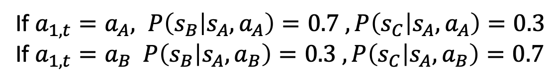
< Model-based reinforcement learning algorithm >
Stage-1
$$Q_{MB}\left(s_{A},a_{1,t}\right)=P\left(s_{B} | s_{A},a_{1,t }\right)\max_{k}{Q_{TD}(s_{B},a_{k})}+P\left(s_{C} | s_{A},a_{1,t }\right)\max_{k}{Q_{TD}(s_{C},a_{k})}$$
If $a_{1,t}=a_{A}, P\left(s_{B} | s_{A},a_{A}\right)=0.7 , P\left(s_{C} | s_{A},a_{A}\right)=0.3$
If $a_{1,t}=a_{B} P\left(s_{B} | s_{A},a_{B}\right)=0.3 , P\left(s_{C} | s_{A},a_{B}\right)=0.7$
The difference from model-free algorithm is
- Q_{MB} itself is not updated based on previous Q_{MB}
- Even if a_{B} at state s_{B} gets no reward at all, it does not affect value of Q_{MB}
Stage-2
$Q_{TD}\left(s_{2,t},a_{2,t }\right)={(1−α_{2})Q}_{TD}\left(s_{2,t }, a_{2,t}\right)+α_{2}(r_{2,t}+0)$

Slide 10
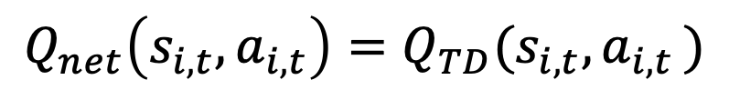
< The net values>
Stage-1
$$Q_{net}\left(s_{A},a_{i,t}\right)=wQ_{MB}\left(s_{A},a_{i,t}\right)+\left(1−w\right)Q_{TD}\left(s_{A},a_{j}\right)$$
Stage-2
$$Q_{net}\left(s_{i,t},a_{i,t}\right)=Q_{TD}(s_{i,t}, a_{i,t })$$
Note that Q_{TD} at stage-2 is completely same
between model-free and model-based algorithm

Slide 11
< The probability of a choice at each stage >
Using softmax function,
$$P\left(a_{i,t} | s_{i,t}\right)=\frac{\exp\left(β_{i}\left[Q_{net}\left(s_{i,t},a_{i,t}\right)+p∗rep\left(a_{i,t}\right)\right]\right)}{\exp\left(β_{i}\left[Q_{net}\left(s_{i,t},a_{A}\right)+p∗rep\left(a_{A}\right)\right]\right)+\exp\left(β_{i}\left[Q_{net}\left(s_{i,t},a_{B}\right)+p∗rep\left(a_{B}\right)\right]\right)}$$
$rep\left(a_{i,t}\right)=1$, if an action is a stage-1 and $a_{1,t}=a_{1,t−1 }$
< Likelihood >
〜Calculation algorithm〜
Set LL = 0
For subjects
All Q values are set to be 0
For trials from 1 to 201
update Q values
LL += log P(a_{1,t} | s_{A}) + log P(a_{2,t} | s_{2,t})

Slide 12
< parameters >
Name | Explanation
w | Index of relative engagement of each model. w = 0 -> habitual, w = 1 -> goal directed.
a₁ , a₂ | Learning rate at each stage
β₁ , β₂ | Inverse parameter, a measure of choice reliability at each stage
p | perseveration of switching
λ | Eligibility trace parameter

Slide 13
< Results >
Groups : HV vs BED, HV vs Obese, HV vs OCD, HV vs Meth, HV vs EtOH
Metrics :
1. model-free vs model-based parameters.
2. w vs measures of severity of diseases
3. Stay probability between groups
4. w vs volume of left medial OFC (orbitofrontal cortical) in HV
BED : 過食性障害, OCD : 脅迫性障害

Slide 14
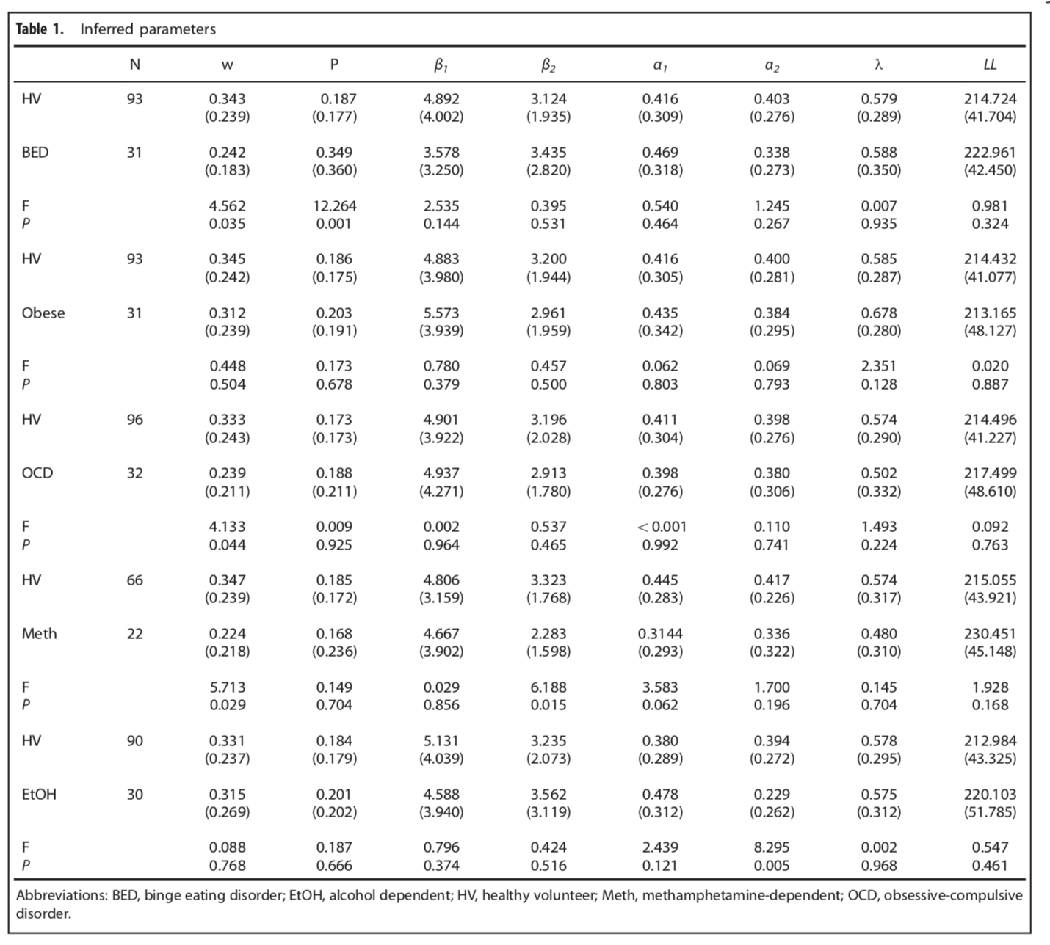
model-free vs
model-based parameters.
F and P values is …?
Multivariate test?

Slide 15
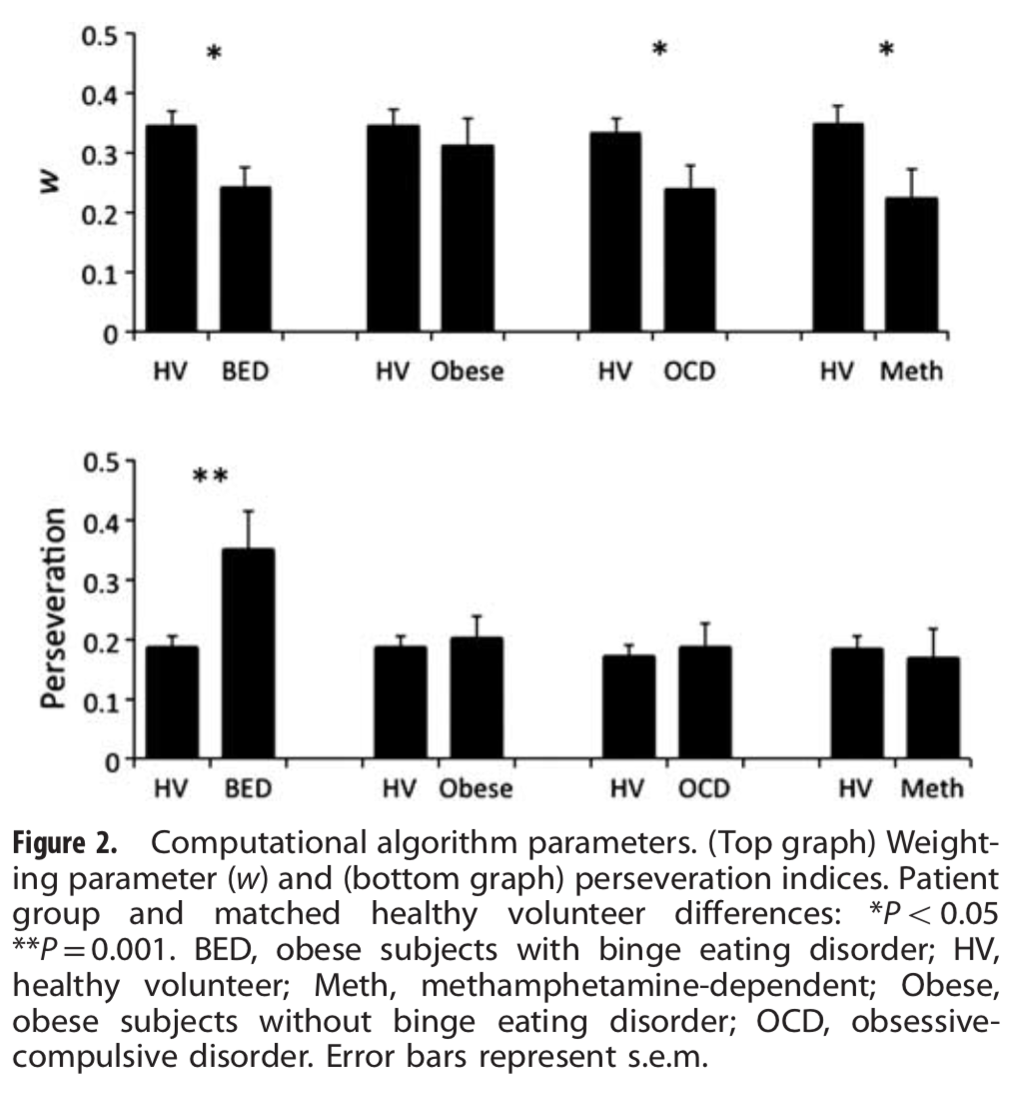
model-free vs
model-based parameters.

Slide 16
2. w vs measures of severity of diseases
w = 0 -> habitual, w = 1 -> goal directed.
For Obese subjects
Binge Eating Scale scores(the higher the worse)
and w were negatively correlated.
* Each question has 3-4 separate responses assigned a numerical value. The score range is from 0-46:
Non-binging; less than 17
Moderate binging; 18-26
Severe binging; 27 and greater
For EtOh subjects
weeks abstinent(禁酒) were positively correlated.
For OCD(YBOCS)
on antidepressants vs not on medications,
no difference in w

Slide 17
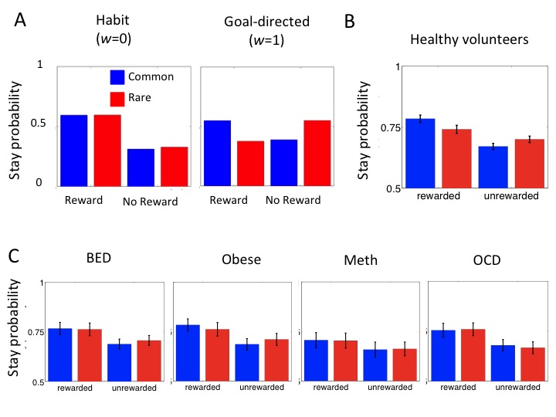
3. Stay probability
Outcome * Frequency *Group
-> BED and OCD has
significant difference
, Meth is p = 0.07

Slide 18
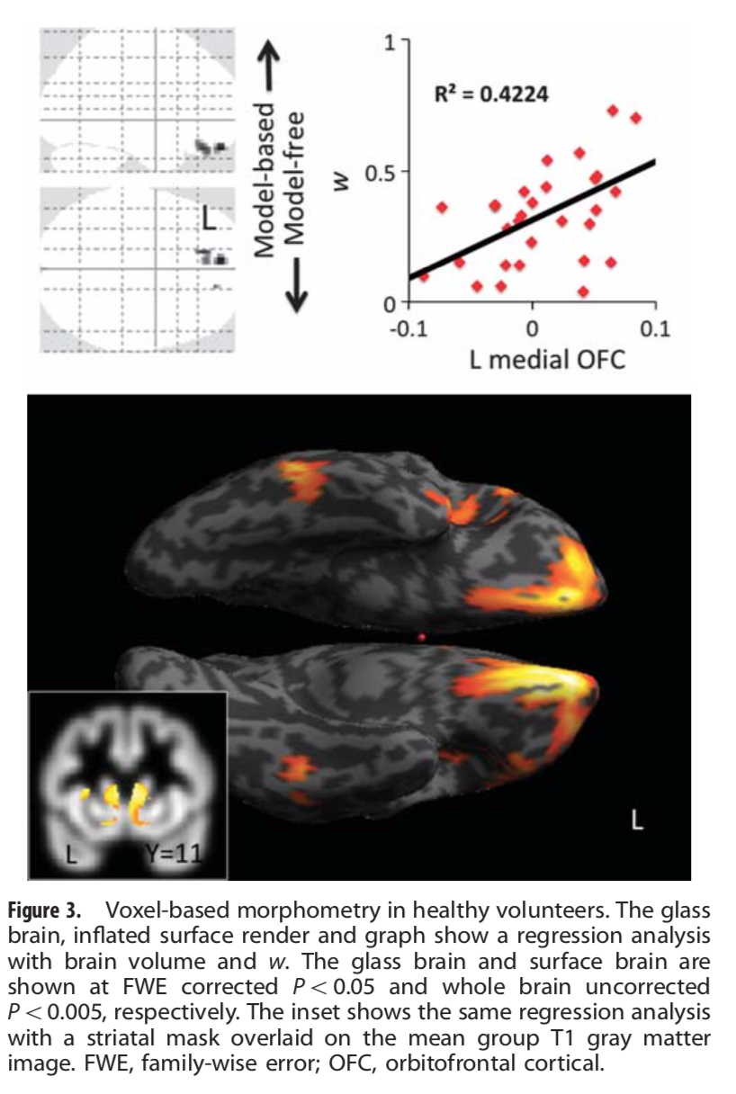
4. w vs volume of
left medial OFC
(orbitofrontal cortical) in HV
Small volume correction analysis shows
w correlated with
bilateral caudate volume
bilateral prefrontal
not correlated with
putamen,
ventral striatum
parietal cortex volume

Slide 19
In summary,
1.BED, OCD and Meth people are tend to do
model-free behavior, that is,
not thinking about future results deeply.
2. patience (kept by future rewards) is
related with model-based thinking.
3. habitual behavior is correlated with
caudate and medial orbitofrontal cortex.

Slide 20
Nathaniel D. Daw’s research flow is excellent
Start with hypothetical proposal from modeling.(2)
↓
Experient on small to large healthy people. (3-1,3-2,etc...)
↓
Research on people with disorders. (3)

