Slide 1
A quantitative simulation-based evaluation of the early detection of poliovirus using environmental surveillance.

Slide 2
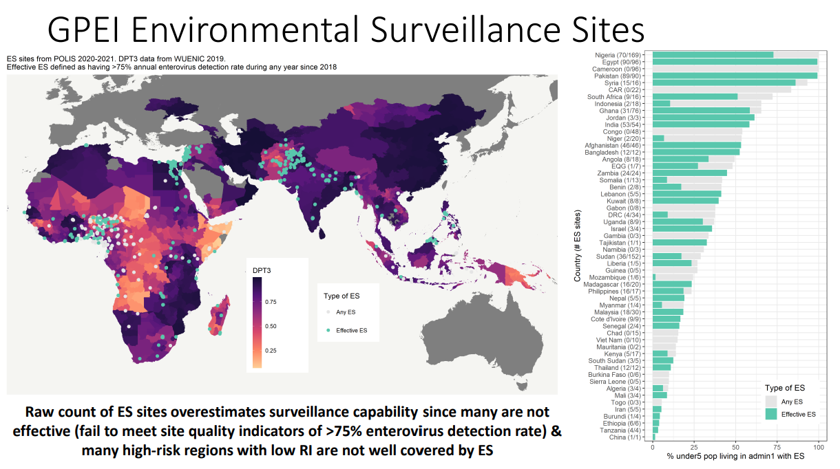

Slide 3
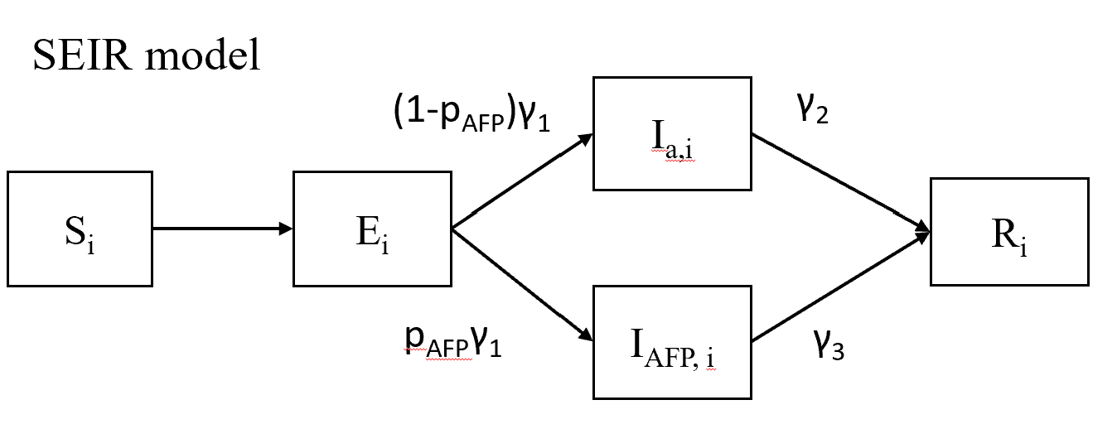
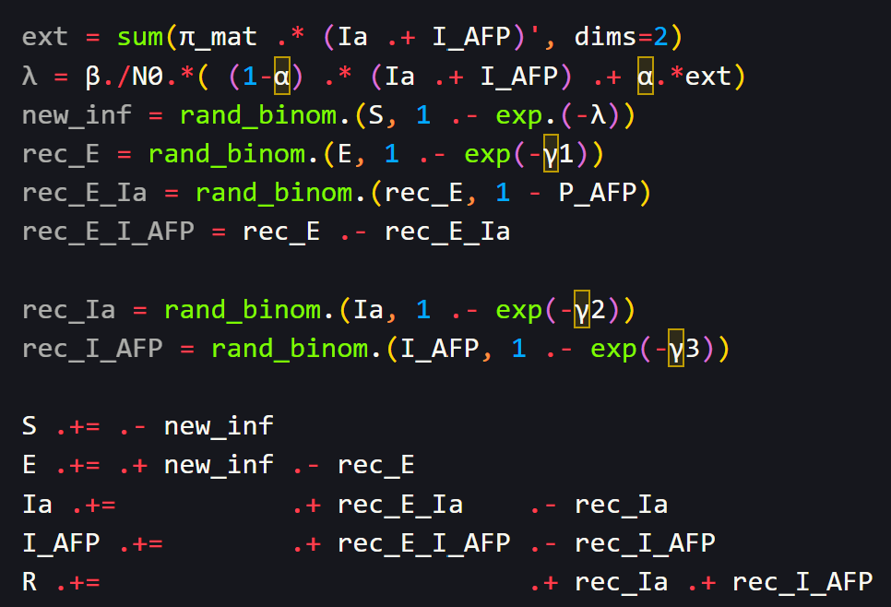
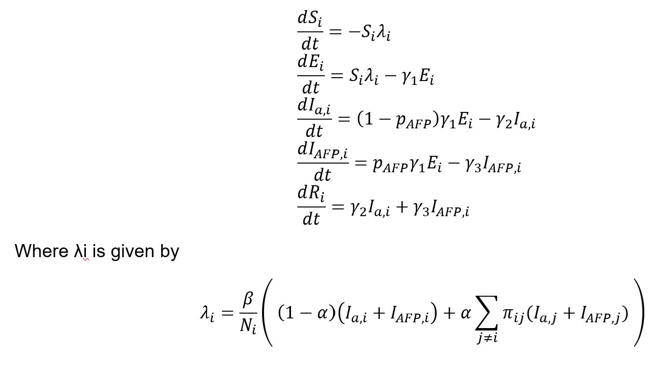
Model formulation
For the stochastic simulation, I used the binomial sampling based on the rate from the differential equations.

Slide 4
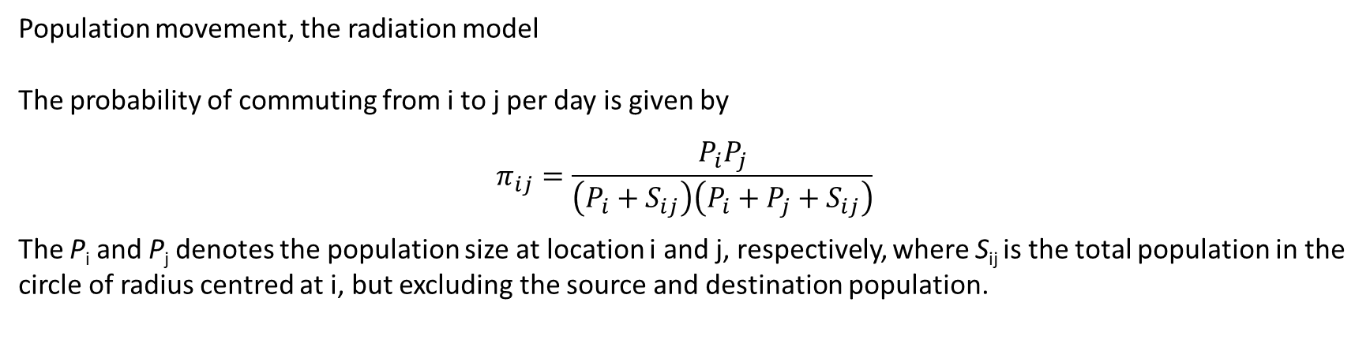
Population movement, the radiation model
The probability of commuting from i to j per day is given by
$$π_{ij}=\frac{P_{i}P_{j}}{\left(P_{i}+S_{ij}\right)\left(P_{i}+P_{j}+S_{ij}\right)}$$
The P_{i} and P_{j} denotes the population size at location i and j, respectively, where S_{ij} is the total population in the circle of radius centred at i, but excluding the source and destination population.

Slide 5
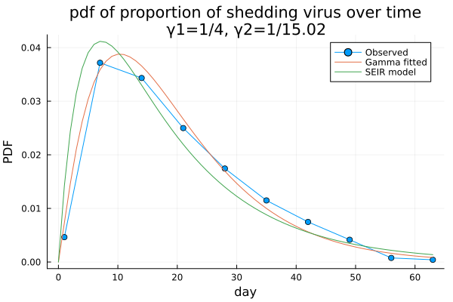
Virus shedding
Using the proportion of virus shedding individuals, scaled to be one for the PDF.
Then gamma fitting results using the Kullback-Leibler divergence show the shape parameter is 2.1,
Indicating the SEIR is suffice. Then, estimating the γ2 using the convolution of exponential distribution,
Obtaining 15.02 for γ2.

Slide 6
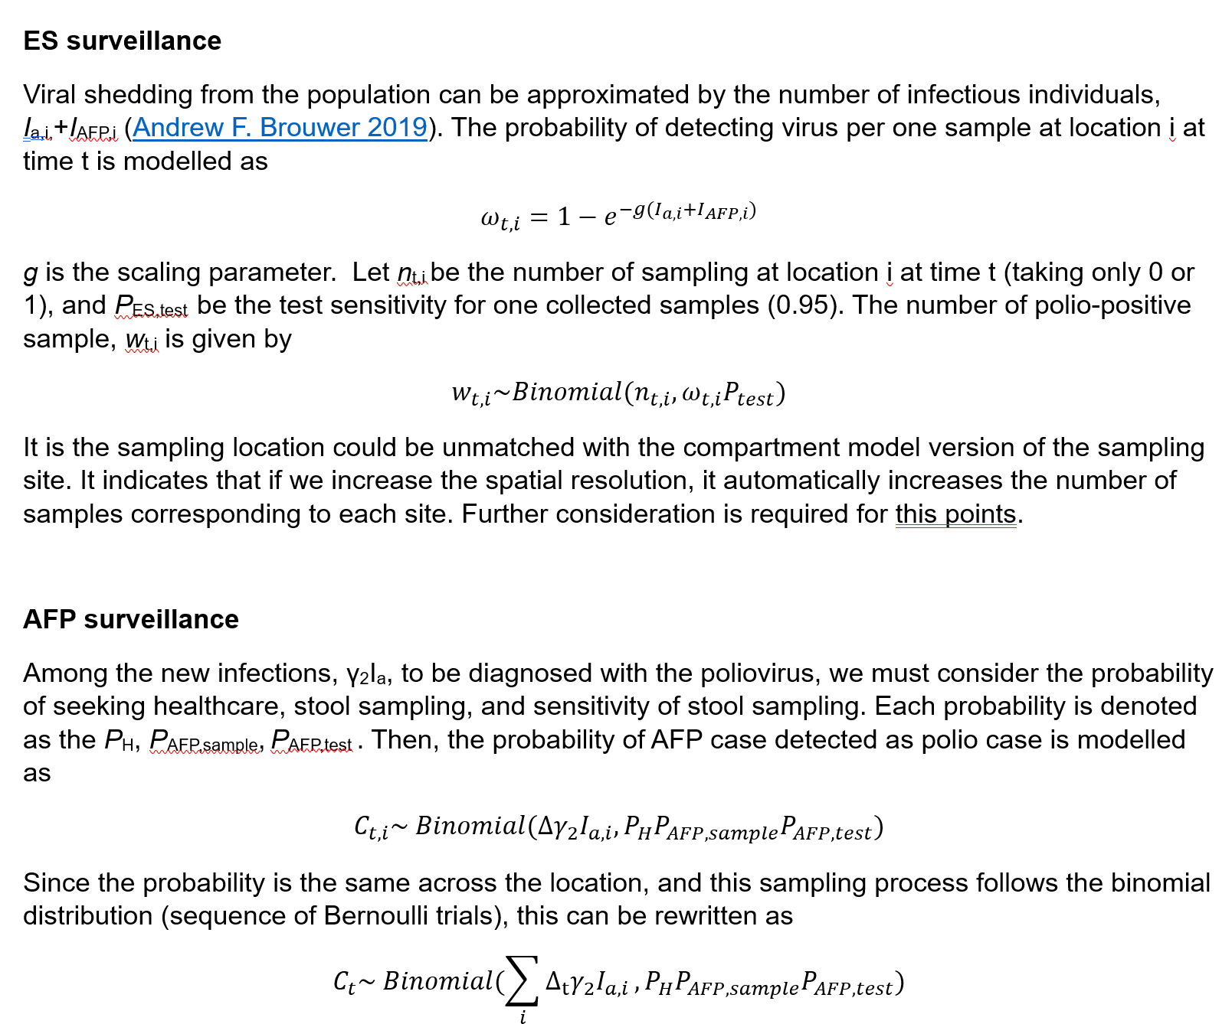

Slide 7
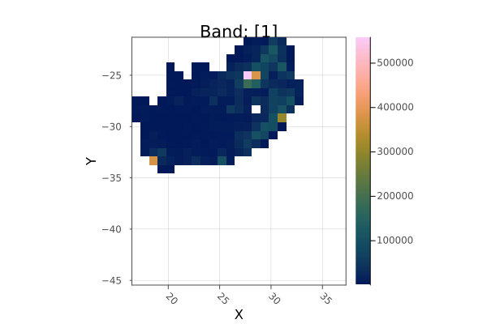
Aggregated population map
Latitude diff: 92.66 km, Longitude diff: 85.84 km
The population is children aged under 5 years old.
I only included 10% of children aged under 5 years old, assuming 90% children get vaccinated, and 10% children are unvaccinated. So, within this simulation, I only consider the unvaccinated individuals.
Baseline environmental surveillance population coverage is set to be 50% (in the order of high population area)

Slide 8
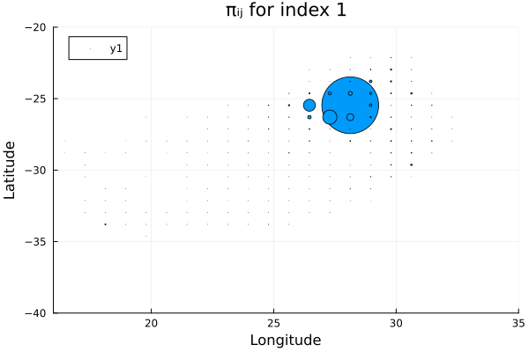
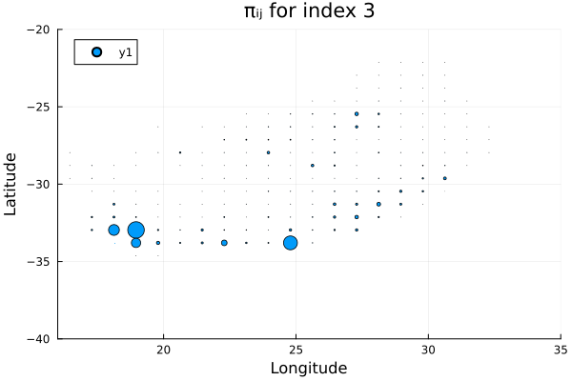
Population movement coefficients, πij
Index 1 represents the most populous area in South Africa,
Index 3 represents the 3rd populous area in South Africa

Slide 9
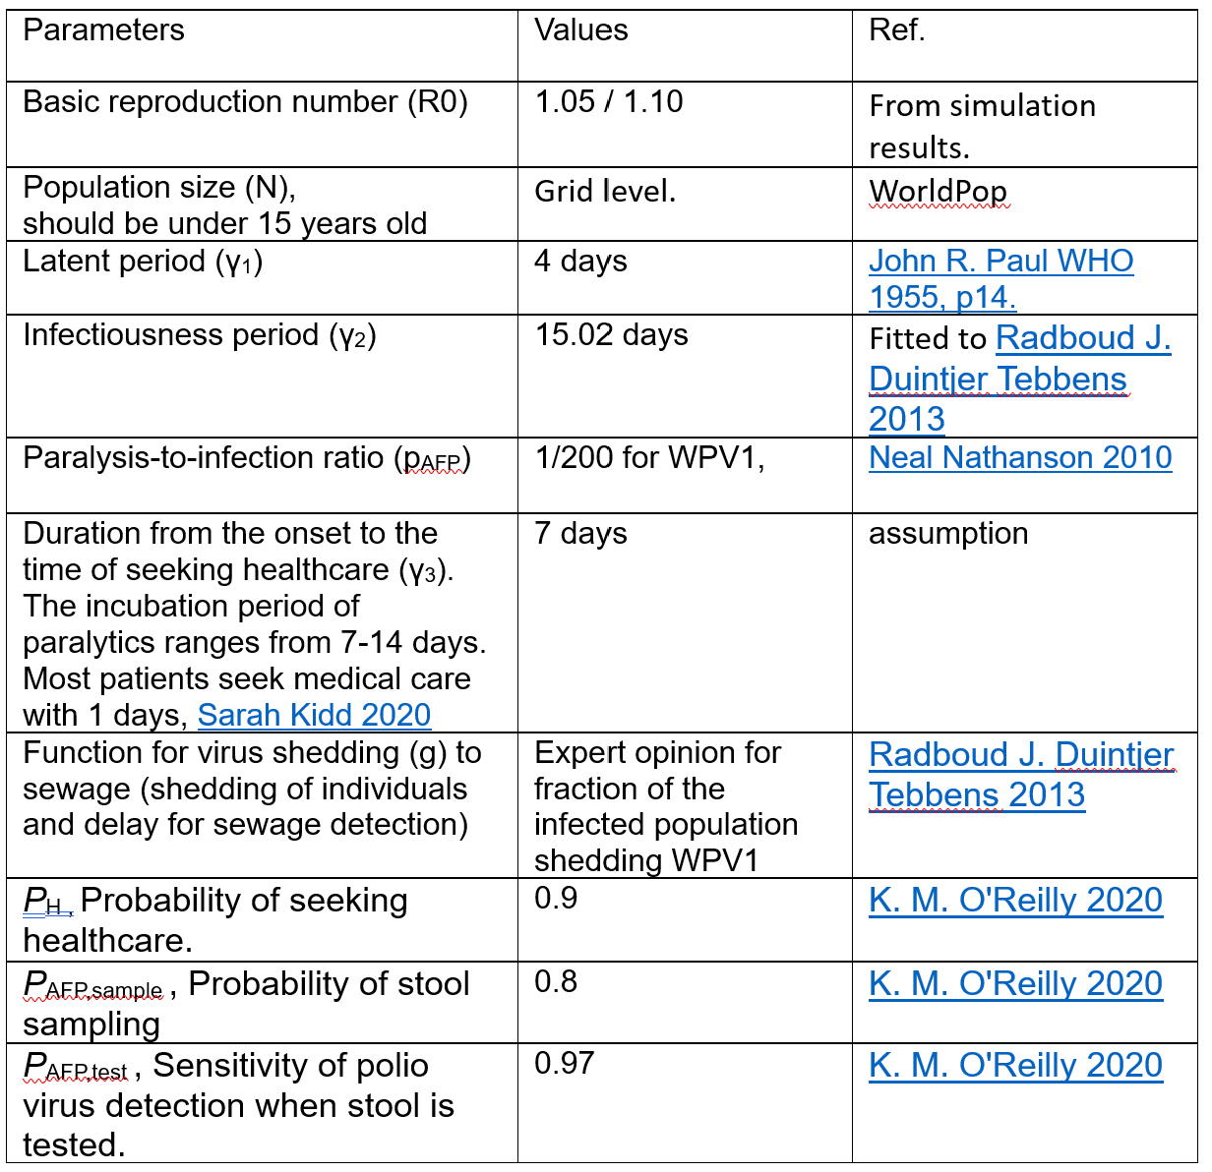

Slide 10
Results
Based on the AFP cases shown in the results,
R0 = 1.05 for 1-25 AFP cases.
R0 = 1.10 for 100~1000 AFP cases.
(Low R0 means high herd immunity from 90% of vaccinated individuals around unvaccinated children.)

Slide 11
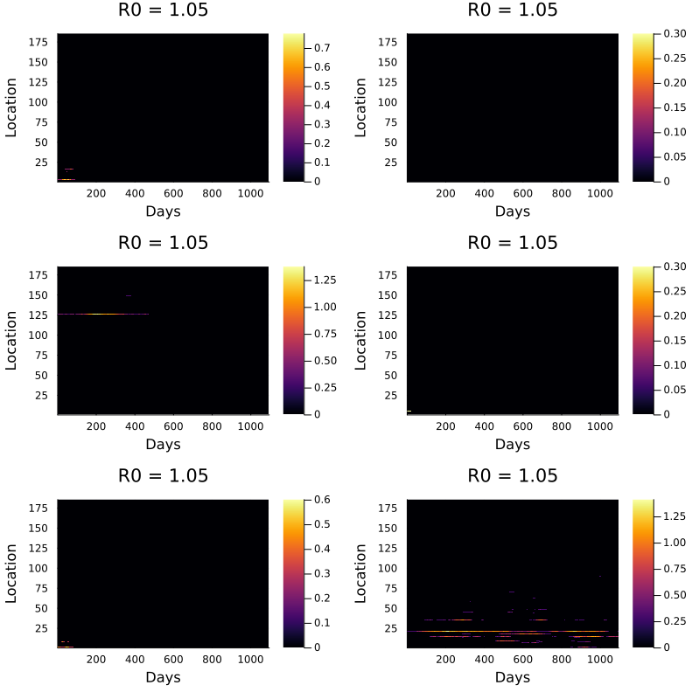
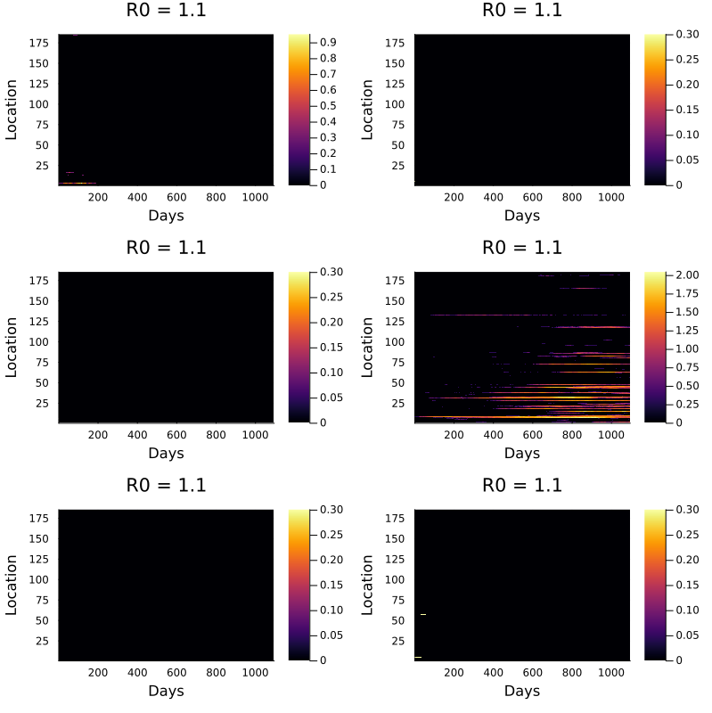
Number of asymptomatic cases (Ia) over time
zaxis is given by log10(Ia + 1)

Slide 12
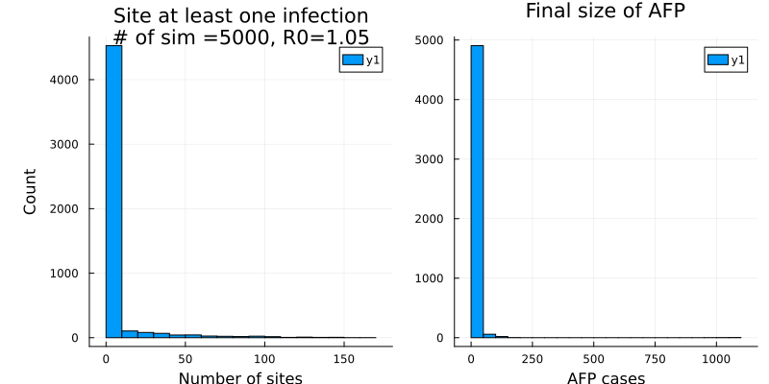
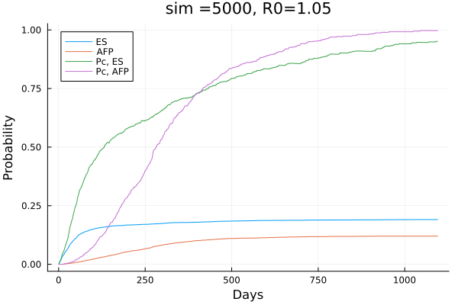
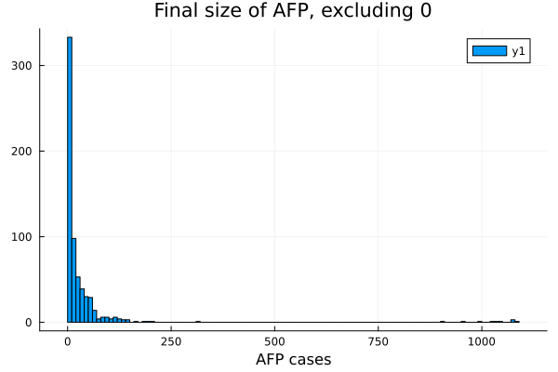
Statistics for AFP cases, Surveillance situation., R0=1.05
Cumulative probability for both surveillance
Under total or conditional probability.
# of detection patterns.
"Both" => 465
"Neither" => 3911
"ES only" => 489
"AFP only" => 135
Mean ES: 92.83 days, Mean AFP: 253.5 days

Slide 13
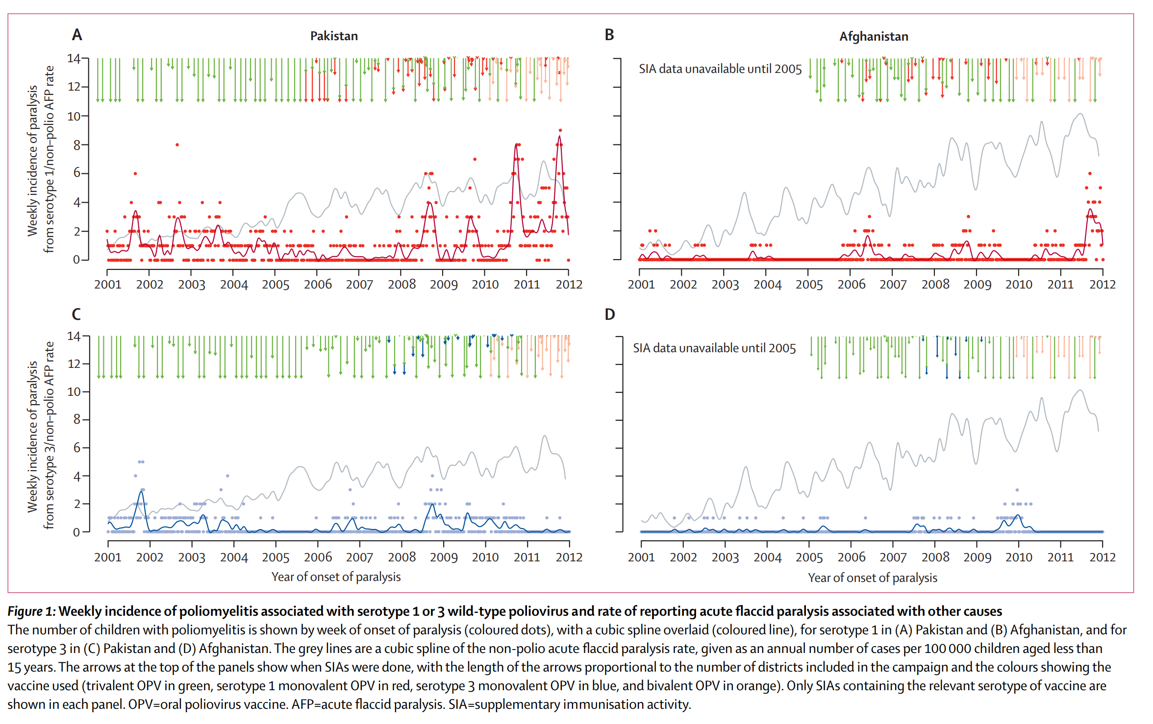
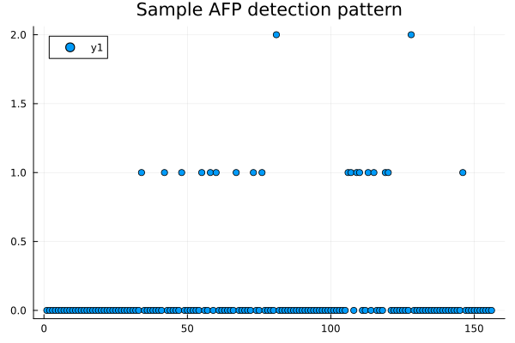

Slide 14
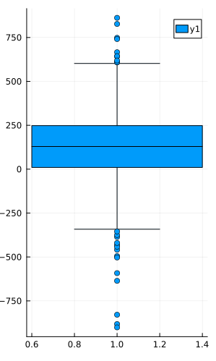
Statistics for AFP cases, Surveillance situation., R0=1.05
Lead time for ES over AFP surveillance
Summary Stats:
Length: 465
Missing Count: 0
Mean: 120.593548
Minimum: -901.000000
1st Quartile: 10.000000
Median: 129.000000
3rd Quartile: 248.000000
Maximum: 862.000000
Type: Float64
% of early detect by ES: 77.2

Slide 15
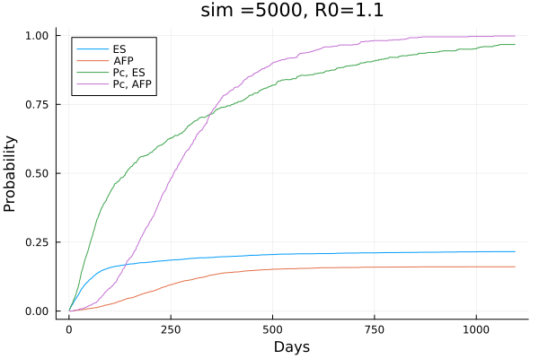
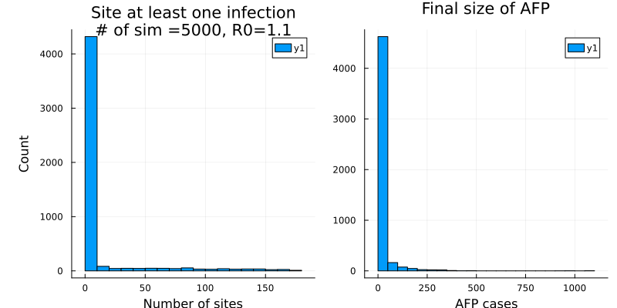
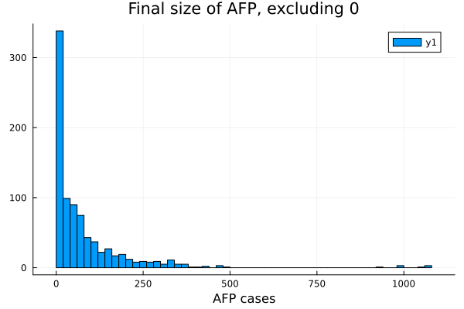
Statistics for AFP cases, Surveillance situation., R0=1.1
Dict{Any, Int64} with 4 entries:
"Both" => 673
"Neither" => 3790
"ES only" => 406
"AFP only" => 131
Mean ES: 116.6 days, Mean AFP: 242.4 days

Slide 16
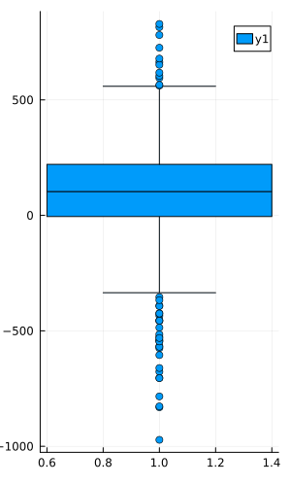
Statistics for AFP cases, Surveillance situation., R0=1.1
Lead time for ES over AFP surveillance
Summary Stats:
Length: 673
Missing Count: 0
Mean: 87.704309
Minimum: -972.000000
1st Quartile: -5.000000
Median: 103.000000
3rd Quartile: 221.000000
Maximum: 829.000000
Type: Float64
% of early detect by ES: 74.29

Slide 17
Sensitivity analysis results for R0=1.05

Slide 18
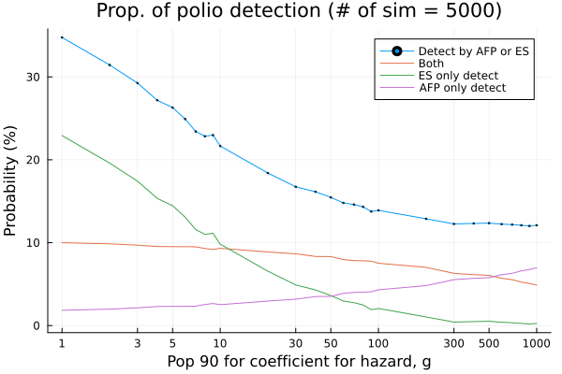
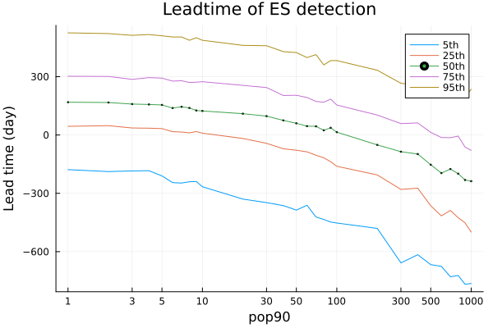
Hazard g
g is chosen such that ωt = 1 – e(g*N_pop90) = 0.9
Baseline value is N_pop90 = 10

Slide 19
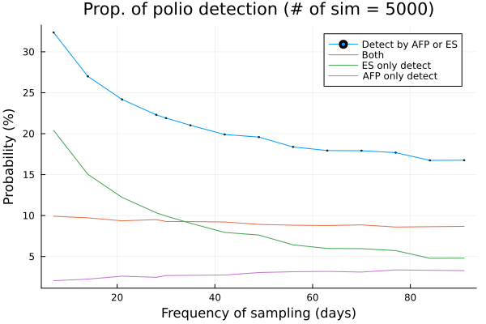
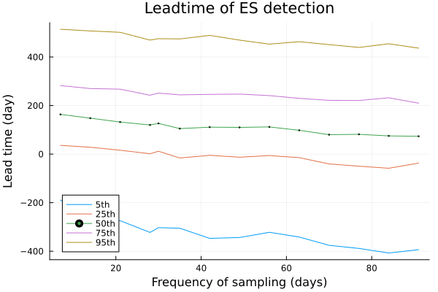
Frequency of environmental sampling
Baseline value is 30 days

Slide 20
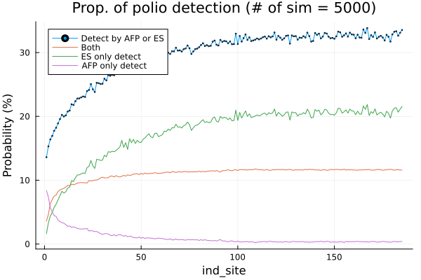
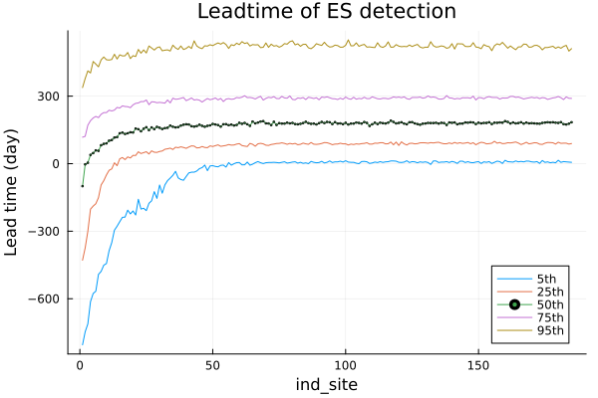
ES catchment area based on area (square, index)
ES area is chosen in the order of large population area.

Slide 21
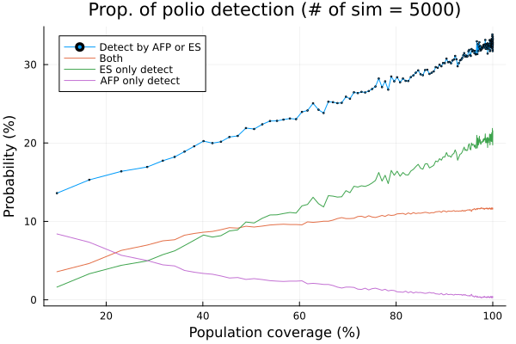
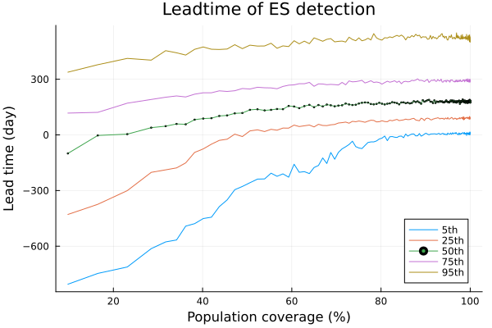
ES catchment area based on the population coverage
Baseline is population coverage = 50%.

Slide 22
Sensitivity analysis results for R0=1.10

Slide 23
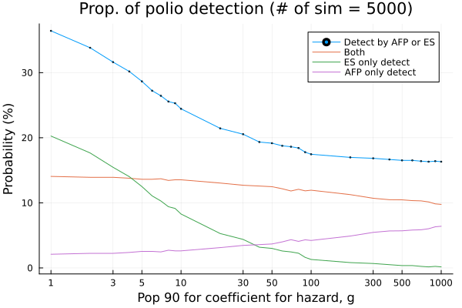
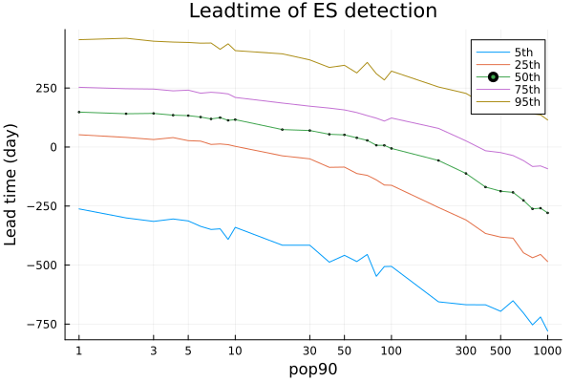
Hazard g
g is chosen such that ωt = 1 – e(g*N_pop90) = 0.9
Baseline value is N_pop90 = 10

Slide 24
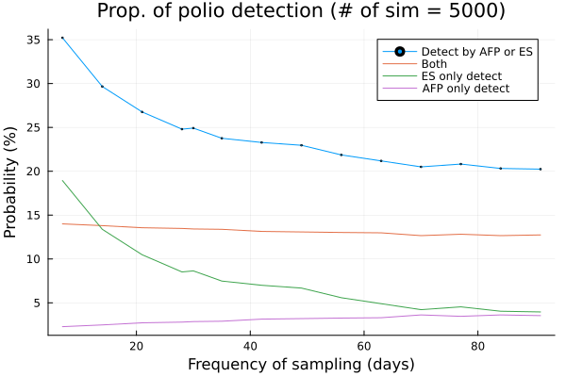
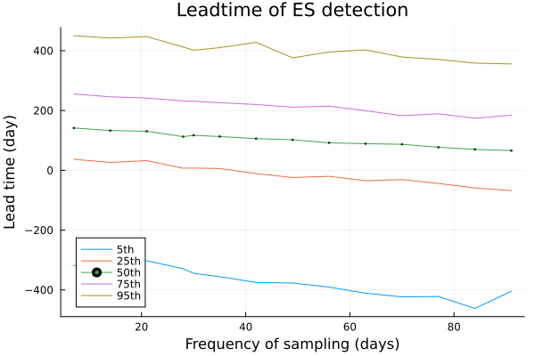
Frequency of environmental sampling
Baseline value is 30 days

Slide 25
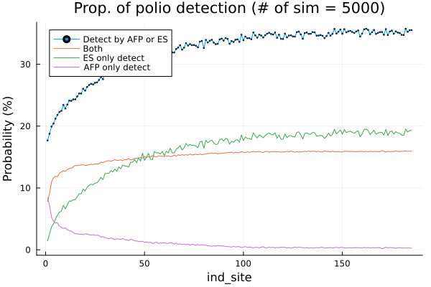
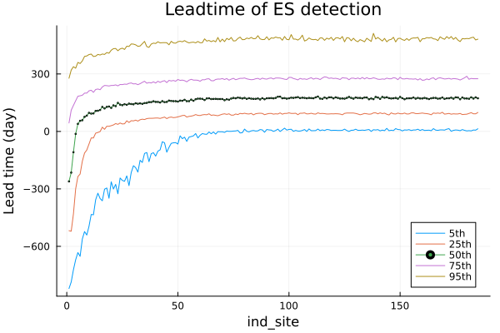
ES catchment area based on area (square, index)
ES area is chosen in the order of large population area.

Slide 26
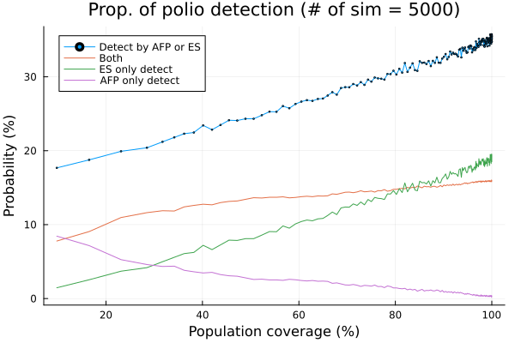
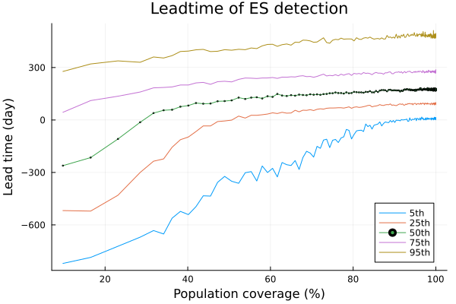
ES catchment area based on the population coverage
Baseline is population coverage = 50%.

Slide 27
Sensitivity analysis results
Varying R0

Slide 28
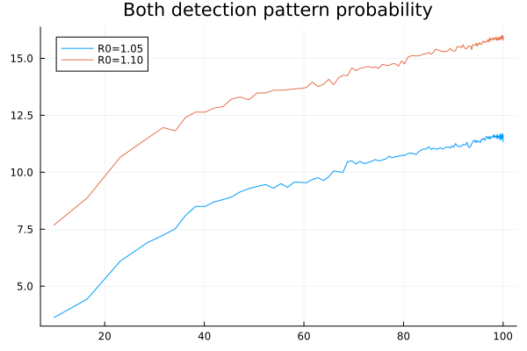
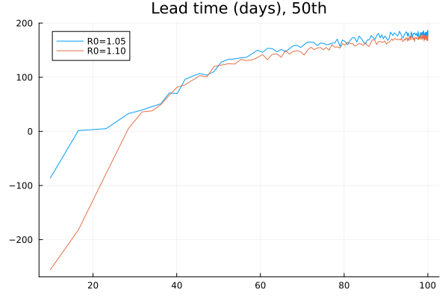

Slide 29
Pending Conclusions
Under the R0=1.05 (Plausible scenario in terms of AFP cases),
% of early detect by ES: 77.2, and 100 days ahead of AFP detections.
Among all detected simulations, ES only accounts for 45%, whereas
AFP only accounts for 12%.
By 50% of population coverage of ES surveillance, the lead time for ES increases significantly, but after that, the additional benefit is diminished.
ES ability of detection, (expressed by hazard coefficient) becomes important if 90% detection probability is achieved when 25 or more infectious individuals appear.
Frequency of sampling increases the ES only detection, but does not affect percentages of both detection and the lead time.

Slide 30
Current consideration
The simulation runs for 3 years, should I include the birth and death?
Though the age distribution in the Bradley G. Wagner 2014 Figure 5 shows when importation/outbreak, under 5 age group accounts for most, but people > 5 years are also affected moderately.
Is it ok to set the ES area according to the population size?
Vaccine introduced model.
If vaccinated individuals do not contribute to the secondary transmissions, the current model (R0=1.05, 1.10) expresses this situation. β/(Nu + Nv)
Link functions for the detection from the number of infections.

Slide 31
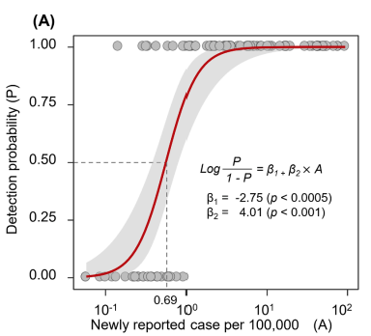
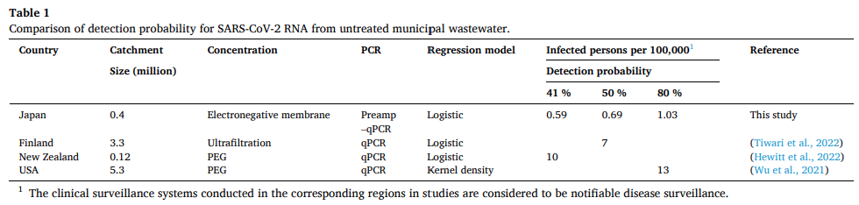
COVID-19 context, first detection is modelled by logistic regression.
Hiroki Ando 2023

Slide 32
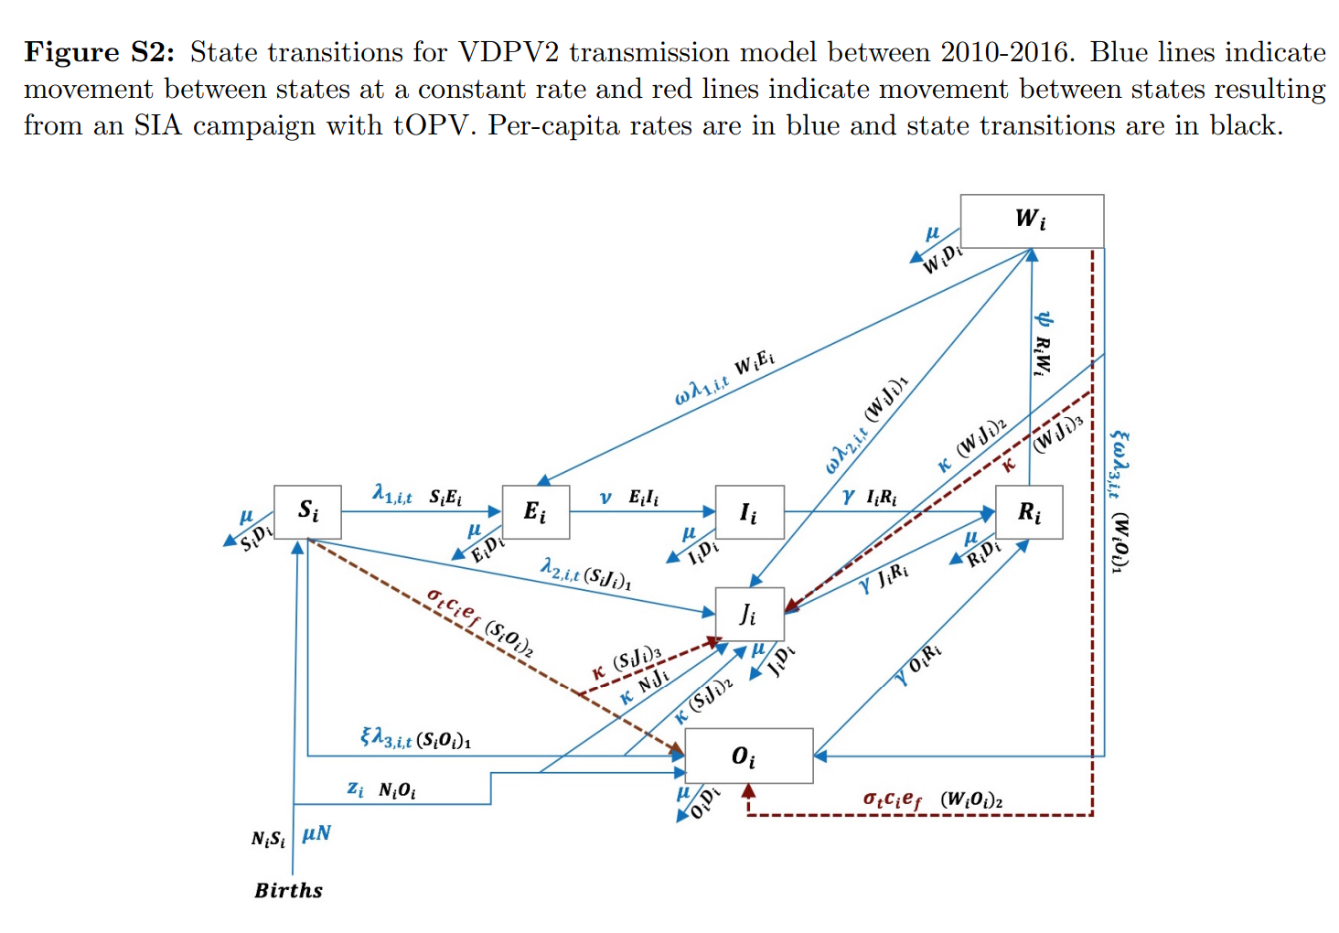
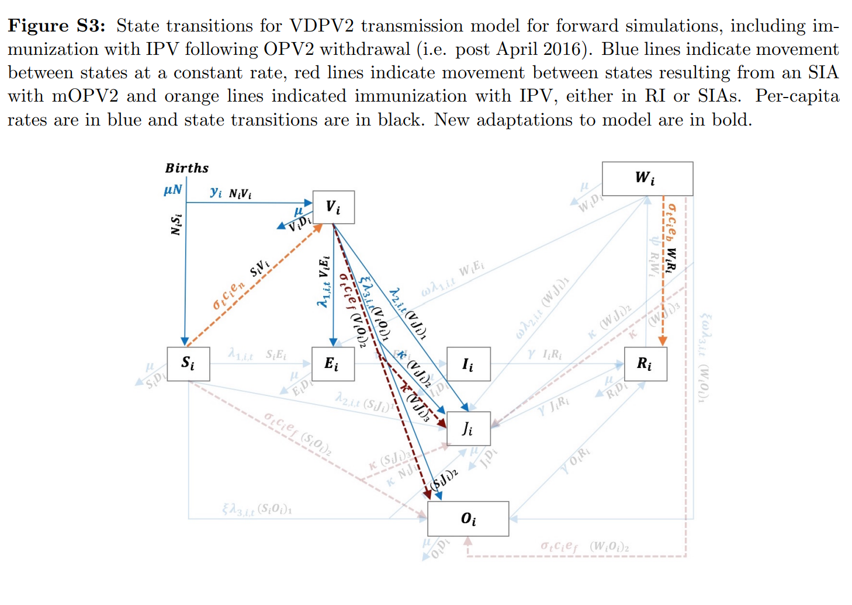
Vaccination effects in the context VDPV2 transmission

Slide 33
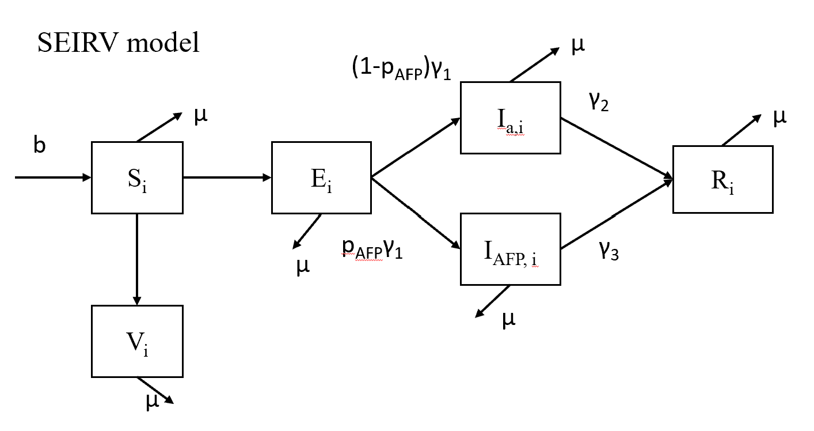
+ I_{IPV} + I_{IPV}
-> Vi (IPV vaccinated) would contribute to the transmission?
If IPV and OPV, it contributes much less for the transmission.
If IPV only, some levels of protection are present due to non-epidemic in developed countries for a long time.
What’s the VE against AFP development from IPV? And Virus shedding contribution is different for ES (but negligible due to lack of mucosal immunity?).

