Slide 1
Natural history of polio
γ2
γ3
Onset of AFP
Seeking healthcare
Notified as polio
γ1
Susceptible
λ
Infected
Secretion in sewage
τ2
Detected in sewage
τ1

Slide 2
Natural history of polio
Asymptomatic
(1-p)γ1
γ2
γ3
Onset of AFP
Seeking healthcare
Notified as polio
pγ1
Susceptible
λ
Infected
Secretion in sewage
τ2
Detected in sewage
τ1

Slide 3
Vaccinated against polio
Asymptomatic
(1-pv)γ1v
γ2
γ3
Onset of AFP
Seeking healthcare
Notified as polio
Susceptible
λv
Infected
pvγ1v
Secretion in sewage
τ2v
Detected in sewage
τ1v

Slide 4
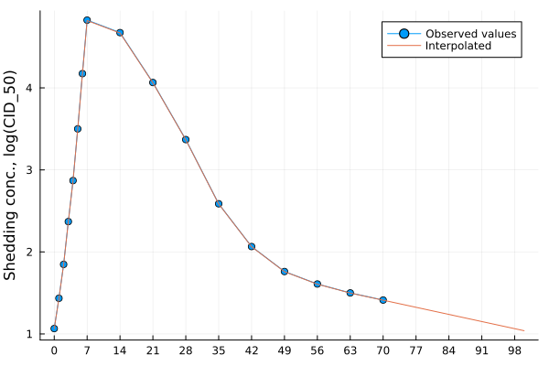
SEIR model
γ2
Ia
R
γ1
S
E
γ1
I_{AFP}
γ3
H
New Ia + I_{AFP}
Shedding following

