Slide 1
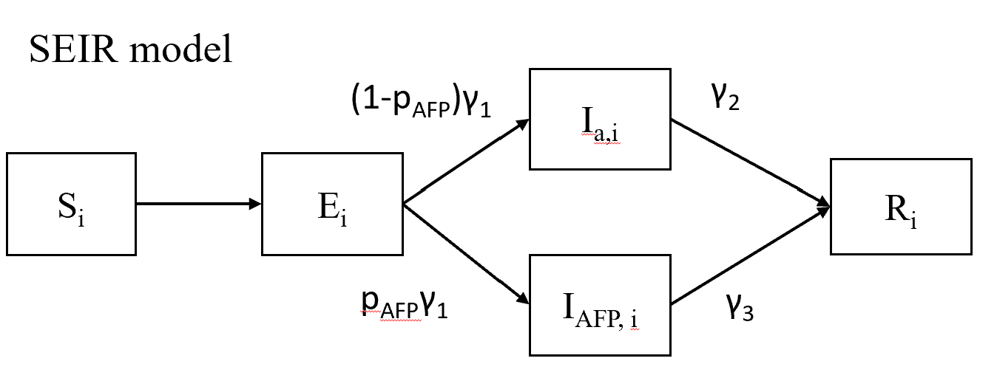
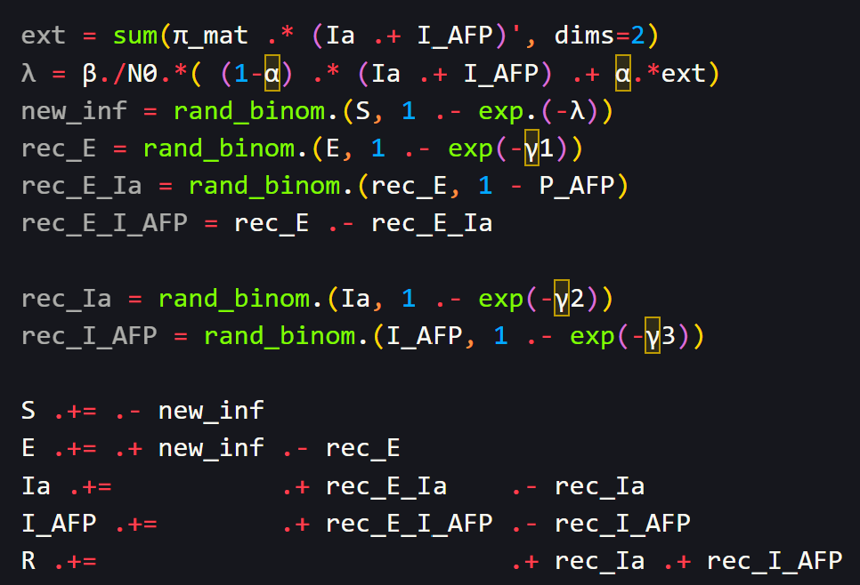
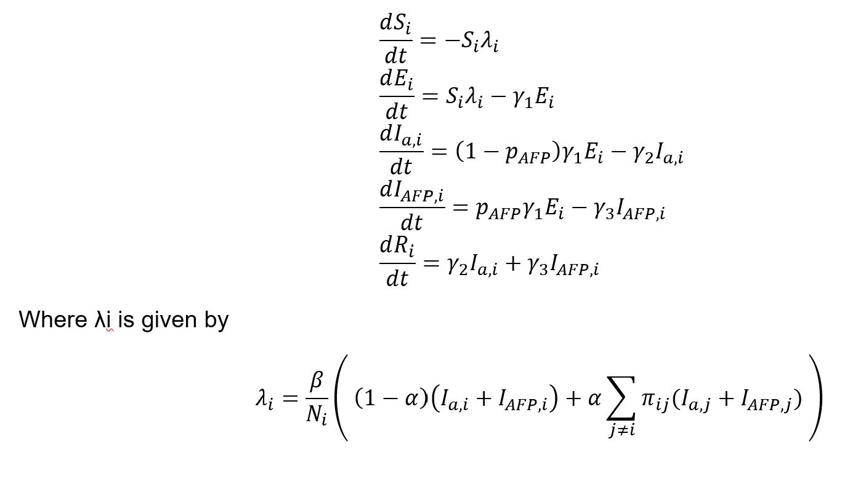
Model formulation
For the stochastic simulation, I used the binomial sampling based on the rate from the differential equations.

Slide 2
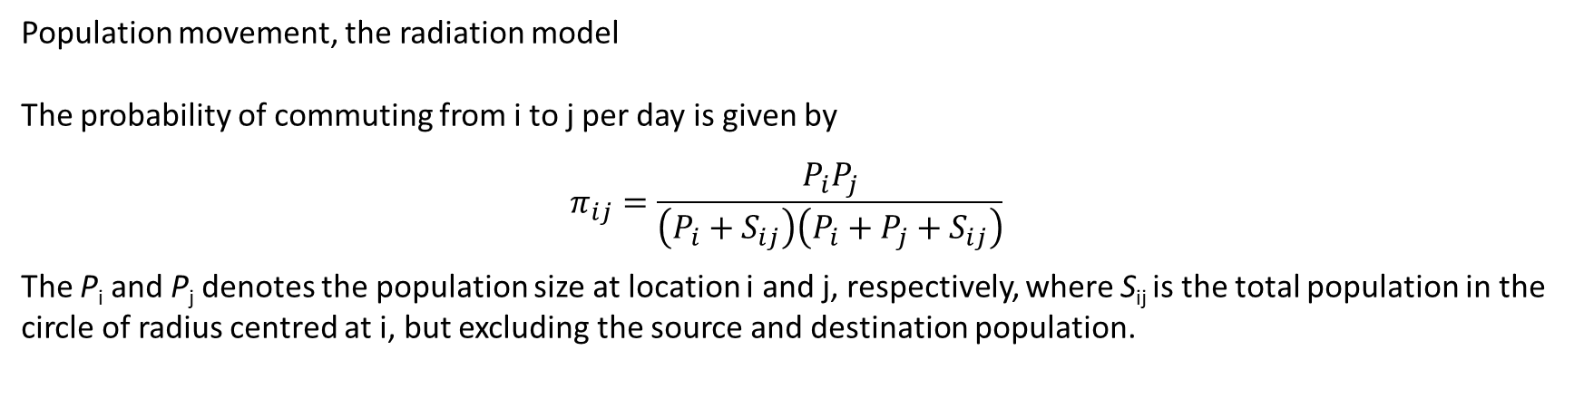
Population movement, the radiation model
The probability of commuting from i to j per day is given by
$$π_{ij}=\frac{P_{i}P_{j}}{\left(P_{i}+S_{ij}\right)\left(P_{i}+P_{j}+S_{ij}\right)}$$
The P_{i} and P_{j} denotes the population size at location i and j, respectively, where S_{ij} is the total population in the circle of radius centred at i, but excluding the source and destination population.

Slide 3
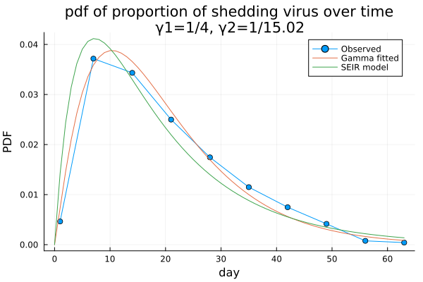
Virus shedding
Using the proportion of virus shedding individuals, scaled to be one for the PDF.
Then gamma fitting results using the Kullback-Leibler divergence show the shape parameter is 2.1,
Indicating the SEIR is suffice. Then, estimating the γ2 using the convolution of exponential distribution,
Obtaining 15.02 for γ2.

Slide 4
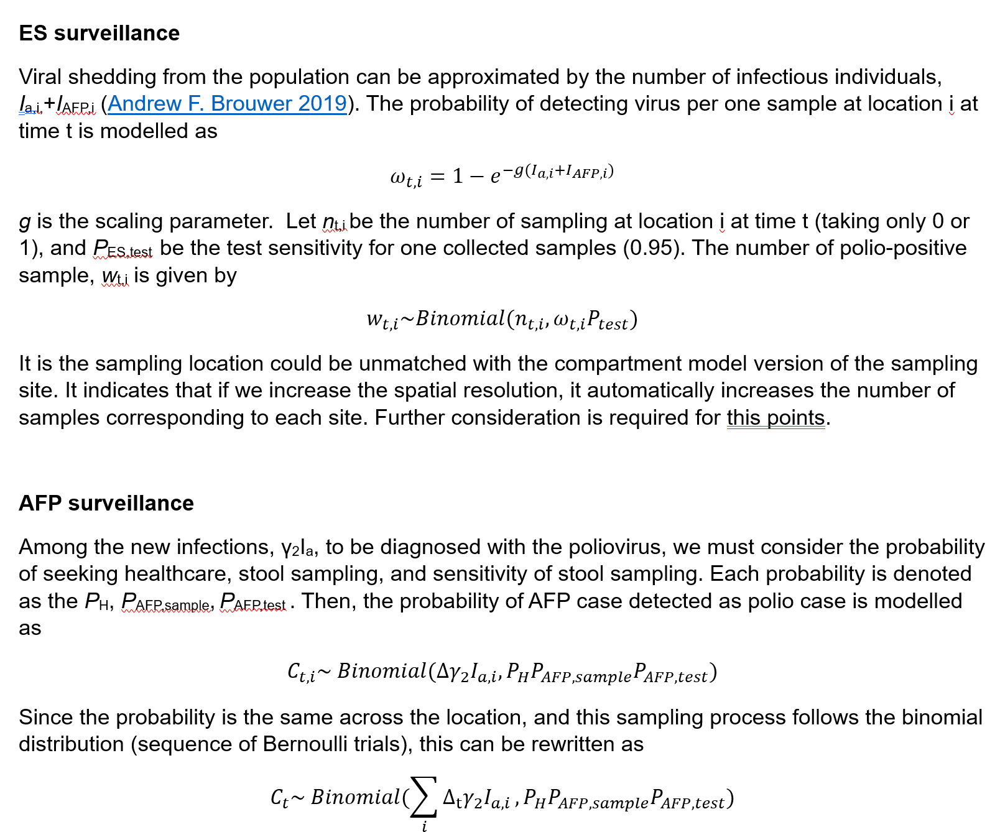

Slide 5
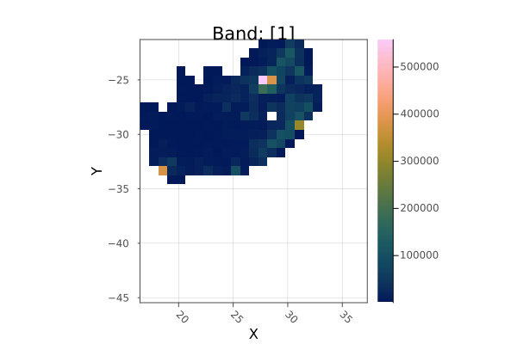
Aggregated population map
Latitude diff: 92.66 km, Longitude diff: 85.84 km
The population is children aged under 5 years old.
I only included 10% of children aged under 5 years old, assuming 90% children get vaccinated, and 10% children are unvaccinated. So, within this simulation, I only consider the unvaccinated individuals.
Baseline environmental surveillance population coverage is set to be 50% (in the order of high population area)

Slide 6
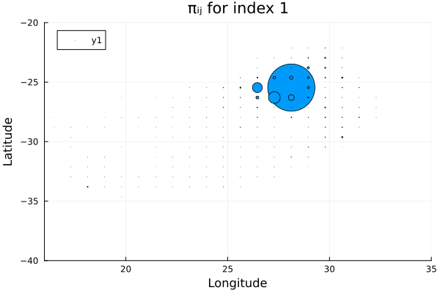
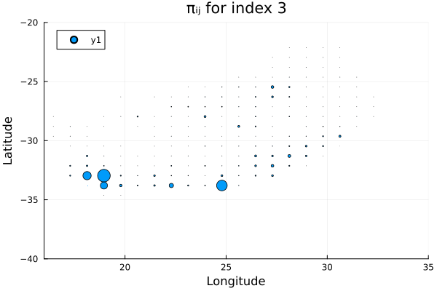
Population movement coefficients, πij
Index 1 represents the most populous area in South Africa,
Index 3 represents the 3rd populous area in South Africa

Slide 7
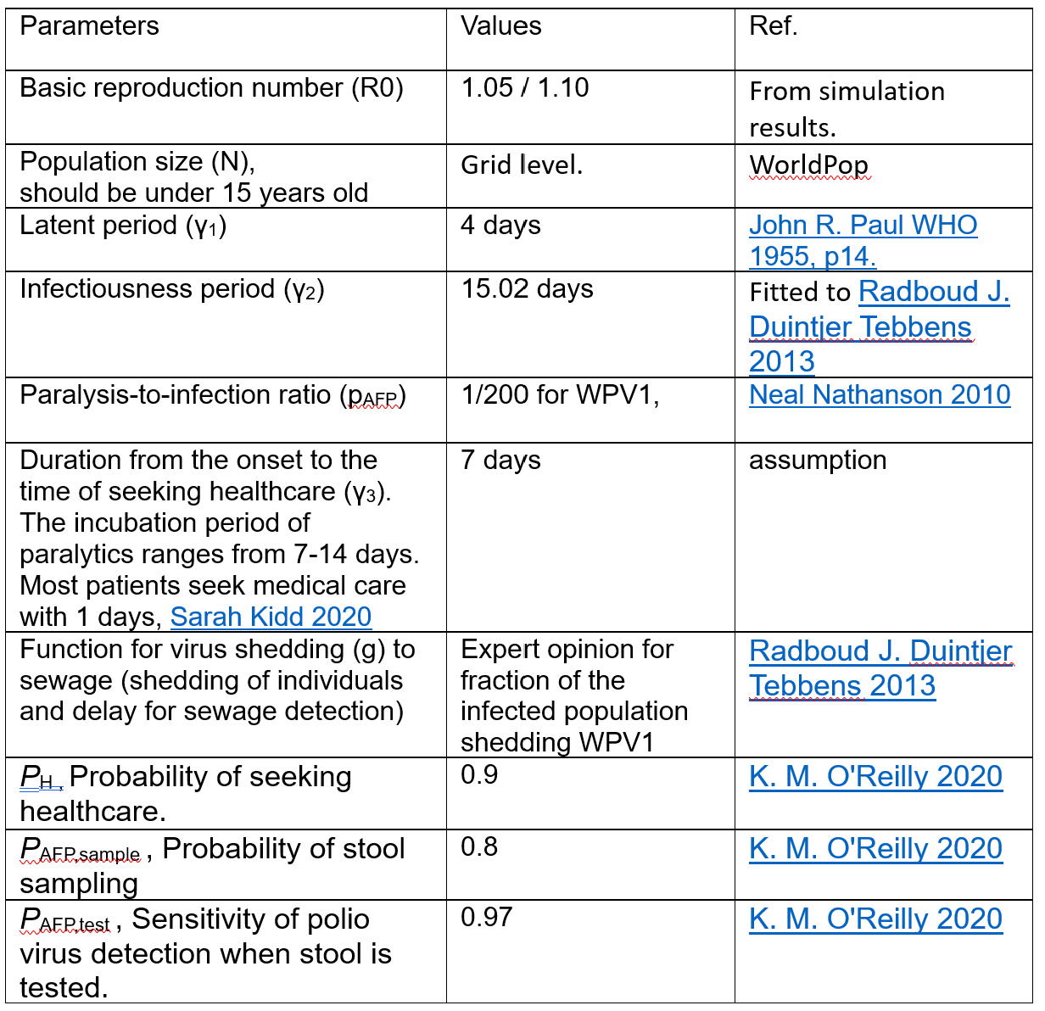

Slide 8
Results
Based on the AFP cases shown in the results,
R0 = 1.05 for 1-25 AFP cases.
R0 = 1.10 for 100~1000 AFP cases.
(Low R0 means high herd immunity from 90% of vaccinated individuals around unvaccinated children.)

Slide 9
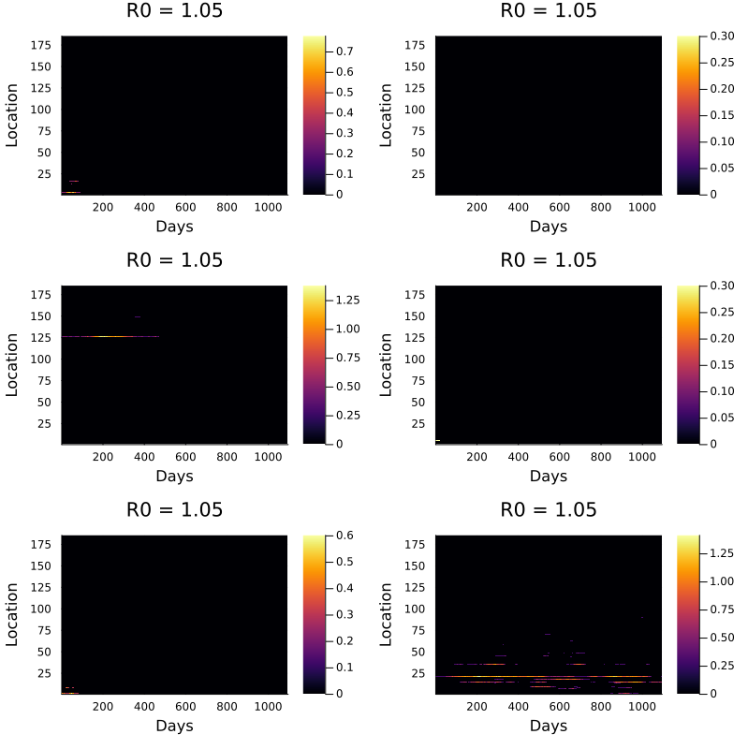
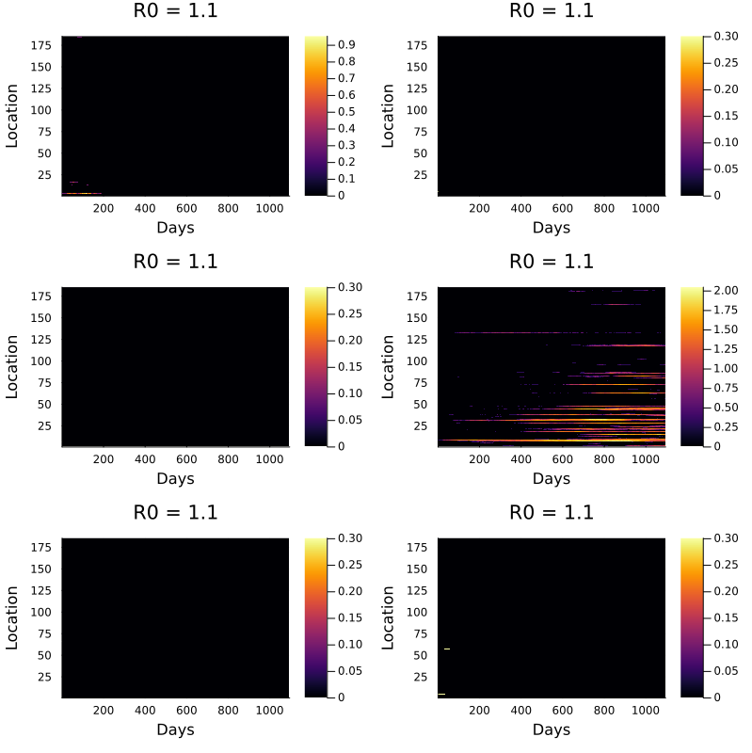
Number of asymptomatic cases (Ia) over time
zaxis is given by log10(Ia + 1)

Slide 10
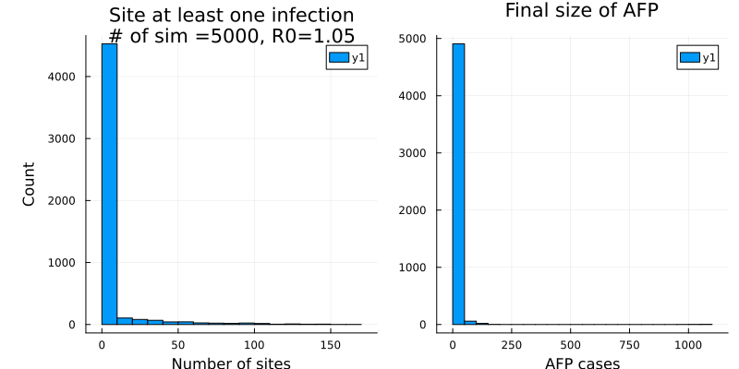
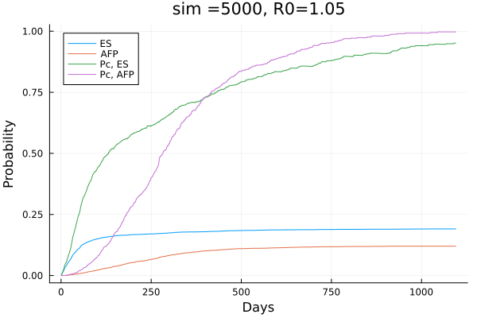
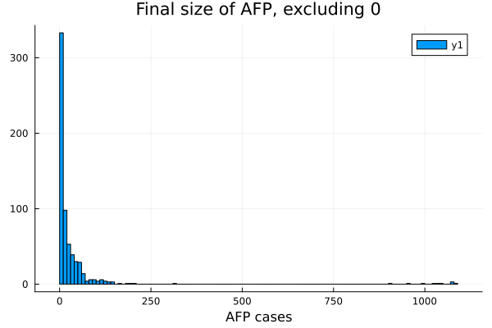
Statistics for AFP cases, Surveillance situation., R0=1.05
Cumulative probability for both surveillance
Under total or conditional probability.
# of detection patterns.
"Both" => 465
"Neither" => 3911
"ES only" => 489
"AFP only" => 135
Mean ES: 92.83 days, Mean AFP: 253.5 days

Slide 11
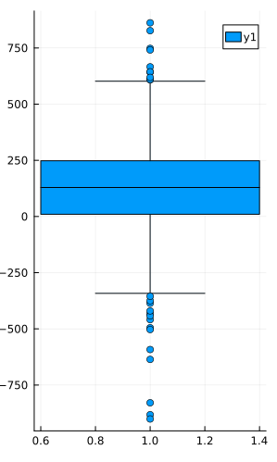
Statistics for AFP cases, Surveillance situation., R0=1.05
Lead time for ES over AFP surveillance
Summary Stats:
Length: 465
Missing Count: 0
Mean: 120.593548
Minimum: -901.000000
1st Quartile: 10.000000
Median: 129.000000
3rd Quartile: 248.000000
Maximum: 862.000000
Type: Float64
% of early detect by ES: 77.2

Slide 12
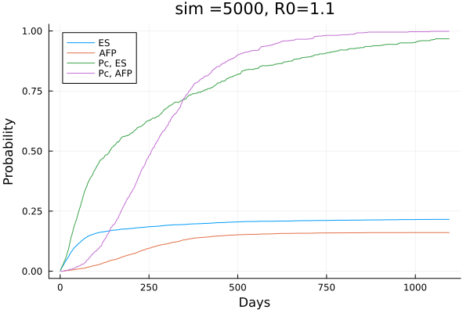
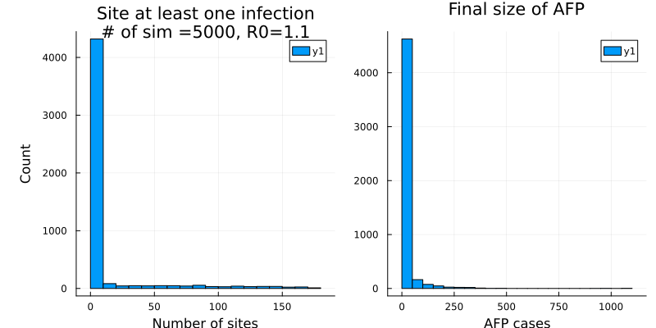
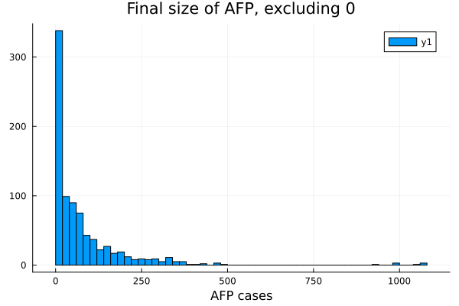
Statistics for AFP cases, Surveillance situation., R0=1.1
Dict{Any, Int64} with 4 entries:
"Both" => 673
"Neither" => 3790
"ES only" => 406
"AFP only" => 131
Mean ES: 116.6 days, Mean AFP: 242.4 days

Slide 13
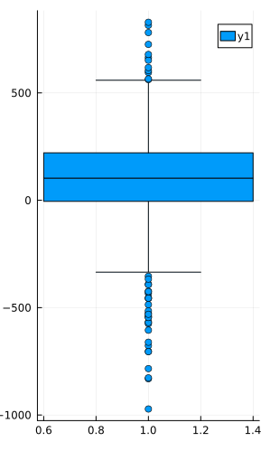
Statistics for AFP cases, Surveillance situation., R0=1.1
Lead time for ES over AFP surveillance
Summary Stats:
Length: 673
Missing Count: 0
Mean: 87.704309
Minimum: -972.000000
1st Quartile: -5.000000
Median: 103.000000
3rd Quartile: 221.000000
Maximum: 829.000000
Type: Float64
% of early detect by ES: 74.29

Slide 14
Sensitivity analysis results for R0=1.05

Slide 15
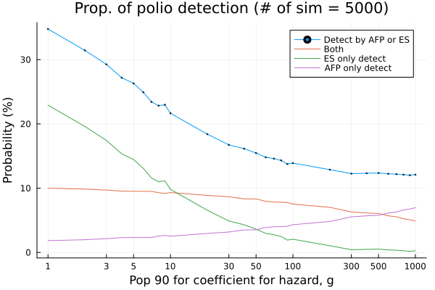
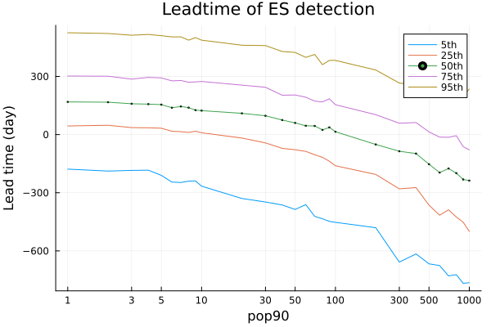
Hazard g
g is chosen such that ωt = 1 – e(g*N_pop90) = 0.9
Baseline value is N_pop90 = 10

Slide 16
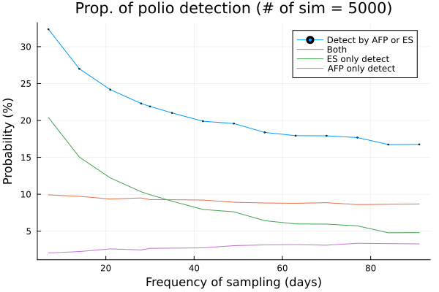
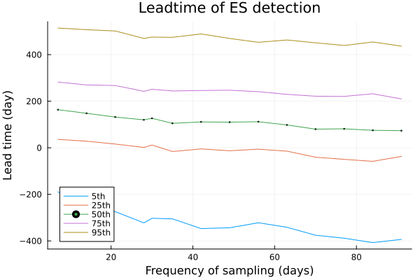
Frequency of environmental sampling
Baseline value is 30 days

Slide 17
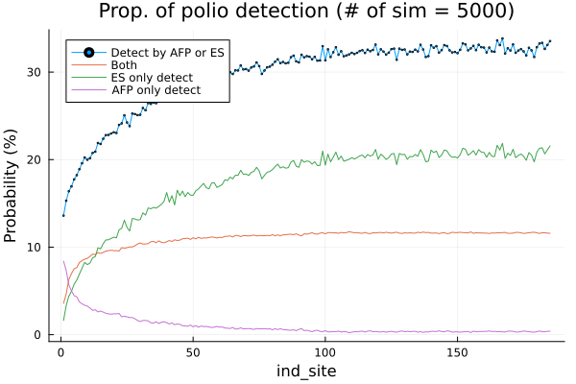
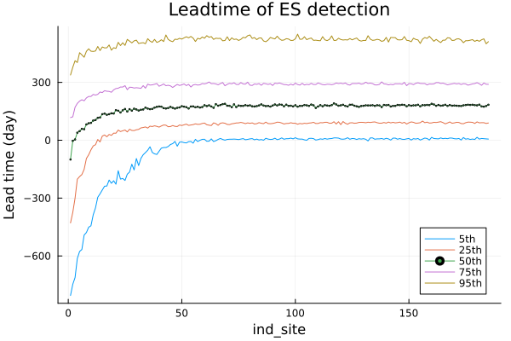
ES catchment area based on area (square, index)
ES area is chosen in the order of large population area.

Slide 18
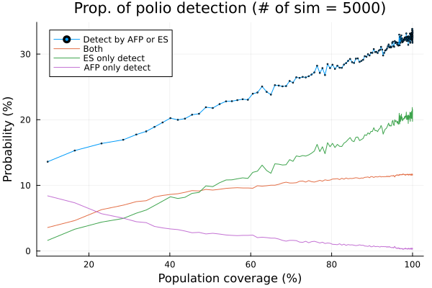
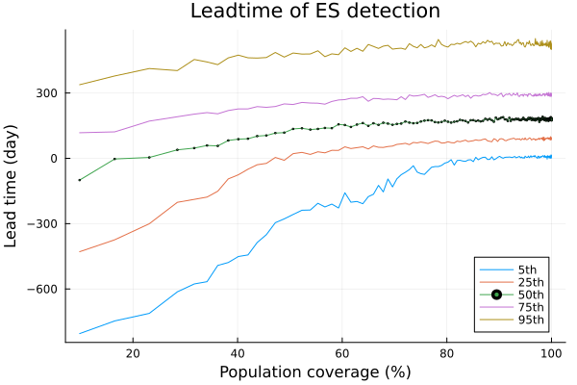
ES catchment area based on the population coverage
Baseline is population coverage = 50%.

Slide 19
Sensitivity analysis results for R0=1.10

Slide 20
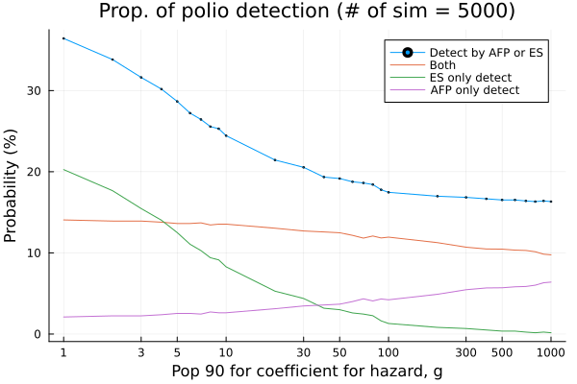
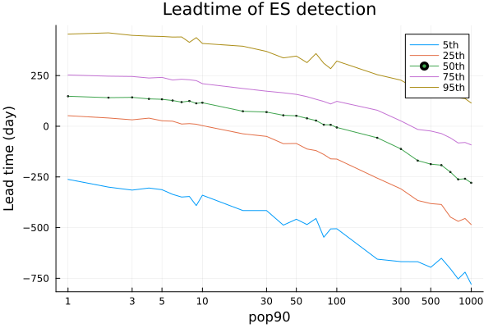
Hazard g
g is chosen such that ωt = 1 – e(g*N_pop90) = 0.9
Baseline value is N_pop90 = 10

Slide 21
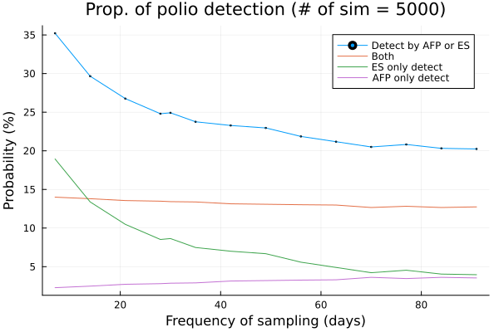
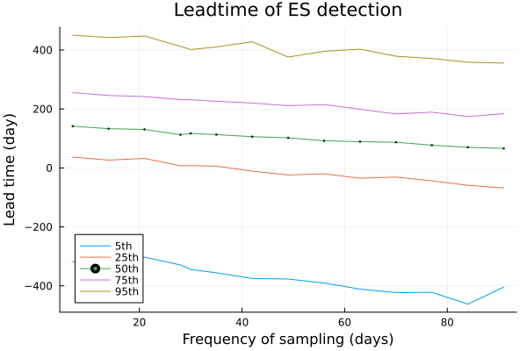
Frequency of environmental sampling
Baseline value is 30 days

Slide 22
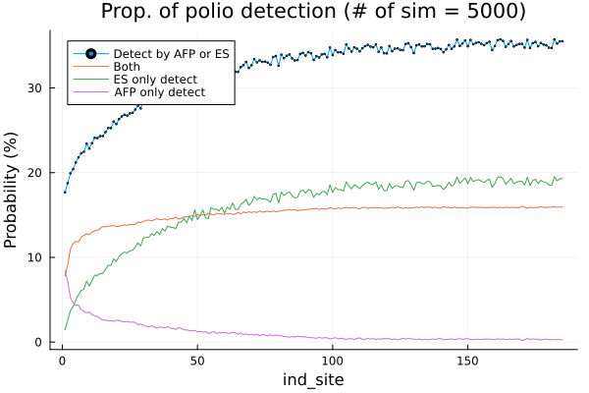
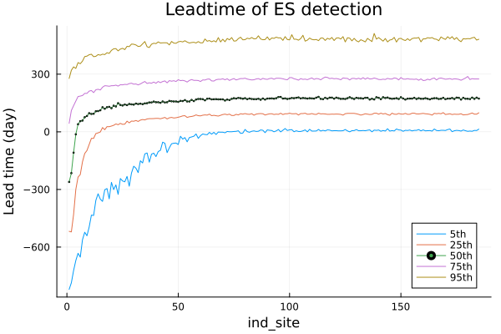
ES catchment area based on area (square, index)
ES area is chosen in the order of large population area.

Slide 23
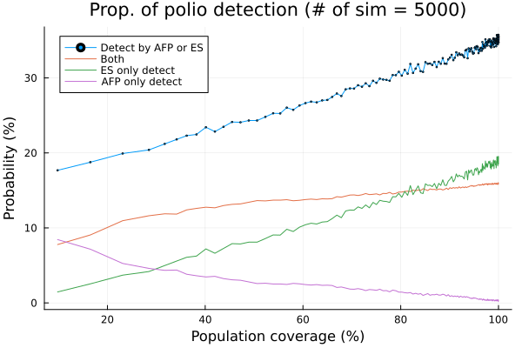
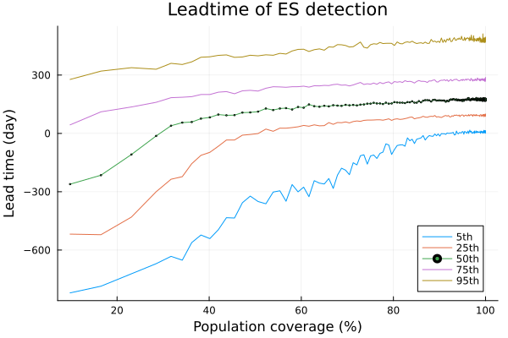
ES catchment area based on the population coverage
Baseline is population coverage = 50%.

Slide 24
Pending Conclusions
Under the R0=1.05 (Plausible scenario in terms of AFP cases),
% of early detect by ES: 77.2, and 100 days ahead of AFP detections.
Among all detected simulations, ES only accounts for 45%, whereas
AFP only accounts for 12%.
By 50% of population coverage of ES surveillance, the lead time for ES increases significantly, but after that, the additional benefit is diminished.
ES ability of detection, (expressed by hazard coefficient) becomes important if 90% detection probability is achieved when 25 or more infectious individuals appear.
Frequency of sampling increases the ES only detection, but does not affect percentages of both detection and the lead time.

