Slide 1
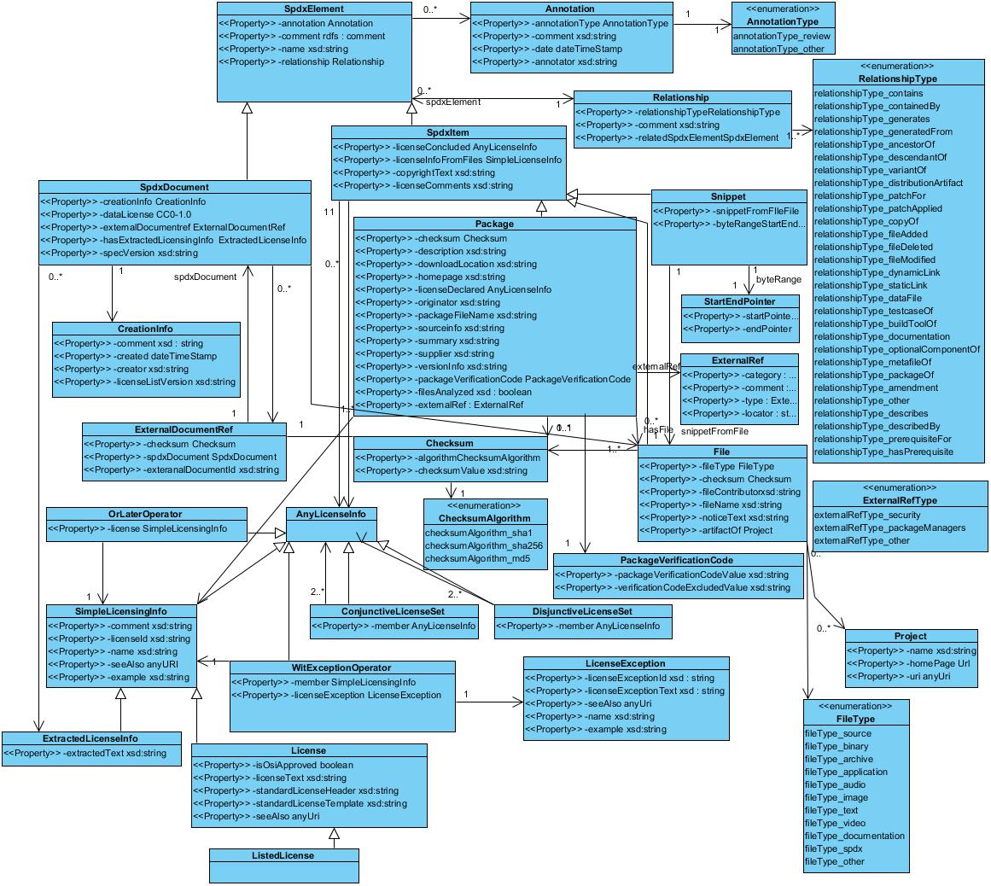
0.*
TargetProductInfo
“ExpirationInfo” (for SPDX description such as “Usage Info.”) might be placed to this level.
It’s an Expiration Date and/or “Supplier’s recommendation of the review deadline for SPDX description such as Product Launch”.
“The Expiration Information for each Package” required another discussion.
<<Property>> -UsageInfo or T.B.D: ExternalRef or String?
0.*
“TargetProductInfo” might be placed as this level.
Proposed as “Prerequisite Produce Name” before. Supplier may use this tag to suggest prerequisite target software environment when they write down “Usage Info.” into SPDX file.
Usage Information (T.B.D)
Usage information such as “not fit with final product, but for verification (T.B.D)” (proposed “License Compatibility” before) might be placed as this level

