Slide 1
OpenChain & SPDX and ISO Standardization
October 15, 2020
H. Fukuchi

Slide 2
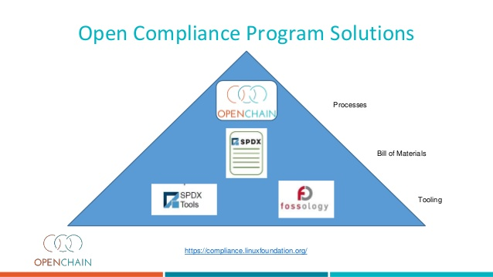
OpenChain & SPDX
LFのOSS compliance関連のプロジェクト
OpenChain
OSS Compliance Programに関する仕様
https://www.openchainproject.org/
SPDX
Software BoM(Bill of Material)の仕様
https://spdx.dev/

Slide 3

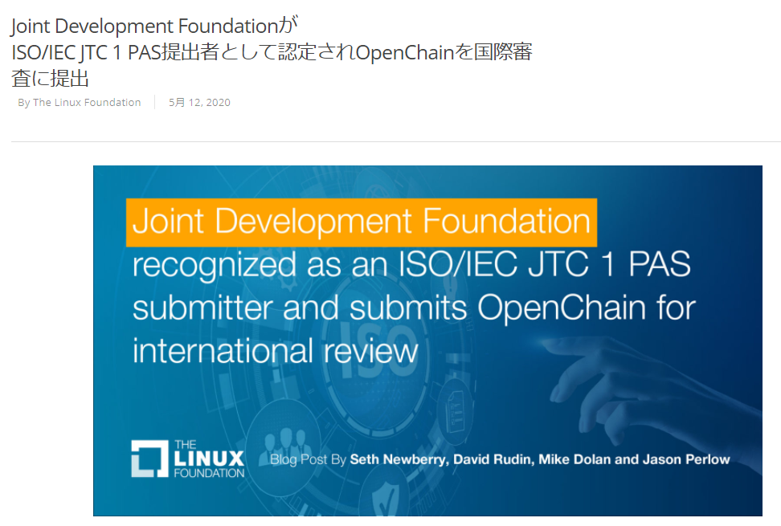
OpenChain仕様のISO化承認
2020年5月 OpenChain仕様2.1のISO化を提案
2020年9月 投票が完了し、ISO化が承認
承認後6週間内 ISO文書として発行予定
ISOに提案した仕様2.1のドラフト版（OpenChain Specification 2.1）：
https://wiki.linuxfoundation.org/_media/openchain/openchainspec-2.1.draft.pdf
ISO提案に関するLFの発表（日本語）：
https://www.linuxfoundation.jp/blog/2020/05/joint-development-foundation-recognized-as-an-iso-iec-jtc-1-pas-submitter-and-submits-openchain-for-international-review/

Slide 4
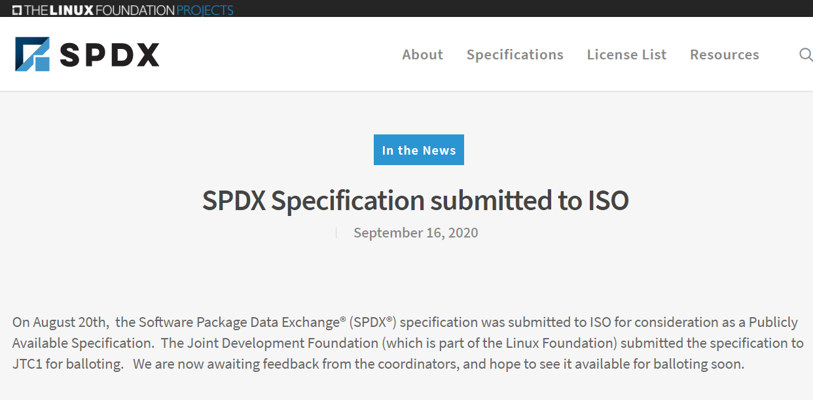
SPDXのISO化提案
2020年8月 SPDX仕様のISO化を提案

Slide 5

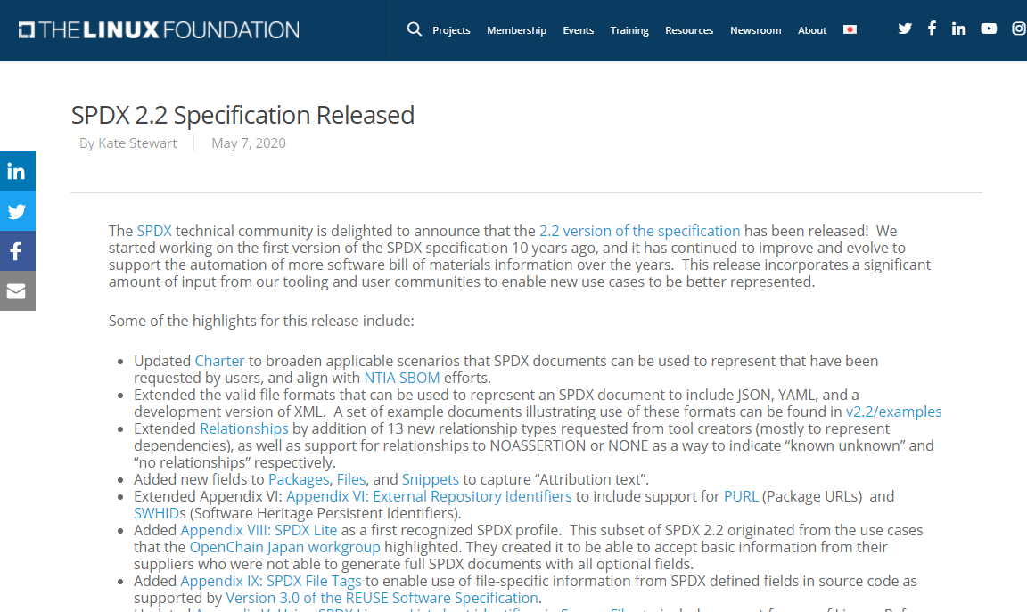

Japan WGによるSPDX仕様へのSPDX Lite提案
https://www.linuxfoundation.org/blog/2020/05/spdx-2-2-specification-released/
Japan workgroup
Added Appendix VIII: SPDX Lite as a first recognized SPDX profile.
This subset of SPDX 2.2 originated from the use cases that the OpenChain Japan workgroup highlighted. They created it to be able to accept basic information from their suppliers who were not able to generate full SPDX documents with all optional fields.

