Slide 1
An Introduction to CHAOSS project
Hiroyuki Fukuchi
Sony

Slide 2
CHAOSS project
The Linux Foundation project
CHAOSS – Community Health Analytics Open Source Software
https://chaoss.community/
Board Member:
Andrea Gallo, Linaro
Ben Lloyd Pearson, Nylas
Brian Proffitt, Red Hat
Daniel Izquierdo, Bitergia
Daniel M. German, University of Victoria
Dawn Foster, Pivotal
Don Marti, Mozilla
Georg Link, Bitergia
Ildikó Vancsa, OpenStack
Kate Stewart, Linux Foundation
Matt Germonprez, University of Nebraska at Omaha
Nicole Huesman, Intel
Ray Paik, GitLab
Sean Goggins, University of Missouri
Wayne Beaton, Eclipse Foundation

Slide 3
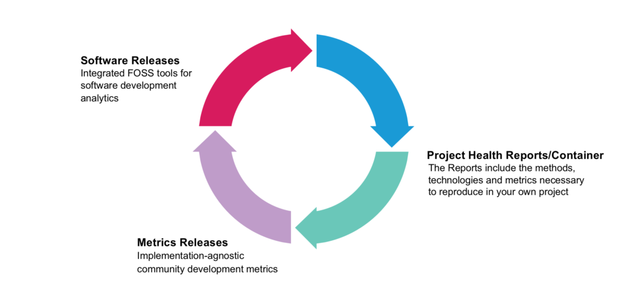
Mission
Establish standard implementation-agnostic metrics for measuring community activity, contributions, and health
Produce integrated open source software for analyzing software community development
Build reproducible project health reports/containers

Slide 4
Some Reasons to Assess Community Health
Risk Mitigation
Track Corporate Engagement
Identify Sustainable Projects
Identify Single Points of Failure
Avoid In-take of an Inactive Project
Identify Open Source Projects that Need Support
Assess Value Generated through Community and Engagement
Show that Active Community Management Bears Desired Results

Slide 5
Some Issues To Look At
Project Maturity
Project Viability
Growth of Community
Momentum of Community
Diversity of Community
Timeliness of Maintainers
Attentiveness of Maintainers
Activity Level - Responsiveness
Distribution of Code Contributions
Vanity metrics (might have use in other cases, e.g. stars)
Ecosystem Health (upstream, downstream, and related projects)
Aggregate Project-tree Health (combined health metrics of all linked dependencies)

Slide 6
Some Contexts to Consider When Evaluating Health
Value Derivation
Style of Project
Project Comparison
Maturity of Project
Programming Language
Quality of Ecosystem
Community Composition

Slide 7
Working Group
Common Metrics Working Group
Diversity & Inclusion Working Group
Evolution Working Group
Value Working Group
Risk Working Group

Slide 8
Metrics Focus Areas
1. Business Risk
Understand how active a community exists around/to support a given software package.
2. Code Quality
Understand the quality of a given software package.
3. Licensing
Understand the potential IP issues associated with a given software package’s use.
4. Security
Understand security processes and procedures associated with the software’s development.
5. Transparency
Understand how transparent a given software package is with respect to dependencies, licensing (?), security processes, etc

Slide 9
Risk WG
Business Risk
Code Quality
Licensing
Security

Slide 10
Business Risk
Goal: Understand how active a community exists around/to support a given software package.
Metric/Details | Question
Committers | How robust and diverse are the contributors to a community?
Elephant Factor | What is the distribution of work in the community?

Slide 11
Code Quality
Goal: Understand the quality of a given software package.
Metric/Details | Question
Test Coverage | How well is the code tested?

Slide 12
Licensing
Goal: Understand the potential intellectual property(IP) issues associated with a given software package’s use.
Metric/Details | Question
License Coverage | How much of the code base has declared licenses?
License Declared | What are the declared software package licenses?
OSI Approved Licenses | What percentage of a project’s licenses are OSI approved open source licenses?

Slide 13
Security
Goal: Understand how transparent a given software package is with respect to dependencies, licensing (?), security processes, etc.
Metric/Details | Question
CII Best Practices badge | What is the current CII Best Practices status for the project?

