Slide 1
Time Series: Autoregressive models ARIMA
<number> / 77

Slide 2
Overview
Introduction of Time Series
Categories and Terminologies
White Noise and Random Walk
Time Series Analysis
ARIMA Models
<number> / 77

Slide 3
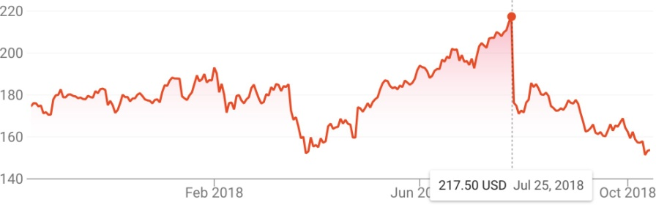
Time Series
A time series is a sequential set of data points, measured typically over successive times.
Time series analysis comprises methods for analyzing time series data in order to extract meaningful statistics and other characteristics of the data.
<number> / 77

Slide 4
Categories and Terminologies
Time-domain vs. Frequency-domain
Time-domain approach: how does what happened today affect what will happen tomorrow?
These approaches view the investigation of lagged relationships as most important, e.g. autocorrelation analysis.
Frequency-domain approach: what is the economic cycle
through periods of expansion and recession?
These approaches view the investigation of cycles as most important, e.g. spectral analysis and wavelet analysis.
This lecture will focus on time-domain approaches.
<number> / 77

Slide 5
Categories and Terminologies (cont.)
Univariate vs. Multivariate
A time series containing records of a single variable is termed as univariate, but if records of more than one variable are considered then it is termed as multivariate.
Linear vs. Non-linear
A time series model is said to be linear or non-linear depending on whether the current value of the series is a linear or non-linear function of past observations.
Discrete vs. Continuous
In a continuous time series observations are measured at every instance of time, whereas a discrete time series contains observations measured at discrete points in time.
We focus on univariate, linear, discrete time series.
<number> / 77

Slide 6
Components of a Time Series
In general, a time series is affected by four components, i.e. trend, seasonal,cyclical and irregular components.
– Trend
The general tendency of a time series to increase, decrease or stagnate over a long period of time.
110
cents per pound
60 70 80 90
2005 2010 2015
The price of chicken: monthly whole bird spot price, Georgia docks, US cents per pound, August 2001 to July 2016, with fitted linear trend line.
<number> / 77

Slide 7
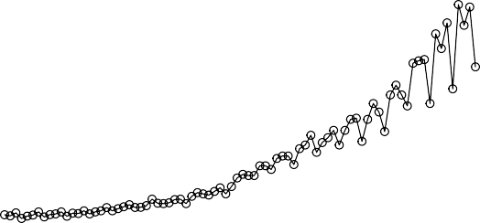
Components of a Time Series (cont.)
In general, a time series is affected by four components, i.e. trend, seasonal,cyclical and irregular components.
– Seasonal variation
This component explains fluctuations within a year during the season, usually caused by climate and weather conditions, customs, traditional habits, etc.
Quarterly Earnings per Share
15
10
5
0
1960 1965 1970 1975 1980
Johnson & Johnson quarterly earnings per share, 84 quarters, 1960-I to 1980-IV.
<number> / 77

Slide 8
Components of a Time Series (cont.)
In general, a time series is affected by four components, i.e. trend, seasonal,cyclical and irregular components.
– Cyclical variation
This component describes the medium-term changes caused by circumstances, which repeat in cycles. The duration of a cycle extends over longer period of time.
130
110
90
70
1970 1972 1974 1976 1978 1980
Average weekly cardiovascular mortality in Los Angeles County. There are 508 six-day smoothed averages obtained by filtering daily values over the 10 year period 1970-1979.
<number> / 77

Slide 9
Components of a Time Series (cont.)
In general, a time series is affected by four components, i.e. trend, seasonal,cyclical and irregular components.
– Irregular variation
Irregular or random variations in a time series are caused by unpredictable influences, which are not regular and also do not repeat in a particular pattern.
These variations are caused by incidences such as war, strike,
earthquake, flood, revolution, etc.
There is no defined statistical technique for measuring random fluctuations in a time series.
<number> / 77

Slide 10
Time Series Analysis
The procedure of using known data values to fit a time series with suitable model and estimating the corresponding parameters.
It comprises methods that attempt to understand the nature of the time series and is often useful for future forecasting and simulation.
<number> / 77

Slide 11
Time Series Analysis
There are several ways to build time series forecasting models,
We will focus on stochastic process.
We assume a time series can be defined as a collection of random variables indexed according to the order they are obtained in time, X₁, X₂, X₃, . . . X_{t}
t will typically be discrete and vary over the integers t = 0, ±1, ±2, . . .
Note
the collection of random variables {X_{t} } is referred to as a stochastic process, while
the observed values are referred to as a realization of the stochastic process.
<number> / 77

Slide 12
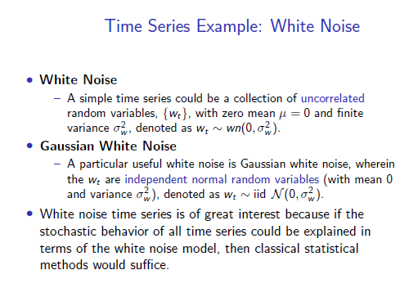

Slide 13
Combination of Four Components
Considering the effects of these four components, two different types of models are generally used for a time series.
Additive Model
Y (t) = T (t) + S(t) + C (t) + I (t)
Assumption: These four components are independent of each other.
Multiplicative Model
Y (t) = T (t) × S(t) × C (t) × I (t)
Assumption: These four components of a time series are not necessarily independent and they can affect one another.
<number> / 77

Slide 14
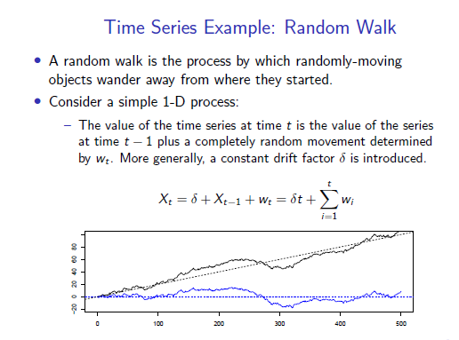

Slide 15
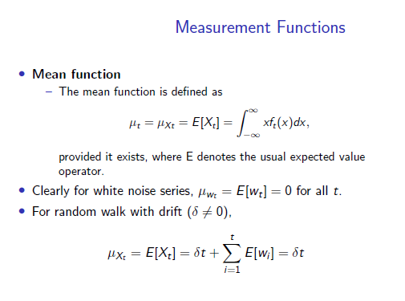

Slide 16
Autocorrelation and ARIMA Models

Slide 17
Time Series Analysis
Seen earlier: There are several ways to build time series forecasting models,
Focus on stochastic process.
assume a time series can be defined as a collection of random variables indexed according to the order they are obtained in time, X₁, X₂, X₃, . . . X_{t}
t will typically be discrete and vary over the integers t = 0, ±1, ±2, . . .
Note
the collection of random variables {X_{t} } is referred to as a stochastic process, while
the observed values are referred to as a realization of the stochastic process.
<number> / 77

Slide 18
Autocorrelation and ARIMA Models
When we use linear regression for time series forecasting, we are able to account for patterns such as trend and seasonality.
However, ordinary regression models do not account for dependence between values in different periods, which in cross-sectional data is assumed to be absent.
Yet, in the time series context, values in neighboring periods tend to be correlated. Such correlation, called autocorrelation, is informative and can help in improving forecasts.
If we know that a high value tends to be followed by high values (positive autocorrelation), then we can use that to adjust forecasts.
Discuss how to compute the autocorrelation of a series, and how best to utilize the information for improving forecasts.

Slide 19
Computing Autocorrelation
Correlation between values of a time series in neighboring periods is called autocorrelation, because it describes a relationship between the series and itself.
To compute autocorrelation, we compute the correlation between the series and a lagged version of the series.
A lagged series is a “copy” of the original series which is moved forward one or more time periods.
A lagged series with lag-1 is the original series moved forward one time period; a lagged series with lag-2 is the original series moved forward two time periods, etc.

Slide 20
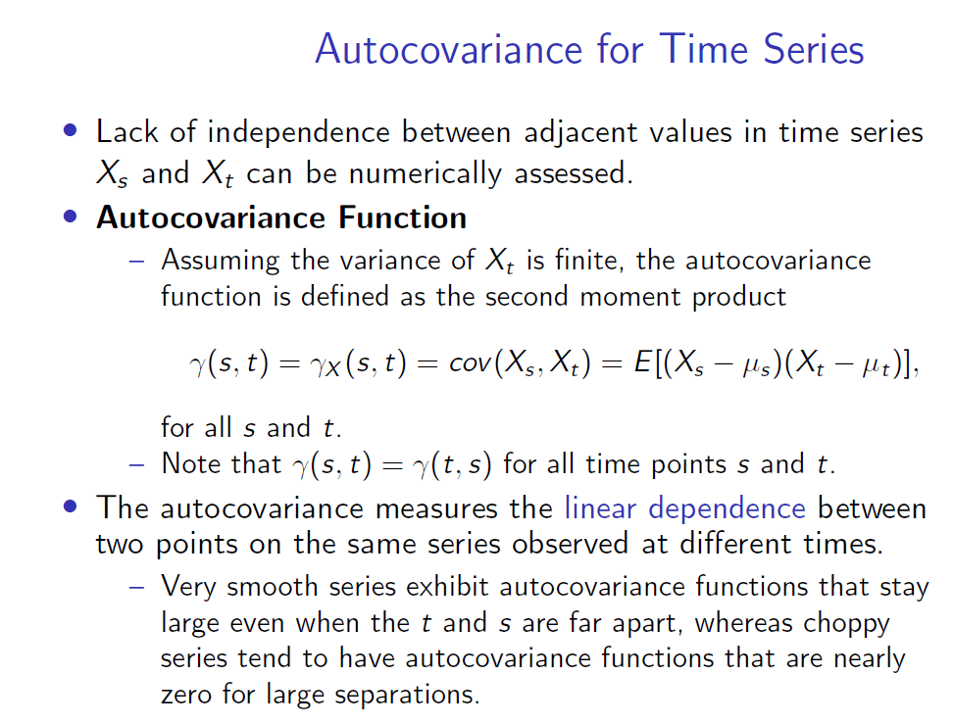

Slide 21
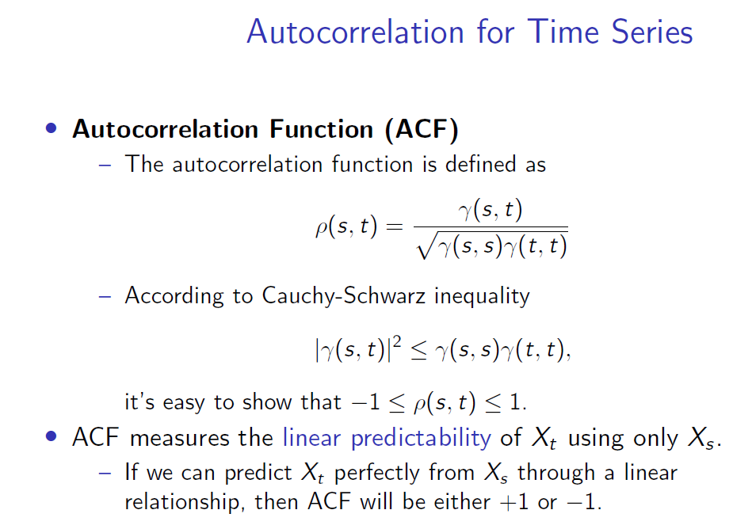

Slide 22
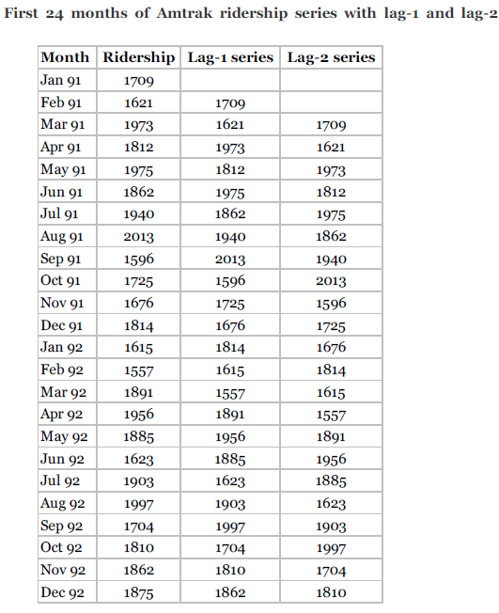
Computing Autocorrelation
Table shows the first 24 months of the Amtrak ridership series, the lag-1 series and the lag-2 series.

Slide 23
lag-1 & lag-2autocorrelation
Compute the lag-1 autocorrelation, which measures the linear relationship between values in consecutive time periods, we compute the correlation between the original series and the lag-1 series (e.g., via the function np.corrcoef) to be 0.063.
NB: lag-1 has one value less
Similarly, the lag-2 autocorrelation, measuring the relationship
between values that are two time periods apart, is the correlation between the original series and the lag-2 series (yielding −0.15).
Use statsmodel’s function
acf to compute the autocorrelation function (ACF) of a series and
plot_acf to directly create a plot.

Slide 24
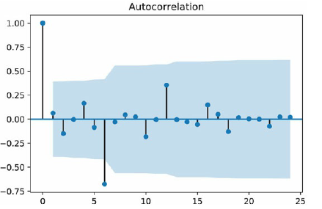
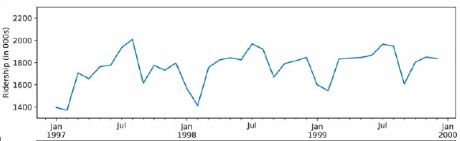
Autocorrelation of a series can therefore help to detect seasonality patterns.
The strongest autocorrelation is at lag 6 and is negative. This indicates a bi-annual pattern in ridership, with 6-month switches from high to low ridership.
A look at the time plot confirms the high-summer low-winter pattern.

Slide 25
A few typical autocorrelation behaviors
1. Strong autocorrelation (positive or negative) at a lag larger than 1 and its multiples (2k, 3k, …)
typically reflects a cyclical pattern.
For example, strong positive lag-12 autocorrelation in monthly data will reflect an annual seasonality (where values during a given month each year are positively correlated).

Slide 26
A few typical autocorrelation behaviors
1. Strong autocorrelation (positive or negative) at a lag larger than 1 and its multiples (2k, 3k, …)
typically reflects a cyclical pattern.
For example, strong positive lag-12 autocorrelation in monthly data will reflect an annual seasonality (where values during a given month each year are positively correlated).
2. Positive lag-1 autocorrelation (called “stickiness’’)
describes a series where consecutive values move generally in the same direction.
In the presence of a strong linear trend, we would expect to see a strong and positive lag-1 autocorrelation.
3. Negative lag-1 autocorrelation reflects swings in the series, where high values are immediately followed by low values and vice versa.

Slide 27
A few typical autocorrelation behaviors
Strong autocorrelation (positive or negative) at a lag larger than 1 and its multiples (2k, 3k, …)
typically reflects a cyclical pattern.
For example, strong positive lag-12 autocorrelation in monthly data will reflect an annual seasonality (where values during a given month each year are positively correlated).
Positive lag-1 autocorrelation (called “stickiness’’)
describes a series where consecutive values move generally in the same direction.
In the presence of a strong linear trend, we would expect to see a strong and positive lag-1 autocorrelation.
Negative lag-1 autocorrelation reflects swings in the series, where high values are immediately followed by low values and vice versa.

Slide 28
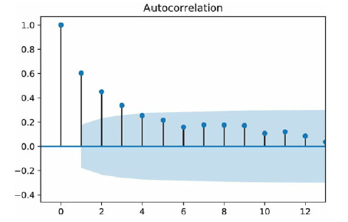
Autocorrelation of the residual series (Forecast errors)
In addition to looking at the autocorrelation of the raw series, it is very useful to look at the autocorrelation of the residual series.
For example, after fitting a regression model (or using any other forecasting method), we can examine the autocorrelation of the series of residuals.

Slide 29
Autocorrelation of the residual series (Forecast errors)
Fig displays the autocorrelations for the residuals from the regression model with seasonality and quadratic trend
It is clear that the 6-month (and 12-month) cyclical behavior no longer dominates the series of residuals, indicating that the regression model captured them adequately.

Slide 30
Autocorrelation of the residual series (Forecast errors)
However, we can also see a strong positive autocorrelation from lag 1 on, indicating a positive relationship between neighboring residuals.
This is valuable information, which can be used to improve forecasts.

Slide 31
Improving Forecasts by Integrating Autocorrelation Information

Slide 32

Improving Forecasts by Integrating Autocorrelation Information
In general, there are two approaches to taking advantage of autocorrelation.
One is by directly building the autocorrelation into the regression model, and the other is
by constructing a 2nd-level forecasting model on the residual series.
Among regression-type models that directly account for autocorrelation are autoregressive (AR) models, or the more general class of models called ARIMA (Autoregressive Integrated Moving Average) models.
AR models are similar to linear regression models, except that the predictors are the past values of the series.
For example, an autoregressive model of order 2, denoted AR(2), can be written as

Slide 33
Improving Forecasts by Integrating Autocorrelation Information
In general, there are two approaches to taking advantage of autocorrelation.
One is by directly building the autocorrelation into the regression model, and the other is by
constructing a 2nd-level forecasting model on the residual series.

Slide 34
Improving Forecasts by Integrating Autocorrelation Information
In general, there are two approaches to taking advantage of autocorrelation.
One is by directly building the autocorrelation into the regression model, and the other is
by constructing a 2nd-level forecasting model on the residual series.
Among regression-type models that directly account for autocorrelation are autoregressive (AR) models, or the more general class of models called ARIMA (Autoregressive Integrated Moving Average) models.
AR models are similar to linear regression models, except that the predictors are the past values of the series.
For example, an autoregressive model of order 2, denoted AR(2), can be written as

Slide 35
AR(2) Models - Improving Forecasts by Integrating Autocorrelation Information
An autoregressive model of order 2, denoted AR(2), can be written as
Estimating such models is roughly equivalent to
1. fitting a linear regression model with the series as the outcome variable, and
2. the two lagged series (at lag 1 and 2 in this example) as the predictors.

Slide 36
Discussion
However, it is better to use designated ARIMA estimation methods (e.g., those available in the statsmodel package) over ordinary linear regression estimation, to produce more accurate results.
Although moving from AR to ARIMA models creates a larger set of more flexible forecasting models, it also requires much more statistical expertise.
Even with the simpler AR models, fitting them to raw time series that contain patterns such as trends and seasonality requires the user to perform several initial data transformations and to choose the order of the model. These are not straight forward tasks.
NB: ARIMA modeling requires more experience and statistical expertise than other methods.

Slide 37
Example: One AR Model
Discuss one particular use of AR models that is straightforward to apply in the context of forecasting, which can provide a significant improvement to short-term forecasts.
This relates to the 2nd approach for utilizing autocorrelation, which requires constructing a second-level forecasting model for the residuals, as follows:
Generate a k-step-ahead forecast of the series (F_{t + k}), using any forecasting method
2. Generate a k-step-ahead forecast of the forecast error (residual) (E _{t + k}),
using an AR (or other) model
3. Improve the initial k-step-ahead forecast of the series by adjusting it according to its forecasted error:
Improved F*_{t + k} = F_{t + k} + E_{t} + k.

Slide 38

Example: One AR Model
In particular, we can fit low-order AR models to series of residuals (or forecast errors) which can then be used to forecast future forecast errors.
To fit an AR model to the series of residuals,
first examine the autocorrelations of the residual series.
then choose the order of the AR model according to the lags in which autocorrelation appears.
Often, when autocorrelation exists at lag-1 and higher, it is sufficient to fit an AR(1) model of the form
where Et denotes the residual (or forecast error) at time t.

Slide 39
Stationarity of Stochastic Process
Forecasting is difficult as time series is non-deterministic in nature, i.e. we cannot predict with certainty what will occur in the future.
But the problem could be a little bit easier if the time series is stationary: simply predict its statistical properties will be the same in the future as they have been in the past!
– A stationary time series is one whose statistical properties such as mean, variance, autocorrelation, etc. are all constant over time.
Most statistical forecasting methods are based on the assumption that the time series can be rendered approximately stationary after mathematical transformations.
<number> / 77

Slide 40
Stationarize Time Series
As all previous methods show that the initial time series is non-stationary, it’s necessary to perform transformations to make it stationary for ARMA modeling.
Detrending
Differencing
Transformation: Applying arithmetic operations like log, square root, cube root, etc. to stationarize a time series.
Aggregation: Taking average over a longer time period, like
weekly/monthly.
Smoothing: Removing rolling average from original time series.
Decomposition: Modeling trend and seasonality explicitly and removing them from the time series.
<number> / 77

Slide 41
Autocorrelation and ARIMA Models

Slide 42
ARIMA Models
ARIMA is an acronym that stands for Auto-Regressive Integrated Moving Average. Specifically,
AR Autoregression. A model that uses the dependent relationship between an observation and some number of lagged observations.
I Integrated. The use of differencing of raw observations in order to make the time series stationary.
MA Moving Average. A model that uses the dependency
between an observation and a residual error from a moving average model applied to lagged observations.
Each of these components are explicitly specified in the model as a parameter.
Note that AR and MA are two widely used linear models that work on stationary time series, and I is a preprocessing procedure to “stationarize” time series if needed.
<number> / 77

Slide 43
Notations - ARIMA
A standard notation is used of ARIMA(p, d, q) where the parameters are substituted with integer values to quickly indicate the specific ARIMA model being used.
p The number of lag observations included in the model, also called the lag order.
d The number of times that the raw observations are differenced, also called the degree of differencing.
q The size of the moving average window, also called the order
of moving average.
A value of 0 can be used for a parameter, which indicates to not use that element of the model.
In other words, ARIMA model can be configured to perform the function of an ARMA model, and even a simple AR, I, or MA model.
<number> / 77

Slide 44
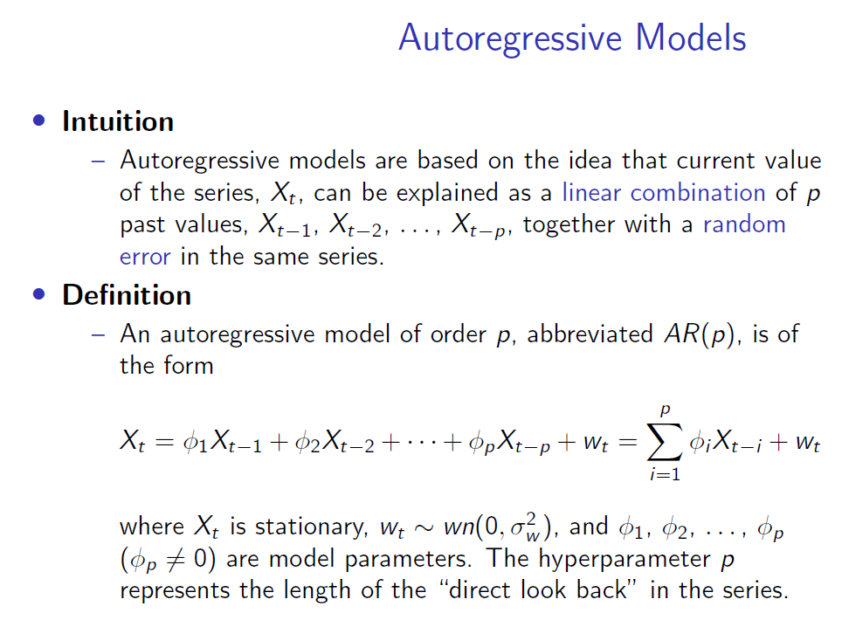

Slide 45
Backshift Operator
Before we dive deeper into the AR process, we need some new notations to simplify the representations.
Backshift Operator
– The backshift operator is defined as
BX_{t} = X_{t−1}.
It can be extended, B²X_{t} = B(BX_{t} ) = B(X_{t−1}) = X_{t−2}, and so on. Thus,
B^{k} X_{t} = X_{t−k}
. Forward-shift operator
We can also define an inverse operator (forward-shift operator ) by enforcing B⁻¹B = 1, such that
X_{t} = B⁻¹BX_{t} = B⁻¹X_{t−1}.
<number> / 77

Slide 46
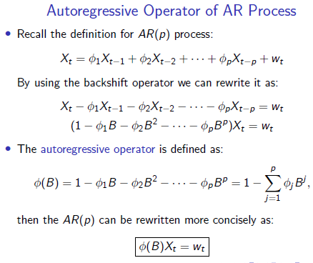

Slide 47
AR Example: AR(0) and AR(1)
The simplest AR process is AR(0), which has no dependence between the terms. In fact, AR(0) is essentially white noise.
AR(1) can be given by X_{t} = φ₁X_{t−1} + w_{t} .
Only the previous term in the process and the noise term contribute to the output.
If |φ₁| is close to 0, then the process still looks like white noise.
If φ₁ < 0, X_{t} tends to oscillate between positive and negative values.
If φ₁ = 1 then the process is equivalent to random walk, which
is not stationary as the variance is dependent on t (and infinite).
<number> / 77

Slide 48
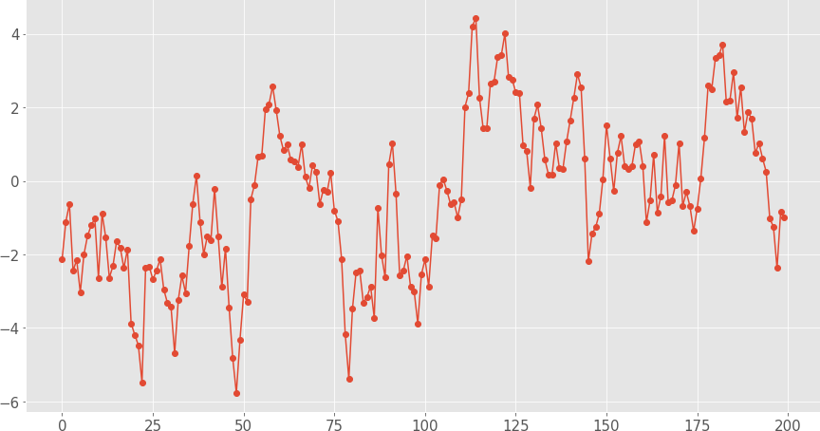
AR Examples: AR(1) Process
Simulated AR(1) Process X_{t} = 0.9X_{t−1} + w_{t} :
Mean
E [X_{t} ] = 0
<number> / 77

Slide 49
AR Models: Parameters Estimation
Note that p is like a hyperparameter for the AR(p) process, thus fitting an AR(p) model presumes p is known and only focusing on estimating coefficients, i.e. φ₁, φ₂, . . . , φ_{p} .
There are many feasible approaches:
Method of moments estimator (e.g. Yule-Walker estimator)
Maximum Likelihood Estimation (MLE) estimator
Ordinary Least Squares (OLS) estimator
If the observed series is short or the process is far from stationary, then substantial differences in the parameter estimations from various approaches are expected.
<number> / 77

Slide 50
Moving Average Models (MA)
The name might be misleading, but moving average models should not be confused with the moving average smoothing.
Motivation
Recall that in AR models, current observation X_{t} is regressed using the previous observations X_{t−1}, X_{t−2}, . . . , X_{t−p} , plus an error term w_{t} at current time point.
One problem of AR model is the ignorance of correlated noise structures (which is unobservable) in the time series.
In other words, the imperfectly predictable terms in current
time, w_{t} , and previous steps,w_{t−1}, w_{t−2}, . . . , w_{t−q} , are also informative for predicting observations.
<number> / 77

Slide 51
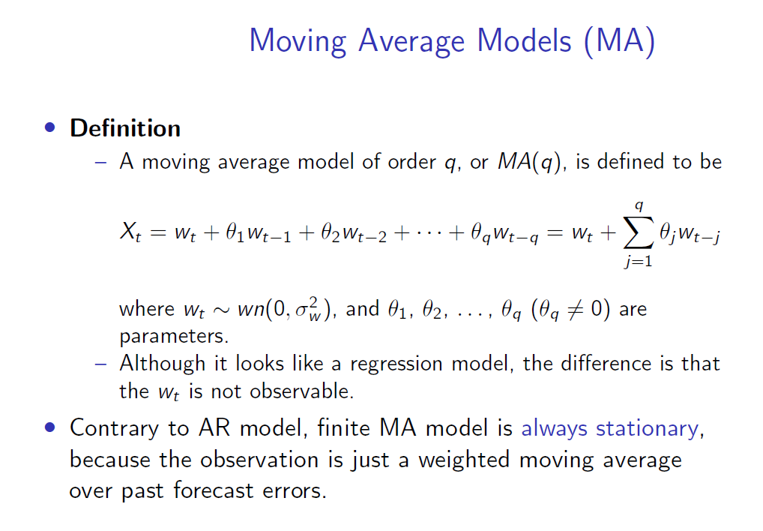

Slide 52
Moving Average Operator
Moving Average Operator
– Equivalent to autoregressive operator, we define moving average operator as:
θ(B) = 1 + θ₁B + θ₂B² + · · · + θ_{q} B^{q},
where B stands for backshift operator, thus B(w_{t} ) = w_{t−1}.
Therefore the moving average model can be rewritten as:
X_{t} = w_{t} + θ₁w_{t−1} + θ₂w_{t−2} + · · · + θ_{q}w_{t−q}
X_{t} = (1 + θ₁B + θ₂B² + · · · + θ_{q} B^{q} )w_{t}
X_{t} = θ(B)w_{t}
<number> / 77

Slide 53
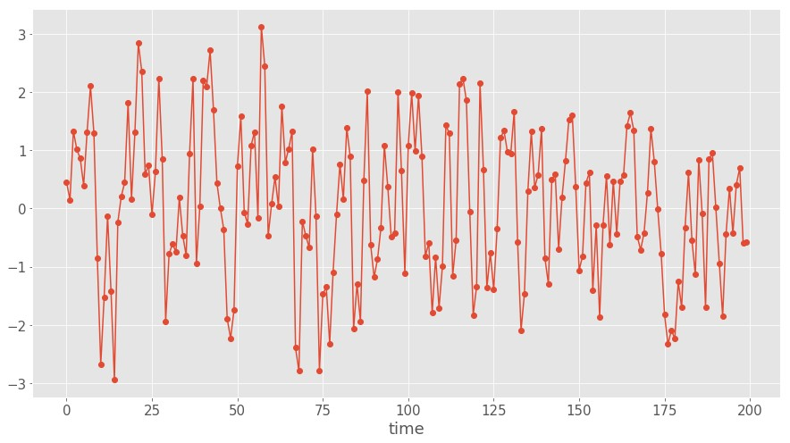
MA Examples: MA(1) Process
Simulated MA(1) Process X_{t} = w_{t} + 0.8 × w_{t−1}:
Mean E [X_{t} ] = 0
<number> / 77

Slide 54
General MA(q) Process
An important property of MA(q) models in general is that there are nonzero autocorrelations for the first q lags, and ρ_{h} = 0 for all lags h > q.
In other words, ACF provides a considerable amount of information about the order of the dependence q for MA(q) process.
<number> / 77

Slide 55
MA Models: Parameters Estimation
A well-known fact is that parameter estimation for MA model is more difficult than AR model.
– One reason is that the lagged error terms are not observable.
We can still use method of moments estimators for MA process, but we won’t get the optimal estimators with Yule-Walker equations.
In fact, since MA process is nonlinear in the parameters, we need iterative non-linear fitting instead of linear least squares.
From a practical point of view, modern scientific computing software packages will handle most of the details after given the correct configurations.
<number> / 77

Slide 56
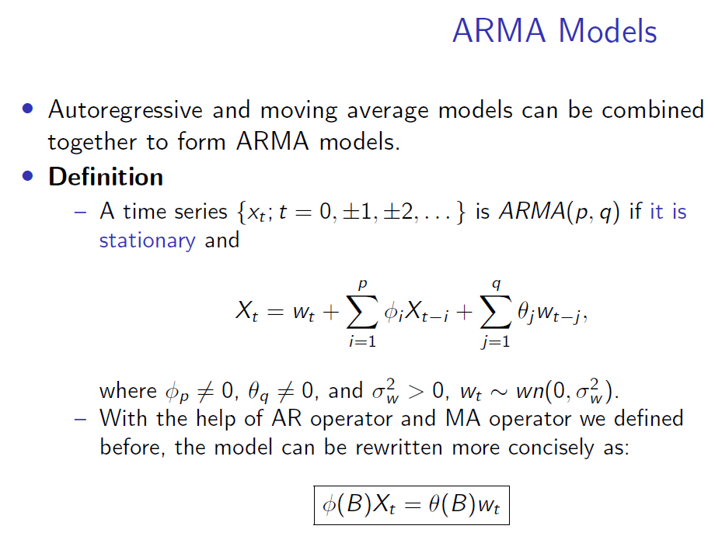

Slide 57
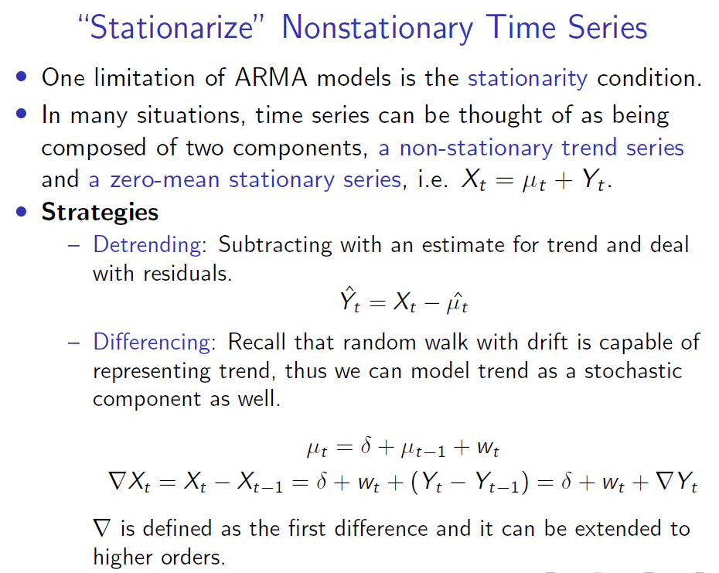

Slide 58
Differencing
One advantage of differencing over detrending for trend removal is that no parameter estimation is required.
In fact, differencing operation can be repeated.
The first difference eliminates a linear trend.
A second difference, i.e. the difference of first difference, can eliminate a quadratic trend.
Recall the backshift operator X_{t} = BX_{t−1}:
∇X_{t} = X_{t} − X_{t−1} = X_{t} − BX_{t} = (1 − B)X_{t}
2
∇ X_{t} = ∇(∇X_{t} ) = ∇(X_{t} − X_{t−1})
= (X_{t} − X_{t−1}) − (X_{t−1} − X_{t−2})
= X_{t} − 2X_{t−1} + X_{t−2} = X_{t} − 2BX_{t} + B²X_{t}
= (1 − 2B + B²)X_{t} = (1 − B)²X_{t}
<number> / 77

Slide 59
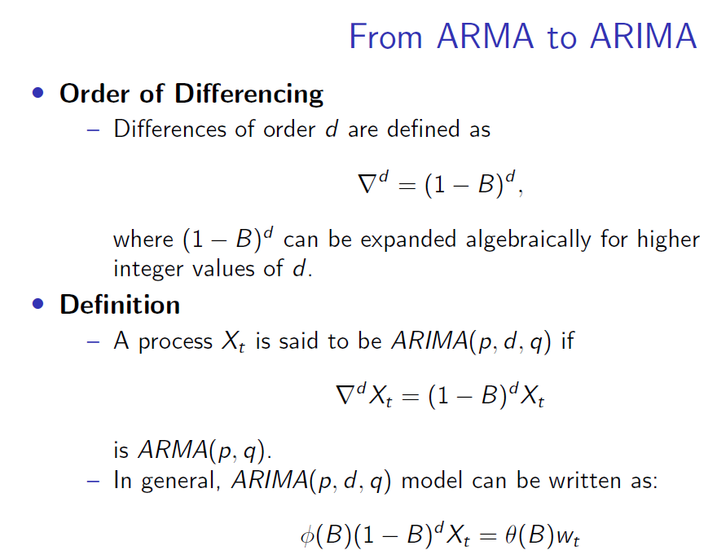

Slide 60
Box-Jenkins Methods
As we have seen ARIMA models have numerous parameters and hyper parameters, Box and Jenkins suggests an iterative three-stage approach to estimate an ARIMA model.
Procedures
Model identification: Checking stationarity and seasonality, performing differencing if necessary, choosing model specification ARIMA(p, d, q).
Parameter estimation: Computing coefficients that best fit the selected ARIMA model using maximum likelihood estimation or non-linear least-squares estimation.
Model checking: Testing whether the obtained model conforms
to the specifications of a stationary univariate process (i.e. the residuals should be independent of each other and have constant mean and variance). If failed go back to step 1.
Let’s go through a concrete example together for this procedure.
<number> / 77

Slide 61
Model Identification
As with any data analysis, we should construct a time plot of the data, and inspect the graph for any anomalies.
The most important thing in this phase is to determine if the time series is stationary and if there is any significant seasonality that needs to be handled.
Test Stationarity
Recall the definition, if the mean or variance changes over time then it’s non-stationary, thus an intuitive way is to plot rolling statistics.
We can also make an autocorrelation plot, as non-stationary time series often shows very slow decay.
A well-established statistical test called augmented
Dickey-Fuller Test can help. The null hypothesis is the time series is non-stationary.
<number> / 77

Slide 62
Pandas Off-the-shelf Packages
Python has a statsmodels module provides time series analysis including ARIMA.
pandas provides dedicated class for time series objects.
<number> / 77
Notes:
<number>

Slide 63
Thank You
<number> / 77

