Slide 1
Dimensionality Reduction

Slide 2
Dim Reduction
Dimension reduction approaches:
Incorporate domain knowledge to remove or combine categories,
Use data summaries to detect information overlap between variables (and remove or combine redundant variables or categories),
Employ automated reduction techniques,(PCA),
New set of variables (which are weighted averages of the original variables) is created.
New variables are uncorrelated and
A small subset of them usually contains most of their combined information (reduce dimension by using only a subset ).
The issue
Large number of variables in the database. New derived variables created (e.g., dummies for categorical variables).
Likely that subsets of variables are highly correlated.. can lead to overfitting, and accuracy and reliability can suffer.
Create computational problems for some supervised as well as unsupervised algorithms.
Superfluous variables can increase costs due to the collection and processing of these variables.

Slide 3
Curse of Dimensionality
The affliction caused by adding variables to multivariate data models.
As variables are added, the data space becomes increasingly sparse
Classification and prediction models fail because the available data are insufficient to provide a useful model across so many variables.
Difficulties increase exponentially with the addition of each variable.
In statistical distance terms, the proliferation of variables means that nothing is close to anything else anymore — too much noise has been added and patterns and structure are no longer discernible.
Esp in Big Data applications…find ways to reduce dimensionality with minimal sacrifice of accuracy… factor selection or feature extraction.

Slide 4
Practical Considerations
Although DM prefers automated methods over domain knowledge, it is important at the first step of data exploration to make sure that the variables measured are reasonable for the task at hand.
Integrate expert knowledge through a discussion with the data provider (or user) for better results.
Practical considerations: Which variables
Are most important for the task at hand, and
Most likely to be useless?
Likely to contain much error?
Available for measurement (and what will it cost to measure them) in the future if the analysis is repeated?
Can actually be measured before the outcome occurs?
For example, if we want to predict the closing price of an ongoing online auction, we cannot use the number of bids as a predictor because this will not be known until the auction closes.
Tax on Total cost

Slide 5
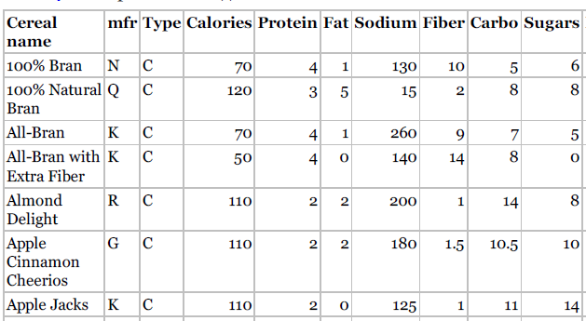
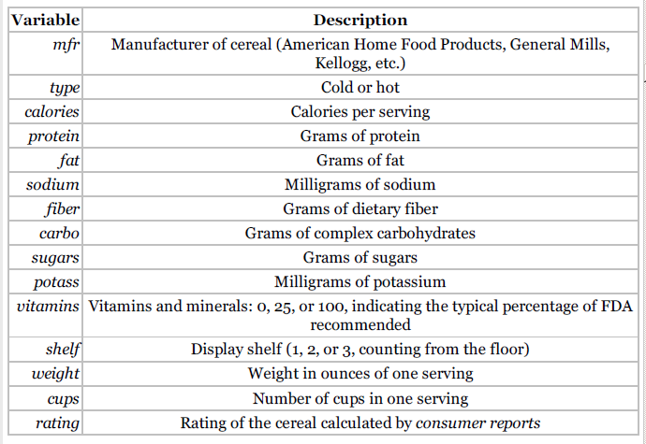
PCA
Data set: Breakfast Cereals
Nutritional information and consumer rating of 77 breakfast cereals (information is based on a bowl of cereal)
The consumer rating is a rating of cereal “healthiness” for consumer information (not a rating by consumers).
For each cereal, 13 numerical variables.
Objective is Dim Reduction

Slide 6

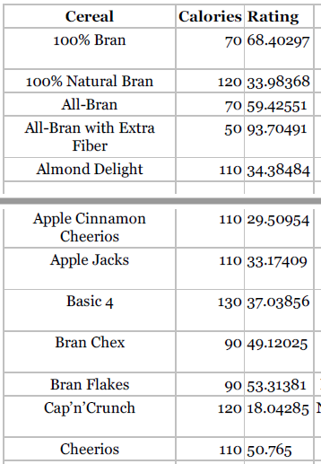

PCA
Focus first on two variables: calories and consumer rating.
The average calories is 106.88 and the average consumer rating is 42.67.
The estimated covariance matrix between the two variables is
The 2 variables are strongly correlated with a negative correlation of

Slide 7
PCA
Covariance
Correlation
Observations
69% of the total variation in both variables is actually “co-variation,” or variation in one variable that is duplicated by similar variation in the other variable => Use this fact to reduce the number of variables, while making maximum use of their unique contributions to the overall variation.
Redundancy in the information that the two variables contain => it might be possible to reduce the two variables to a single variable without losing too much information.
PCA: Find a linear combination of the two variables that contains most, even if not all, of the information, so that this new variable can replace the two original variables.
Information here is in the sense of variability: What can explain the most variability among the 77 cereals? The total variability here is the sum of the variances of the two variables, which in this case is 379.63 + 197.32 = 577.
This means that calories accounts for 66% = 379.63 /577 of the total variability, and rating for the remaining 34%.
If we drop one of the variables for the sake of dimension reduction, we lose at least 34% of the total variability.
Can we redistribute the total variability between two new variables in a more polarized way? If so, it might be possible to keep only the one new variable that (hopefully) accounts for a large portion of the total variation.

Slide 8
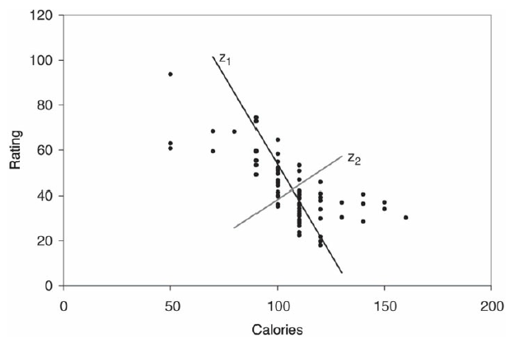
Scatter plot of rating vs. calories
PCA
The line z1 is the direction in which the variability of the points is largest.
z1 captures the most variation in the data ..if we decide to reduce the dimensionality of the data from two to one.
Among all possible lines, it is the line for which, if we project the points in the dataset orthogonally to get a set of 77 (one-dimensional) values, the variance of the z1 values will be maximum. .. called the first principal component.
It is also the line that minimizes the sum-of-squared perpendicular distances from the line.
The z2-axis is chosen to be perpendicular to the z1-axis.

Slide 9
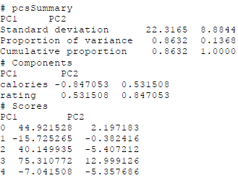
PCA
Running PCA in scikit-learn is done with the class sklearn.decomposition.PCA.
Output from running PCA on the two variables calories and rating.
The value components of this function is the rotation matrix, which gives the weights that are used to project the original points onto the two new directions. The weights for z1 are given by (−0.847, 0.532), and for z2 they are given by (0.532, 0.847).
The summary gives the reallocated variance:
z1 accounts for 86% of the total variability and
z2 for the remaining 14%.
Therefore, if we drop z2, we still maintain 86% of the total variability.

