Slide 1

19AI704 Applied Predictive Analytics
Overview of the course
Dr. PN Kumar
Dept of Computer Science and Engg
Amrita Vishwa Vidyapeetham, Coimbatore

Slide 2
Predictive Data Analytics
The term predictive modeling stir associations such as ML, PR, and DM.
Indeed, these associations are appropriate and the methods implied by these terms are an integral piece of the predictive modeling process.
While each field approaches the problem using different perspectives and tool sets, the ultimate objective is the same: to make an accurate prediction……=> pool these terms into the commonly used phrase predictive modeling.

Slide 3
Predictive Data Analytics
Predictive modeling encompasses much more than the tools and techniques for uncovering patterns within data.
The practice of predictive modeling defines the process of developing a model in a way that we can understand and quantify the model’s prediction accuracy on future, yet-to-be-seen data.
Predictive modeling: the process of developing a mathematical tool or model that generates an accurate prediction

Slide 4
Predictive Data Analytics
Data is the new gold:
mine this gold to create business value
today’s context of a highly networked and digital society
requires a new skill set that
haven’t traditionally been delivered in business/statistics/ engg programs.
Big Data:
3 billion++ plus people on the online social grid, and
close to 5 billion++ people carrying increasingly sophisticated mobile devices.
Likely to be dwarfed by tomorrow’s smarter physical ecosystems fueled by the Internet of Things (IoT).
Analytics:
new era will be fuelled by analytics and
the ability to harness data for competitive advantage.

Slide 5
Analytics
Proficiency requirement in Analytics discipline:
grounded in the fundamentals of domains (eg: business): know the right questions to ask,
ability to harness, store, and optimally process vast datasets from a variety of structured and unstructured sources, and
Use techniques from ML/ statistics to uncover new insights for decision-making.
19AI704 shall explain:
the core set of concepts required for today’s analytics using real-world data-rich cases in a hands-on manner,
Provides a modern day foundation for Analytics, the notion of linking the x’s to the y’s of interest in a predictive sense.

Slide 6
What Is Analytics?
Analytics
is the practice and art of bringing quantitative data to bear on decision-making.
Intelligence
refers to data visualization and reporting
for understanding “what happened and what is happening.”..
done by use of charts, tables, and dashboards to display, examine, and explore data.
earlier statistical reports, has evolved into
more user-friendly and effective tools and practices,
creating interactive dashboards that allow the user not only to access real-time data, but also to directly interact with it.

Slide 7
What Is Analytics? Contd..
Analytics now typically includes
sophisticated data analysis methods, such as
statistical models and
data mining algorithms
used for
exploring data,
quantifying and explaining relationships between measurements, and
predicting new records.
Methods like regression models are used to
describe and quantify “on average” relationships (e.g., between advertising and sales),
to predict new records (e.g., whether a new patient will react positively to a medication), and
to forecast future values (e.g., next week’s web traffic).
Analytics toolkit also includes statistical experiments. These are often used for pricing decisions:
Orbitz, the travel site, found that it could price hotel options higher for Mac users than Windows users.
Staples online store found it could charge more for staplers if a customer lived far from a Staples store.

Slide 8
19AI704 Applied Predictive Analytics
Preamble
Predictive analytics is used to predict of future outcomes based on historical data using statistical and machine learning techniques. This course provides a comprehensive review of various analytics methods. Students will gain an in-depth understanding of supervised and unsupervised learning for predictive analytics. The course will also cover the principles of forecasting analytics.
Course Objectives
To familiarize students with the methods for exploration and visualization of data
To develop machine learning models for predictive tasks
To choose suitable performance measures for predictive models
To apply predictive modelling techniques in real world data
Course Outcomes-Program Outcomes (CO-PO) Mapping
CO | Statement | Level | PO1 | PO2 | PO3 | PO4 | PO5
CO1 | Understand analytical methods used in predictive analytics | L3 | 3 | 3 | 2 | 1 | 1
CO2 | Evaluate the measures to access predictive performance of data mining tasks | L4 | 3 | 4 | 4 | 1 | 1
CO3 | Understand and design prediction , classification methods | L4 | 3 | 3 | 2 | 2 | 2
CO4 | Study approaches for forecasting time series data | L3 | 3 | 3 | 2 | 1 | 1
CO5 | Apply suitable predictive methods in real life problems | L4 | 3 | 3 | 3 | 4 | 4

Slide 9
Course Out comes & BTL
CO | Statement | Level | PO1 | PO2 | PO3 | PO4 | PO5
CO1 | Understand analytical methods used in predictive analytics | L3 | 3 | 3 | 2 | 1 | 1
CO2 | Evaluate the measures to access predictive performance of data mining tasks | L4 | 3 | 4 | 4 | 1 | 1
CO3 | Understand and design prediction , classification methods | L4 | 3 | 3 | 2 | 2 | 2
CO4 | Study approaches for forecasting time series data | L3 | 3 | 3 | 2 | 1 | 1
CO5 | Apply suitable predictive methods in real life problems | L4 | 3 | 3 | 3 | 4 | 4

Slide 10
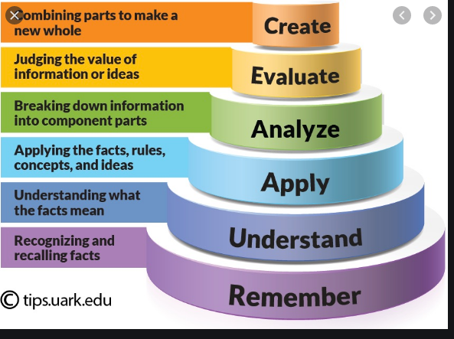
Bloom’s Taxonomy Levels

Slide 11
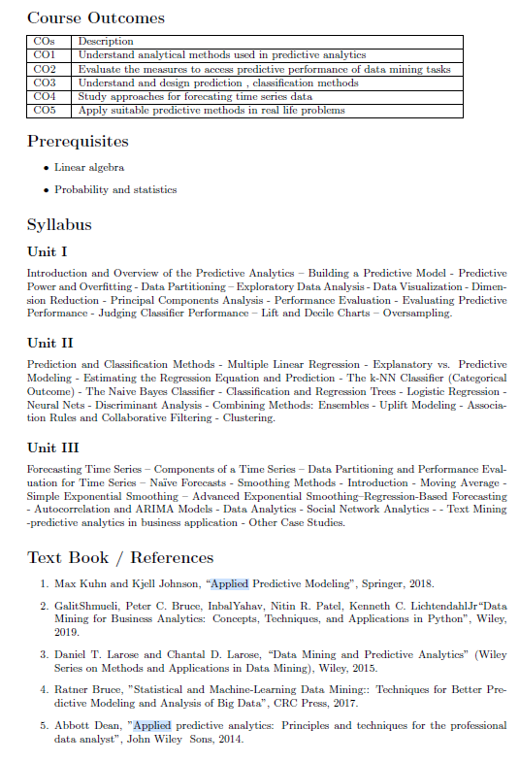
19AI704 Applied Predictive Analytics

Slide 12
Evaluation Strategy
Continuous Evaluation: 70% and End Exam: 30% ( Online Exam-10% and Viva 20%)
Internal | Marks | Distribution
PT1 | 10 | 5+5viva
PT2 | 10 | 5+5viva
Quiz/Assign | 10 | 5 x 2 = 10
Lab (25) Evaluation Labs | 25 | 5 x 5 =25
Case Study(15) 3x Reviews (@PT1 & PT2 & End) | 15 | 3 x 5 =15

Slide 13
Case Study(15 Marks)
Analytics is a very hands-on subject. One needs to demonstrate various concepts learnt in predictive analytics(i.e. from data collection and preprocessing to design, implementation and more importantly analysis).
This is an individual work. Students can select challenging data sets (preferably from Kaggle/ any other contest data set, so as to suit the objectives of the study). Three reviews will be held, timed along with the two periodical tests and end semester viva-voce.
Review 1 (5 Marks): Week 7
Data preprocessing; Handle Missing values, Dummy variables, correlation analysis, Data Scaling/Transformation, dimensionality reduction (at least 2 methods); strategies to avoid over fitting;
Data visualization and EDA(Plotly, Bokeh and Tableau to be employed to elicit intelligence with both static and dynamic features).
Model1 –Classification and Regression (two models); Bagging, Boosting;Confusion Matrix, Accuracy, F-Measure, 10 fold cross validation, Student T-Test and RoC Tests
Review 2 (5 marks): Week 14
Model2- Web/ Text mining (eg sentiment analysis)
Model3-Clustering (Hopkins Test and any two algorithms to be implemented and evaluated)
Model4-Association Rule Mining
Review 3 (5 marks): Week 21
Model5- Time series analysis (eg stock market prediction/ Demand forecasting)
Model6 – Recommender System
Students shall submit their study in Jupyter Notebook (To be uploaded in AmritaGit 2 days prior to Final Review). The work should have explanatory notes embedded.

Slide 14
Course communications
Whatsapp
AUMS, Mentimeter
Quizzes
MS – Teams
Live lectures, project presentation and interactions

Slide 15
The Steps in Analytics
Some of the most serious errors in analytics projects result from a poor understanding of the problem—an understanding that must be developed before we get into the details of algorithms to be used.
List of steps(a typical venture):
1. Develop an understanding of the purpose of the project:
2. Obtain the dataset to be used in the analysis:
3. Explore, clean, and preprocess the data:
4. Reduce the data dimension, if necessary:
5. Determine the task (classification, prediction, clustering, etc.):
6. Partition the data (for supervised tasks):
7. Choose the techniques to be used (regression, neural nets, hierarchical clustering etc).
8. Use algorithms to perform the task:
9. Interpret the results of the algorithms:
10. Deploy the model.

Slide 16
Why predictive models fail?
There are a number of common reasons why predictive models fail, includes
inadequate pre-processing of the data,
inadequate model validation,
unjustified extrapolation (e.g., application of the model to data that reside in a space which the model has never seen), or, most importantly,
over-fitting the model to the existing data.
Furthermore, predictive modelers often
only explore relatively few models when searching for predictive relationships - usually due to either modelers’ preference/ knowledge or
expertise in only a few models or the lack of available software that would enable them to explore a wide range of techniques.

Slide 17
We shall concentrate on
Foundational principles for building predictive models
Intuitive explanations of many commonly used predictive modeling methods for both classification and regression problems
Principles and steps for validating a predictive model
Computer code to perform the necessary foundational work to build and validate predictive models
To illustrate these principles and methods, we will use a diverse set of real-world examples ranging primarily from business and finance data

Slide 18
Prediction Versus Interpretation
While the primary interest of predictive modeling is to generate accurate predictions, a secondary interest may be to interpret the model and understand why it works.
The unfortunate reality is that as we push towards higher accuracy, models become more complex and their interpretability becomes more difficult.
This is almost always the trade-off we make when prediction accuracy is the primary goal.

Slide 19
Modeler with expert knowledge and context of the problem
Effective prediction mandates a modeler with expert knowledge and knowledge of the context of the problem.
This expert knowledge should first be applied in obtaining relevant data for the desired research objectives.
While vast databases of information can be used as substrate for constructing predictions, irrelevant information can drive down predictive performance of many models.
Subject-specific knowledge can help separate potentially meaningful information from irrelevant information, eliminating detrimental noise and strengthening the underlying signal.
Undesirable, confounding signal may also exist in the data.
To conclude: Problem-specific knowledge is important
Predictive modeling is not a substitute for intuition, but rather a complement
Traditional experts make better decisions when they are provided with the results of statistical prediction

Slide 20
Lab ex

Slide 21
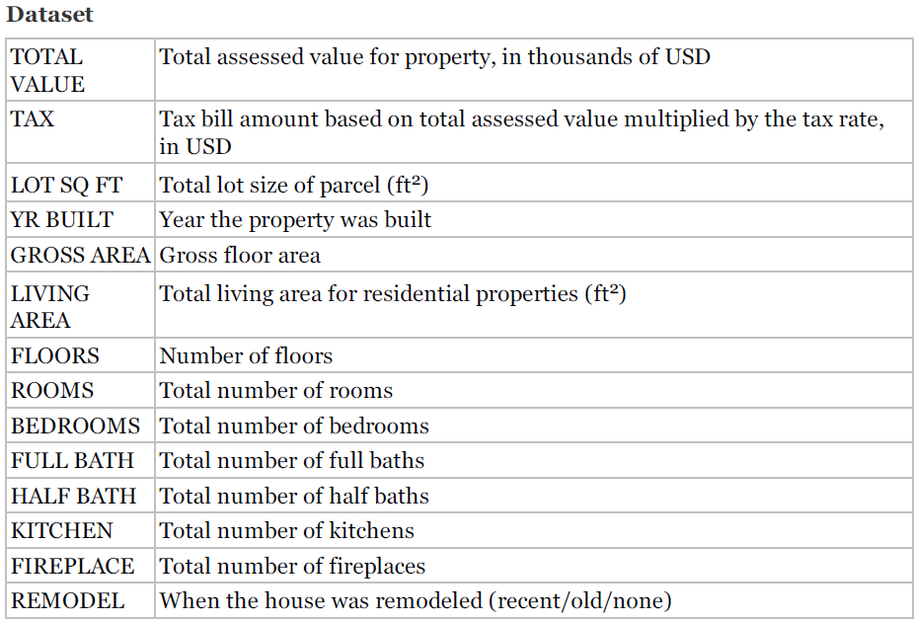
Lab- Ex1
Ex-1: Predicting Home Values in the West Roxbury Neighborhood, Boston(2014)
Zillow (www.zillow.com)
The most popular online real estate information site in the US
Dominant platform for checking house prices and, as such, dominant online advertising venue for realtors.
Zillow’s business model—redirecting the 6% commission away from realtors and to itself.
Data Set: WestRoxbury.csv
WestRox pd.read_csv('https://raw.githubusercontent.com/reisanar/datasets/master/WestRoxbury.csv')
14 variables are recorded for over 5000 homes.
Each row represents a home- eg assessed value: $344,200, its tax:$4430, size: 9965 sq ft, built in 1880, and so on.

Slide 22
Lab Ex1
Load data: 'https://raw.githubusercontent.com/reisanar/datasets/master/WestRoxbury.csv‘
find the dimension of data frame
show the first five rows
Rename columns: replace spaces with ’_’ to allow dot notation
Practice showing the first four rows of the data (use loc and iloc)
Different ways of showing the first 10 values in column TOTAL_VALUE
TOTAL_VALUE : use dot notation if the column name has no spaces
Show the fifth row of the first 10 columns
Use a slice to return a data frame housing_df.iloc[4:5, 0:10]
Use pd.concat to combine non-consecutive columns into a new data frame.
The axis argument specifies the dimension along which the concatenation happens, 0=rows, 1=columns.
Specify any one full column
Show the first 10 rows of the first column
Random sample 5 observations.
Oversample houses with over 10 rooms
Descriptive statistics
show length of first column
show mean of column
show summary statistics for each column

Slide 23
Lab ex - OTW

Slide 24
Lab Ex1
TAX[0:4] is a slice of variable TAX containing the first five records.
Note that Python uses 0-indexing, which means that indices start at 0 and not at 1.
Pandas uses two methods to access rows in a data frame: loc and iloc.
The loc method is more general and allows accessing rows using labels.
The iloc method on the other hand only allows using integer numbers.
To specify a range of rows, use the slice notation, for example, 0:9.
In general, Python excludes the end index in the slice and the iloc method conforms with this convention.
The loc method, however, includes it, so be careful when using these methods.

Slide 25
Sampling from a Database
Typically, we perform DM on less than the complete database.
DM algorithms will have varying limitations on data handling capability(records and variables)
Limitations that may be specific to computing power/capacity / software limitations.
Accurate models can often be built with as few as several thousand records. Hence, sample a subset of records for model building.
Code for sampling : # random sample of 5 observations : housing_df.sample(5)

Slide 26
Oversampling Rare Events in Classification Tasks
If classifying rare events, for example, customers purchasing a product in response to a mailing, or fraudulent credit card transactions, sampling a random subset of records may yield so few events (e.g., purchases) that we have little information on them.
We would end up with lots of data on non-purchasers and non-fraudulent transactions but little on which to base a model that distinguishes purchasers from non-purchasers or fraudulent from non-fraudulent.
In such cases, sampling procedure should overweigh the rare class (purchasers or frauds) relative to the majority class (non-purchasers, non-frauds) so that the sample would end up with a healthy complement of purchasers or frauds.
Code for Over/ Under sampling.
Eg: # oversample houses with over 10 rooms
weights = [0.9 if rooms > 10 else 0.01 for rooms in housing_df.ROOMS]
housing_df.sample(5, weights=weights)

Slide 27
Types of Variables
Variables can be numerical or text (character/string), be continuous (able to assume any real numerical value, usually in a given range), integer (taking only integer values), categorical (assuming one of a limited number of values), or date.
Categorical variables can be either coded as numerical (1, 2, 3) or text (payments current, payments not current, bankrupt).
Categorical variables can be unordered (called nominal variables) with categories such as North America, Europe, and Asia; or they can be ordered (called ordinal variables) with Categories such as high value, low value, and nil value.
Continuous variables can be handled by most data mining routines with the exception of the NB classifier, which deals exclusively with categorical predictor variables.
The ML roots of DM grew out of problems with categorical outcomes; Vs, the roots of statistics lie in the analysis of continuous variables.
Sometimes, it is desirable to convert continuous variables to categorical variables.
Most typically in the case of outcome variables, where the numerical variable is mapped to a decision. E.g.
credit scores above a certain threshold mean “grant credit,”
a medical test result above a certain threshold means “start treatment”.

Slide 28
Thank You

