Slide 1
Lab3
Connected Component (50%)
Foreground Detection (50%)

Slide 2
1. Connected Component (50%)
Two-Pass Algorithm
Pass 1
  Perform label assignment and label propagation
  Construct the equivalence relations between labels when two different labels propagate to the same pixel
  Apply resolve function to find the transitive closure of all equivalence relations
Pass 2:
  Perform label translation

Slide 3
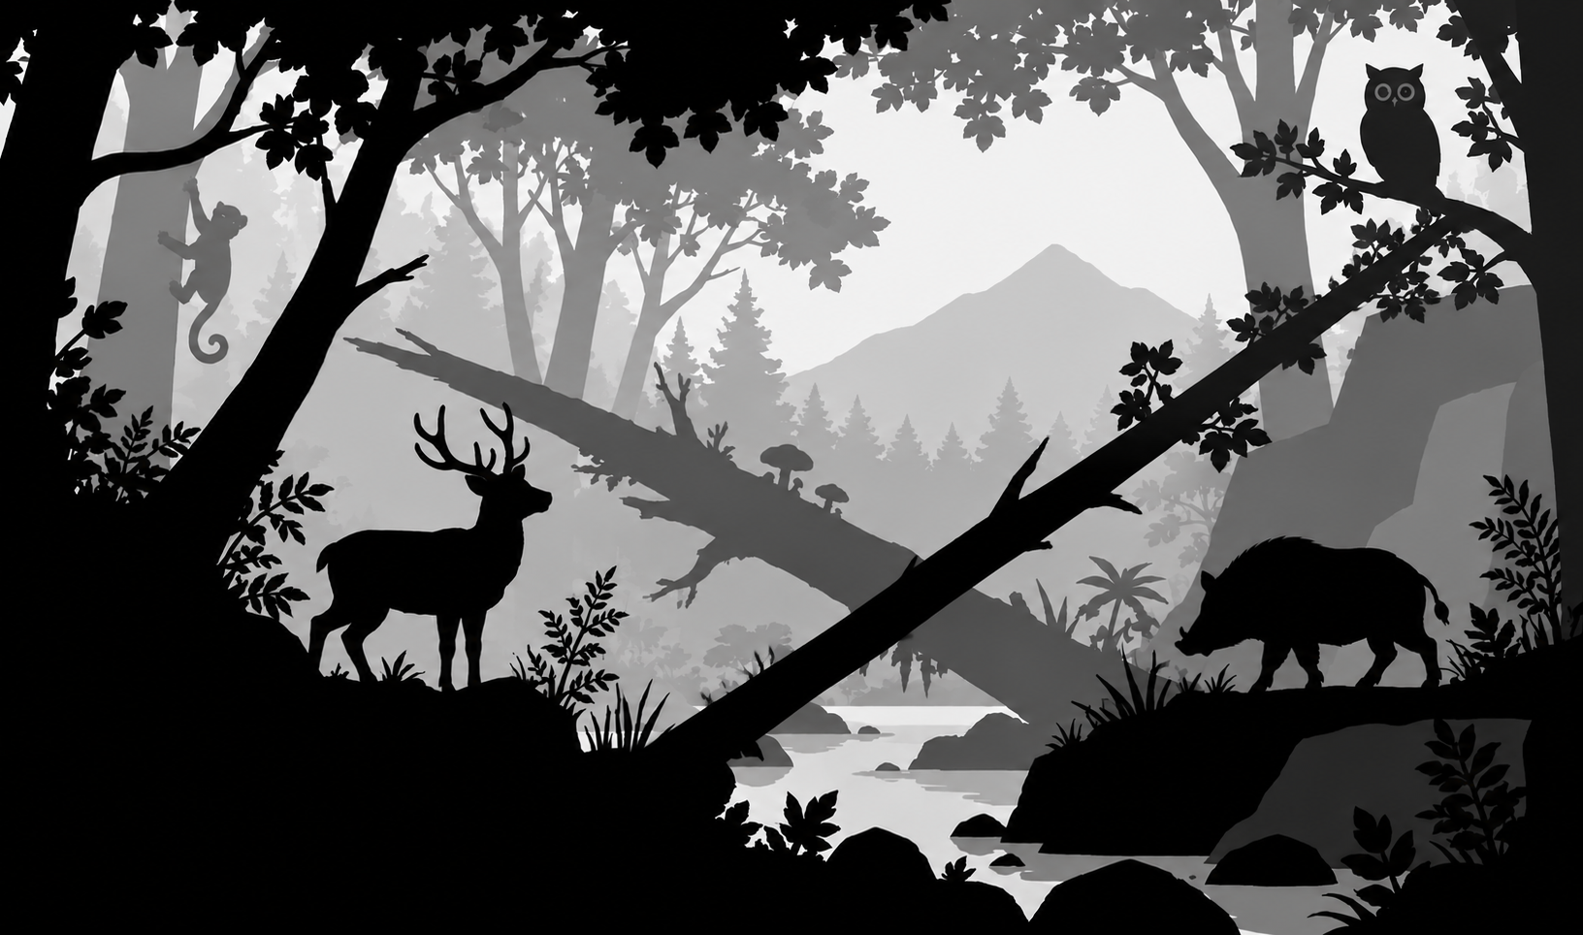
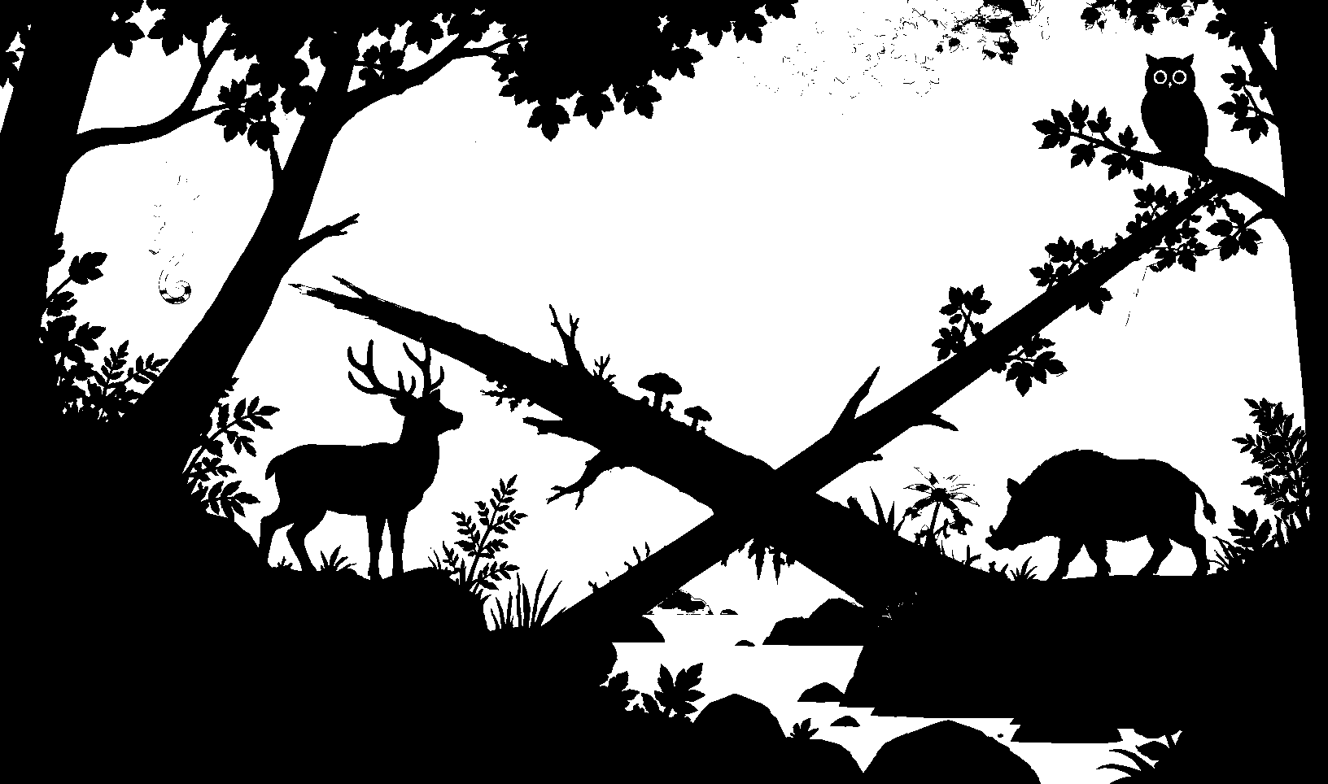
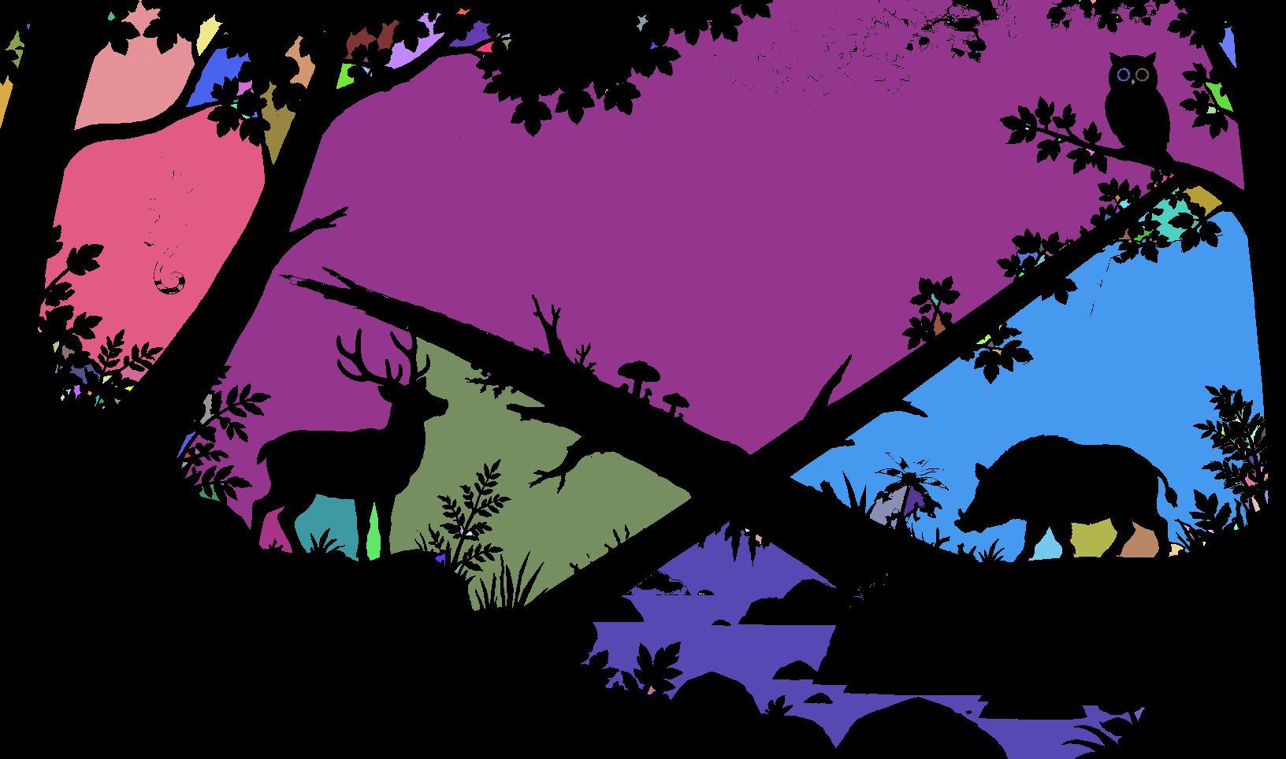
1. Connected Component (50%)
對做完 Otsu threshold （上次作業）的圖片找出 connected component
把不同區域塗上不同顏色
顏色不限制，不用跟範例一樣
input
Otsu
Connected Component

Slide 4
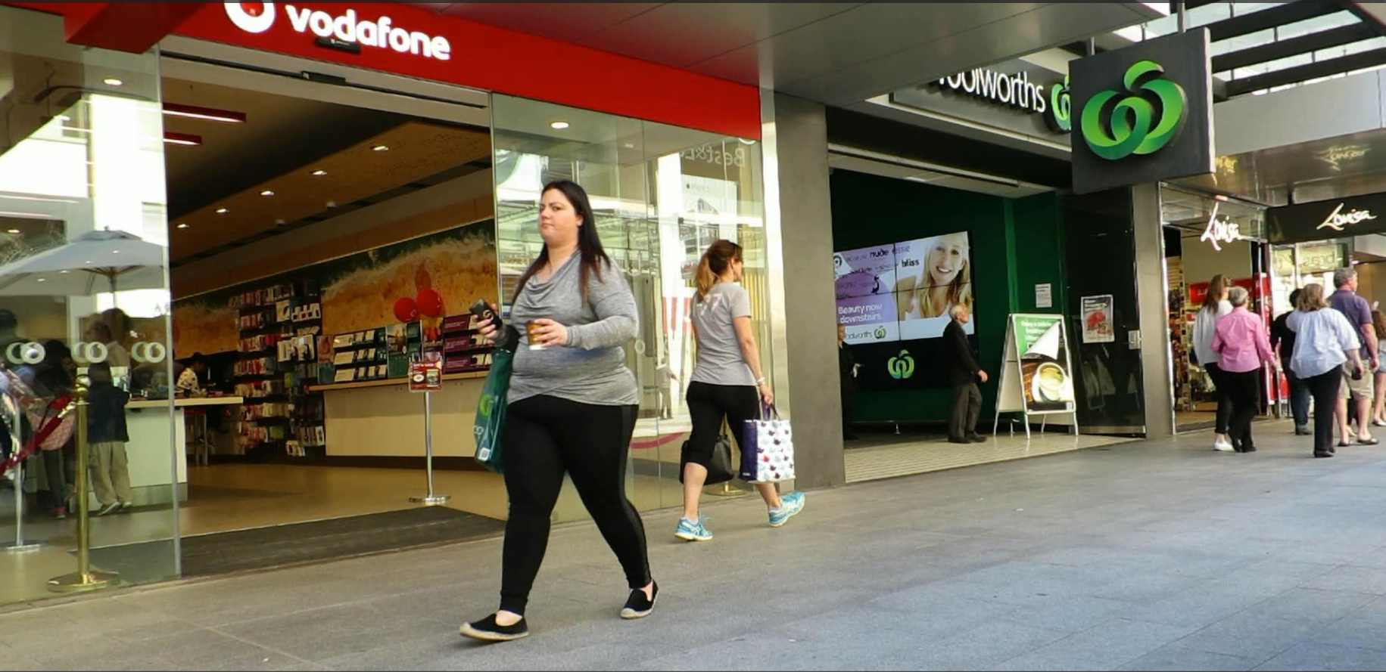
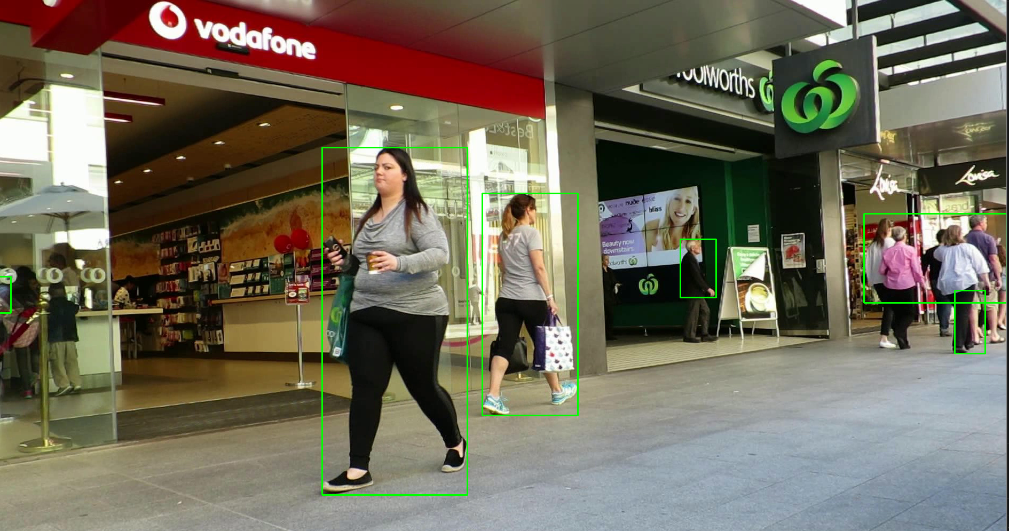
2. Foreground Detection (50%)

Slide 5
2. Foreground Detection (50%)
Video
  Videos are formed by continuous frames, new frames are shown when the video is being played. The time between each frame is called frame rate.
How to read videos
  cap = cv2.VideoCapture(filename)
  cap.isOpened(): 檢查影片是否被成功讀取
  ret, frame = cap.read(): 不斷讀取來源影格，把資訊寫進frame
  cv2.imshow("frame", videoFrame): 顯示影片
  cv2.waitKey(33): 等待幾毫秒再讀取下一禎

Slide 6
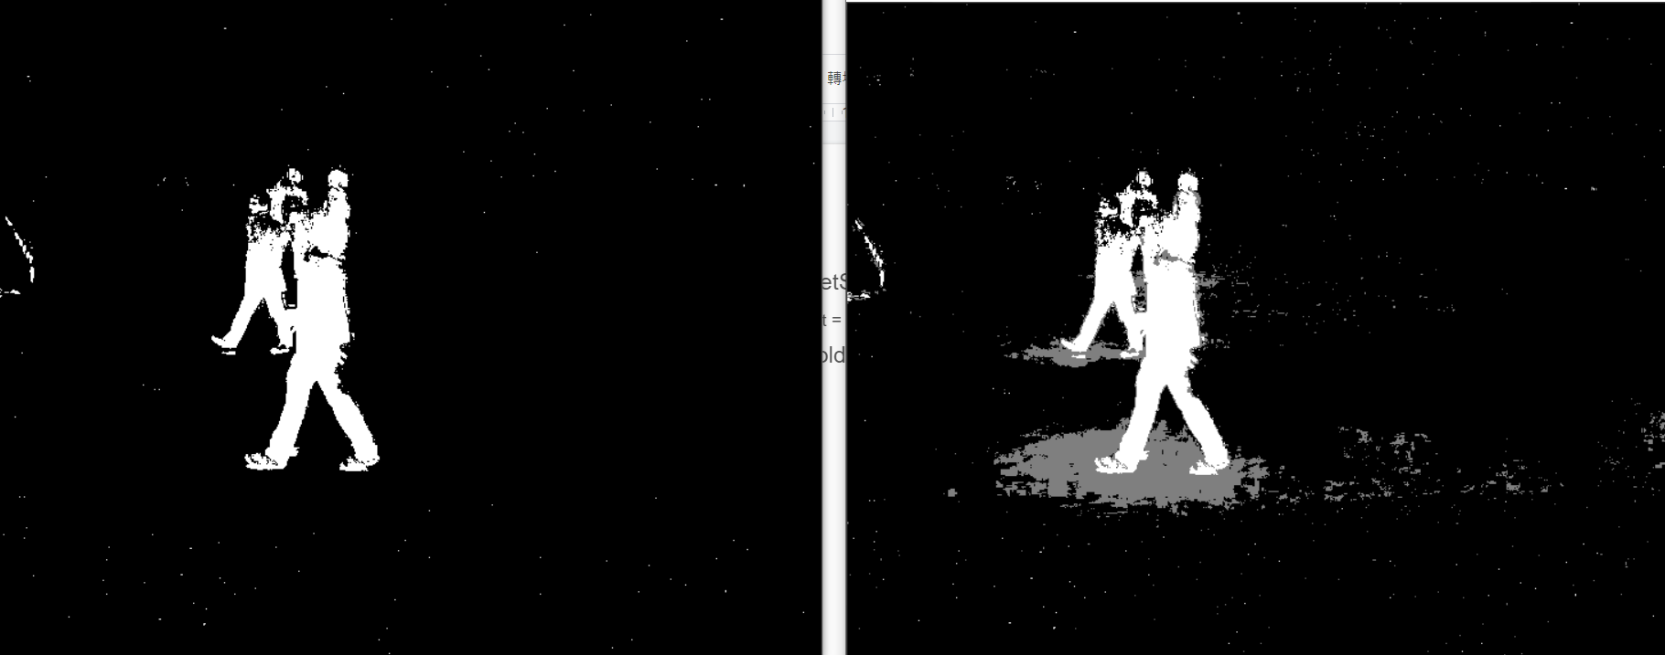
2. Foreground Detection (50%)
Background Subtraction
  創造一個 BackgroundSubtractor
    backSub = cv2.createBackgroundSubtractorMOG2()
  用在 frame 上面
    fgmask = backSub.apply(frame)

Slide 7
2. Foreground Detection (50%)
Threshold
  找出 shadow 的值 (default=127, background=0, foreground=255)
    shadow_val = backSub.getShadowValue()
  ret, nmask = cv2.threshold(fgmask, shadow_val, 255, cv2.THRESH_BINARY)

Slide 8
2. Foreground Detection (50%)
Connected component (修改第一題的 code)
  找connected component時，要同時計算相連區域面積
  若相連區域面積 > T，找出相連區域最外圍的四個邊
Draw rectangles
  cv2.rectangle(image, (x1, y1), (x2, y2), color, line_width)

