Slide 1
Application of STATCOM for Harmonic Mitigation and Power Factor Improvement Using Direct Current Control Technique
2017 IEEE International Conference on Electrical, Computer and Communication Technologies (IEEE ICECCT 2017)
Presented By
Akshay D. Kadu
Department of Electrical Engineering
Rajiv Gandhi College of Engineering and Research
Nagpur, India
akshaykadu001@gmail.com
at
SVS College of Engineering, Coimbatore, Tamil Nadu,

Slide 2
CONTENT
INTRODUCTION
OPERATING PRICIPLE OF STATCOM
DIRECT CURRENT CONTROL METHOD OF STATCOM
SIMULATION RESULTS
CONCLUSION
REFERENCES

Slide 3
INTRODUCTION
Due to industrial development and a variety of load now a days power quality issue gain more importance.
Improve the reliability, controllability and rapidity of modern power system has become a urgent problem to be solved.
STATCOM is the central device of modern FACTS, compared with the traditional reactive power compensation device.
STATCOM has the advantage of fast response, improve power factor, harmonic current, low loss, small size, etc.

Slide 4
ABSTRACT
STATCOM using direct current control method (DCC).
In direct control method instantaneous value of system current is used for feedback control hence fast response is achieved.
Compared to direct control method, indirect control method is simple but due to fast response and precise control, direct current control method is quite effective.
An extensive digital simulation of the recommended STATCOM and its controller is carried out using MATLAB/SIMULINK software .

Slide 5
OPERATING PRICIPLE OF STATCOM
Fig.1. Equivalent circuit of STATCOM
When STATCOM voltage is greater than supply voltage it inject reactive power
When STATCOM voltage is less than supply voltage it absorbs the reactive power.
When both voltages are equal no interaction between STATCOM and system.
Cont..

Slide 6
OPERATING PRICIPLE OF STATCOM
Voltage source converter is coupled to power system through reactor.
Voltage source converter used in STATCOM may be two-level or three-level type, depending on the required output power.
VSC is used to produce reactive power required for compensation.
Fig.2. power circuit of STATCOM

Slide 7
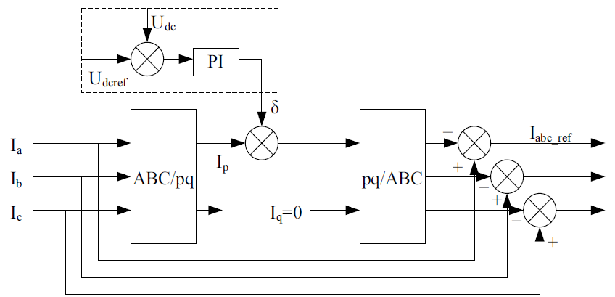
DIRECT CURRENT CONTROL METHOD OF STATCOM
Fig.3 Block diagram of the instantaneous reactive and harmonic current detection method
The control method of STATCOM has two kinds : current indirect control and direct control.
Direct current control uses track PWM technology on current instantaneous value to feedback control.
I_{a}, I_{b}, I_{c} is a three-phase load currents, U_{dcref} is DC side voltage reference value, U_{dc} is the detected DC side voltage.

Slide 8
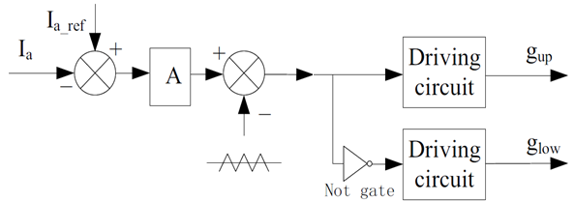
DIRECT CURRENT CONTROL METHOD OF STATCOM
Figure 4. Triangle wave comparison
Triangle wave comparison control compared the detected deviation between the current actual value and reference value.
After this deviated current is compared with triangular wave to obtain gate pulses for Voltage source inverter.
Notes:
Triangle wave comparison control compared the detected
deviation between the current actual value and reference
value with the high frequency triangular carrier phase pulse,
the pulse as the inverter switching device to control signal,
resulting in the inverter output to obtain the desired current
waveform, the control process is shown in figure 4.

Slide 9
SYSTEM UNDER STUDY
Figure. 5 Schematic diagram of STATCOM connected power system with Linear and Non-Linear load

Slide 10
SIMULATION RESULTS
SYSTEM PARAMETERS
System Voltage | 220V- line voltage, 50 Hz, Balanced/ Distorted
Non- Linear Load | Three phase uncontrolled rectifier with R = 15Ω , L = 100 mH
Interface Inductor | R_{f} = 5Ω , L_{f} = 3 mH
PI controller gains | K_{p} = 0.1 K_{i} = 0.005
DC link | V_{dc1}=V_{dc2}= 359V, C_{dc1}=C_{dc2}= 2000 μF V_{dcref} = 359V

Slide 11
SIMULATION RESULTS
Non-Linear Load
(Before Compensation)
Fig. No.6 System voltage and current waveform for non linear load
(After Compensation)
Fig. No.7 System voltage and current waveform for non linear load

Slide 12
SIMULATION RESULTS
Linear & Non-Linear Load
Before Compensation
Fig. No.8 System voltage and current waveform for non linear load
After Compensation
Fig. No.9 System voltage and current waveform for non linear load

Slide 13
THD Analysis
SIMULATION RESULTS
(a)
(Before Compensation)
(b)
(After Compensation)
Fig. 10 Phase B Current waveform Harmonic (FFT) analysis

Slide 14
SIMULATION RESULTS
Power Factor Measurement
(a)
(Before Compensation)
Fig.11 The B phase power factor

Slide 15
SIMULATION RESULTS
Power Factor Measurement
(b)
(Before Compensation)
Fig.12 The B phase power factor

Slide 16
CONCLUSIONS
Direct control method is complex in implementation as compared to indirect control method, but its response is fast and have precise controllability.
It is observed that using direct control the overall power factor is improved and total harmonic distortion of system is under control.

Slide 17
REFERENCES
Narain G. Hingorani, Laszlo Gyugyi, Understanding FACTS, Wiley-Technology & Engineering, 2000
K. R. Padiyar, Facts Controllers In Power Transmission And Distribution, New Age International (P) Limited, Publishers,2007
Garica-Gonzalez, P., Garcia-Cerrada, A, “Control system for a PWM-based STATCOM”, IEEE Transactions on Power Delivery, Vol. 15, Issue.4, pp.1252-1257, Oct-2000
Li Shengqing, Li Weizhou, Xu Wenxiang, Zeng Huanyue, “The Direct Current Control Method of STATCOM and It’s Simulation”, Third International conference ISDEA, pp.1426-1429, Jan-2013.
Hanson, D.J. , Woodhouse, M.L. , Horwill, C. , Monkhouse, D.R. , Osborne, M.M., “STATCOM: a new era of reactive compensation”, IET Power Engg., Vol.16, Issue.3, pp.151-160, June-2002.
Xu, W. ; Marti, J.R. ; Dommel, H.W., “Harmonic analysis of systems with static compensators”, IEEE Transactions on power system, Vol. 6, Issue.1, pp183-190, Feb-1991
An Luo ; Zhikang Shuai ; Wenji Zhu ; Shen, Z.J. , “Combined System for Harmonic Suppression and Reactive Power Compensation”, IEEE Transactions on Industrial Electronics, Vol.56, Issue.2, pp 418-428, Dec-2008
T. Furuhashi , S. Okuma and Y. Uchikawa "A study on the theory of instantaneous reactive power", IEEE Trans. Ind. Electron., vol. 37, no. 1, pp.86 -90, Feb-1990
Saad-Saoud, Z. ; Lisboa, M.L. ; Ekanayake, J.B. ; Jenkins, N. ;Strbac, G., “Application of STATCOMs to wind farms”, IEE Proceedings- Generation, Transmission and Distribution, Vol.145, Issue 5, pp511-516, Sep-1998

Slide 18
THANK YOU

