Slide 1
DTEG Generic ICL/PDL Val Infrastructure - DUVE-M -
Igor Molchanov
WW38, 2020

Slide 2
Why ICL/PDL?
IEEE1687 ICL/PDL is industry standard and supported by EDA tools (Mentor Tessent)
Good support of the tool & methodology by tool vendor, quickly evolving and improving capabilities
Native retargeting support of IP level sequences & recipes @ SoC
Allows sequences to be defined, validated and delivered by IP owner
Original limitation of Intel internal TFM
Native support of variable length registers/chains (IOV, BSCAN, IJTAG, etc.)
Original limitation of Intel internal TFM
Ease of integration and collateral reuse for 3rd party IP’s (like Synopsys PHY)
Support of “not usual” TAP implementations and mixed networks
Original limitation of Intel internal TFM
Ease of IP TAP/DFT logic & ICL/PDL collateral validation
Original limitation of Intel internal TFM
PDL provides similar test writing capabilities and experience as Intel SPF or Saola TAL
ICL data modeling in EDA and extendable set of API to introspect ICL/test metadata
Easy of enhancing and customization for Intel TFM needs (using provided vendor tool API)
New capabilities: support of clock specification & checking
Promise to address legacy gaps in Intel internal flows

Slide 3

Vison of IP-SoC TAP Collateral Handoff
IP RTL
SOC
IP TAP RDL`
Legacy Collateral & TFM
DTEG
TAP RDL2ICL
IP TAP ICL
New ICL/PDL-based Collateral & TFM
DTEG
TAP ICLGEN
Front-End GUI
IP TAP PDL
Validated
Other RTL/ICL TFM options
Any TFM can be used for IP RTL & ICL:
Manual coding for RTL and DTEG TAP RDL2ICL or TAP ICL GEN GUI for ICL
DTEG DFTB based RTL & ICL generation
Mentor Tessent Shell based RTL & ICL generation/extraction
DTEG
DFT Build TFM
IP DFx
RTL & ICL
Mentor
Tessent Shell
IP DFx
RTL & ICL

Slide 4
TAP Validation: ICL/PDL + DUVE-M
Only required DFx & Functional interfaces!
IP RTL
Mentor
Verilog Test Bench
VCS
IP TAP RDL`
Mentor
Tessent Shell
.v
Intel SV/OVM/UVM TB
with DTEG
SVF Reader & JTAG BFM
.svf
DTEG
TAP RDL2ICL
IP TAP ICL
DTEG DUVE-M
IP TAP PDL
TAP TESTS COMMON PDL
DUVE-M CFG
IPDS-M TAP DRC (ETA:Q4)
TAP UTILS PDL
Mentor Verilog TB can use minimal configuration of DFx & Functional IP interfaces – improved coverage for screening of undesired dependencies!

Slide 5
DUVE-M Summary
Generic IEEE1687 infrastructure & tests for TAP validation
Requires Mentor Tessent (TIP: always use the latest available tool version!)
TAP architecture/implementation agnostic
Works with any IEEE 1687/Tessent compliant ICL
DTEG will support ICL creation/generation for IPs and HTAP & TapLink fabrics
@IP: TAP RDL2ICL push-button flow to generate IP ICL from existing TAP RDL(or MS-Excel GUI for new IPs)
@SoC: DFTB will be able to integrate ICL from IP and generate full-chip (or subsystem) level ICL (WIP)
Auto-checking of readable TDR bits - RW, RO (in Tessent/Verilog test bench)
Support of Intel specific: Reset generation, Security, Access Types
Flexible – configurable to match design configuration and validation scope
Local configuration files per DUT/targeted scope/initialization preamble
Support of auto-detection of POWERGOOD and Security interfaces
L2 regression-able – randomization & seed management
Roadmap includes implementation of IPDS-like static DRC checks based on ICL design spec
Notes:
Add notes about Nebulon use model
CTT tool replacement

Slide 6
DUVE-M Test Content
TDI-TDO continuity
IR/DR reset validation
Any combinations of POWERGOOD & FUNCTIONAL resets,TLR
TRST validation is limited due to ICL/PDL/Tessent considering it as Global Reset
Auto-detected/configurable port names
Read-Write tests
Random and Configurable patterns, ICL Alias Random test
Including screening of free running repeaters
Reserved Opcode test
TDR Security tests
All opcodes
Coverage for all 16 Intel security levels
Auto-detected *secure* port names
TDR readability check
Screening of not readable bits for the specified registers (CaptureSource “x-info”)

Slide 7
Special PDL sequences & Custom API
Configurable reset (type/target signals/duration)
Security level control
Auto-initialization of strap values (based on DefaultLoadValue properties in ICL)
Tessent procedures to access/process ICL metadata (tap_utils.pdl)
Scope management
Custom iRead/iWrite procedures
Soft collapsing of hierarchical Tap Network
Locked security status for TDR
IR/DR-Tap register mapping & Tap parent mapping
Expected TDO calculation, TDR RW & TDO masks
Metadata access: register size, reset value, alias info, etc.
Number/bit stream transformations

Slide 8
Test Configuration .do files - Example
IP local .do files per DUT/target scope/test flow:
verif/cfg/ip_test_cfg.do & verif/cfg/ip_pattern_do.do
Design Config/Initialization
# Design TOP and base test pattern names
set current_design ip1_top
set pattern_set ip1_basic_tap_tests
# Additional free-running functional clocks to generate in TB
#add_clocks RTL_port_clk1 -period 100ns // define as async clocks
# Tester clock & TCLK
set tester_period 10ns
set tck_ratio 1
set tck_period 10ns
Test Target Scope Management
# TAP/TDR inclusions/exclusions/mapping
set included_instances {*}
#set included_instances {ssh_par1}
#set included_instances {par1_dfx_mem_wrapper}
set included_registers {}
set excluded_modules {intel_htap_sel intel_tap_ir* intel_bypass_rsvd_reg ijtag_sib sib *__SCANDUMP_CHAIN *dfx_mem_wrapper* *_ssh_*}
set excluded_registers {*IOVRESET* *__SCANDUMP_CHAIN *fake_data_bus_reg* *streaming_through_ijtag_en*}
set continuity_test_only_registers {*BRKPTEN* *BRKPTCTL* *DEBUGCOUNTER?_*}
set ir_reg_names {}
set ir_module_names {intel_tap_ir*}; # * for support of parameterized modules
set bypass_reg_names {}
set bypass_module_names {intel_bypass_reg}
set network_control_modules {intel_htap_sel* ijtag_sib sib ip74xodit05_tctrl ip74xvdmt05_tctrl}
set network_control_registers {}
set trst_tlr_test_excluded_modules {}
set trst_tlr_test_excluded_registers {*IOVCONFIG*}
set tap_opcodes_tap_instances {htap2}
# Opcodes/Registers to exclude for ALL OPCODES tests (requires separate line per opcode)
array set tap_opcodes_to_exclude {}
set tap_opcodes_to_exclude(htap2:0x32) *IOVRESET*
# DFX & Functional powergood/reset signals
# Note, that FUNCTIONAL powergood/reset signals should be handled separately
# Suffix 0/1 of reset index indicates active reset polarity
set reset_name_list(DFX:0) {fdfx_powergood}; #reset_b
set reset_name_list(DFX:1) {}; #reset
set reset_name_list(FUNC:0) {}; #reset_b
set reset_name_list(FUNC:1) {}; #reset
# Seed for generator of random numbers
set seed 1
iProcsForModule [get_single_name [get_current_design -icl]]
iTopProc tap_reset_preamble {} {
iCall tap_set_secure_policy
iCall tap_reset POWERGOOD:DFX 10 reset_name_list
iCall tap_set_secure_policy RED
iCall tap_init_ports
#iForcePort ftap_slvidcode[31:0] 0x12345679
#iApply
}
# User defined pre-/post- reset procedures
iTopProc reset_powergood_post {} {}

Slide 9
Test Flow PDL - Example
# DUVE-M: verif/pdl/tap_tests_all.pdl
iCall tap_reset_preamble
iCall tap_dr_continuity_test $test_reg_collection
iCall tap_dr_reset_test $test_reg_collection POWERGOOD:DFX 0 reset_name_list $test_trst_regs $test_tlr_regs $network_control_regs
iCall tap_dr_reset_test $trst_tlr_test_collection TRST 0 reset_name_list $test_trst_regs $test_tlr_regs $network_control_regs
iCall tap_dr_reset_test $trst_tlr_test_collection TLR 0 reset_name_list $test_trst_regs $test_tlr_regs $network_control_regs
iCall tap_dr_rw_test $test_reg_collection 01
iCall tap_dr_rw_random_test $test_reg_collection 2
iCall tap_dr_field_rw_random_test $test_reg_collection 2
iCall tap_reserved_opcodes_test $test_reg_collection {} {$excluded_opcodes} tap_ir_map
iCall tap_all_opcodes_security_test $test_reg_collection GREEN $excluded_opcodes $excluded_registers
iCall tap_all_opcodes_security_test $test_reg_collection ORANGE $excluded_opcodes $excluded_registers
# Example of test for explicit security level value
iCall tap_all_opcodes_security_test $test_reg_collection 0x1 $excluded_opcodes $excluded_registers
# Print info about not readable/not checked registers/fields
tap_utils::print_all_capture_source_x_info $test_reg_collection

Slide 10
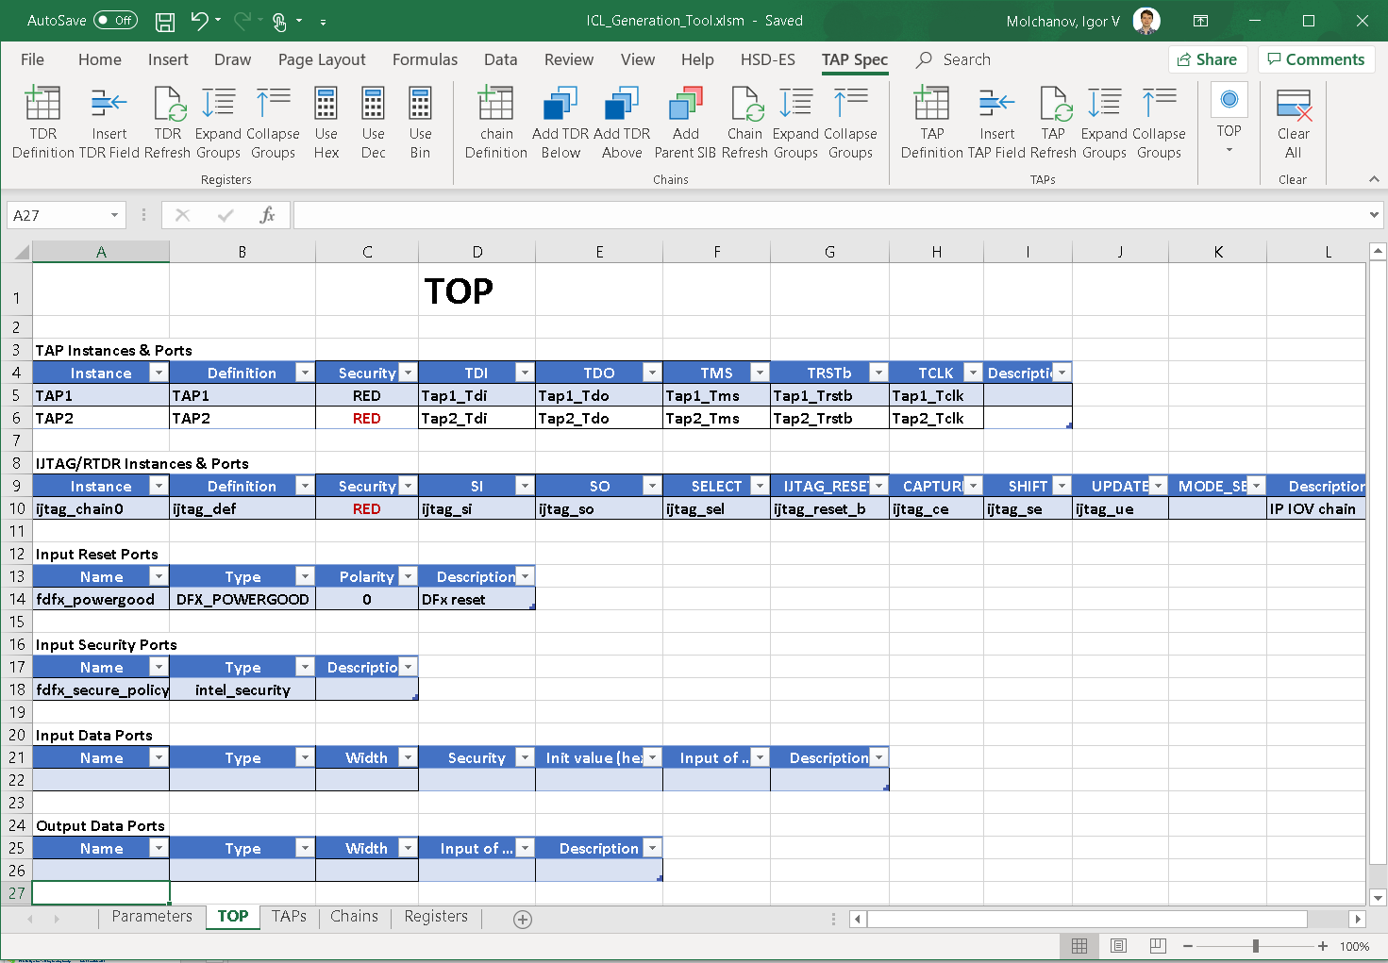
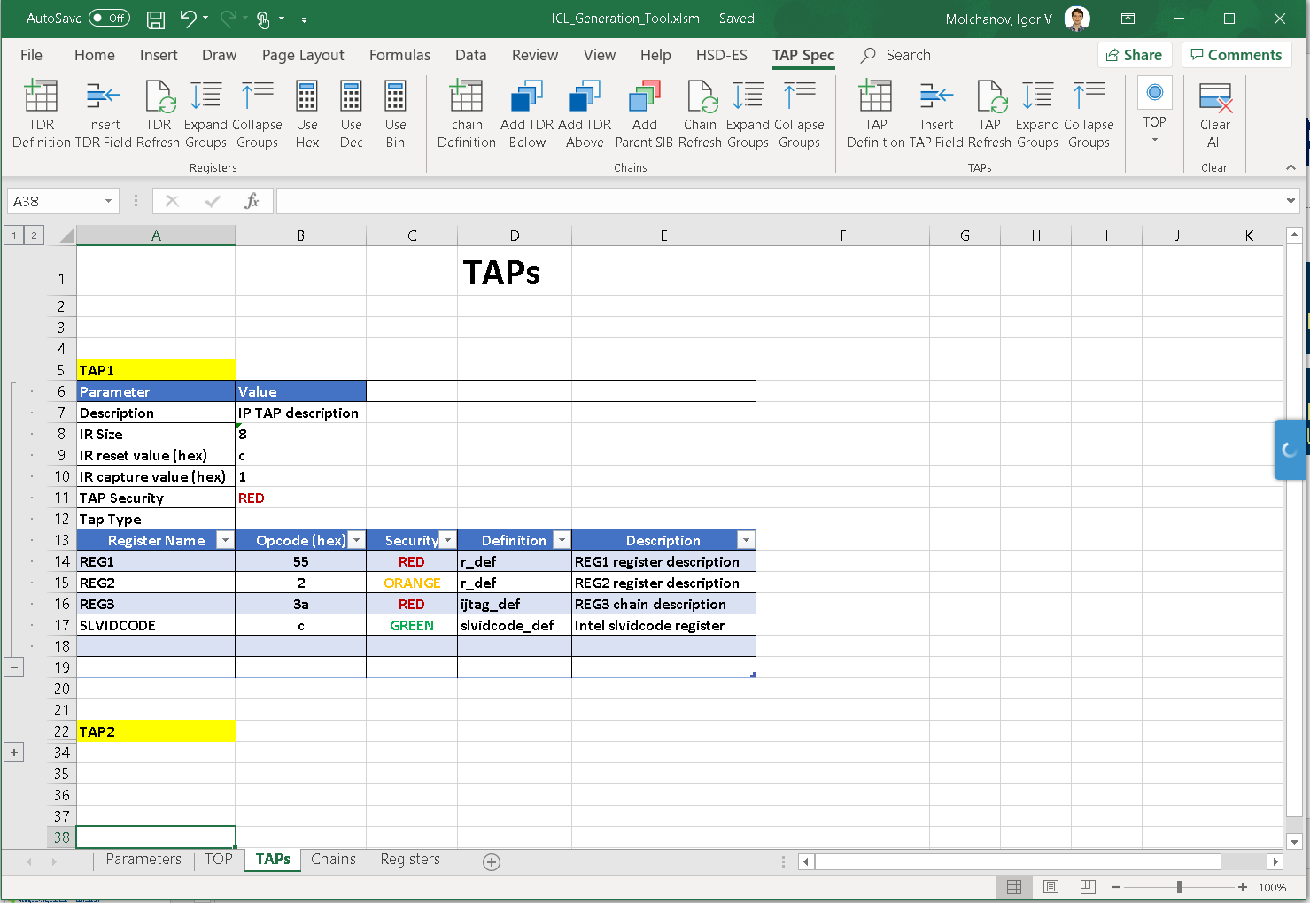
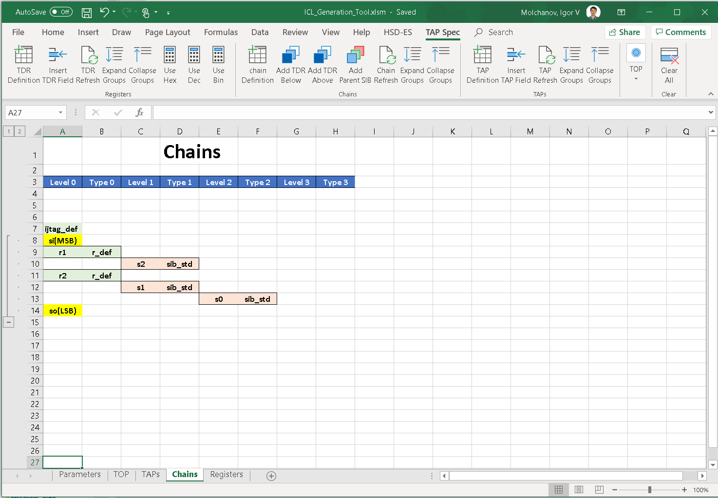
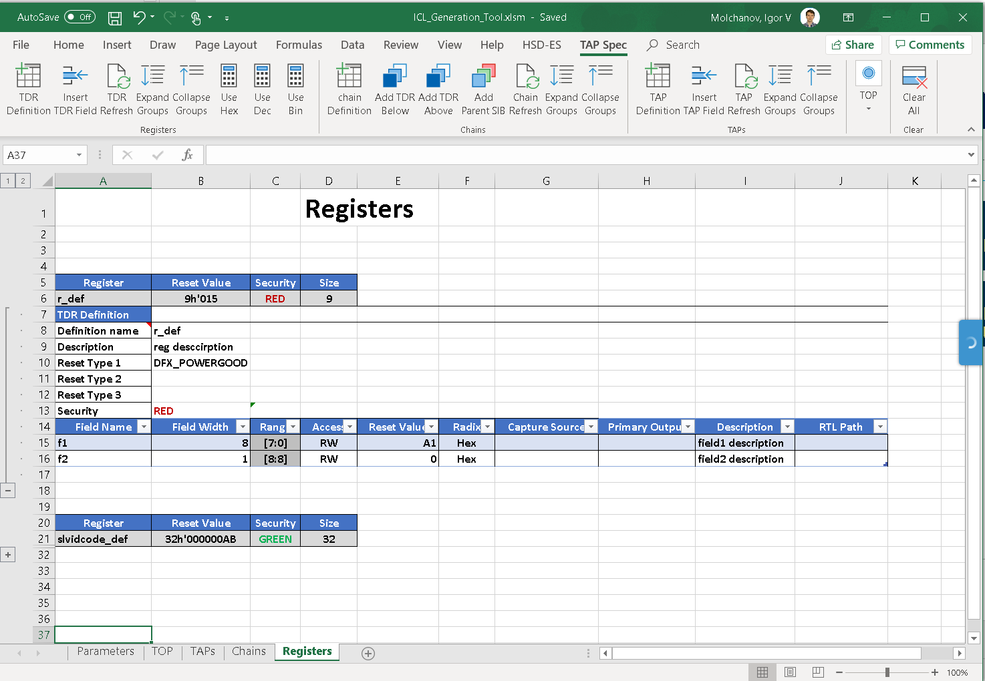
IP TAP RDL2ICL and ICLGEN
TAP RDL2ICL flow: for IP with existing TAP RDL
“Push button” conversion RDL/RDL 2.0 -> ICL
ICL header file is required to specify DFx/TAP port names/functions
TAP ICLGEN GUI: for new IP (beta)
Based on MS Excel with special macros to add/manage elements of TAP spec (TAPs, chains, registers, fields)
Part of DUVE-M
IP TAP RDL`
DTEG
TAP RDL2ICL
IP TAP ICL
DTEG
TAP ICLGEN
Front-End GUI

Slide 11
Release
Released through IPX
DTEG continues development of custom checkers and utilities to improve validation and design data access & design collateral generation capabilities

Slide 12
Backup

Slide 13
IEEE 1687
IEEE1687
defines hardware architecture and methodology for accessing of embedded
instrumentation via IEEE 1149.1 Test Access Port (TAP)
Three components
Architecture: IJTAG (internal JTAG)
Design spec: ICL (Instrument Connectivity Language)
Procedures: PDL (Procedural Description Language
IEEE 1687 scope and coverage
Architecture: we are only looking at the serial (TAP) fabric aspects for now
ICL/PDL: no limitations on Tap Network implementation if it follows IEEE1149.1 protocol
works for Intel HTAP & TapLink TAP fabrics
Multiple projects at Intel are using ICL/PDL already: THB, MTL, DG2, GNR, VLC
IEEE 1687
IJTAG
ICL
PDL

Slide 14
IEEE 1687 - ICL & PDL
Design spec: ICL (Instrument Connectivity Language)
Similar to Intel SPF Spec
Describes instrument registers and how to access them
Serial: TAP registers, chains (e.g. IJTAG), TAP controller & network
Parallel: parallel data registers and a few addressing modes
Architecture agnostic – can describe hierarchical TAP network or Taplink
High level logical description
Supports reconfigurable registers & chains (BSCAN, IOV, IJTAG)
Can capture additional design info
Clock generation and distribution
User-defined attributes , aliases, value enums
Sequences: PDL (Procedural Description Language)
Similar to Intel SPF Sequence
Describes procedures to use instruments
Supports creating reusable recipes/sequences/tests at IP level that are directly reuseable at higher levels
Supports TCL to add programming constructs, and APIs to introspect design and test metadata
SIB
BAP
MBIST TAP
SIB
BAP
CLTAP
HTAP
HTAP
SIB
USC
PLL
RTDR
RTDR
SIB
USC
instrument: DFT IP, typically with internal registers that can be accessed over a serial or parallel fabric

Slide 15
ICL spec/model
For illustration only
// Simple register ICL
Module tdr2 {
Parameter RESET_VALUE = 8'h0;
ResetPort rstn { ActivePolarity 0;}
ScanInPort si;
ScanOutPort so { Source reg[0]; }
DataOutPort enable[0:0] { Source en; RefEnum OnOff;}
DataOutPort time_counter[6:0] { Source reg[7:1]}
ScanRegister reg[7:0] {
ScanInSource si;
ResetValue $RESET_VALUE;
CaptureSource reg[7:0]; }
Alias en = reg[0:0];
Alias counter[6:0] = reg[7:1];
Enum OnOff { On = 1'b1; Off = 1'b0; }
}
// Chip level ICL
Module chip {
TCKPort tck;
ScanInPort tdi;
ScanOutPort tdo { Source MyTap.tdo; }
TMSPort tms;
TRSTPort trst;
Instance MyTap Of tap {
InputPort tck = tck ;
InputPort tdi = tdi ;
InputPort tms = tms ;
InputPort trst = trst ;
InputPort from_so = MySib1.so ;
}
Instance MySib1 Of sib {
...
}
...
}
Instrument Connectivity Language
Hierarchical using modules & instances
Captures
Ports, Registers, Parameters
Connectivity, Simple comb logic (e.g. muxes)
Sub-instances
Attributes, field aliases, value enums
ICL can be created:
Manually
Auto-generated & extracted by Mentor’s Tessent tool
Generated by other design & integration automation (e.g. DTEG DFT Build, WIP)
ICL is used by EDA tools
to build and retarget sequences for accessing the requested instrument registers/components and applying user-provided procedures and sequences
to auto-generate validation patterns

Slide 16
PDL test specification
For illustration only
Procedural Description Language
Instrument programming sequence description
Attached to any module in the ICL model
Typically, written at the instrument level
Captures
Register or Port level operations
PDL iWrite == SPF set
PDL iRead == SPF compare
PDL iApply == SPF flush
Target = register, reg alias, reg bit range or module port
Some other operations
iReset, iClock, iRunLoop
Supports hierarchical sequences
Use iProc to define an instrument “recipe” PDL
Use iCall to invoke PDL defined for sub-module
iCall <hier.path.to.submodule>.<iProc_name> <args>
Retargeting is done based on ICL description
Supports full TCL to add flow constructs, etc.
EDA tools provide API to access ICL data model and sequence metadata
// Example PDL commands
iProcsForModule my_bist_instrument
iProc do_bist {
iWrite Config.en ON
iWrite Config.seed 0x6A
iApply
iRunLoop 10
iRead Status.state DONE
iRead Status.misr 0xDEADBEEF
iApply
}
iCall InstA.do_bist

