Slide 1
DTEG RDL2ICL TFM DUVE-M version 1.0 (ww05)
Igor Molchanov
WW05, 2021

Slide 2
IEEE 1687
IEEE1687
defines hardware architecture and methodology for accessing of embedded
instrumentation via IEEE 1149.1 Test Access Port (TAP)
Three components
Architecture: IJTAG (internal JTAG)
Design spec: ICL (Instrument Connectivity Language)
Procedures: PDL (Procedural Description Language
IEEE 1687 scope and coverage
Architecture: we are only looking at the serial (TAP) fabric aspects for now
ICL/PDL: no limitations on Tap Network implementation if it follows IEEE1149.1 protocol
works for Intel HTAP & TapLink TAP fabrics
Multiple projects at Intel using ICL/PDL already: THB, MTL, DG2, GNR IO, VLC
IEEE 1687
IJTAG
ICL
PDL

Slide 3
IEEE 1687 - ICL & PDL
Design spec: ICL (Instrument Connectivity Language)
Similar to Intel SPF Spec
Describes instrument registers and how to access them
Serial: TAP registers, chains (e.g. IJTAG), TAP controller & network
Parallel: parallel data registers and a few addressing modes
High level logical description
Architecture agnostic – can describe hierarchical TAP network or Taplink
Supports reconfigurable registers & chains (BSCAN, IOV, IJTAG)
Can capture additional design info
Clock generation and distribution
User-defined attributes , aliases, value enums
Supports parameterization (limited)
Sequences: PDL (Procedural Description Language)
Similar to Intel SPF Sequence
Describes procedures to use instruments
Supports creating recipes/sequences/tests at IP level that are directly reusable at higher levels
Supports TCL to add programming constructs, and APIs to introspect design and test metadata
SIB
BAP
MBIST TAP
SIB
BAP
CLTAP
HTAP
HTAP
SIB
USC
PLL
RTDR
RTDR
SIB
USC
instrument: DFT IP, typically with internal registers that can be accessed over a serial or parallel fabric

Slide 4
Why ICL/PDL?
IEEE1687 ICL/PDL is industry standard and supported by EDA tools (Mentor Tessent)
Good support of the tool & methodology by tool vendor, quickly evolving and improving capabilities
Native retargeting support of IP level sequences & recipes @ SoC
Allows sequences to be defined, validated and delivered by IP owner
Original limitation of Intel internal TFM
Native support of variable length registers/chains (IOV, BSCAN, IJTAG, etc.)
Original limitation of Intel internal TFM
Ease of integration and collateral reuse for 3rd party IP’s (like Synopsys PHY)
Support of “not usual” TAP implementations and mixed networks
Original limitation of Intel internal TFM
Ease of IP TAP/DFT logic & ICL/PDL collateral validation
Original limitation of Intel internal TFM
PDL provides similar test writing capabilities and experience as Intel SPF or Saola TAL
ICL data modeling in EDA and extendable set of API to introspect ICL/test metadata
Easy of enhancing and customization for Intel TFM needs (using provided vendor tool API)
New capabilities: support of clock specification & checking
Promise to address legacy gaps in Intel internal flows

Slide 5

Vision of IP-SoC TAP Collateral Handoff
IP RTL
SOC
IP TAP RDL`
Legacy Collateral & TFM
DTEG
TAP RDL2ICL
IP TAP ICL
New ICL/PDL-based Collateral & TFM
DTEG
TAP ICLGEN
Front-End GUI
IP TAP PDL
Validated
Other RTL/ICL TFM options
Any TFM can be used for IP RTL & ICL:
Manual coding for RTL and DTEG TAP RDL2ICL or TAP ICL GEN GUI for ICL
DTEG DFTB based RTL & ICL generation
Mentor Tessent Shell based RTL & ICL generation/extraction
DTEG
DFT Build TFM
IP DFx
RTL & ICL
Mentor
Tessent Shell
IP DFx
RTL & ICL

Slide 6
Intel TAP RDL as ICL source
RDL is current POR for specifying TAP architecture @ IP level
Most recent spec: TAP RDL 2.0 with IJTAG support
RDL2ICL TFM supports complete scope of RDL syntax, used in TAP RDL, including:
multiple-instantiated instances, dynamic assignments, parameterization (embedded Perl code)
POR: keep RDL as a source for ICL generation @ IP level
Manual maintenance of ICL isn’t as simple/friendly as maintenance of RDL
Parameterization support in ICL is limited
RDL2ICL considers following RDL properties and UDP:
all levels: name, desc, TapCollateralVisibility
addrmap: TapInstName, TapIrLength, TapIrCaptureValue, TapSecurityLevel
regfile: TapRegType, RegOpcode, TapOpcodeSecurityLevel
reg: TapRegType, TapTotalNumRegBits, TapShiftRegLength, RegOpcode, TapOpcodeSecurityLevel, TapRegResetType, TapDrIsFixedSize, TapSibRef
field: AccessType, TapFieldIsNoInit
Examples of TAP RDL for different IP configurations: $DUVE_M_HOME/icl_gen/examples/

Slide 7
TAP RDL to ICL Mapping
RDL2ICL TFM uses following RDL -> ICL object mapping:
addrmap: TOP -> ICL Module with TAP/register/chain Module instances
addrmap: TAP -> ICL Module with register/chain Module instances
addrmap: no TAP, individual registers only -> ICL Module with register/chain Module instances
RDL/UDP ‘TapType = “reg_only”;’
regfile: TAP chain definition (IJTAG, etc.) -> ICL Module with register Module instances
RDL/UDP ‘TapRegType = “IJTAG”;’
reg: TAP register definition -> ICL Module with ScanRegister instances
field: register bit range associated with specific functionality -> ICL Alias to ScanRegister bit range
ICL: ‘Alias en[0:0] = DR[5:5];’
ICL header file is required to provide IP module name and TAP/DFx port names/usage in RTL
ICL header file syntax aligned with ICL standard, defined in IEEE 1687
Module & port names in ICL must match RTL
Only port specification is used, the rest of ICL header file will be ignored
Additional attributes used to link TAPs/chains/registers in RDL with ports in RTL

Slide 8
IP ICL Creation Strategy
For IP with simple TAP logic
no integrated external TAP subcomponents with ICL
complete IP ICL can be generated from TAP RDL using RDL2ICL flow
For IP with integrated external subcomponents
Subcomponents come with separate ICL (IOV, USC, MBIST, etc.)
ICL is generated for the internal IP DFx logic wrapper, encapsulating IP-owned TAP logic/registers and providing required interfaces to the integrated sub-components
Top level ICL is created using ICL Extraction from RTL (by Mentor Tessent Shell)
For IP with multiple Corekits
ICL created per Corekit (slide #24)

Slide 9
IP: Single TAP
Module ip { // ICL header file
ScanInPort TdiT731L;
ScanOutPort TdoT731H { Source NOT_IMPORTANT;}
TMSPort TmsT731L;
TRSTPort TrstbT731L;
TCKPort Tclk;
// DFx powergood
ResetPort fdfx_powergood {
ActivePolarity 0 ;
Attribute intel_signal_type = "powergood";
}
// DFx Secure bus
DataInPort fdfx_secure_policy[3:0] {
Attribute intel_signal_type = "secure_policy";
}
// SLVIDCODE strap
DataInPort ftap_slvidcode[31:0] {
DefaultLoadValue 32'h0a1;
Attribute intel_tdr_dest = "SLVIDCODE";
}
ScanInterface c_tap {
Port TdiT731L;
Port TdoT731H;
Port TmsT731L;
}
}
Collateral example
$DUVE_M_HOME/icl_gen/examples/single_tap/
Notes:
Both TAP and TOP addrmap/RDL can be used with the same generated ICL result
If IP has single TAP, no need to use special naming convention for TAP ScanInterface, tool will do linkage automatically
3rd parry TAP (no Intel TAP Security):
no register level security properties must be specified in RDL (UDP TapOpcodeSecurityLevel)! Only Intel TAPs with implemented Security logic must have these attributes!
It can have TAP level security specified in RDL (UDP TapSecurityLevel) - attribute will be used to check security level, assigned to the TAP when it is integrated into the TAP network

Slide 10
IP: Individual RTDRs, separate interfaces
Module ip { // ICL header file
TCKPort Tclk;
// DFx powergood
ResetPort fdfx_powergood {
ActivePolarity 0 ;
Attribute intel_signal_type = "powergood";
}
// Ports/Interface of regA
ScanInPort si[0:0];
ScanOutPort so[0:0] { Source NOT_IMPORTANT;}
SelectPort sel[0:0];
CaptureEnPort capture[0:0];
ShiftEnPort shift[0:0];
UpdateEnPort update[0:0];
ScanInterface c_regA {
Port si[0:0];
Port so[0:0];
Port sel[0:0];
Port capture[0:0];
Port shift[0:0];
Port update[0:0];
}
// Ports/Interface of regB
...
ScanInterface c_regB {
...
}
}
TAP RDL
addrmap ip_def {
TapType = “reg_only”;
...
regA_def regA;
regB_def regB;
};
Collateral example
$DUVE_M_HOME/icl_gen/examples/rtdr_separate/
Notes:
Mapping of ports/interfaces is done based on ScanInterface naming convention ‘c_<tdr_instance>’

Slide 11
IP: Individual RTDRs, shared interfaces
Module ip { // ICL header file
TCKPort Tclk;
CaptureEnPort capture;
ShiftEnPort shift;
UpdateEnPort update;
// DFx powergood
ResetPort fdfx_powergood {
ActivePolarity 0 ;
Attribute intel_TapRegResetType = "powergood" ;
}
ScanInPort si_AB;
ScanOutPort so_AB { Source NOT_IMPORTANT;}
SelectPort sel_A {
Attribute intel_tdr_dest = "regA";
}
SelectPort sel_B {
Attribute intel_tdr_dest = "regB";
}
ScanInterface c_ip {
Port si_AB;
Port so_AB;
Port capture;
Port shift;
Port update;
}
}
TAP RDL
addrmap ip_def {
TapType = “reg_only”;
...
regA_def regA;
regB_def regB;
};
Collateral example
$DUVE_M_HOME/icl_gen/examples/rtdr_shared/
Notes:
Single scan interface with shared si/so and control signals
Selects are NOT included into the ScanInterface
RDL->ICL mapping is based on Attribute intel_tdr_dest
Encoded selects example: rtdr_shared_encoded_sel

Slide 12
IP: Multiple TAPs & Individual RTDRs
TAP RDL
addrmap ip_top_def {
...
tap0_def tap0;
tap1_def tap1;
rtdr_def rtdrs;//with regA & regB
};
Module ip { // ICL header file (simplified)
...
ScanInterface c_tap1 {
Port TdiT731L;
Port TdoT731H;
Port TmsT731L;
}
...
ScanInterface c_tap2 {
Port Tdi_2;
Port Tdo_2;
Port Tms_2;
}
...
ScanInterface c_regA {
Port si_A;
Port so_A;
Port sel_A;
}
...
ScanInterface c_regB {
Port si_B;
Port so_B;
Port sel_B;
}
}
Collateral example
$DUVE_M_HOME/icl_gen/examples/multi_tap_rtdr/
Notes:
No ‘rtdrs’ in the regA/regB path required for “reg_only” addrmap
All individual RTDR implementations are supported based on mapping, shown in the previous examples

Slide 13
IP: Security Interfaces
Collateral examples
$DUVE_M_HOME/icl_gen/examples/single_tap/
$DUVE_M_HOME/icl_gen/examples/tap_with_feature_en_security/
Notes:
Two types of Intel Security interfaces supported:
DFx Secure Policy interface (4-bit secure policy bus)
Decoded GREEN/ORANGE/RED interface (based on feature_en outputs of the DFx Secure Plugin)
3rd parry TAP (no Intel TAP Security):
no register level security properties must be specified in RDL (UDP TapOpcodeSecurityLevel)! Only Intel TAPs with implemented Security logic must have these attributes!
It can have TAP level security specified in RDL (UDP TapSecurityLevel) - attribute will be used to check security level, assigned to the TAP when it is integrated into the TAP network
// ICL header file
DataInPort fdfx_secure_policy[3:0] {
Attribute intel_signal_type = "secure_policy";
}
DataInPort feature_en[2:2] {
Attribute intel_signal_type = "secure_red";
}
DataInPort feature_en[1:1] {
Attribute intel_signal_type = "secure_orange";
}
DataInPort feature_en[0:0] {
Attribute intel_signal_type = "secure_green";
}

Slide 14
IP: Multiple Powergood/Resets
TAP RDL
// In the reg definition
TapRegResetType = "PWRGOOD";
TapRegResetType = "PWRGOOD_D1";
TapRegResetType = "TLR";
// For the reg instance
regA_def regA;
regA -> TapRegResetType = "PWRGOOD_D2";
// ICL header file (simplified)
ResetPort fdfx_powergood {
ActivePolarity 0;
Attribute intel_signal_type = "powergood";
}
ResetPort fdfx_powergood_d1 {
ActivePolarity 0 ;
Attribute intel_signal_type = "powergood_d1";
}
ResetPort fdfx_powergood_d2 {
ActivePolarity 0 ;
Attribute intel_signal_type = "powergood_d2";
}
ResetPort ijtag_reset_b {
ActivePolarity 0;
Attribute intel_signal_type = "tlr";
}
Collateral example
$DUVE_M_HOME/icl_gen/examples/multiple_tdr_resets/
Notes:
Supported UDP values: “PWRGOOD”, “PWRGOOD_<id>”, “TLR”
Legacy value "PWRGOOD, TRST, TLR" is treated as "TLR".
Tag <id> represents power domain ID, used to link register reset with the corresponding reset port in ICL header file (case insensitive)

Slide 15
IP: Other situations
Tool supports other variations of TAP logic, described in the User Guide and covered in the included examples:
IJTAG chains, specified according to Intel TAP RDL 2.0 (example: ijtag)
Export of parallel TDR in/out interfaces (demonstrated in single_tap example, full example: data_port_export)
TAP with host scan ScanInterface for external RTDR (example: tap_with_rtdr_interface)
Blackboxed RTDR (example: tap_with_blackbox_tdr)
Please contact Igor Molchanov if you IP has some non-standard TAP logic implementation

Slide 16
IP ICL Questionnaire
TAP logic implementation
Single TAP
Individual RTDRs
Shared/Separate si/so and control
Select encoding
Multiple TAPs
Multiple TAPs & Individual RTDRs
Same sub-options as for ‘Individua RTDRs’ above
Intel Security
Secure policy interface
Feature enable interface
No Intel security
Resets
TDRs in single or multiple power domains
Active levels
TLR/TRST
Inputs (captured by TDRs)
Straps (ports tied to specific constant values when IP is integrated, e.g., SLVIDCODE port)
Chip level input ports (e.g., A0 debug strap)
Ports, expected to be driven by external TDRs if it is desirable to model that behavior in ICL (otherwise, it would be modeled as unknow/X).
Outputs (driven by TDRs)
Ports which control TAP network topology
Ports which drive inputs of other TDRs
Ports which drive chip level output ports
RDL/ICL parameterization
For register/field sizes, register/field existence, TAP/IJTAG/RTDR interface existence
Can SoC have multiple IP instances with different TAP configurations (due to different parameterization or different IP versions)?

Slide 17
Running RDL2ICL
Tool is a part of DTEG DUVE-M VIP
Released through IPX
Latest release: ww49 (dteg_verif_ip.duve_m@2.R0)
To download, include DUVE_M into the IP BOM in Carbon (or use alternative method from Release Notes)
DUVE-M in Carbon: https://hsdes.intel.com/appstore/carbon/overview/16011240521
Contact Bulusu, Shivaprashant (shivaprashant.bulusu@intel.com) for any access-related questions
Set ‘setenv DUVE_M_HOME <path to your local DUVE-M repo>’
Command line:
> $DUVE_M_HOME/icl_gen/tap_icl_gen.pl -inp <ip>.rdl -icl -hdr <ip>_hdr.icl [other options] > <log>
Some other useful options
-out_dir <dir> : output folder name for generated ICL (default: ./output/)
-out_file <file> : output ICL file name (default: based on Module name in header file)
<file> shouldn’t include file extension!
-param "name=value“ : overriding default value of Perl parameter in RDL
-icl_param <name> : keeping RDL parameters in generated ICL (reg/field size parameters only) NEW!
-prefix <string> : uniquification prefix
-suffix <string> : uniquification suffix

Slide 18
Sanity Check of Generated ICL
// Tessent dofile #1, no loading of IP RTL
set_context patterns –ijtag
///### loading ICL
read_icl $env(DUVE_M_HOME)/icl_gen/icl_src/intel_tap_common.icl
read_icl icl/*.icl
set_current_design asf
add_black_boxes -auto
set_system_mode analysis
open_pattern_set test
iReset
iRunLoop 10
create_icl_verification_patterns
close_pattern_set
report_pattern_set
write_patterns ip_test.pdl -pdl -replace
exit
Using Mentor Tessent shell
Always use the latest available Tessent version!
Set appropriate ‘setenv MGLS_LICENSE_FILE <..>’
/p/com/eda/mentor/tessent/<version>/bin/tessent -shell [<switches>]
Simplified Tessent dofile (#1)
No IP RTL loaded
Pattern uses Tessent shell command ‘create_icl_verification_pattern’
No Verilog test bench generated for simulation
Dofile with loading of IP RTL (#2)
Additional check of ICL vs. RTL ports
Only top-level RTL/included files need to be read
If initialization of non-existing in ICL ports is needed, use iForcePort PDL commands (it requires loading of top-level RTL)
Refer to DUVE-M User Guide for more details
// Tessent dofile #2, with loading of IP RTL
set_context dft -rtl
set_context patterns –ijtag
///### loading ICL
read_icl $env(DUVE_M_HOME)/icl_gen/icl_src/intel_tap_common.icl
read_icl icl/*.icl
// ### Loading TOP level IP RTL
set sv_args "-force -ignore_synthesis_off_sections On -vcs_compatibility -mfcu -no_duplicate_modules_warnings -verbose -format sv2009"
set_design_include_directories src/rtl/include
set_design_macros INTEL_SVA_OFF
read_verilog src/rtl/asf.sv -interface_only $sv_args
set_current_design asf
...

Slide 19
Tessent Shell run log example
SETUP> dofile asf_pattern_gen.dofile
// command: set_context patterns -ijtag
// command: read_icl $env(DUVE_M_HOME)/icl_gen/icl_src/intel_tap_common.icl
// command: read_icl icl/*.icl
// command: set_current_design asf
// ---------------------------------------------------------------------------
// Begin ICL elaboration and checking.
// -----------------------------------
// ICL elaboration completed, CPU time=0.01 sec.
// ---------------------------------------------------------------------------
// command: add_black_boxes -auto
// command: set_system_mode analysis
// command: open_pattern_set test
// command: iReset
// command: iRunLoop 1
// command: create_icl_verification_patterns
// command: close_pattern_set
// command: report_pattern_sets
// name | timeplate | tester | tck | tester | initial | TCK edge after | active scan | network | TAP start | TAP end | saved
// | | period | ratio | cycles | iReset | scanout strobe | interfaces | end state | state | state |
// -----+-----------+--------+-------+--------+---------+----------------+-------------+-----------+-----------+---------+------
// test | (default) | 100ns | 1 | 325 | yes | rising | (all) | keep | any | IDLE | no
// command: write_patterns asf.pdl -pdl -replace
ANALYSIS> exit

Slide 20
Collateral location in the IP repo
Current proposals: $IP_REPO/tools/icl
ICL header file, generated ICL, README ( how to re-generate ICL), etc.
Not aligned with CTH2 guidelines - to be discussed/finalized

Slide 21
Special IP Configurations
Next slides cover special situations found in some Intel IPs

Slide 22
IP:TAP logic only in the Sub-IP
Applicable to the IP with no its “own” TAP logic, all TAP logic is inside some sub-IP, which comes with ICL/PDL
Example: IP instantiates Cadence Xtensa uC IP
Solution for SIP:
IF IP implements DIRECT connections between sub-IP TAP interface and IP TOP ports/TAP interface
AND IP doesn’t deliver additional IP-specific PDL content for IP/sub-IP
THEN IP can deliver sub-IP ICL/PDL without creating IP-specific collateral versions
Long term, IP should create its top level ICL using ICL extraction (next slide) and use produced ICL for TAP integration validation
ELSE IP needs to create/delver top level ICL which instantiates/includes sub-IP ICL
It can be done using ICL extraction or other approaches
Contact Igor Molchanov to review options
Solution for HIP
IP needs to create/delver top level ICL which instantiates/includes sub-IP ICL
similar to the last SIP option above

Slide 23
IP: ICL Extraction
ICL Extraction used to generate TOP level ICL which instantiates/connects ICL modules of sub-IPs or other IP components with ICL
IMPORTANT: Logic for extraction in RTL can only include buffers/inverters for data/control signals and buffers/inverters/muxes for clocks
Sub-IP ICL/RTL can be parameterized (using the same parameter names)
On the right - example of Tessent shell dofile for ICL extraction
// Tessent dofile for ICL extraction
set_context dft -rtl
read_icl $env(DUVE_M_HOME)/icl_gen/icl_src/intel_tap_common.icl
// Load all sub-IP ICL files
read_icl icl/sub_ip.icl
# Load IP RTL
# Note: to load SV files (please update accordingly):
#set sv_args "-force -ignore_synthesis_off_sections On -vcs_compatibility -mfcu -no_duplicate_modules_warnings -verbose -format sv2009"
#set_design_include_directories $env(IP_ROOT)/source/rtl/include
#read_verilog $env(IP_ROOT)/source/rtl/ip_top.sv $sv_args
read_verilog sub_ip.v
read_verilog ip_top.v
set_current_design ip_top
add_black_boxes -auto
extract_icl
write_icl ip_top.icl -replace

Slide 24
IP: Multiple Corekits
Applicable to the IP which consists of multiple corekits and those corekits can be combined in different ways at SoC level
No single IP TOP module
Example: punit IP
Solution:
separate ICL should be generated for every corekit with TAP logic
It means separate RDL/ICL header files for those individual corekits
ICL/RTL module and port matching requirements applied to those individual corekits

Slide 25
IP: MI @ SoC
SoC can have multiple versions of the same IP with different TAP logic configuration
due to parameterization, due to IP design changes and due to using different versions in different Super-IPs
Problem
Today, Tessent doesn’t support NameSpaces in ICL
ICL modules with same names from different IPs will conflict/override definitions at SoC level
we requested support of NameSpaces in Tessent shell, no ETA yet
Solution
ICL module definitions for different IP versions/configurations should be uniquified
Providing unique names for Top/TAPs/chains/register Modules
Use ‘-suffix <id>’ option to add specified <id> as suffix for the module names (it can be value of RDL parameter(s) or IP version)
Use ‘-prefix <id>’ script option to add Super-IP/SoC-specific prefix <id> into the module names

Slide 26
IP: Parameterized TAP RDL, MI @ SoC
Applicable to the IP with parameterized TAP RDL (SoC/Super-IP can change IP configuration)
Problem
If same IP module instantiated multiple times with different parameter values in RTL, we need the corresponding ICL with matching parameters
Solutions
If we need to keep parameterization for register/filed sizes only (sets of registers/fields and interfaces are always the same)
use ‘-icl_param’ options to generate ICL with required parameterization
parameters in RTL and TAP RDL must have the same names
parameterization in ICL supported for register/field size parameters ONLY!
reg/field sizes and field lsb/msb positions should be linear functions of parameters (a0 + a1*P1 + a2*P2…)
collateral/flow examples: $DUVE_M_HOME/icl_gen/examples/*_param/
If integrated IP configurations have different sets of TDRs/fields or different integration properties of TDRs (opcode, security, resets) or type of used parameterization isn’t supported by the flow
RTL integration can be done with non-parameterized uniquified wrappers, provided with the corresponding ICL (created using generation or extraction flows)

Slide 27
References
TAP RDL: Intel TAP UDP HAS and SystemRDL specification 1.0 @ Accellera website
DUVE-M User Guide ($DUVE_M_HOME/doc)
IEEE std 1687-2014
https://wiki.ith.intel.com/download/attachments/1422105758/IEEE%20Std%201687.pdf
Mentor Online Support & documentation
https://support.sw.siemens.com/
Mentor Documentation:
Mentor Tessent IJTAG User’s Manual (latest)
ICL modeling/extraction & PDL modeling/retargeting flow
Mentor Tessent Shell Reference Manual (latest)
Recorded Mentor presentations:
iJTAG Overview - Part 1: https://videoportal.intel.com/media/0_tg1gk8hv
iJTAG Overview - Part 2: https://videoportal.intel.com/media/0_tnzg9h9v
iJTAG Overview - Part 3: https://videoportal.intel.com/media/0_d4jfc9gs
iJTAG Overview - Part 4: https://videoportal.intel.com/media/0_s0989mi3

Slide 28
Q & A

Slide 29
Thank You!

Slide 30
Backup

Slide 31
ICL spec/model
For illustration only
// Simple register ICL
Module tdr2 {
Parameter RESET_VALUE = 8'h0;
ResetPort rstn { ActivePolarity 0;}
ScanInPort si;
ScanOutPort so { Source reg[0]; }
DataOutPort enable[0:0] { Source en; RefEnum OnOff;}
DataOutPort time_counter[6:0] { Source reg[7:1]}
ScanRegister reg[7:0] {
ScanInSource si;
ResetValue $RESET_VALUE;
CaptureSource reg[7:0]; }
Alias en = reg[0:0];
Alias counter[6:0] = reg[7:1];
Enum OnOff { On = 1'b1; Off = 1'b0; }
}
// Chip level ICL
Module chip {
TCKPort tck;
ScanInPort tdi;
ScanOutPort tdo { Source MyTap.tdo; }
TMSPort tms;
TRSTPort trst;
Instance MyTap Of tap {
InputPort tck = tck ;
InputPort tdi = tdi ;
InputPort tms = tms ;
InputPort trst = trst ;
InputPort from_so = MySib1.so ;
}
Instance MySib1 Of sib {
...
}
...
}
Instrument Connectivity Language
Hierarchical using modules & instances
Captures
Ports, Registers, Parameters
Connectivity, Simple comb logic (e.g. muxes)
Sub-instances
Attributes, field aliases, value enums
ICL can be created:
Manually
Auto-generated & extracted by Mentor’s Tessent tool
Generated by other design & integration automation (e.g. DTEG DFT Build, WIP)
ICL is used by EDA tools
to build and retarget sequences for accessing the requested instrument registers/components and applying user-provided procedures and sequences
to auto-generate validation patterns

Slide 32
PDL test specification
For illustration only
Procedural Description Language
Instrument programming sequence description
Attached to any module in the ICL model
Typically, written at the instrument level
Captures
Register or Port level operations
PDL iWrite == SPF set
PDL iRead == SPF compare
PDL iApply == SPF flush
Target = register, reg alias, reg bit range or module port
Some other operations
iReset, iClock, iRunLoop
Supports hierarchical sequences
Use iProc to define an instrument “recipe” PDL
Use iCall to invoke PDL defined for sub-module
iCall <hier.path.to.submodule>.<iProc_name> <args>
Retargeting is done based on ICL description
Supports full TCL to add flow constructs, etc.
EDA tools provide API to access ICL Data Model and sequence metadata
// Example PDL commands
iProcsForModule my_bist_instrument
iProc do_bist {
iWrite Config.en ON
iWrite Config.seed 0x6A
iApply
iRunLoop 10
iRead Status.state DONE
iRead Status.misr 0xDEADBEEF
iApply
}
iCall InstA.do_bist

Slide 33
TAP Validation: ICL/PDL + DUVE-M
Only required DFx & Functional interfaces!
IP RTL
Mentor
Verilog Test Bench
VCS
IP TAP RDL`
Mentor
Tessent Shell
.v
Intel SV/OVM/UVM TB
with DTEG
SVF Reader & JTAG BFM
.svf
DTEG
TAP RDL2ICL
IP TAP ICL
DTEG DUVE-M
IP TAP PDL
TAP TESTS COMMON PDL
DUVE-M CFG
IPDS-M TAP DRC (ETA:Q4)
TAP UTILS PDL
Mentor Verilog TB can use minimal configuration of DFx & Functional IP interfaces – improved coverage for screening of undesired dependencies!

Slide 34
DUVE-M Summary
Generic IEEE1687 infrastructure & tests for TAP validation
Requires Mentor Tessent (TIP: always use the latest available tool version!)
TAP architecture/implementation agnostic
Works with any IEEE 1687/Tessent compliant ICL
DTEG will support ICL creation/generation for IPs and HTAP & TapLink fabrics
@IP: TAP RDL2ICL push-button flow to generate IP ICL from existing TAP RDL(or MS-Excel GUI for new IPs)
@SoC: DFTB will be able to integrate ICL from IP and generate full-chip (or subsystem) level ICL (WIP)
Auto-checking of readable TDR bits - RW, RO (in Tessent/Verilog test bench)
Support of Intel specific: Reset generation, Security, Access Types
Flexible – configurable to match design configuration and validation scope
Local configuration files per DUT/targeted scope/initialization preamble
Support of auto-detection of POWERGOOD and Security interfaces
L2 regression-able – randomization & seed management
Roadmap includes implementation of IPDS-like static DRC checks based on ICL design spec
Notes:
Add notes about Nebulon use model
CTT tool replacement

Slide 35
DUVE-M Test Content
TDI-TDO continuity
IR/DR reset validation
Any combinations of POWERGOOD & FUNCTIONAL resets,TLR
TRST validation is limited due to ICL/PDL/Tessent considering it as Global Reset
Auto-detected/configurable port names
Read-Write tests
Random and Configurable patterns, ICL Alias Random test
Including screening of free running repeaters
Reserved Opcode test
TDR Security tests
All opcodes
Coverage for all 16 Intel security levels
Auto-detected *secure* port names
TDR readability check
Screening of not readable bits for the specified registers (CaptureSource “x-info”)

Slide 36
Special PDL sequences & Custom API
Configurable reset (type/target signals/duration)
Security level control
Auto-initialization of strap values (based on DefaultLoadValue properties in ICL)
Tessent procedures to access/process ICL metadata (tap_utils.pdl)
Scope management
Custom iRead/iWrite procedures
Soft collapsing of hierarchical Tap Network
Locked security status for TDR
IR/DR-Tap register mapping & Tap parent mapping
Expected TDO calculation, TDR RW & TDO masks
Metadata access: register size, reset value, alias info, etc.
Number/bit stream transformations

Slide 37
Test Configuration .do files - Example
IP local .do files per DUT/target scope/test flow:
verif/cfg/ip_test_cfg.do & verif/cfg/ip_pattern_do.do
Design Config/Initialization
# Design TOP and base test pattern names
set current_design ip1_top
set pattern_set ip1_basic_tap_tests
# Additional free-running functional clocks to generate in TB
#add_clocks RTL_port_clk1 -period 100ns // define as async clocks
# Tester clock & TCLK
set tester_period 10ns
set tck_ratio 1
set tck_period 10ns
Test Target Scope Management
# TAP/TDR inclusions/exclusions/mapping
set included_instances {*}
#set included_instances {ssh_par1}
#set included_instances {par1_dfx_mem_wrapper}
set included_registers {}
set excluded_modules {intel_htap_sel intel_tap_ir* intel_bypass_rsvd_reg ijtag_sib sib *__SCANDUMP_CHAIN *dfx_mem_wrapper* *_ssh_*}
set excluded_registers {*IOVRESET* *__SCANDUMP_CHAIN *fake_data_bus_reg* *streaming_through_ijtag_en*}
set continuity_test_only_registers {*BRKPTEN* *BRKPTCTL* *DEBUGCOUNTER?_*}
set ir_reg_names {}
set ir_module_names {intel_tap_ir*}; # * for support of parameterized modules
set bypass_reg_names {}
set bypass_module_names {intel_bypass_reg}
set network_control_modules {intel_htap_sel* ijtag_sib sib ip74xodit05_tctrl ip74xvdmt05_tctrl}
set network_control_registers {}
set trst_tlr_test_excluded_modules {}
set trst_tlr_test_excluded_registers {*IOVCONFIG*}
set tap_opcodes_tap_instances {htap2}
# Opcodes/Registers to exclude for ALL OPCODES tests (requires separate line per opcode)
array set tap_opcodes_to_exclude {}
set tap_opcodes_to_exclude(htap2:0x32) *IOVRESET*
# DFX & Functional powergood/reset signals
# Note, that FUNCTIONAL powergood/reset signals should be handled separately
# Suffix 0/1 of reset index indicates active reset polarity
set reset_name_list(DFX:0) {fdfx_powergood}; #reset_b
set reset_name_list(DFX:1) {}; #reset
set reset_name_list(FUNC:0) {}; #reset_b
set reset_name_list(FUNC:1) {}; #reset
# Seed for generator of random numbers
set seed 1
iProcsForModule [get_single_name [get_current_design -icl]]
iTopProc tap_reset_preamble {} {
iCall tap_set_secure_policy
iCall tap_reset POWERGOOD:DFX 10 reset_name_list
iCall tap_set_secure_policy RED
iCall tap_init_ports
#iForcePort ftap_slvidcode[31:0] 0x12345679
#iApply
}
# User defined pre-/post- reset procedures
iTopProc reset_powergood_post {} {}

Slide 38
Test Flow PDL - Example
# DUVE-M: verif/pdl/tap_tests_all.pdl
iCall tap_reset_preamble
iCall tap_dr_continuity_test $test_reg_collection
iCall tap_dr_reset_test $test_reg_collection POWERGOOD:DFX 0 reset_name_list $test_trst_regs $test_tlr_regs $network_control_regs
iCall tap_dr_reset_test $trst_tlr_test_collection TRST 0 reset_name_list $test_trst_regs $test_tlr_regs $network_control_regs
iCall tap_dr_reset_test $trst_tlr_test_collection TLR 0 reset_name_list $test_trst_regs $test_tlr_regs $network_control_regs
iCall tap_dr_rw_test $test_reg_collection 01
iCall tap_dr_rw_random_test $test_reg_collection 2
iCall tap_dr_field_rw_random_test $test_reg_collection 2
iCall tap_reserved_opcodes_test $test_reg_collection {} {$excluded_opcodes} tap_ir_map
iCall tap_all_opcodes_security_test $test_reg_collection GREEN $excluded_opcodes $excluded_registers
iCall tap_all_opcodes_security_test $test_reg_collection ORANGE $excluded_opcodes $excluded_registers
# Example of test for explicit security level value
iCall tap_all_opcodes_security_test $test_reg_collection 0x1 $excluded_opcodes $excluded_registers
# Print info about not readable/not checked registers/fields
tap_utils::print_all_capture_source_x_info $test_reg_collection

Slide 39
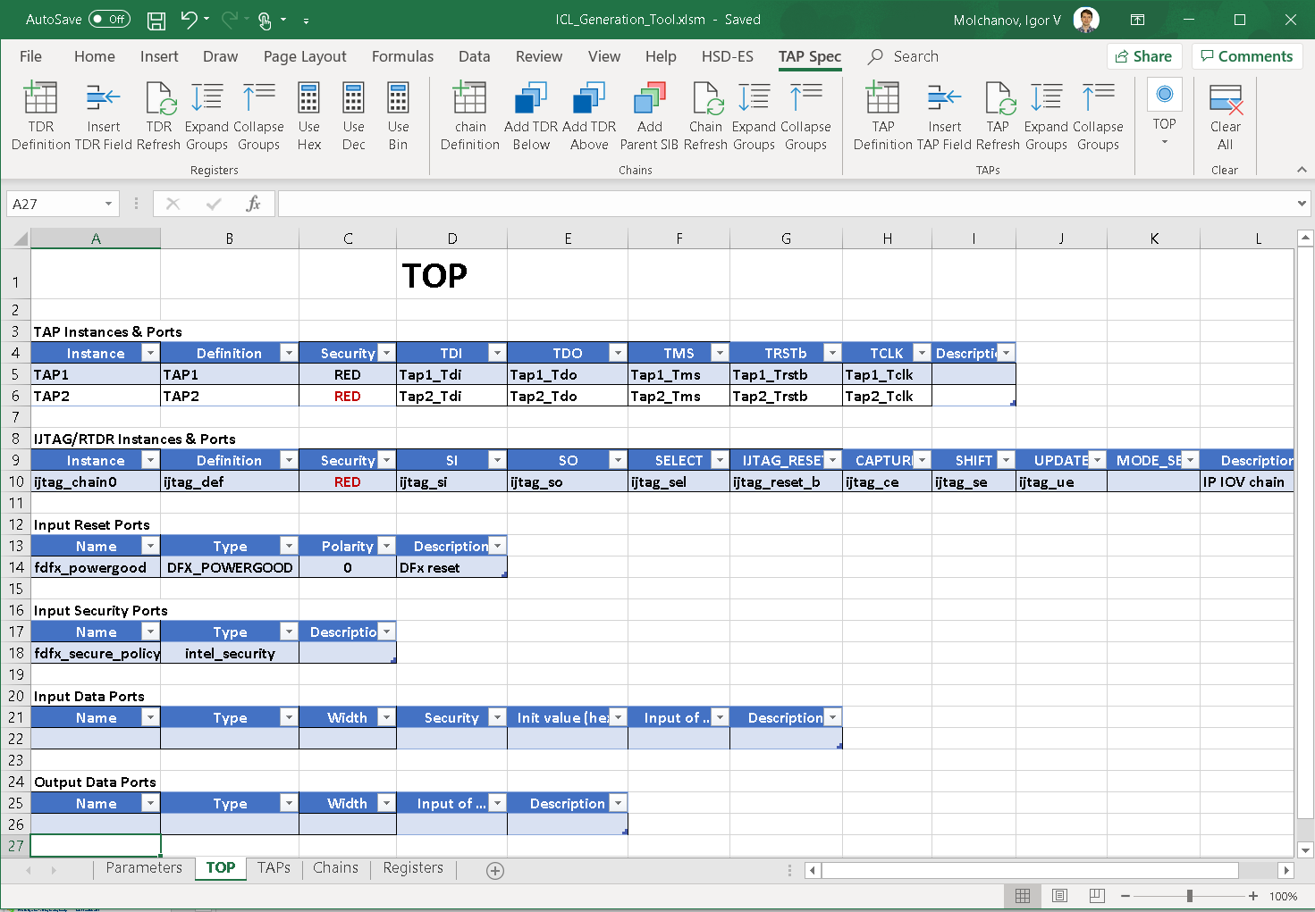
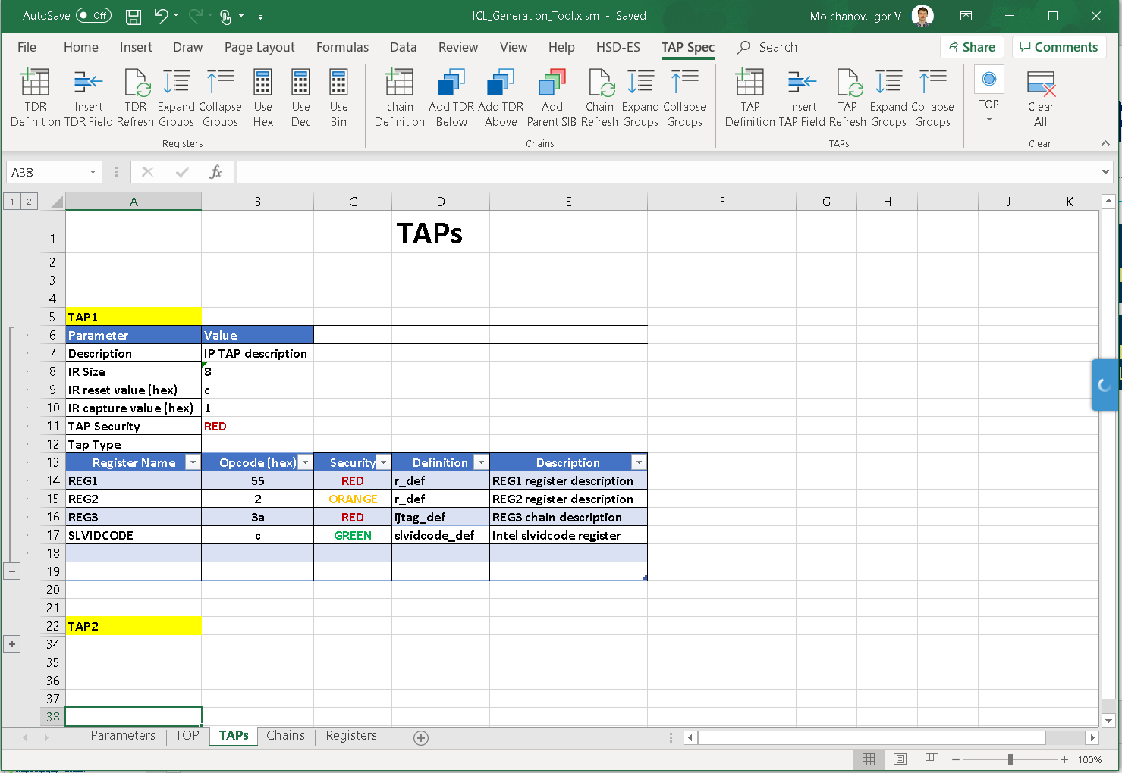
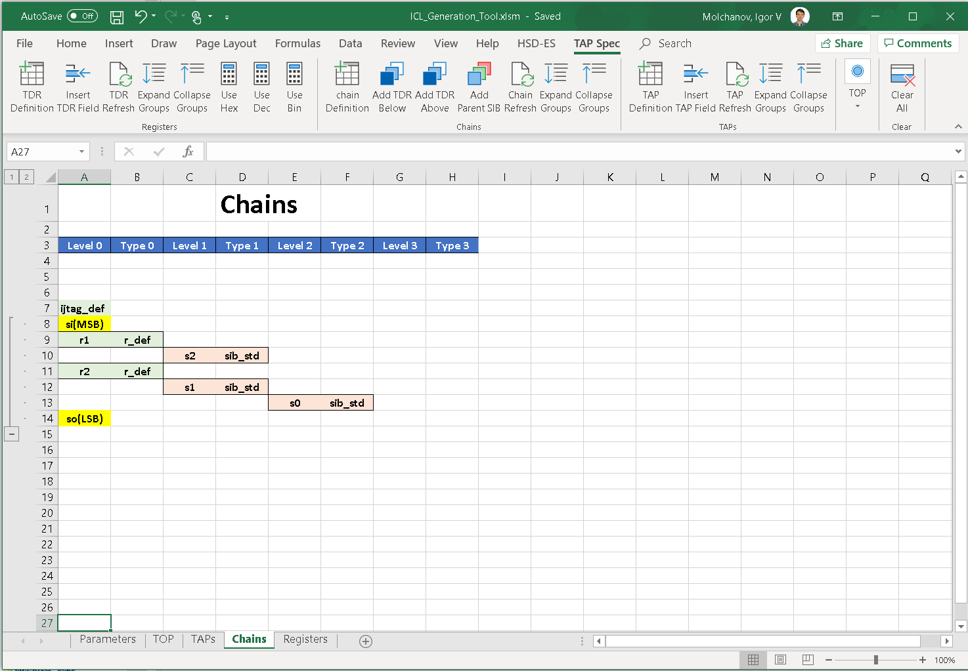
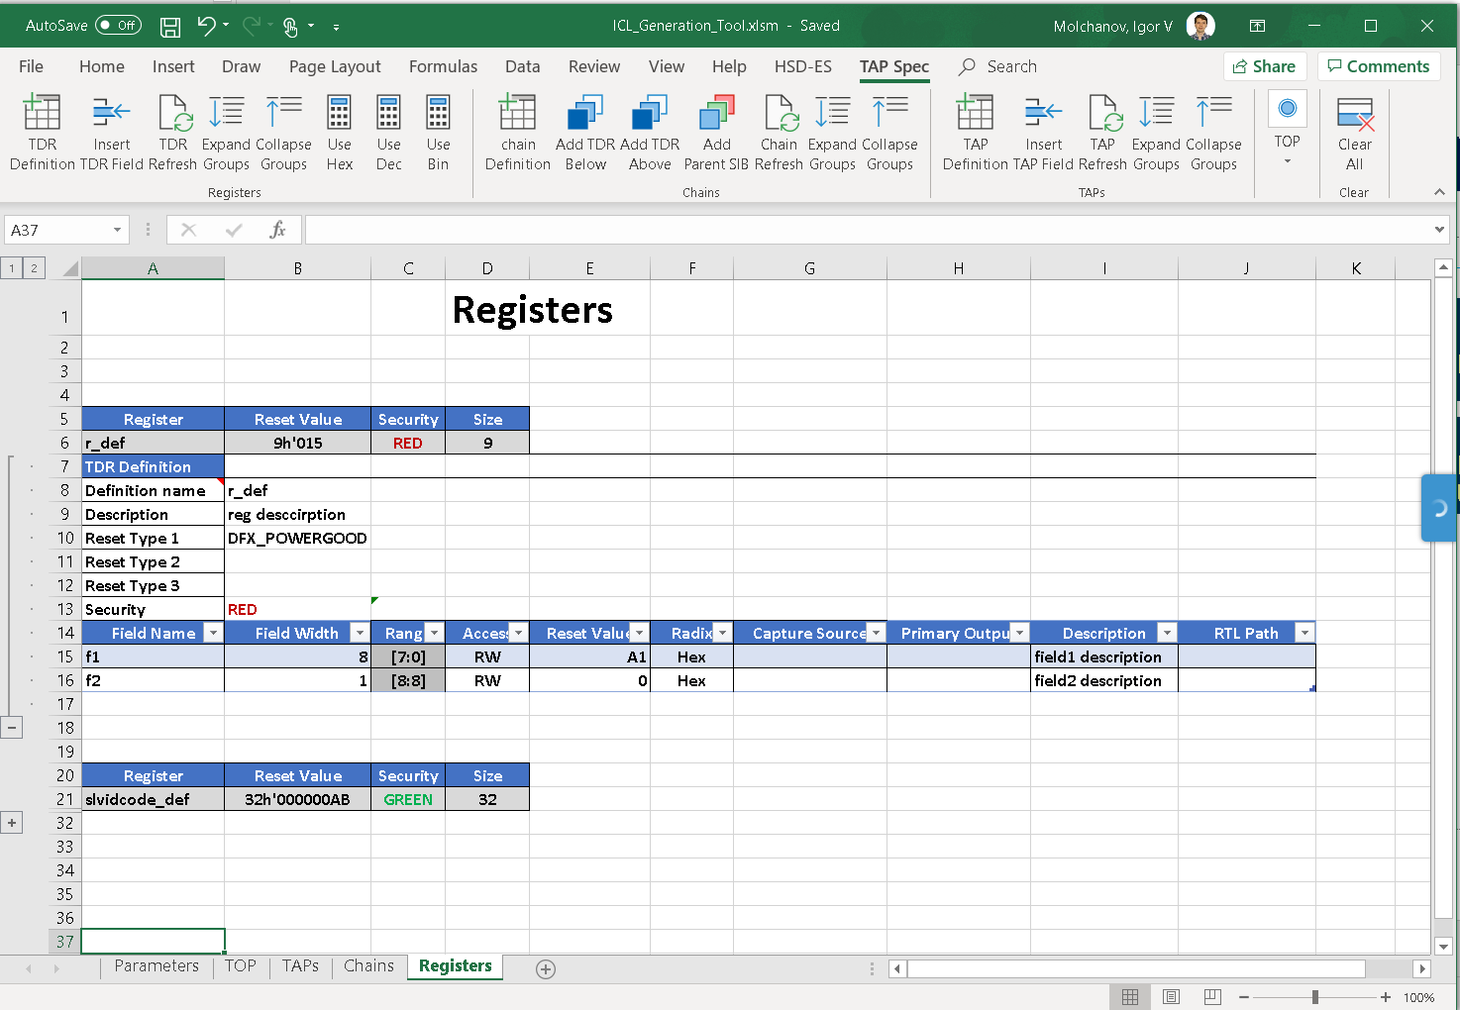
IP TAP RDL2ICL and ICLGEN
TAP RDL2ICL flow: for IP with existing TAP RDL
“Push button” conversion RDL/RDL 2.0 -> ICL
ICL header file is required to specify DFx/TAP port names/functions
TAP ICLGEN GUI: for new IP (beta)
Based on MS Excel with special macros to add/manage elements of TAP spec (TAPs, chains, registers, fields)
Part of DUVE-M
IP TAP RDL`
DTEG
TAP RDL2ICL
IP TAP ICL
DTEG
TAP ICLGEN
Front-End GUI

