Slide 1
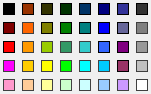
pUC
ori
PCMV IE
XhoI
Fwd
Rev
Kan^{r}/
Neo^{r}
BamHI
SV40 ori
PSV40
Mutation

Slide 2
Fwd
EGFP
1
1
1
Rev

