Slide 1
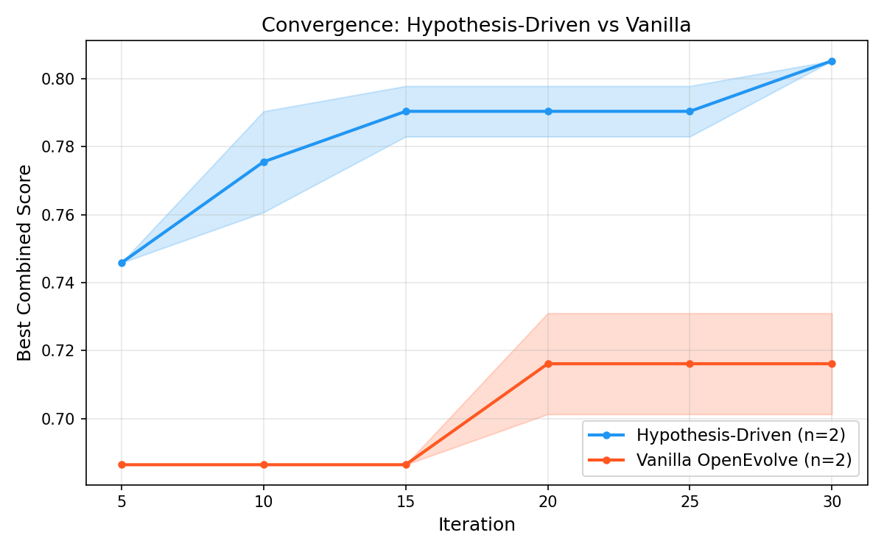
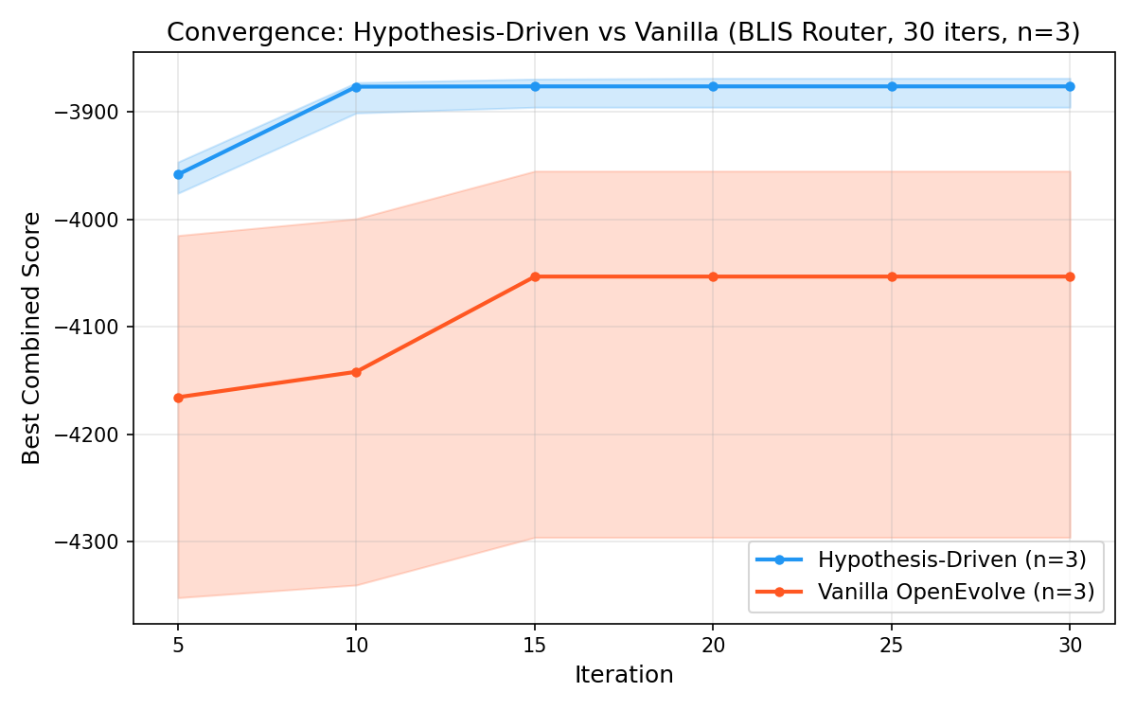
Executive Summary — Hypothesis A/B Results
Does structured scientific reasoning (HYPOTHESIS → RESULT) improve OpenEvolve code evolution?
Experiment | Models | Metrics | Delta | Winner
Web Scraper | GPT-4o + Sonnet 4.5 | 4 (acc, comp, robust, parse) | +12.4% | TREATMENT
BLIS Router | Opus 4.5 + Sonnet 4.5 | 5+ (latency, throughput, SLO) | +4.6% | TREATMENT
Rust Sort | GPT-5.2 + Opus 4.6 | 5 (perf, adapt, correct) | +0.0005% | Tie
Circle Packing | GPT-5.2 + Opus 4.6 | 1 (sum_radii) | -0.76% | CONTROL
Func Minimization | Gemini Flash | 1 (combined) | -0.76% | CONTROL
When Hypotheses-driven Evolution Help:
1. Multi-metric feedback (tradeoffs to reason about)
2. Problem hard enough (not solved in <5 iterations)
3. Capable model (inject rate >40%)
When They Don’t:
• Single scalar metric — nothing to reason about
• Weak model — can't follow hypothesis format
• Too easy — ceiling reached before reasoning helps
Web Scraper (+12.4%)
BLIS Router (+4.6%)

Slide 2
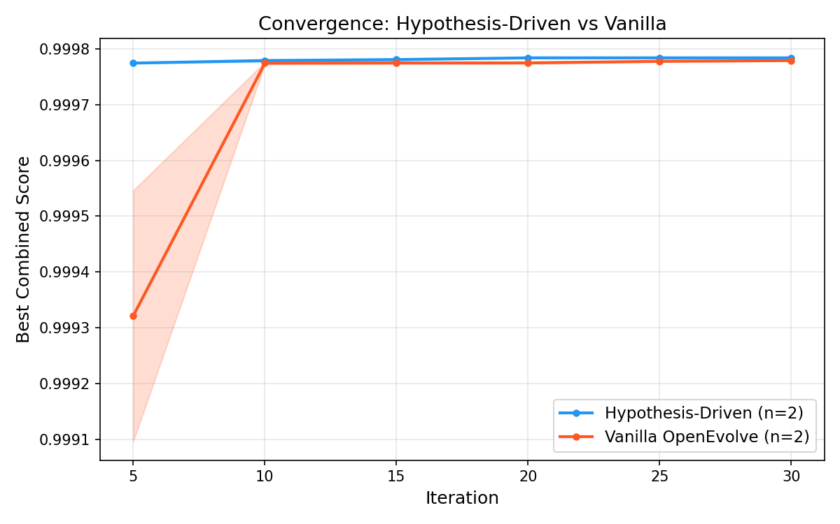
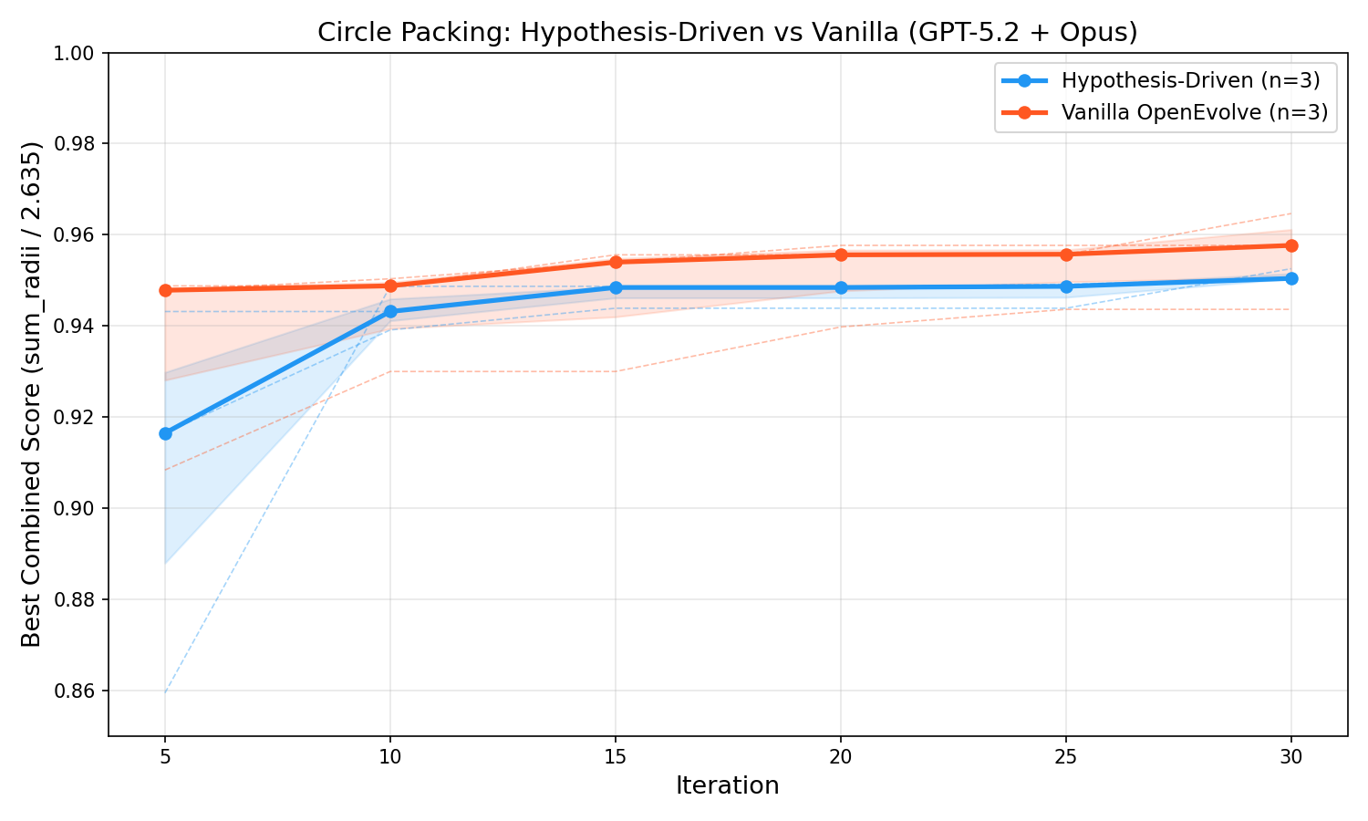
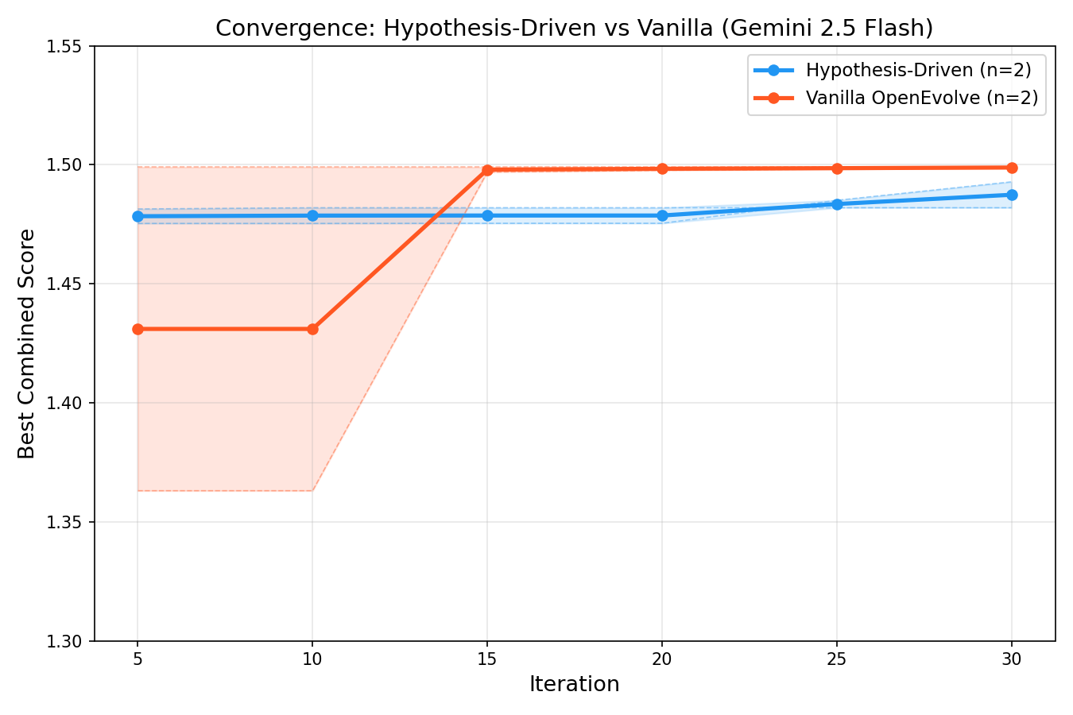
V2: Results by Outcome — Helped / Marginal / Hurt
HELPED
MARGINAL
HURT
Web Scraper: +12.4%
GPT-4o + Sonnet 4.5 | 4 metrics
Treatment 0.805 vs Control 0.716
Control seed=501 stuck at initial score
Rust Sort: +0.0005%
GPT-5.2 + Opus 4.6 | 5 metrics
Both reach 0.9998 — problem too easy
Treatment converges 5 iters faster
Circle Packing: -0.76%
GPT-5.2 + Opus | 1 metric
Single scalar — no tradeoffs to reason about
Func Min: -0.76%
Gemini Flash | 1 metric
Weak model: inject rate only 30-37%
Can't follow structured hypothesis format
BLIS Router: +4.6%
Opus + Sonnet | 5+ metrics
Treatment -3876 vs Control -4053
13x lower variance (IQR 27 vs 341)

Slide 3
V3: Convergence Analysis — How Treatment vs Control Evolve Over Time
Web Scraper (+12.4%)
BLIS Router (+4.6%)
Rust Sort (tie)
Treatment leads from iter 5, gap widens
Steady treatment advantage, low variance
Treatment faster to ceiling, control catches up
Circle Packing (-0.76%)
Func Min (-0.76%)
Control leads throughout
Control slightly better, both near-optimal
Pattern: 4/5 experiments show treatment converging faster. On hard problems, the gap persists. On easy problems, control catches up.

Slide 4
V4: Model Strength & Hypothesis Pipeline Health
Model Tier | Hypos/iter | Persist | Inject | Inherit | Hypo Benefit?
Claude Opus/Sonnet | 3.2–4.2 | 54–72% | 88–100% | 67–83% | Yes (BLIS +4.6%)
GPT-5.2 + Opus | 3.1–4.2 | 54–63% | 97–100% | 70–79% | Marginal (too easy)
GPT-4o + Sonnet | 3.2–3.8 | 72% | 47–53% | 76–83% | Yes (Web +12.4%)
Gemini Flash | 2.8–3.1 | 45–52% | 30–37% | 48–55% | No (broken pipeline)
Problem Type × Model Strength Matrix
Key Findings:
Inject rate is the critical metric:
>85%: Pipeline works well (Claude, GPT-5.2)
47-53%: Still beneficial if problem has room (GPT-4o)
<40%: Pipeline too broken to help (Gemini Flash)
The Goldilocks Zone:
Mid-tier model + multi-metric + hard problem
= maximum hypothesis benefit
Recommendation:
Monitor inject rate in first 5 iterations.
If <40%, disable hypotheses to avoid overhead.
 | Single Metric | Multi-Metric
Strong (GPT-5.2) | Circle Pack: CONTROL wins | Rust Sort: TIE
Mid (GPT-4o, Sonnet) | — | Web Scraper: TREATMENT +12%
Mid-Strong (Opus+Sonnet) | — | BLIS Router: TREATMENT +5%
Weak (Gemini Flash) | Func Min: CONTROL wins | —
Hypotheses succeed in the multi-metric column — where there are genuine tradeoffs to reason about. Model strength matters less than feedback richness.

Slide 5
V5: Bugs Found, Fixes & Practical Recommendations
Bugs Discovered During Experiments
Practical Recommendations
1. Comment syntax for non-Python languages
Template showed # (Python) but Rust needs //
Caused ~2% compilation failures in Rust programs
Fix: Language-aware template + ASCII-only rule
2. Fitness tracking used wrong metric name
Evaluator returned 'score' not 'combined_score'
Fallback averaged ALL metrics including avg_time
Lower avg_time = lower fitness (backwards!)
Initial program appeared 'best' for 30 iterations
Fix: Renamed to combined_score in evaluator
3. Convergence CSV overwritten by sequential runs
Each run_experiment.py call overwrote the CSV
Fix: Rebuild CSVs from checkpoint data
Enable hypotheses when:
• Multi-metric problem with genuine tradeoffs
• Model inject rate > 40% (check in first 5 iters)
• Problem not solvable in < 5 iterations
Skip hypotheses when:
• Single scalar metric optimization
• Weak model (Gemini Flash, GPT-5-nano)
• Problem trivially easy for the chosen model
Best model pairing:
• Primary: mid-tier (GPT-4o, Sonnet) — benefits most
• Secondary: strong (Opus) — provides diversity
• Avoid: frontier models on easy problems (waste)
Experiment | Result | Key Takeaway
Web Scraper | +12.4% | Multi-metric + mid-tier model = best combo
BLIS Router | +4.6% | Hard problem + rich feedback = sustained advantage
Rust Sort | Tie | Faster convergence but ceiling too low
Circle Packing | -0.76% | Single metric — nothing to reason about
Func Minimization | -0.76% | Weak model breaks hypothesis pipeline
Bottom line: Hypothesis-driven evolution is not universally better — it shines on multi-metric problems with capable models.

