Slide 1




Palestinian Advanced School - 2026
Cosmic-ray propagation with the DRAGON2 code
Pedro de la Torre Luque
pedro.delatorre@uam.es

Slide 2
The DRAGON2 code
Where to find and download it
https://github.com/cosmicrays/DRAGON2-Beta_version
Previous version of the code
https://github.com/cosmicrays/DRAGON
Technical papers
Numerical solver and astrophysical ingredients
https://arxiv.org/abs/1607.07886
Nuclear interactions with the interstellar gas
https://arxiv.org/abs/1711.09616

Slide 3
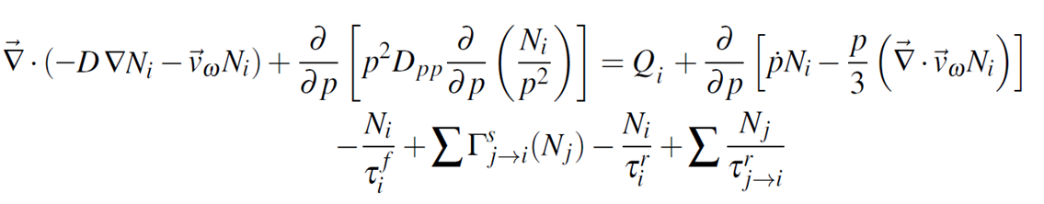
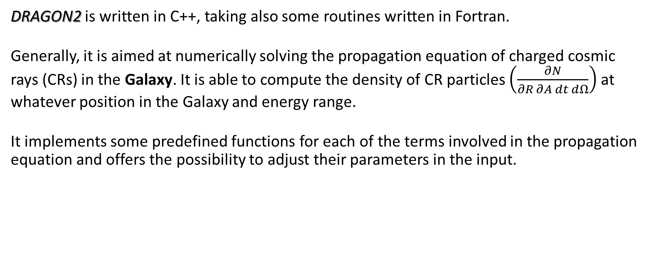
The DRAGON2 code
DRAGON2 is written in C++, taking also some routines written in Fortran.
Generally, it is aimed at numerically solving the propagation equation of charged cosmic rays (CRs) in the Galaxy. It is able to compute the density of CR particles $\left(\frac{∂N}{∂R ∂A dt dΩ}\right)$ at whatever position in the Galaxy and energy range.
It implements some predefined functions for each of the terms involved in the propagation equation and offers the possibility to adjust their parameters in the input.
Notes:
Crank Nicholson numerical scheme that solves this iteratively in time, similar to GALPROP

Slide 4


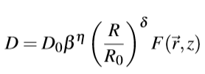


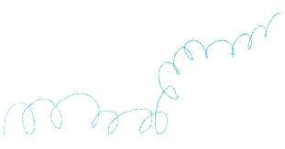





The DRAGON2 code
The basic idea is that primary particles are accelerated in astrophysical sources (namely SNRs) and propagate throughout the Galaxy during millions of years, due to scattering with plasma waves. Occasionally, they interact with gas and produce secondary nuclei through spallation.
$$Dpp ∝\frac{p2 VA2}{D}$$

Slide 5










The DRAGON2 code
The basic idea is that primary particles are accelerated in astrophysical sources (namely SNRs) and propagate throughout the Galaxy during millions of years, due to scattering with plasma waves. Occasionally, they interact with gas and produce secondary nuclei through spallation.
$$Dpp ∝\frac{p2 VA2}{D}$$
Galactic Winds
Notes:
Winds which are moving the gas from active regions of

Slide 6


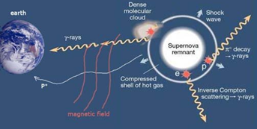

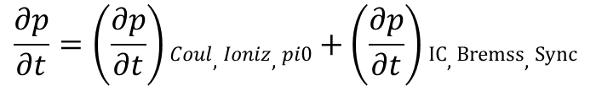

The DRAGON2 code
The basic idea is that primary particles are accelerated in astrophysical sources (namely SNRs) and propagate throughout the Galaxy during millions of years, due to scattering with plasma waves. Occasionally, they interact with gas and produce secondary nuclei through spallation.
$$\frac{∂N}{∂R}q(x, y, z)$$
$$Dpp ∝\frac{p2 VA2}{D}$$
CROSEC paramet.
DRAGON2 paramet.
$$\frac{∂p}{∂t}=\left(\frac{∂p}{∂t}\right)Coul,Ioniz, pi0+\left(\frac{∂p}{∂t}\right)IC, Bremss,Sync$$

Slide 7
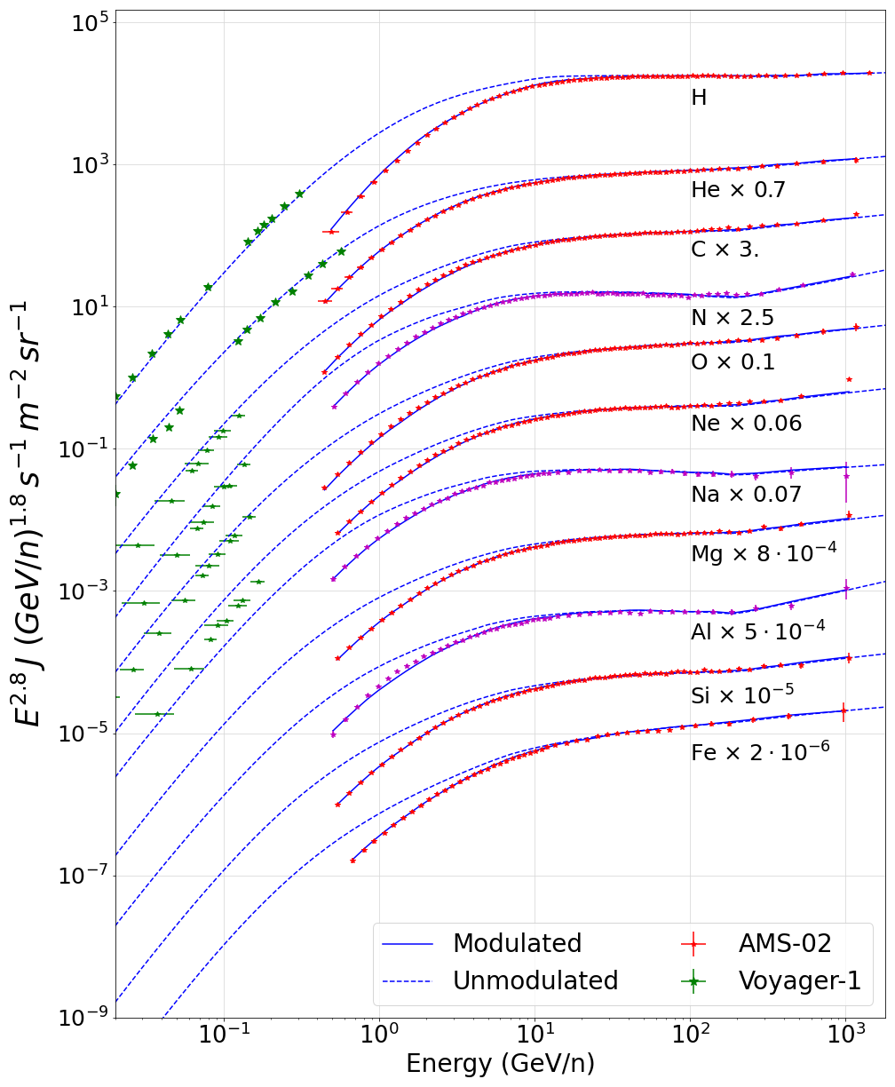
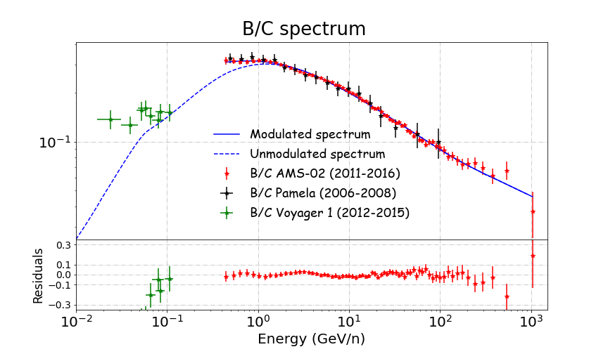
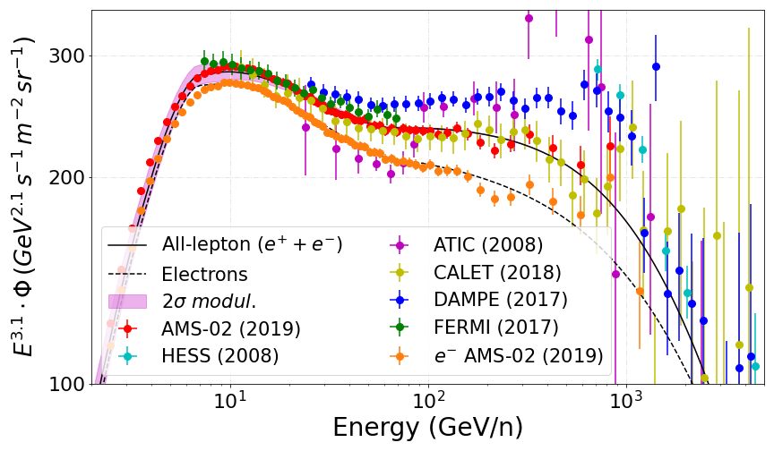
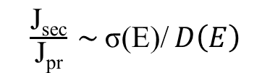
DRAGON is used to propagate charged particles in the Galaxy, from nuclei and anti-nuclei to leptons. Either particles injected from sources, products of dark matter annihilation or other nuclei produced from collisions.
P.D.L. et al arXiv:2202.03559
P.D.L. et al arXiv:2202.03559
$\frac{\text{J}\text{sec}}{\text{J}\text{pr}} \sim$σ(E)/ $D\left(E\right)$
P.D.L. et al JCAP03 (2021) 099

Slide 8
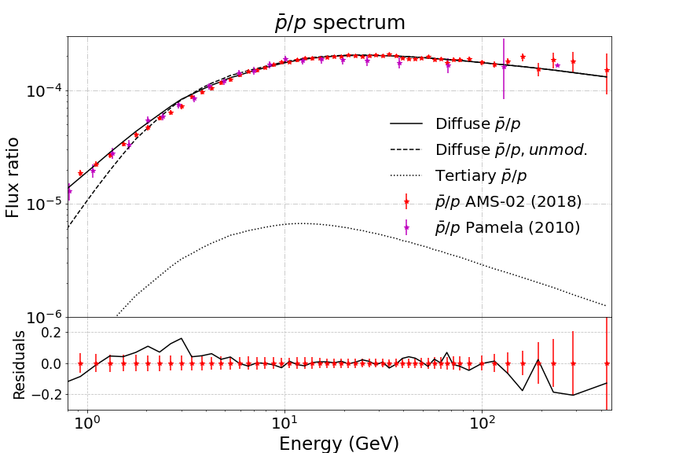

DRAGON is used to propagate charged particles in the Galaxy, from nuclei and anti-nuclei to leptons. Either particles injected from sources, products of dark matter annihilation or other nuclei produced from collisions.
P.D.L. et al arXiv:2202.03559
Secondary:
Tertiary:

