Slide 1
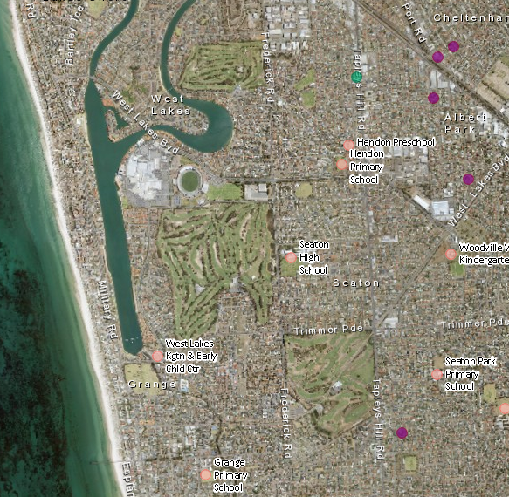
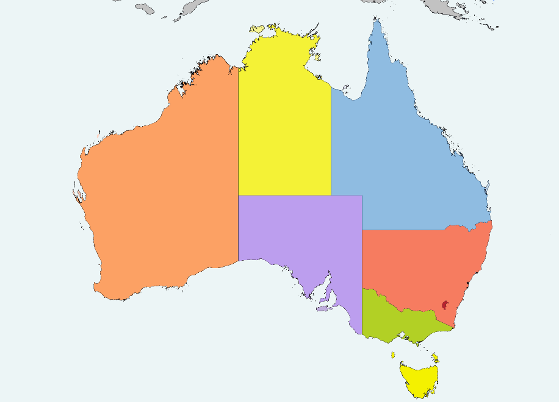
What are your priorities?
Education
Transportation
Internet Access
Where are you going to move?
SA
Suggest me

Slide 2
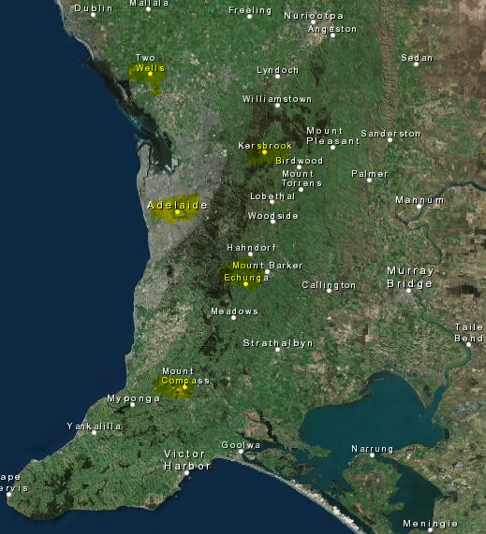


Slide 3
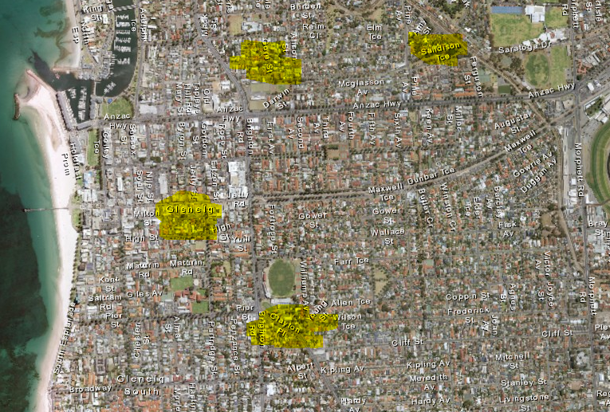
UniSA

