Slide 2
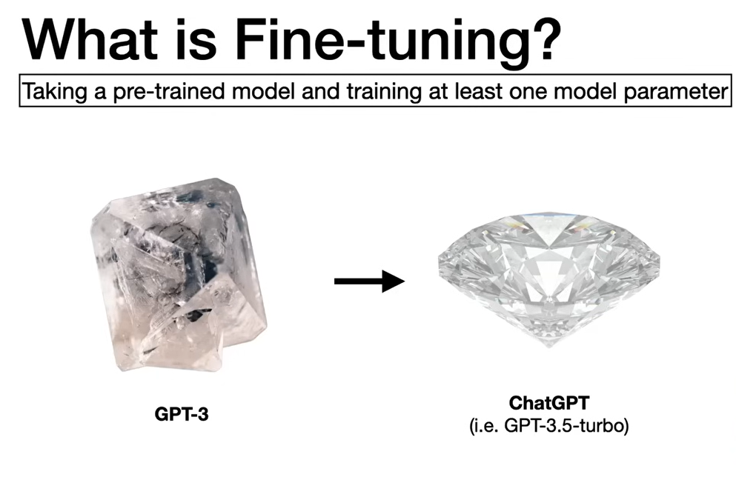
Bringing Multimodal Gemma 4 E2B to the Edge: A Deep Dive into LiteRT-LM and Qualcomm QNN | by Kartikey Rawat | Google Developer Experts | Medium

Slide 3
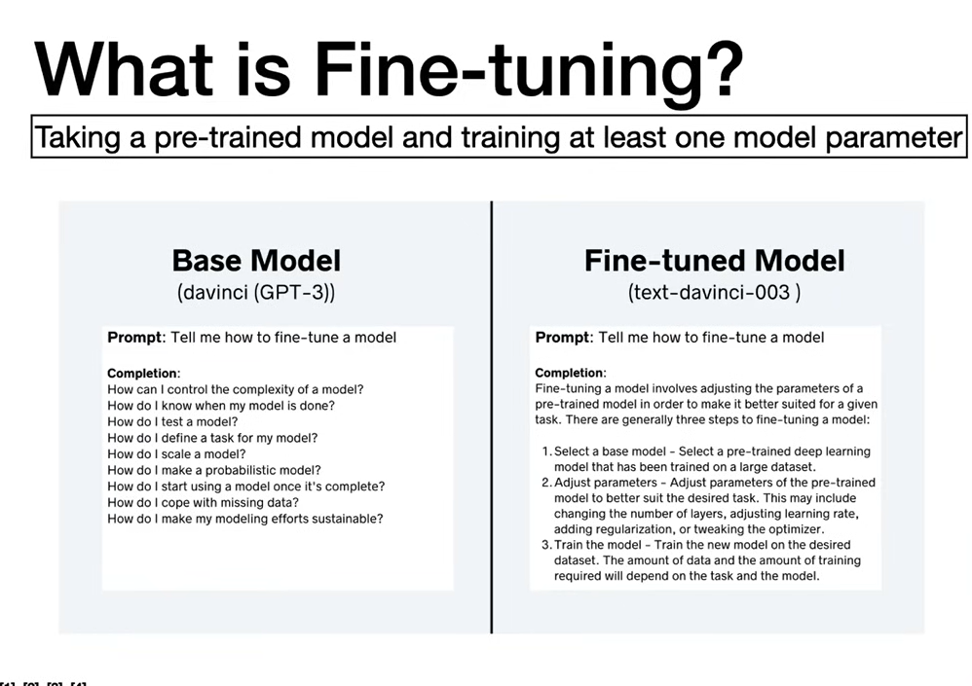
Bringing Multimodal Gemma 4 E2B to the Edge: A Deep Dive into LiteRT-LM and Qualcomm QNN | by Kartikey Rawat | Google Developer Experts | Medium

Slide 4
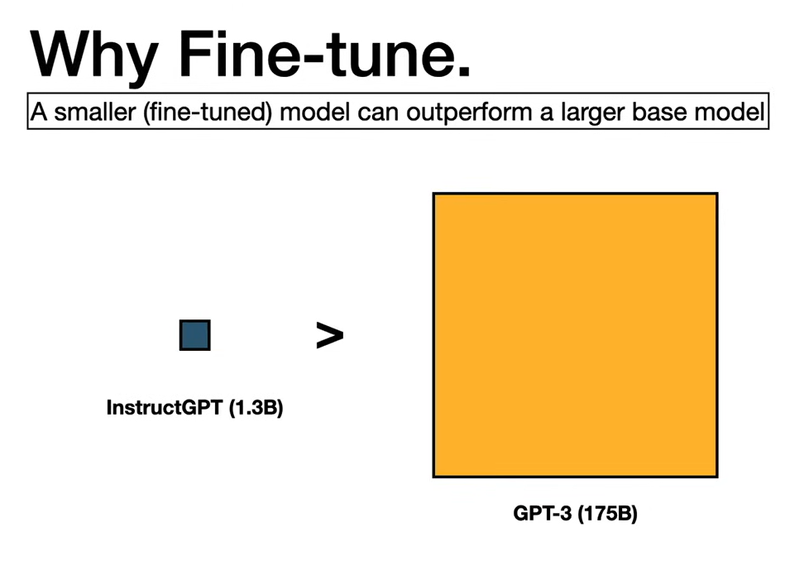
Bringing Multimodal Gemma 4 E2B to the Edge: A Deep Dive into LiteRT-LM and Qualcomm QNN | by Kartikey Rawat | Google Developer Experts | Medium

Slide 5
3 Ways to Fine-Tune
Self-Supervised
2. Supervised
3. Reinforcement Learning

Slide 6
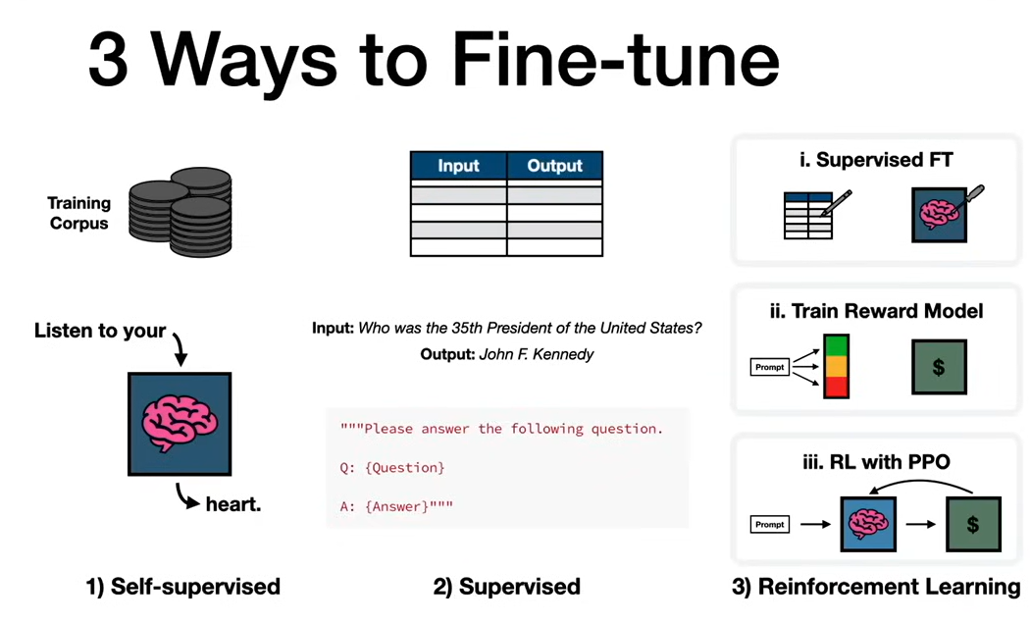

Slide 7
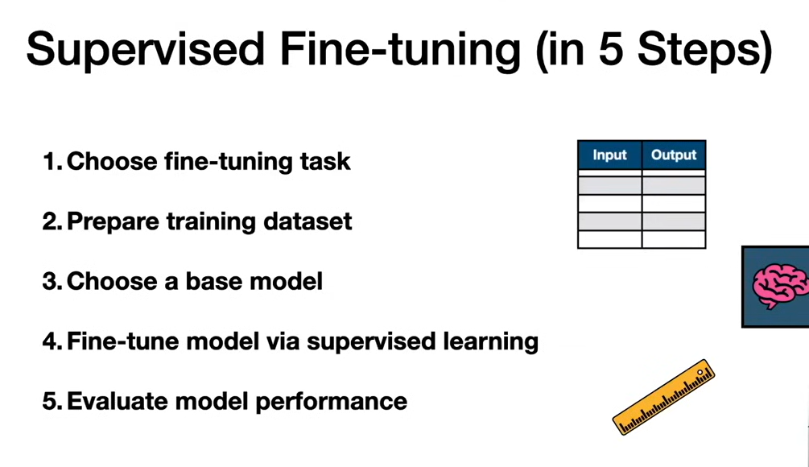

Slide 8
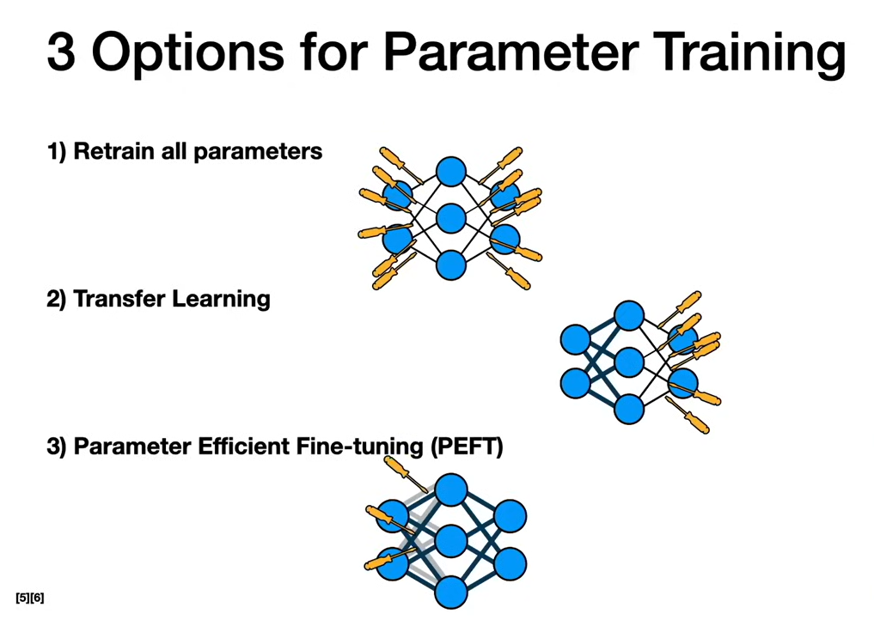

Slide 9
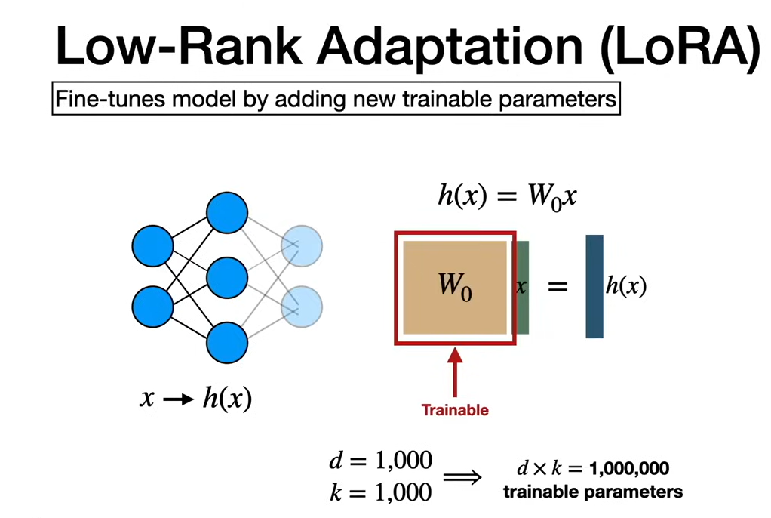

Slide 10
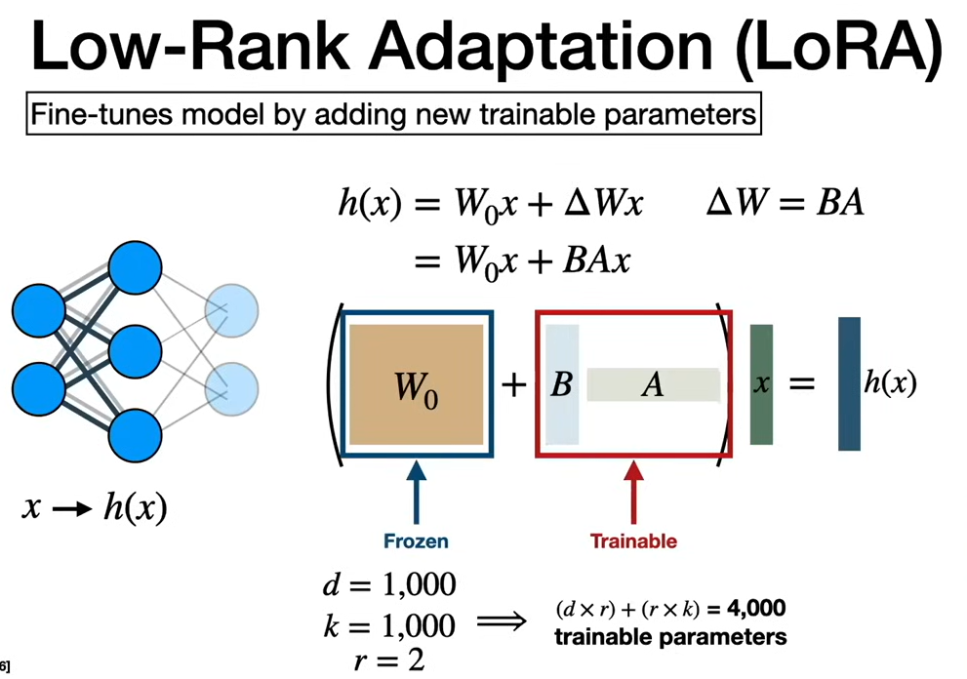

Slide 12
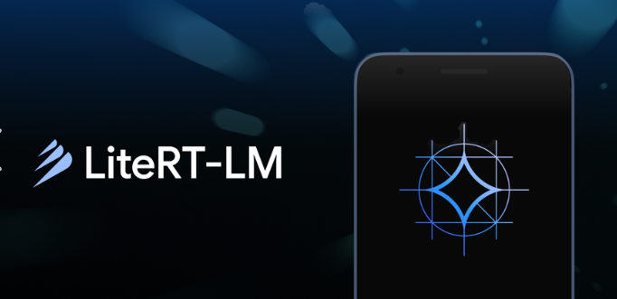

Slide 13
Frameworks
Framework | Maker | Notes
ONNX Runtime (ORT) / ORT Mobile | Microsoft + community | Cross-framework, runs ONNX models on mobile/edge
PyTorch Mobile / ExecuTorch | Meta | ExecuTorch is Meta's newer, more actively developed edge runtime
Core ML | Apple | Apple-only, deeply integrated with iOS/macOS hardware acceleration
NCNN | Tencent | Lightweight, popular for mobile CV apps
MNN | Alibaba | Mobile-focused, good for CV and some LLM inference
llama.cpp / GGML | Community (Georgi Gerganov) | Dominant for running LLMs (GGUF format) on CPU/edge devices
MLC-LLM | MLC.ai | Compiles LLMs for GPU/mobile/edge across many backends
OpenVINO | Intel | Optimized for Intel CPUs/GPUs/VPUs, edge and server
Qualcomm AI Engine / QNN | Qualcomm | Hardware-specific, tuned for Snapdragon NPUs

Slide 14
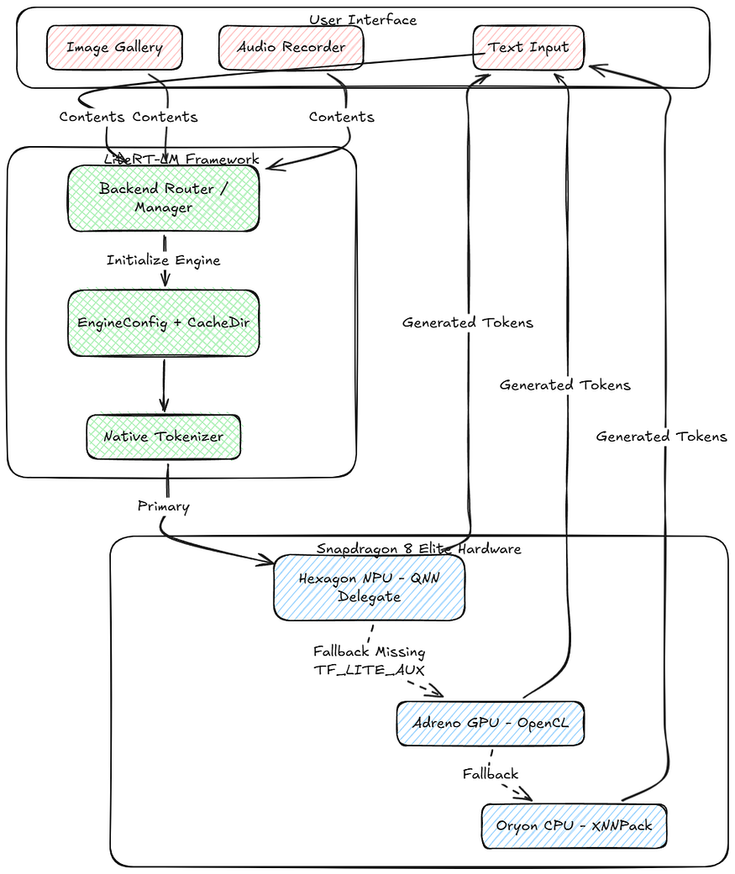
LiteRT
Bringing Multimodal Gemma 4 E2B to the Edge: A Deep Dive into LiteRT-LM and Qualcomm QNN | by Kartikey Rawat | Google Developer Experts | Medium

Slide 15
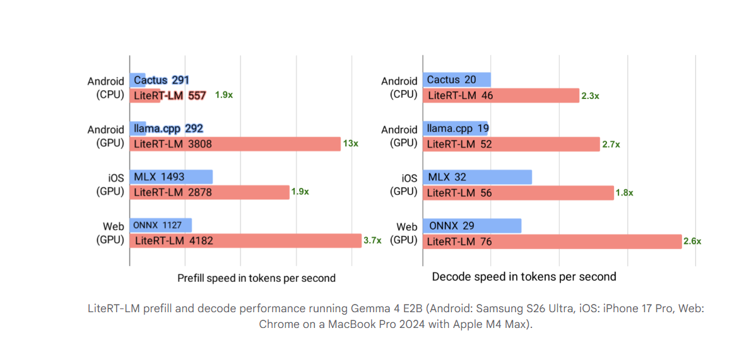
LiteRT-LM prefill and decode performance
Blazing fast on-device GenAI with LiteRT-LM - Google Developers Blog

Slide 16
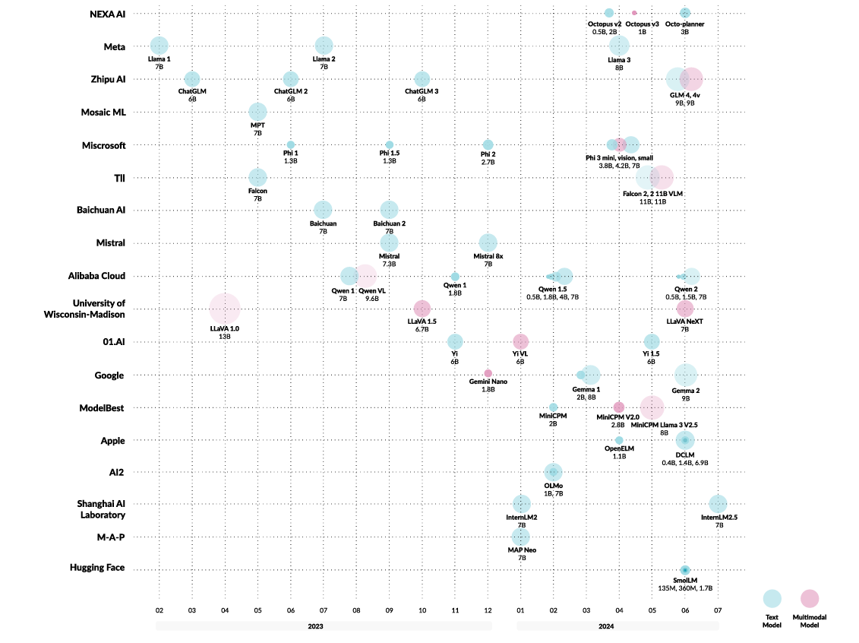
Summary of on-device LLMs’ evolution

Slide 17
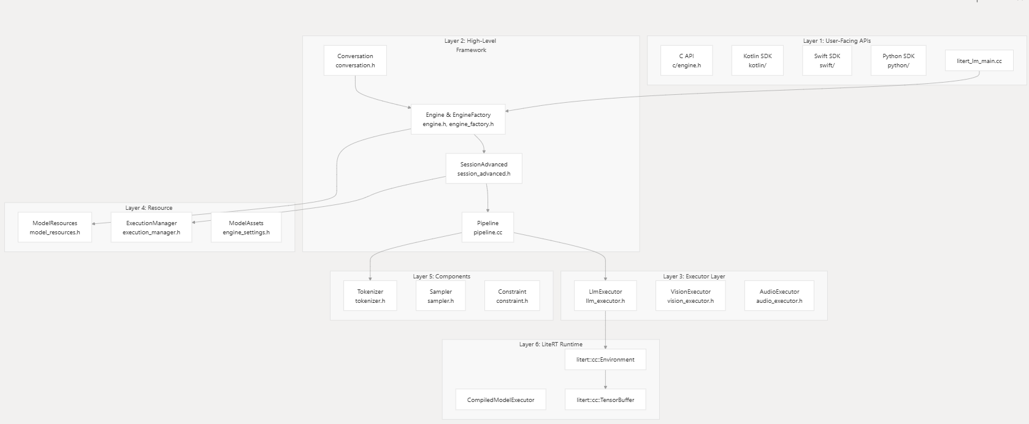
LiteRT-Architecture
Architecture Overview | google-ai-edge/LiteRT-LM | DeepWiki

Slide 18
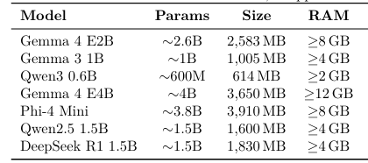
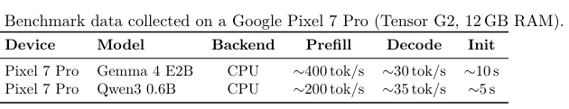
OpenSource Model Size
BenchMark
Less Is More: Engineering Challenges of On-Device Small Language Model Integration in a Mobile Application

Slide 19
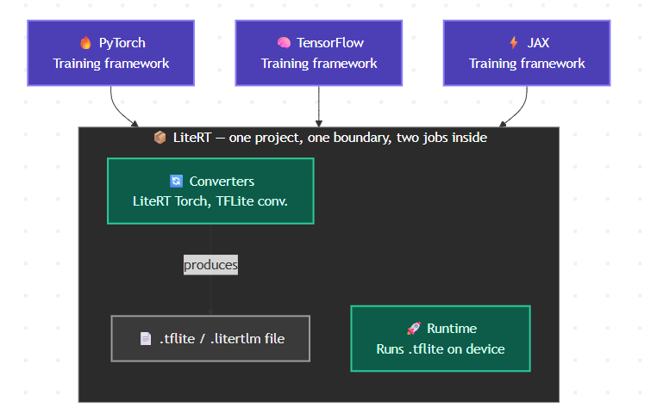
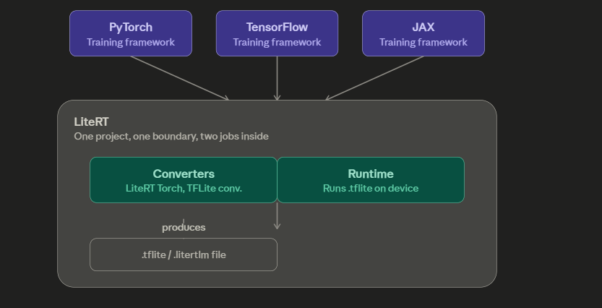

Slide 20
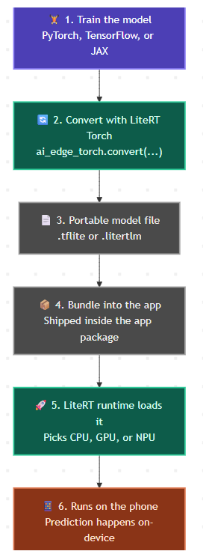
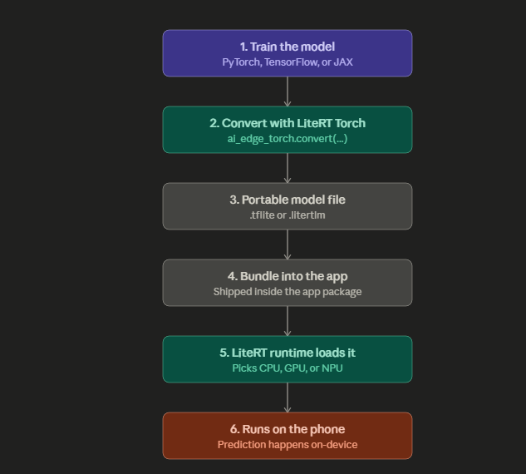

Slide 21
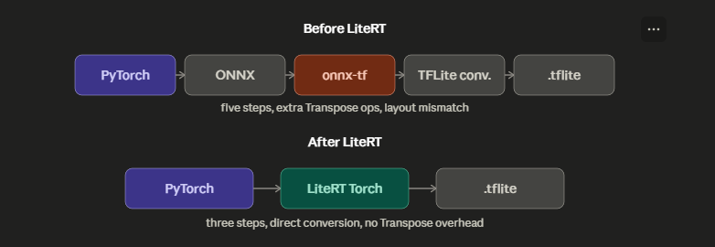
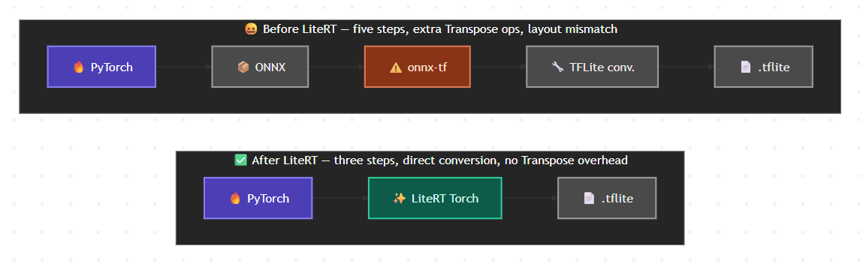

Slide 22
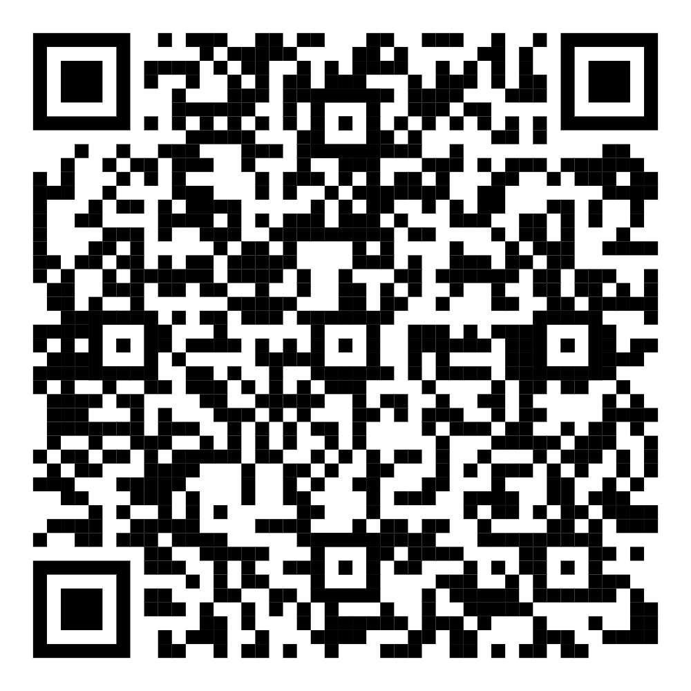
THANK YOU
CONNECT ME HERE

