Slide 1

Chart Express
Create charts on the go!
Struan Clark

Slide 2
Requirements
Requirement 1,UI
AbsoluteLayout
Button
EditText
ImageButton
ImageView
Spinner
TextView
Toast

Slide 3
Requirements
Requirement 2, Network Communication
Receives binary data, such as an image
Requirement 3, Frameworks
Downloading and loading a remote image
Storing data to the SD card
The share Intent receiver

Slide 4
What does it do?
Create simple charts
Bar
Line
Pie
Create QR codes
Two dimensional barcode for storing data
Send them as an image

Slide 5

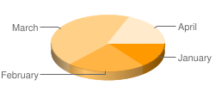
How does it work?
Chart API
http://code.google.com/apis/chart/
Returns a chart as a .png for a properly formatted URL
Lots of display possibilities, but some limitations
http://chart.apis.google.com/chart?cht=p3&chd=s:Uf9a&chs=250x100&chl=January|February|March|April

Slide 6
How does it work?
User inputs data and taps “Generate Chart”
User data is normalized between 0 and 100 for Chart API
URL built and sent to Chart API
Chart is downloaded via AsyncTask, and then displayed to the user and saved to the SD card as a JPEG
User now has the option to send the chart via the ACTION_SEND intent

Slide 7
Design Features
One Activity
GUI elements are made visible when they are needed
Image is downloaded via AsyncTask
Prevents blocking of GUI thread
Downloaded as an InputStream which is converted to a Drawable for display
Drawable is converted to a bitmap which as saved to a JPEG as DCIM/chart.jpg
Image can be sent via ACTION_SEND intent
Subject and signature are preloaded to appear if sent in an email

Slide 8
Design Issues
Chart API requires data values between 0 and 100
Created a method that converts the input string to an array of integers, scales them between 0 and 100, and returns them to an output string
In the line graph, the scale is common among all the graphs
Saving to the SD card Pictures directory failed
Saved to DCIM instead
File downloadedPic = new File( Environment.getExternalStoragePublicDirectory( Environment.DIRECTORY_DCIM), "/chart.jpg");

Slide 9
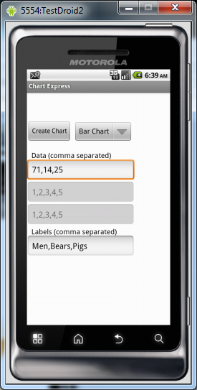
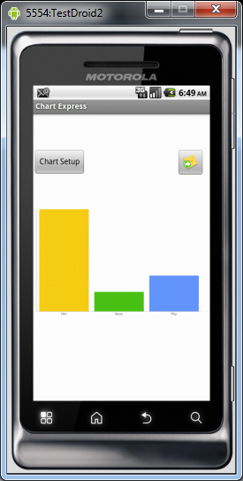
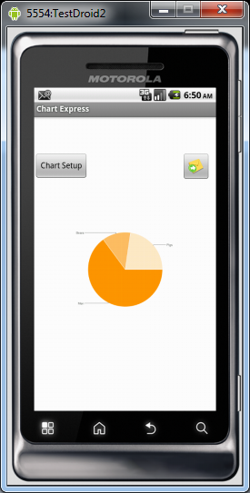
Bar/Pie Chart

Slide 10
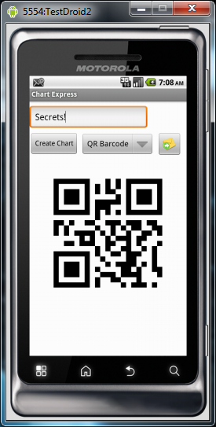
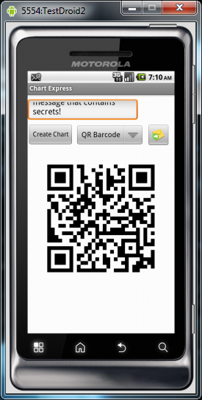
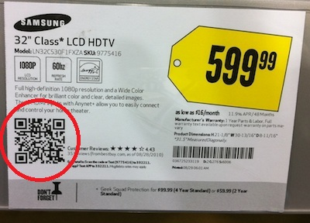
QR Code
What is it?
Two dimensional barcode
that can be used to store
text/URL/VCards

Slide 11
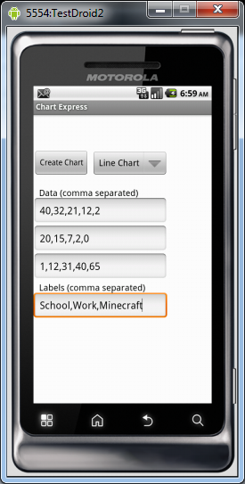
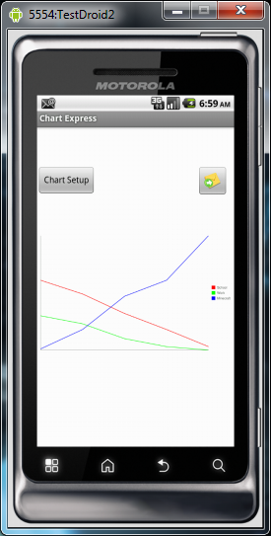
Sending a Line Chart

Slide 12
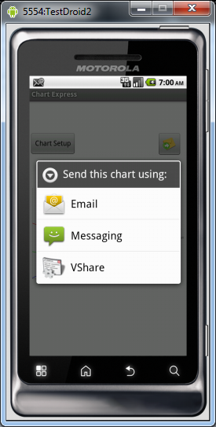
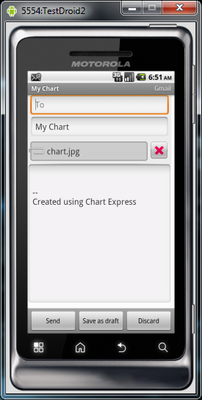
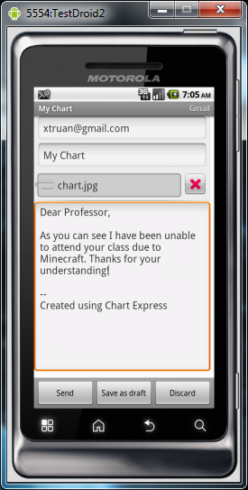
Sending a Line Chart

Slide 13
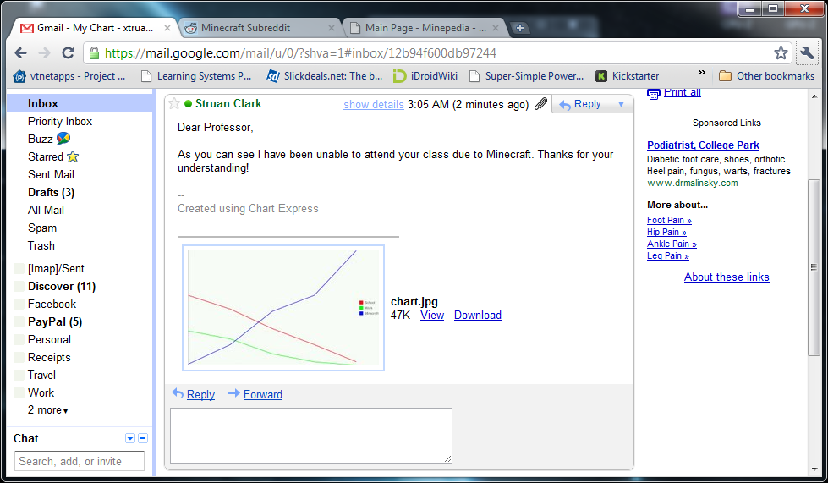
Sending a Line Chart

Slide 14
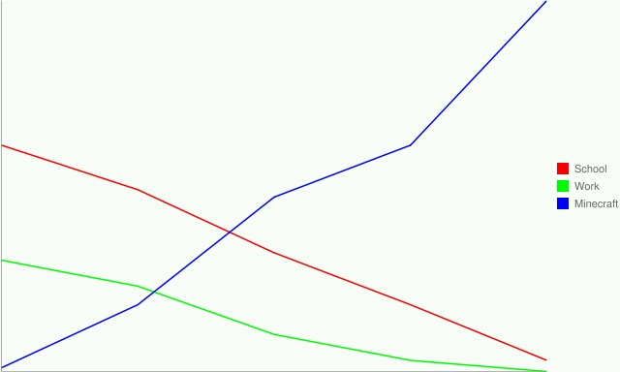
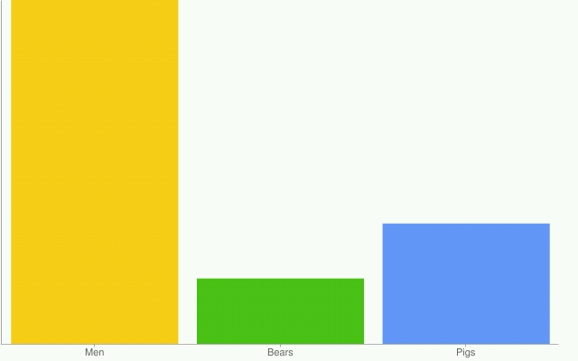
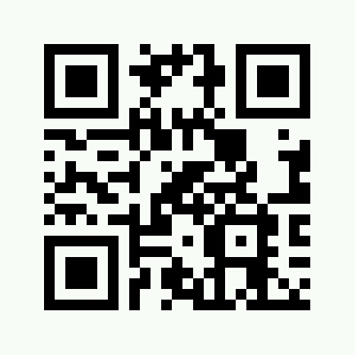
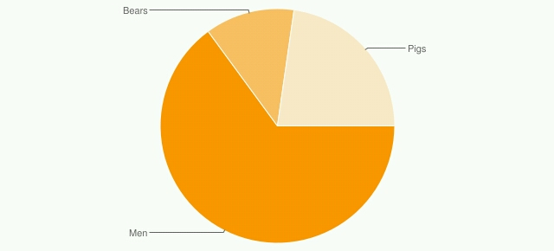
Charts

Slide 15
Questions?

