Slide 1
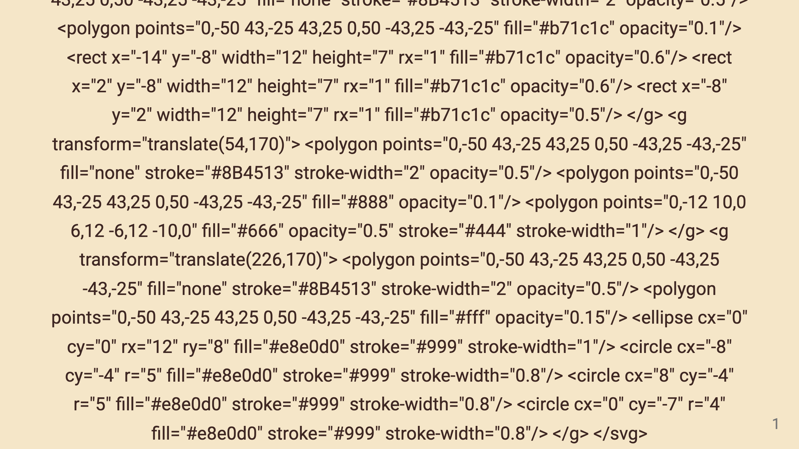

Slide 2
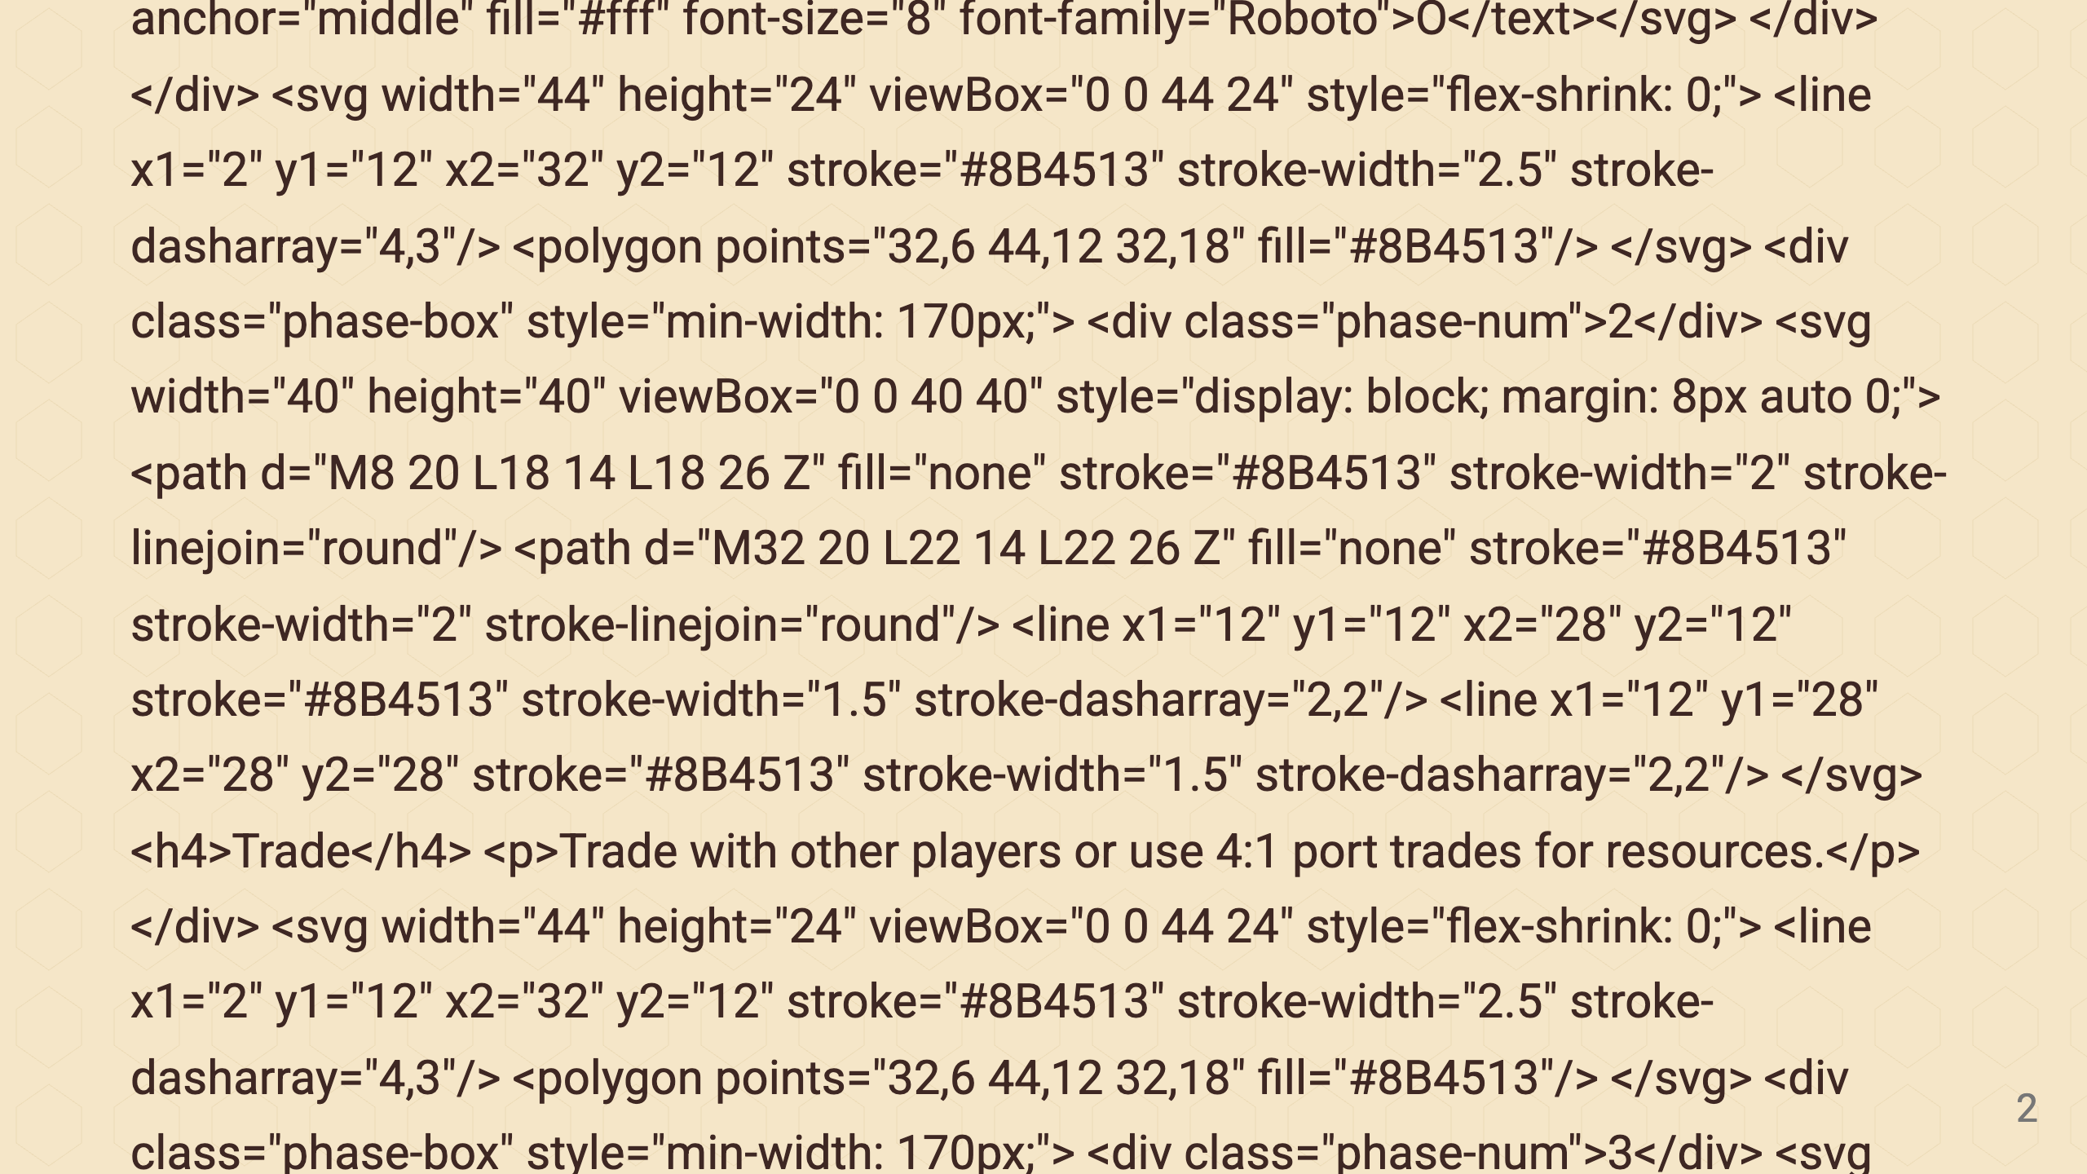
Notes:
Arrow 1 Phase 2: Trade Arrow 2 Phase 3: Build Arrow 3 Phase 4: Draw

Slide 3
