Slide 1


Slide 2
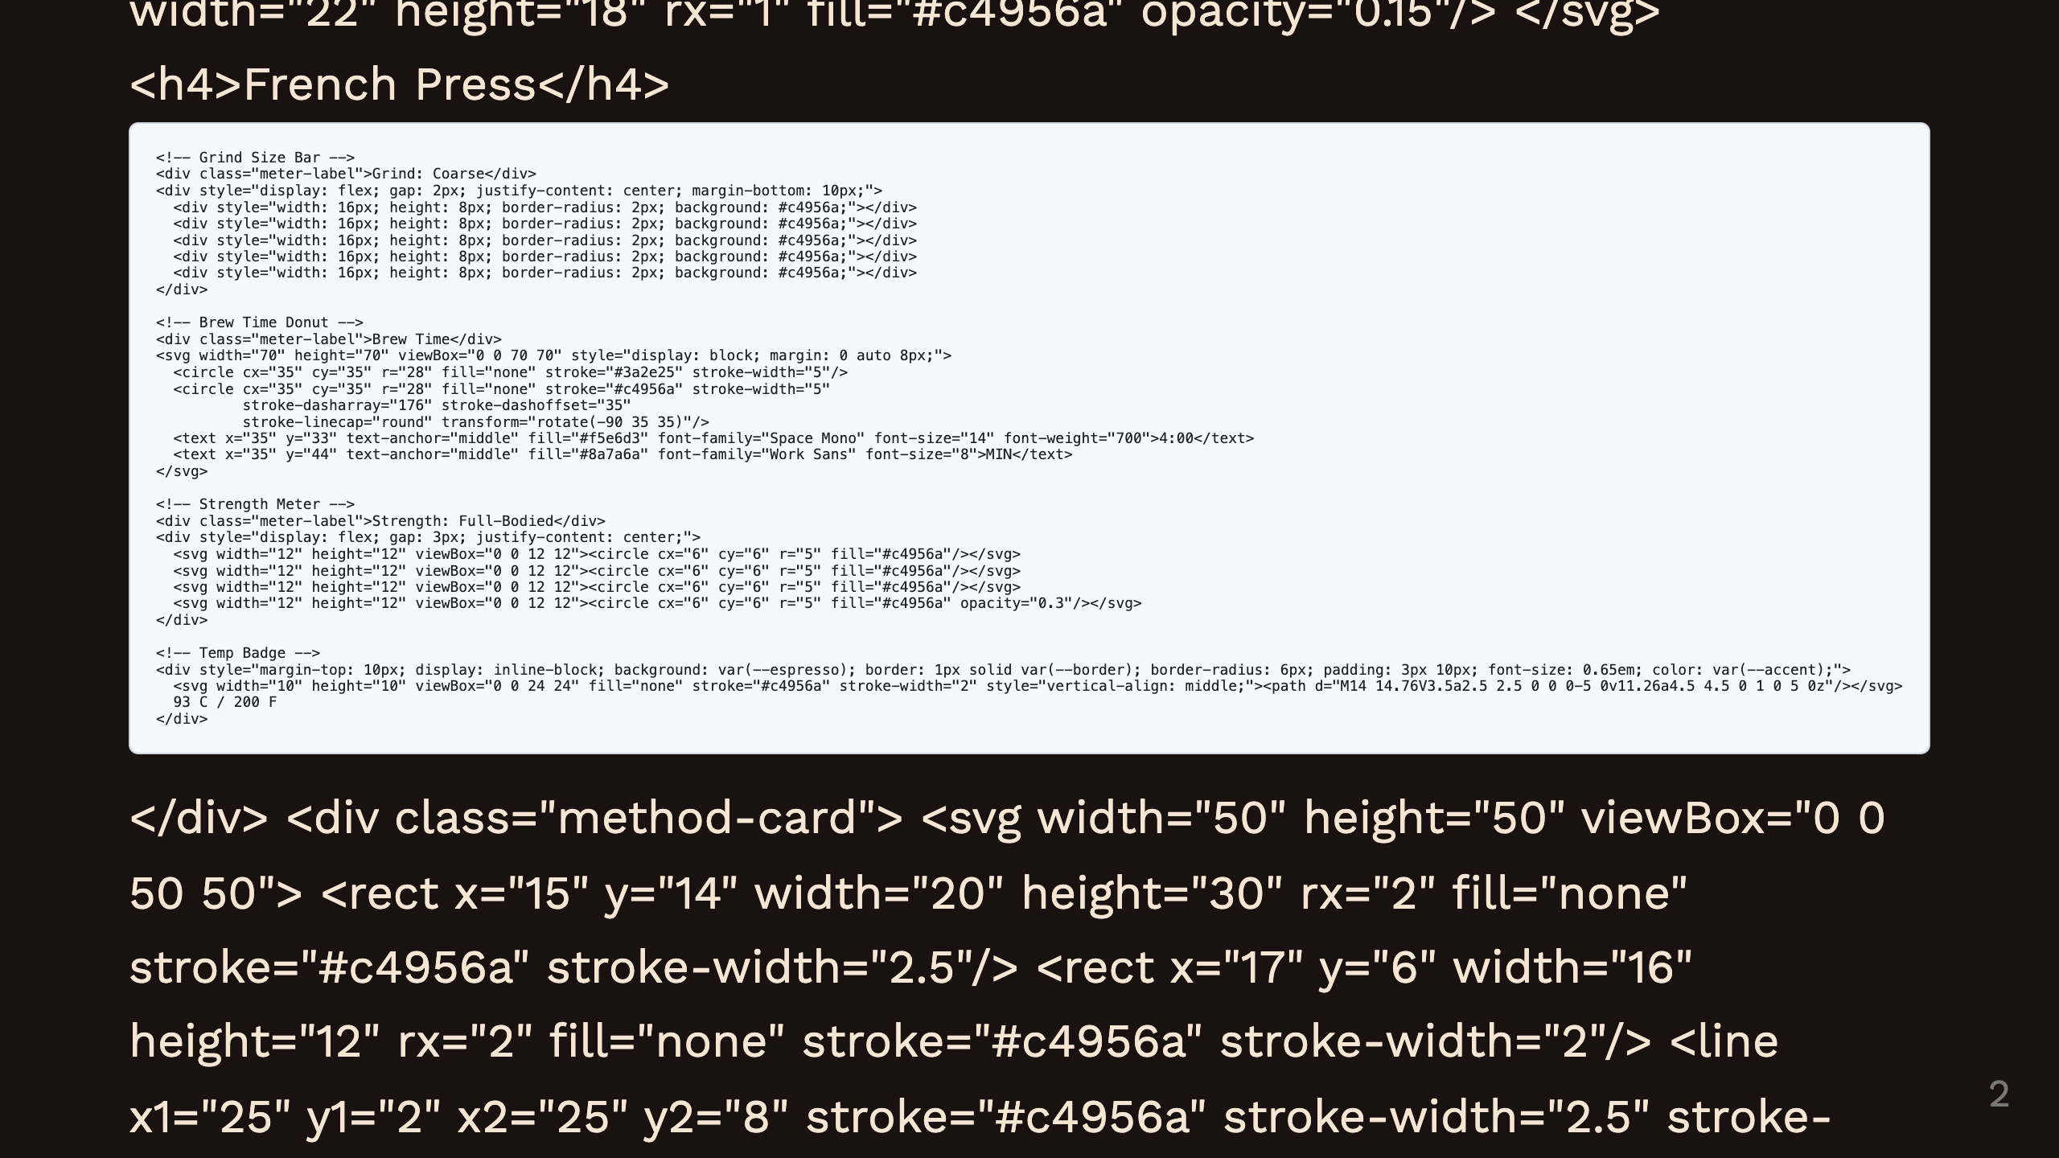
Notes:
Pour Over French Press AeroPress

Slide 3
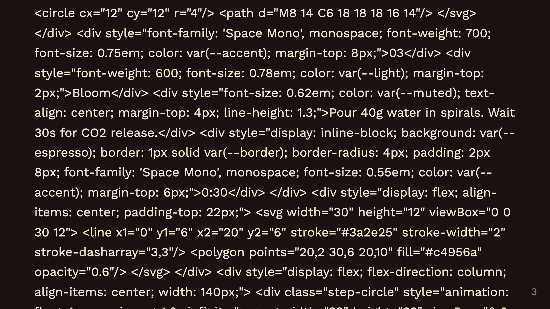
Notes:
Step 1 Connector Step 2 Connector Step 3 Connector Step 4 Connector Step 5 Total time bar

