Slide 1
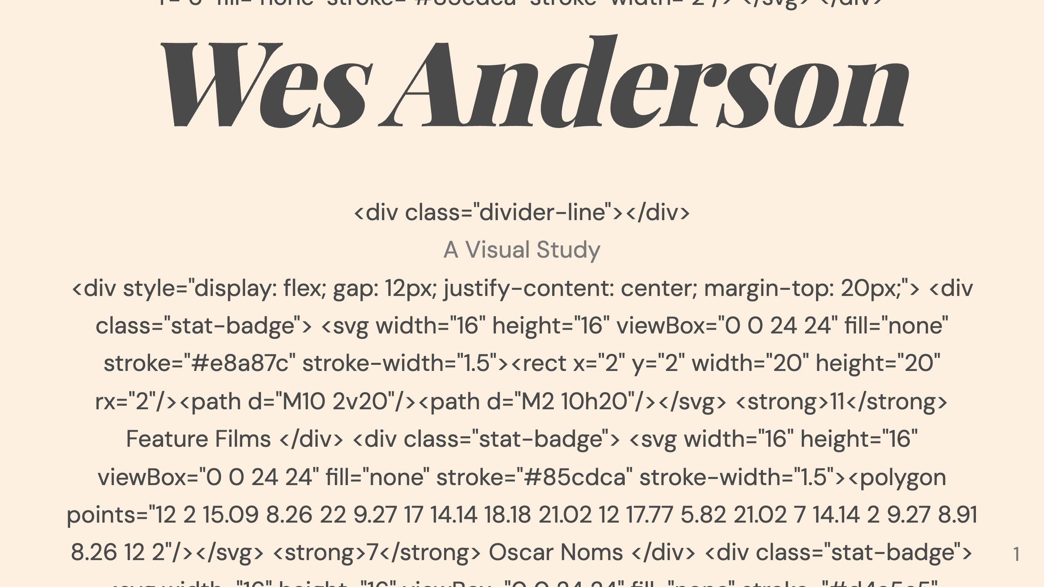

Slide 2
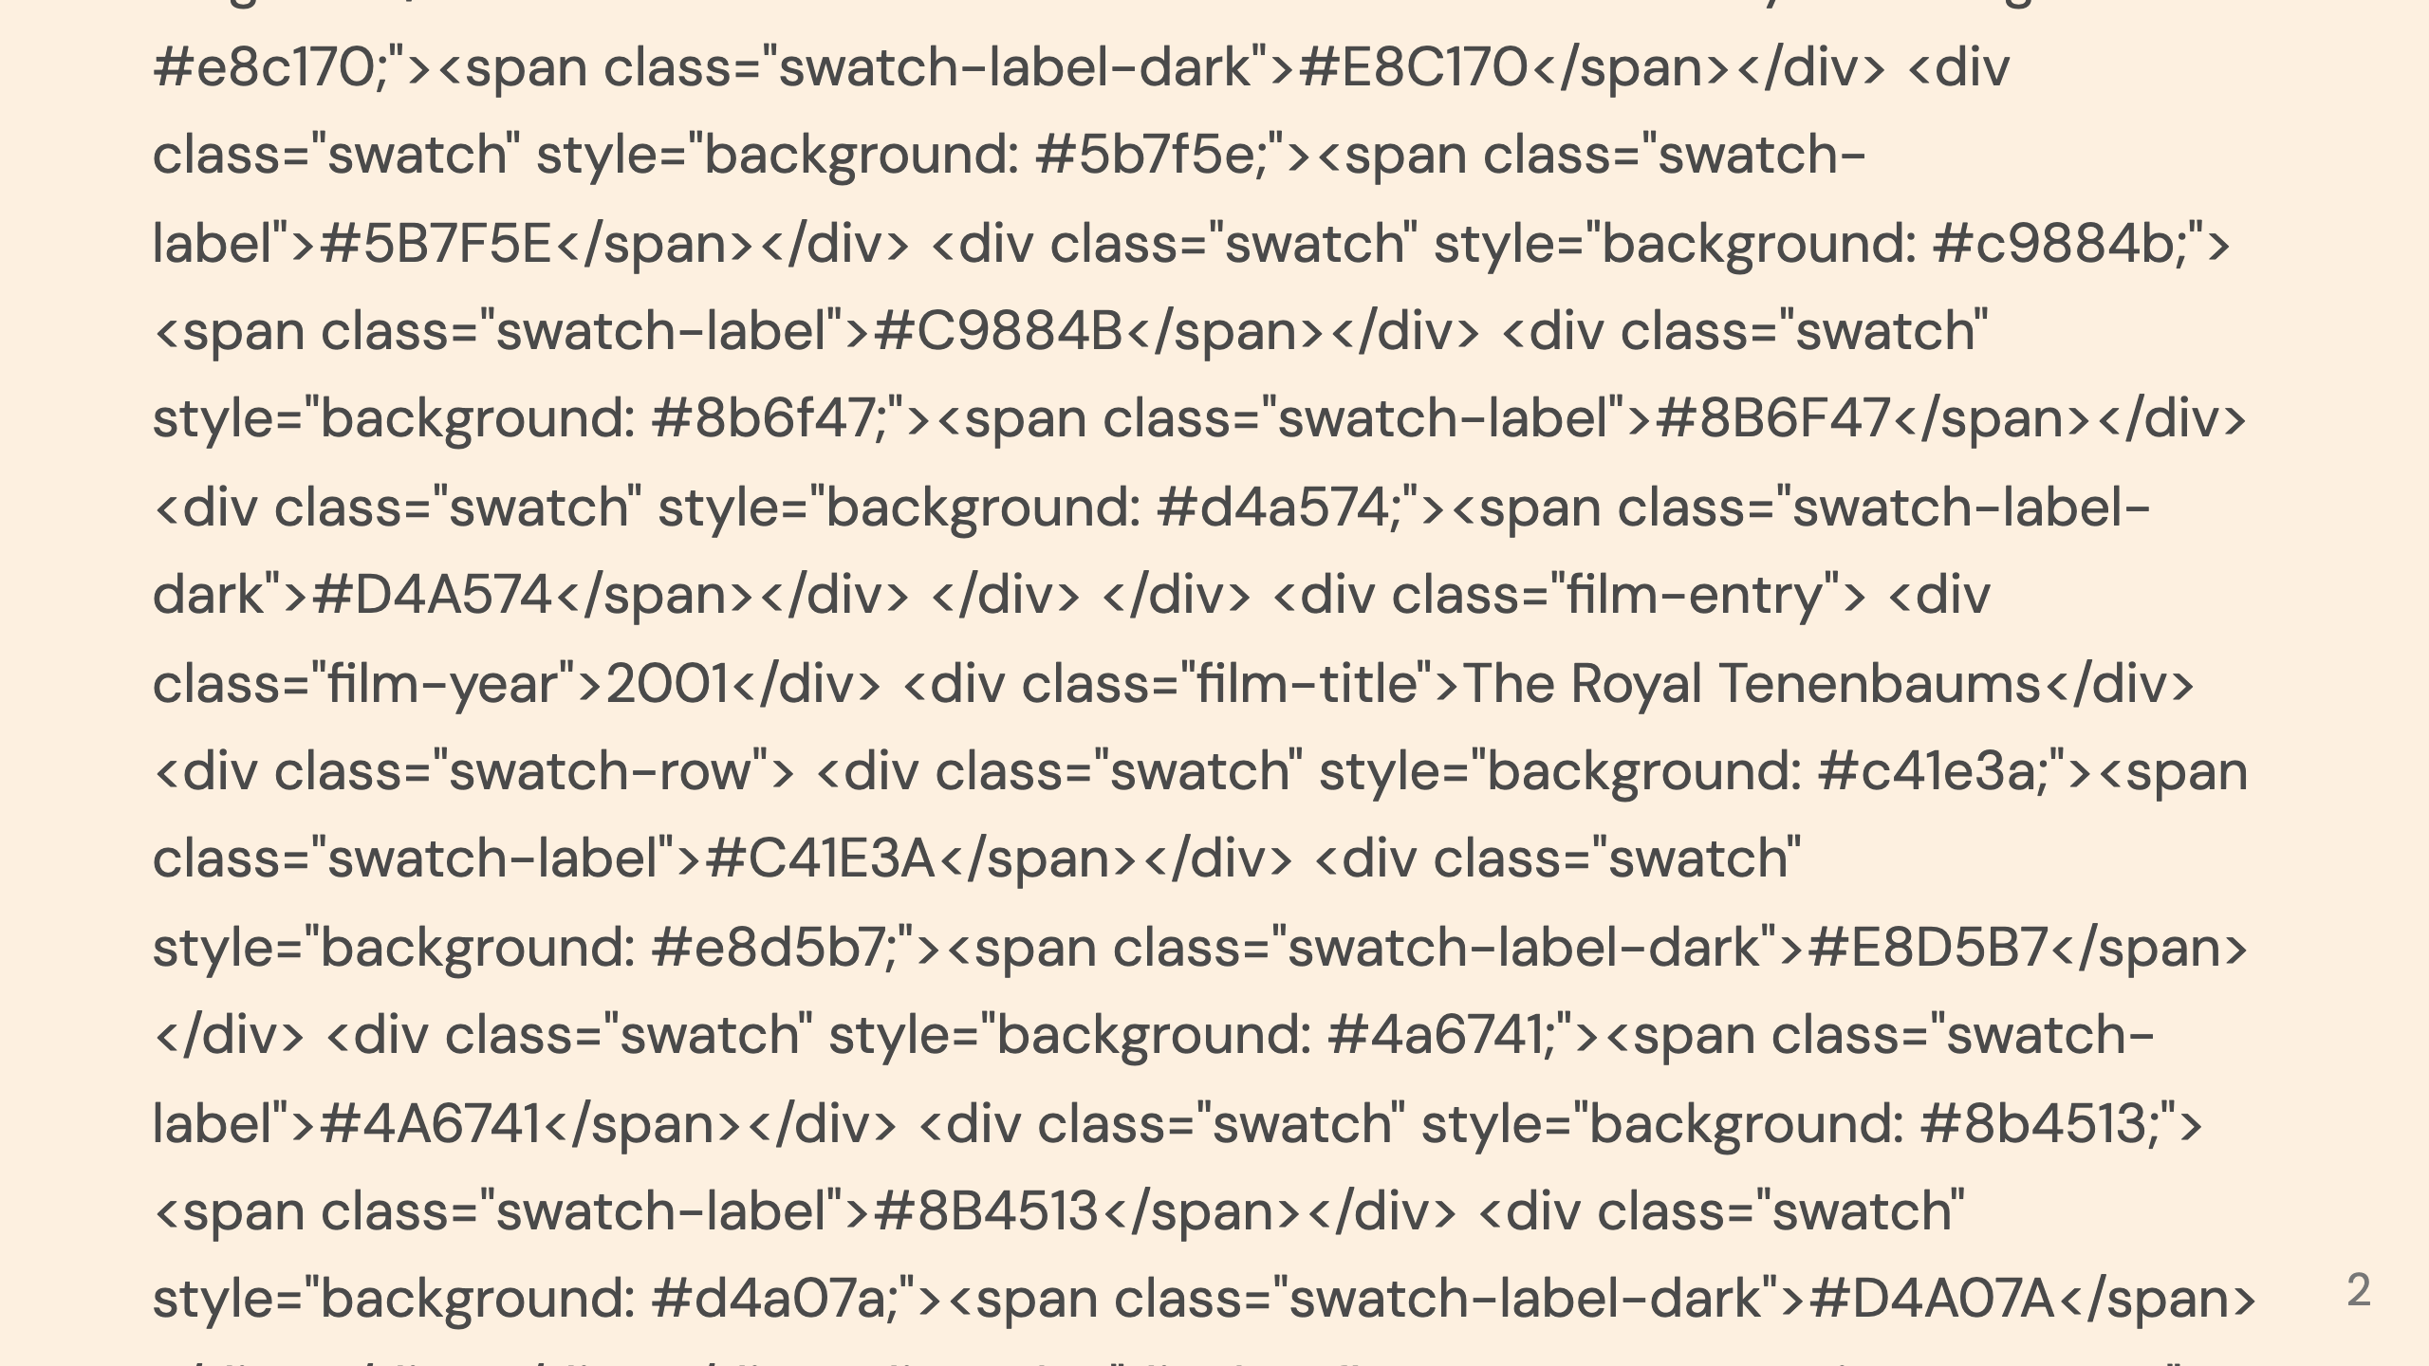
Notes:
Moonrise Kingdom The Royal Tenenbaums

Slide 3
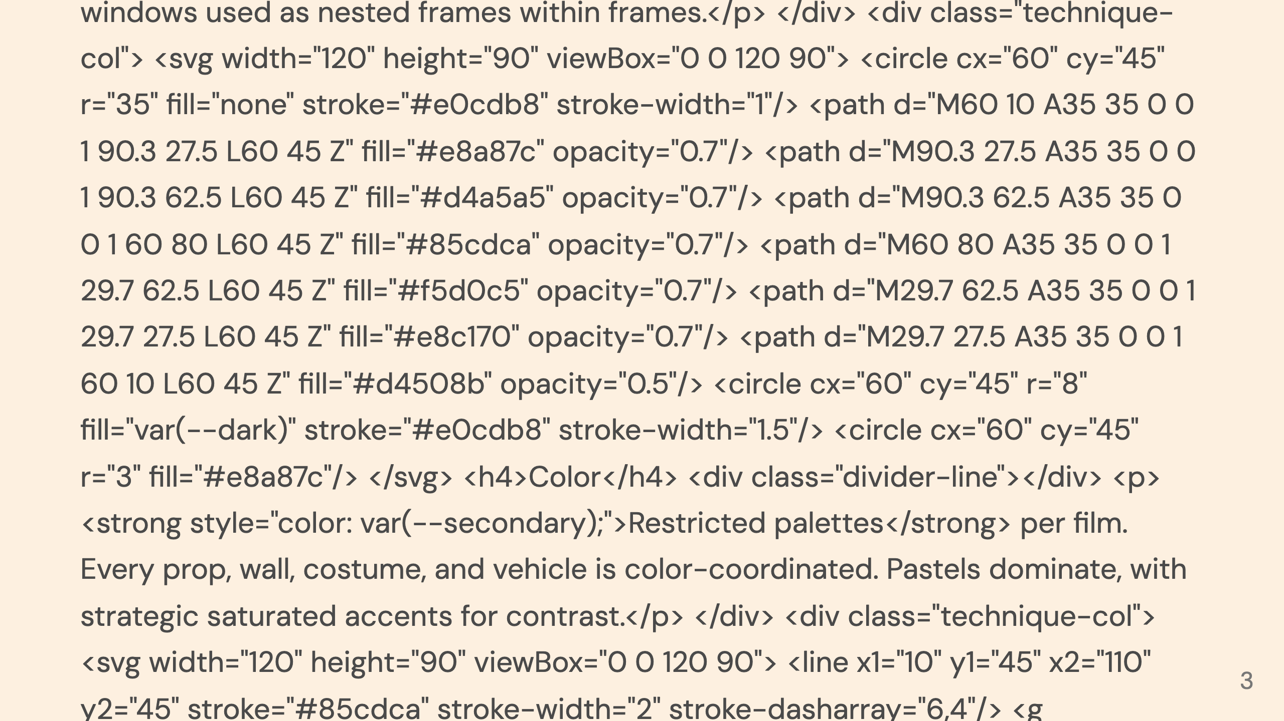
Notes:
Framing Column Color Column Movement Column

