Slide 1
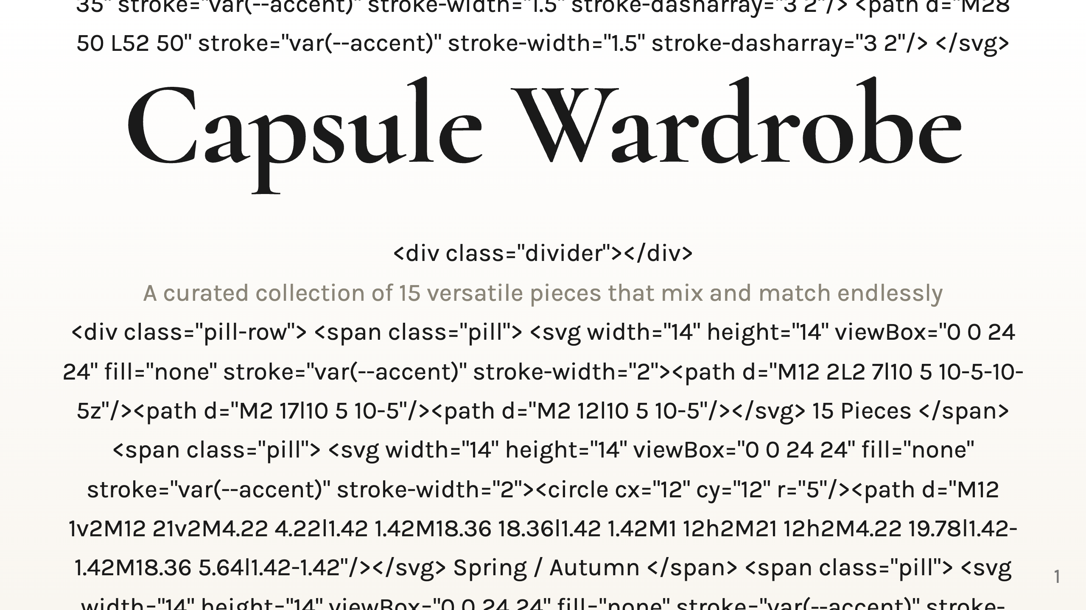

Slide 2
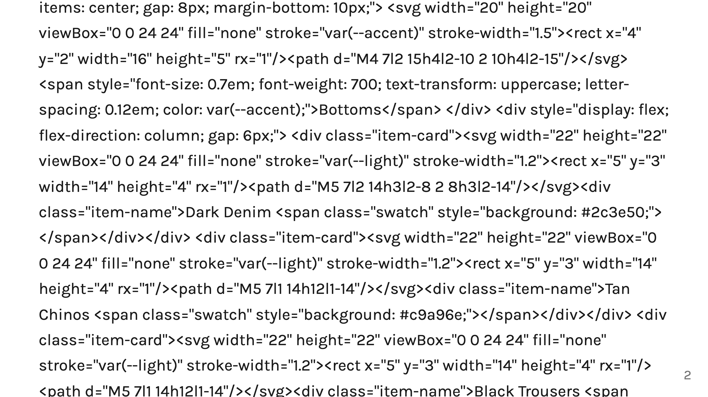
Notes:
TOPS BOTTOMS LAYERS + SHOES

Slide 3
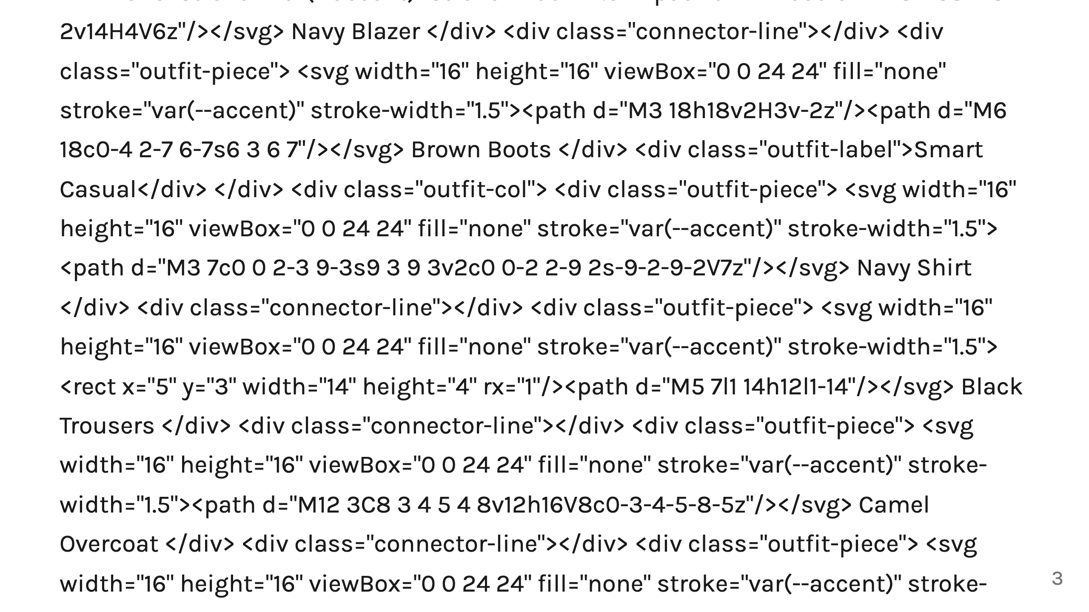
Notes:
Outfit 1 Outfit 2 Outfit 3 Outfit 4

