Slide 1
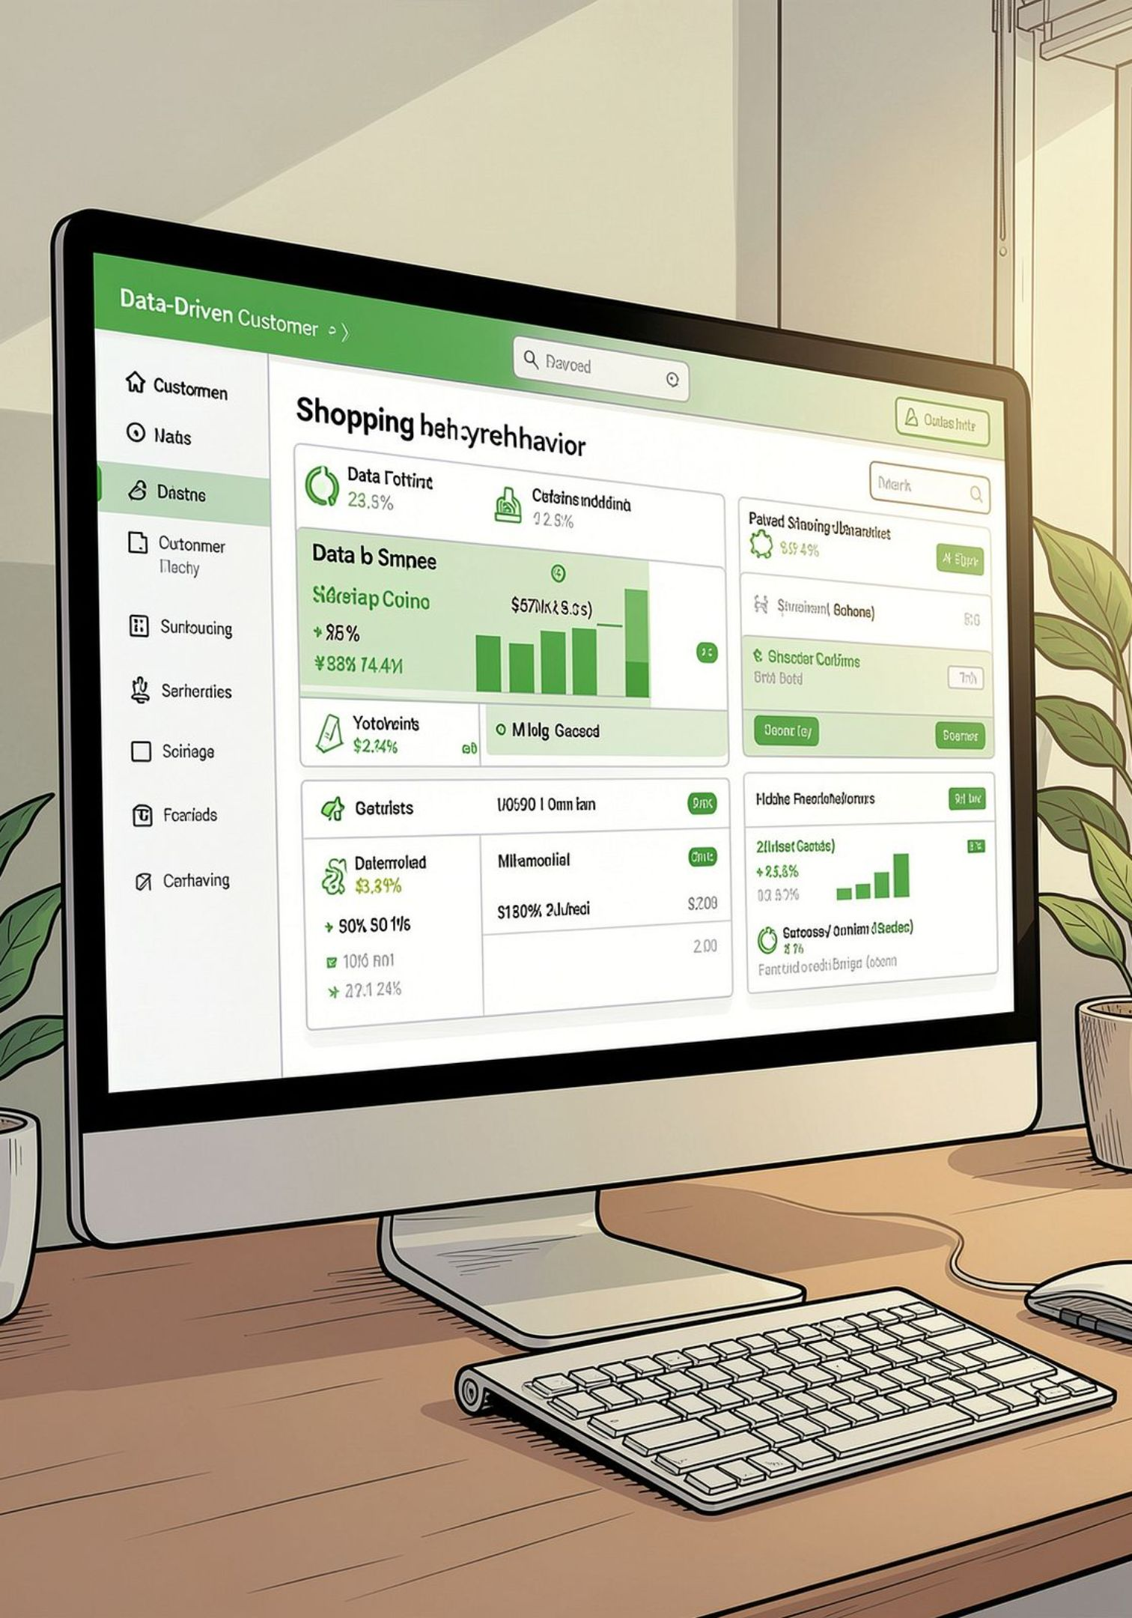
Customer Shopping Behavior Analysis
Analysis of 3,900 transactions to reveal spending patterns, segments, product preferences, and subscription behavior to guide strategy.

Slide 2
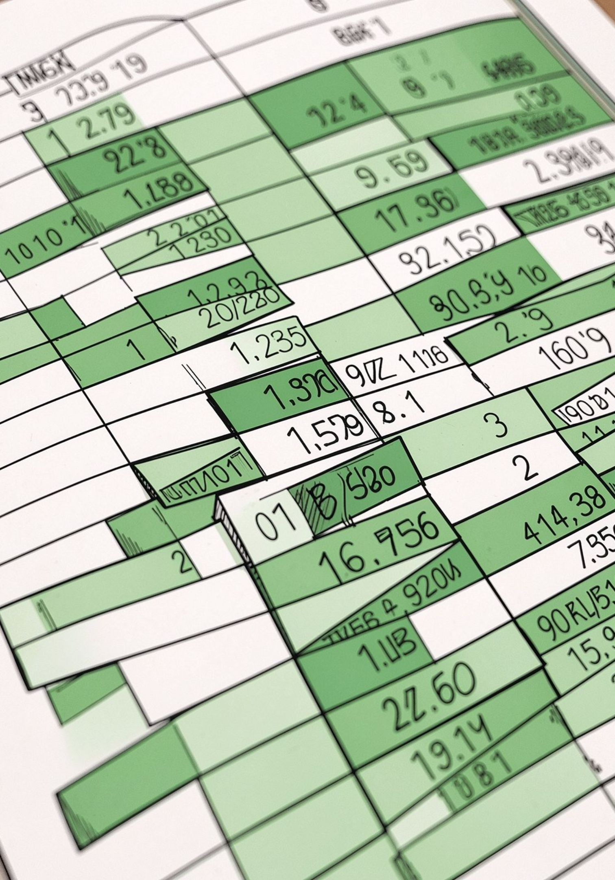
Dataset at a Glance
Scope
Key Features
Data Quality
3,900 rows × 18 columns covering demographics, purchases, and behavior.
Age, Gender, Location, Item, Category, Purchase Amount, Season, Rating, Subscription, Shipping, Discounts.
Missing: 37 values in Review Rating; handled during cleaning.

Slide 3

Data Preparation (Python)
Loaded with pandas; used df.info() and .describe() for structure and summary. Renamed columns to snake_case for consistency. Imputed missing review ratings using category median.
Created age_group bins
Derived purchase_frequency_days
Dropped promo_code_used (redundant with discount_applied)

Slide 4

Database Integration
Cleaned DataFrame loaded into PostgreSQL for SQL analysis and aggregation. Enabled business queries for revenue, segments, discounts, and product ranks.

Slide 5
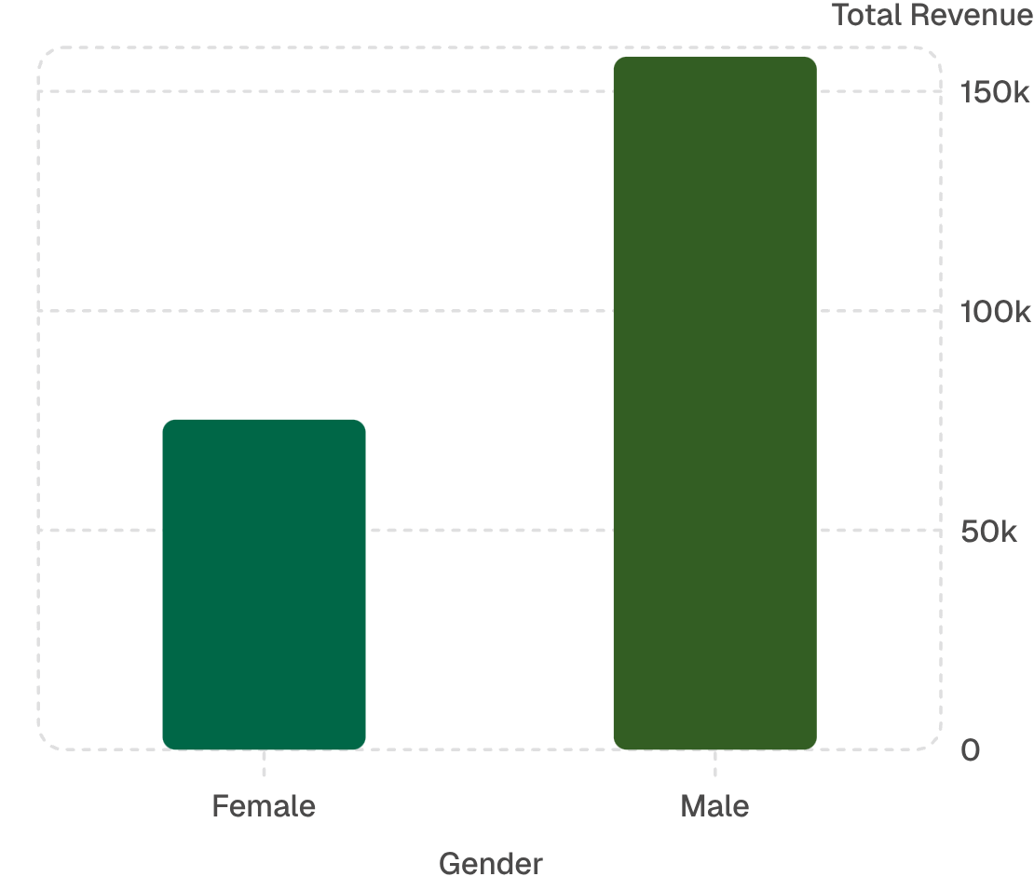

Revenue & Demographics
Male customers generated higher total revenue in the dataset. Use this insight alongside age-group analysis for targeted campaigns.

Slide 6

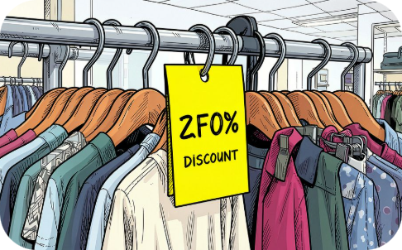
Top Products & Discounts
Top Rated Items
Discount-Dependent Products
Gloves, Sandals, Boots, Hat, Skirt (average ratings 3.86–3.78)
Hat 50.00%, Sneakers 49.66%, Coat 49.07%, Sweater 48.17%, Pants 47.37 — high discount rates noted.

Slide 7
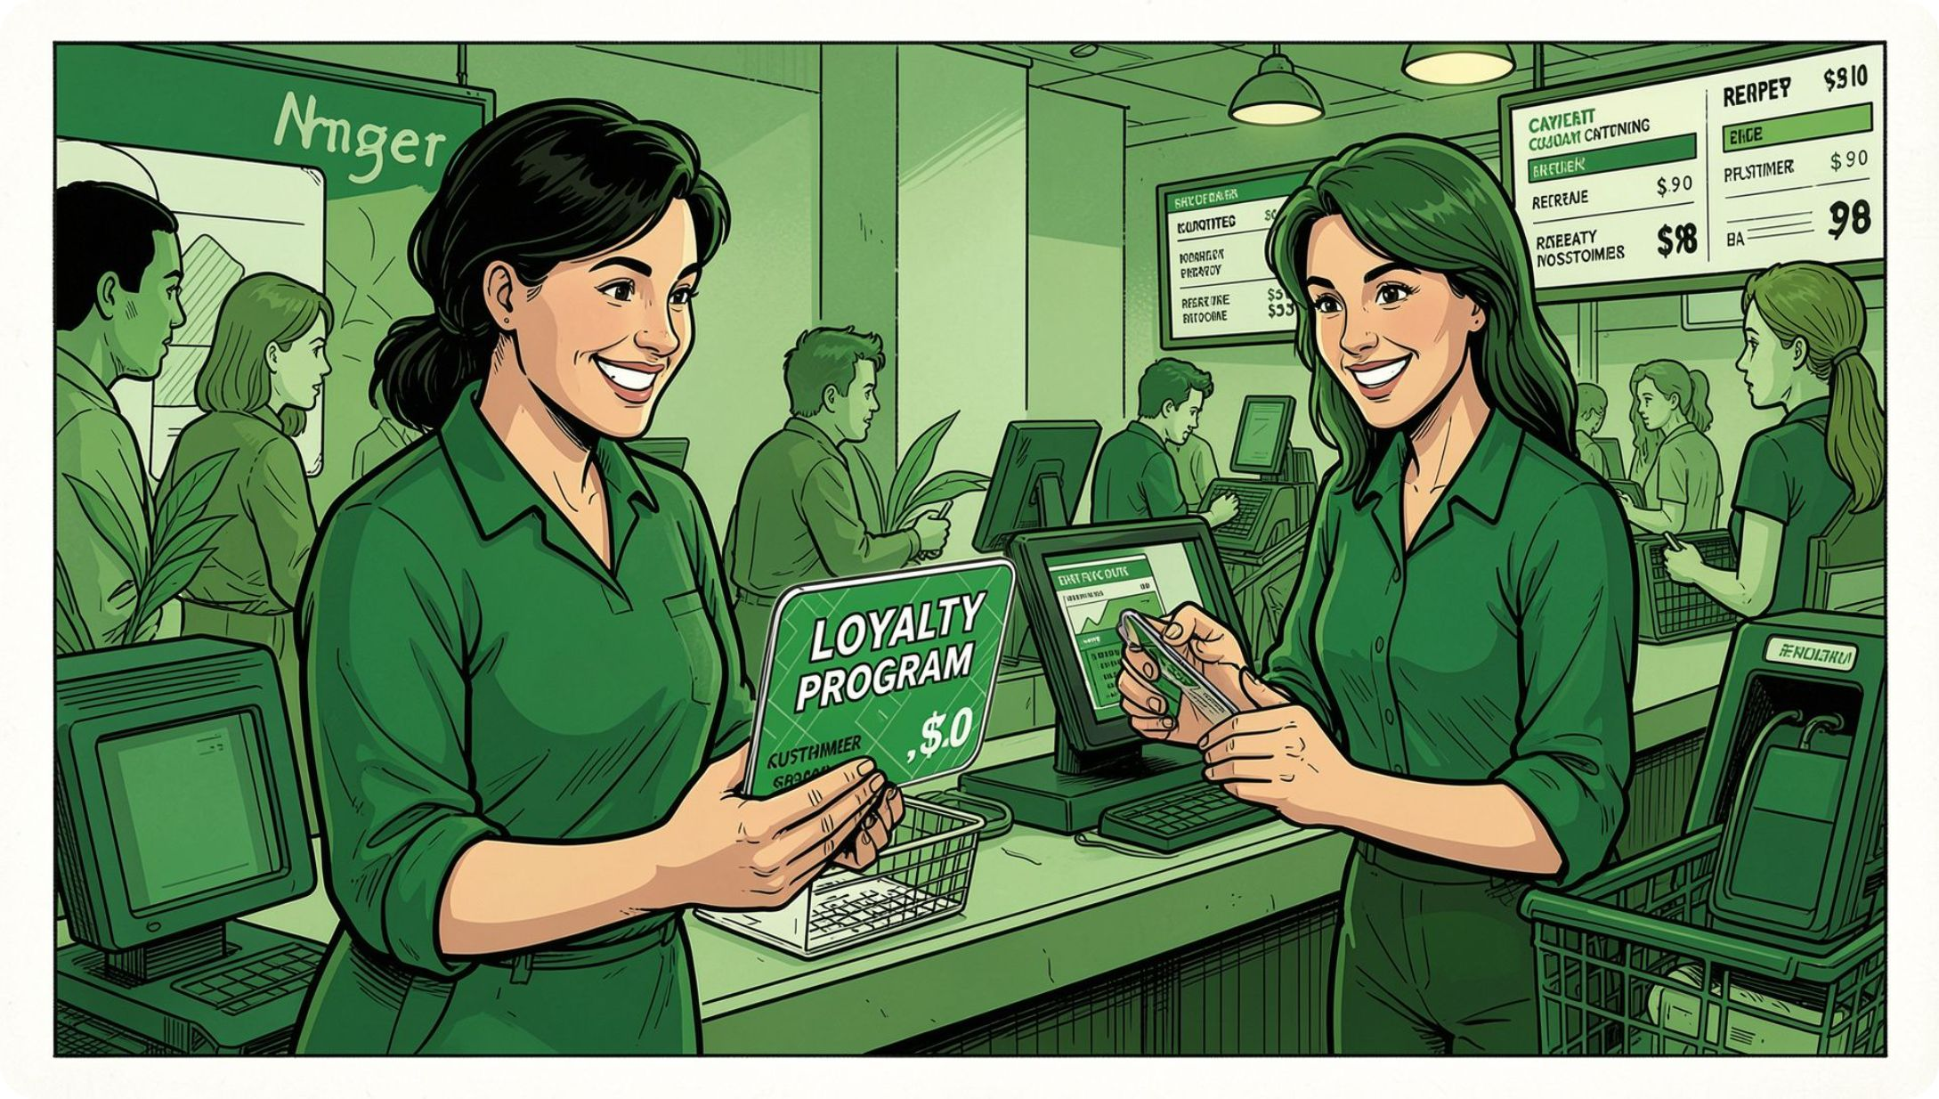
Customer Segments & Loyalty
Segment classification based on purchase history:
Loyal
3,116 customers
Returning
701 customers
New
83 customers
Repeat buyers (>5 purchases): more likely to be non-subscribers overall, but loyalty programs can convert returning buyers into Loyal segment.

Slide 8
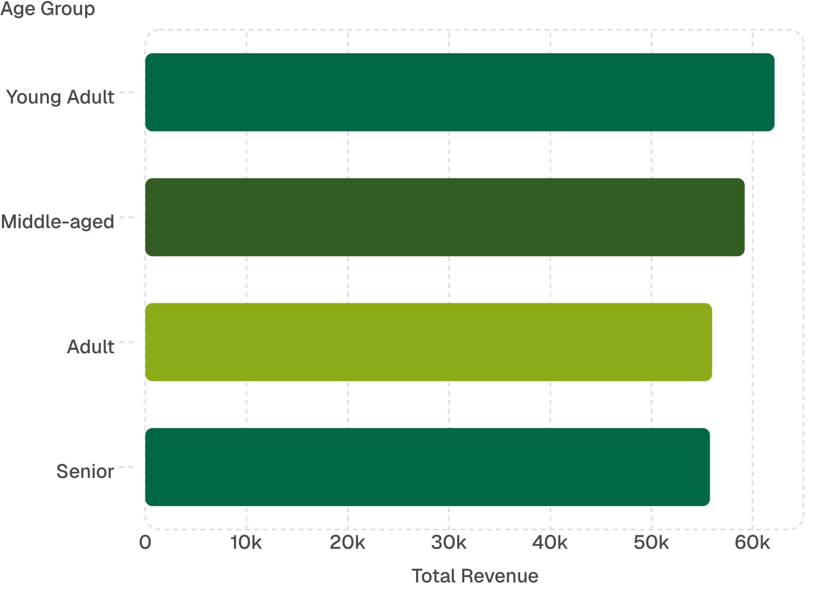
Age Group Revenue & Sales
Young Adults contribute the most revenue; prioritize targeted marketing and product positioning for this group. Also consider Express-shipping preferences for higher spend.

Slide 9
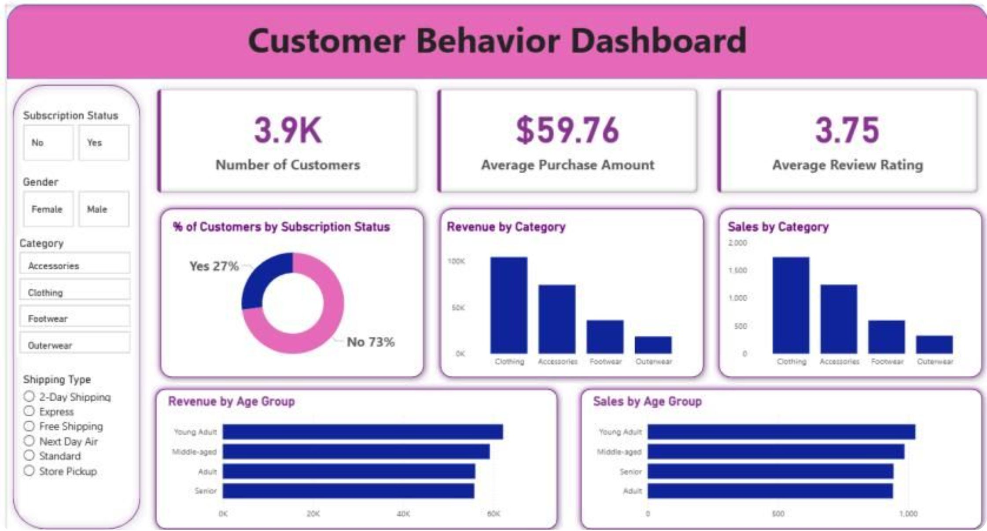
Key Dashboard Metrics (Power BI)
3.9K
$59.76
3.75
Customers
Avg Purchase
Avg Rating
Visuals include subscription donut (27% yes), revenue & sales by category, and age-group breakouts used for interactive exploration.

Slide 10

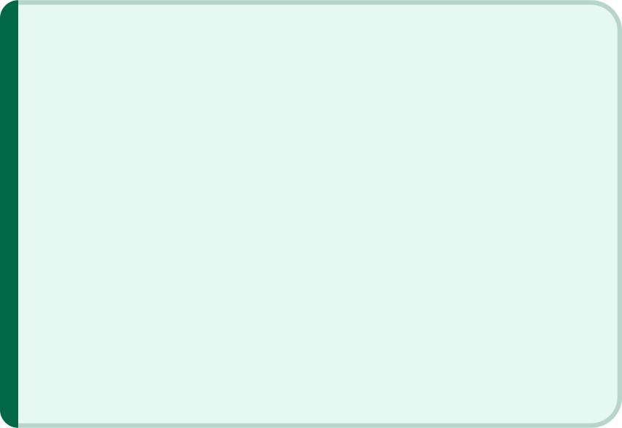

Business Recommendations
Boost Subscriptions
Loyalty Programs
Review Discount Policy
Product Positioning
Promote exclusive subscriber benefits to increase recurring revenue.
Reward repeat buyers to grow the Loyal segment and lifetime value.
Feature top-rated and best-selling items prominently in campaigns.
Balance promotional lift with margin control; monitor high discount products.
Targeted Marketing
Focus on high-revenue age groups and express-shipping users for tailored offers.
Next steps: A/B test subscription offers, refine discount thresholds, and update Power BI dashboards with live SQL views.

