Slide 1
Uncertainty analysis of a global energy system transition
17th November 2021
Energy modelling, sensitivity analysis and machine learning
Dr Alexander J. M. Kell
Sustainable Gas Institute
Imperial College London

Slide 2
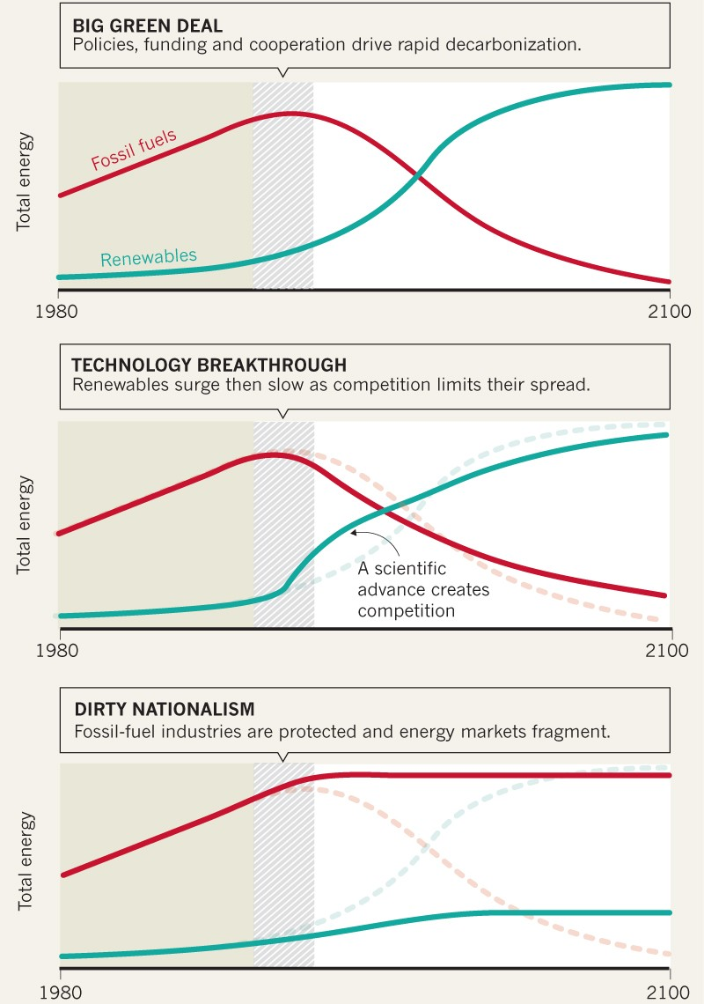
Energy modelling
Uncertainty analysis of a global energy system transition
17th November 2021
Desire to understand different pathways to reach net-zero by 2050
Different scenarios possible
Policy makers are increasingly relying on quantitative models
Quantitative models allow us to understand:
Which actions should be taken
Which technologies should be invested in
Possible energy scenarios.
Bazilian, Morgan, et al. "Model and manage the changing geopolitics of energy." (2019): 29-31.

Slide 3
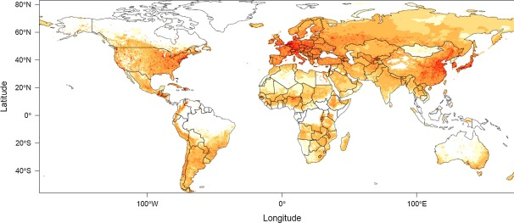
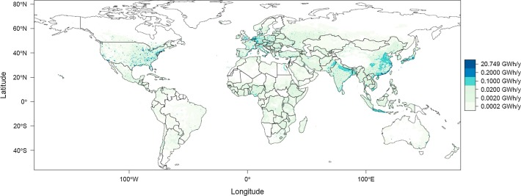
Spatially and temporally resolved models
Uncertainty analysis of a global energy system transition
17th November 2021
Increasing amount of data required for a comprehensive model
Spatially resolved:
GDP data
Supply data
Energy demand
Temporally resolved:
Electricity demand
Weather data
Changing climate
Requires high throughput computing
Global heating demand b) Global cooling demand.
Sachs, Julia, et al. "Clustered spatially and temporally resolved global heat and cooling energy demand in the residential sector." Applied Energy 250 (2019): 48-62.

Slide 4
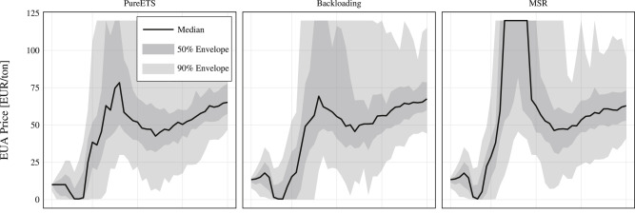
Sensitivity analysis
Uncertainty analysis of a global energy system transition
17th November 2021
Requirement of multiple runs to explore uncertainties
Monte-carlo runs to inform policy
Different input parameter distributions can have large impact on outputs
Exponentially increasing number of runs:
Number of scenarios
Different parameters
Sensitivity analyses
Requires multi-core analysis
Modelling EU emission allowances (EUA) prices in different scenarios.
Richstein, Jörn C., Émile JL Chappin, and Laurens J. de Vries. "The market (in-) stability reserve for EU carbon emission trading: Why it might fail and how to improve it." Utilities Policy 35 (2015): 1-18.

Slide 5
Machine learning and optimisation
Uncertainty analysis of a global energy system transition
17th November 2021
Impossible to manually explore entire search space
Requirement to find optimal parameters: global and local optimisations using genetic algorithms
Modelling bidding strategies using reinforcement learning
Forecasting input data:
Weather
GDP
Electricity demand
High throughput and multiple cores required
Finding the optimal carbon tax to reduce average electricity price
Kell, Alexander JM, A. Stephen McGough, and Matthew Forshaw. "Optimizing carbon tax for decentralized electricity markets using an agent-based model." Proceedings of the Eleventh ACM International Conference on Future Energy Systems. 2020.

Slide 6
Conclusion
Uncertainty analysis of a global energy system transition
17th November 2021
Requirement to understand possible pathways to a net-zero energy system
High amounts of data inform these models
Multiple scenario and uncertainty analyses required
Machine learning to find optimal parameters and behaviours
Use of supercomputers to expedite this process
Possible energy scenarios.
Bazilian, Morgan, et al. "Model and manage the changing geopolitics of energy." (2019): 29-31.

