Slide 1
Traffic Speed Prediction Using LSTM

Slide 2
Project Overview
- Objective: Predict traffic speed at various nodes using LSTM
- Background: Importance of traffic prediction for smart cities
- Data: Node ID, Speed, Timestamp

Slide 3
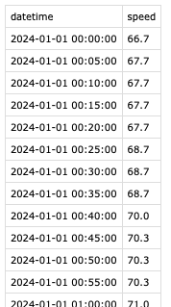
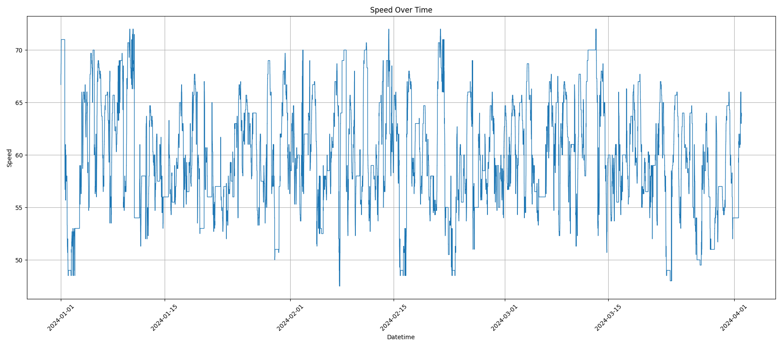
Data Preprocessing
- Load and inspect data
- Handle missing values and convert data types
- Save processed data by Node ID

Slide 4
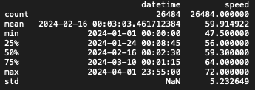
Exploratory Data Analysis (EDA)
- Statistical summary of data
- Time series visualization
- Speed distribution analysis by Node ID

Slide 5



LSTM Model Building and Training
- Overview of LSTM model architecture
- Split data into training and testing sets
- Train the model and save the trained model

Slide 6

Model Evaluation and Prediction
- Compare predicted data with actual data
- Visualize prediction results
- Save results for future analysis
Working…
Something is wrong

Slide 7
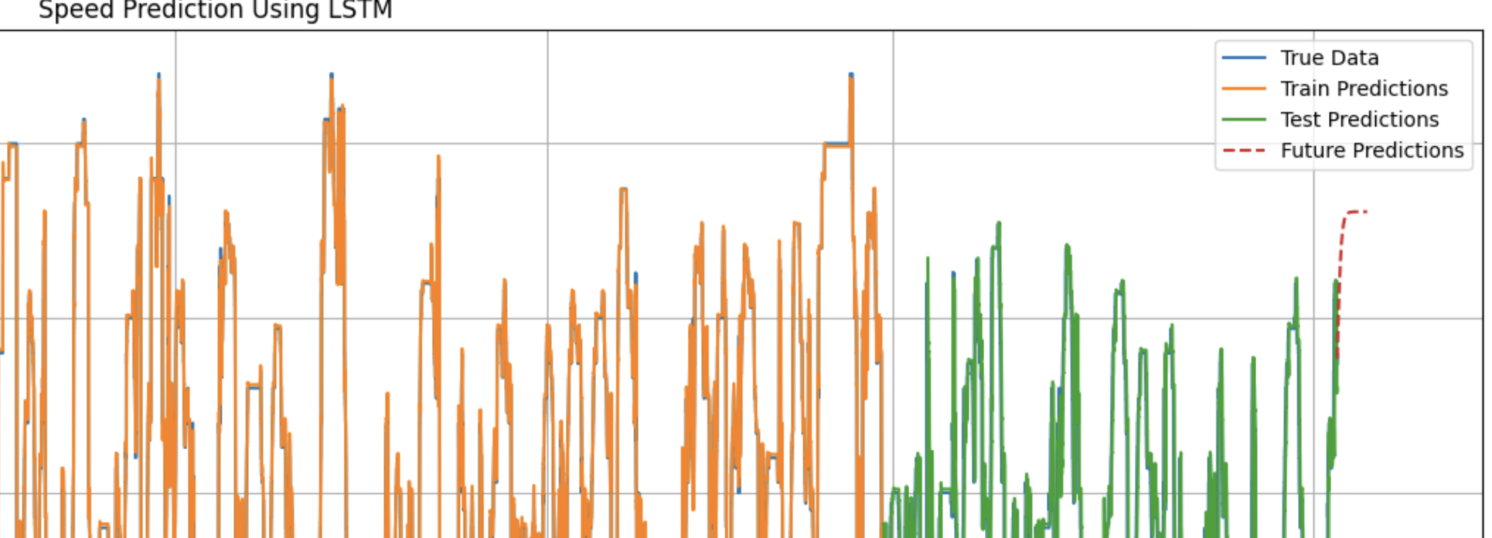
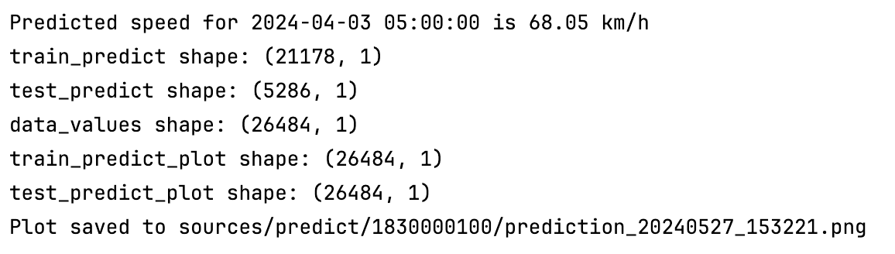
Prediction - Future

Slide 8
Conclusion and Future Work
- Summary of project and key findings
- Interpretation of results
- Future improvements and additional tasks

