Slide 1


L5:
Deep Learning &
Artificial Intelligence
Digital Health
UCSD Extension – Specialization Certificate
Data Science for Healthcare
Hobson Lane, UC San Diego
Instructor

Slide 2
Agenda
Shallow Learning Review
Deep Learning
  What it is
  Why?
  How?
Example Application
  Heart sounds
  Cancer detection
  Genomics

Slide 3
Review: Diabetes Prediction

Slide 4
Linear Regression
y = intercept_ + coef_[0]*x[0] + coef_[1]*x[1] + …

Slide 5
Data Flow
y = intercept_ + coef_[0]*x[0] + coef_[1]*x[1] + …
x[3]
x[2]
x₃ (BMI)
x[1]
x₂ (sex)
x[0]
x₁ (age)

Slide 6
Model Multiplication
y = intercept_ + coef_[0]*x[0] + coef_[1]*x[1] + …
x[3]
x[2]
x₃ (BMI)
x[1]
x₂ (sex)
x[0]
x₁ (age)
-.2* age
-20* sex
+6* bmi
+1* bp

Slide 7
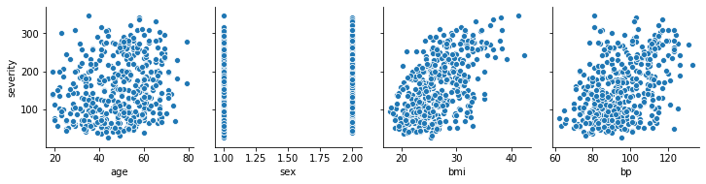
Nudges
y = intercept_ + coef_[0]*x[0] + coef_[1]*x[1] + …
x[3]
x[2]
x₃ (BMI)
x[1]
x₂ (sex)
x[0]
x₁ (age)
-.2* age
-20* sex
+6* bmi
+1* bp

Slide 8
Combine the Nudges
y = intercept_ + coef_[0]*x[0] + coef_[1]*x[1] + …
x[3]
x[2]
x₃ (BMI)
x[1]
x₂ (sex)
x[0]
x₁ (age)
-.2* age
-20* sex
+6* bmi
+1* bp
150*1.0+
+
y (severity)

Slide 9
Shallow Learning
age sex BMI
x₁ x₂ x₃
LDL HDL BP
x₄ x₅ x₆
TCH GLU ...
x₇ x₈ ...
-20*x₂
+6*x₃
-.2*x₁
+
y (severity)

Slide 10
Shallow Learning
age sex BMI
x₁ x₂ x₃
LDL HDL BP
x₄ x₅ x₆
TCH GLU ...
x₇ x₈ ...
-20*x₂
+6*x₃
-.2*x₁
+
y (severity)

Slide 11
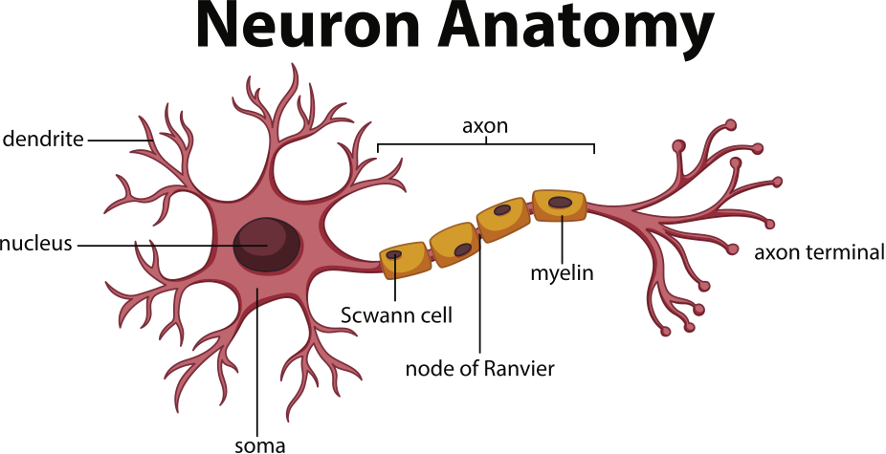
Perceptron = Neuron Simulation

Slide 12
Perceptron = Neuron Simulation

Slide 13
Shallow Learning
age sex BMI
x₁ x₂ x₃
LDL HDL BP
x₄ x₅ x₆
TCH GLU ...
x₇ x₈ ...
-20*x₂
+6*x₃
-.2*x₁
+
y (severity)

Slide 14
Deep Learning
age sex BMI
x₁ x₂ x₃
LDL HDL BP
x₄ x₅ x₆
TCH GLU ...
x₇ x₈ ...
?
?
?
?
?
?
?
?
?
?
+
heart
+
+
body
pancreas?
+
y (severity)

Slide 15
Deep Learning
age sex BMI
x₁ x₂ x₃
LDL HDL BP
x₄ x₅ x₆
TCH GLU ...
x₇ x₈ ...
?
?
?
?
?
?
?
?
?
?
+
heart
+
+
body
pancreas?
+
y (severity)

Slide 16
Deep Learning from Biology
x[0]
x[1]
x[2]
x[3]
x[4]
x[5]
x[6]
y_body
y_heart
y_pancreas

Slide 17
Deep Learning from Biology
x[0]
x[1]
x[2]
x[3]
x[4]
x[5]
x[6]
y_body
y (severity)
y_heart
y_pancreas

Slide 18
Diabetes Severity Multivariate Regression
Combine 3 regressions together?
Better representation of the world (biology)?
Height
Weight
gender
body type
LDL
HDL
BP
vascular
health
diabetes
severity
TCH
GLU
?
thyroid+
pancreas
health

Slide 19
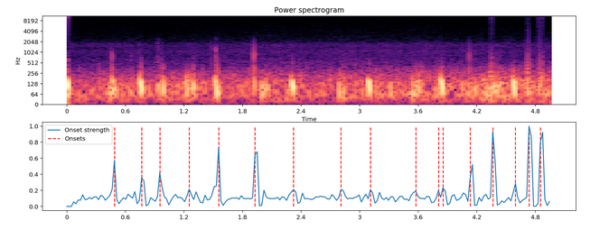
Stethoscope Heartbeat Detection
72% accuracy for deep learning model
LSTM

Slide 20
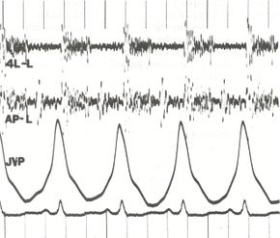
Man vs Machine
Internists: bit.ly/ucsd-stethescope
  Baseline: 40% accuracy: 5 heart murmurs
  Stethescope training app: 80% accuracy
Machines: bit.ly/ucsd-steth-ai
  Normal vs abnormal phonocardiograms
  97% F1 Score (94.8% recall, 99.7% precision)
bit.ly/wiki-phonocardiogram

Slide 21
NLP Application: Summarization
Clinical Medical Records
  Doctor review
  Adjudication
  Insurance Claims
  Retrospective Utilization Review

Slide 22
NLP Application: Search & QA
LiveStrong.com
MayoClinic.com
WebMD.com

Slide 23
What is Deep Learning?
What is AI?
How do they apply to healthcare?

Slide 24
Assignments

Slide 25
Quiz
Why is understanding Baye’s Rule so important?

Slide 26
Homework:
Start your Hyperparameter Log
Create an empty spreadsheet, python list, or paper table with headings: num input dimensions, layer 1 neurons, layer 2 neurons, layer 3 neurons, training set accuracy, test set accuracy (see next slide)
Train two neural networks to predict MNIST hand-written digits and record your hyperparameters (numbers of neurons) and performance (accuracies)
TIP: Start with 0 neurons for layer 2 and layer 3

Slide 27
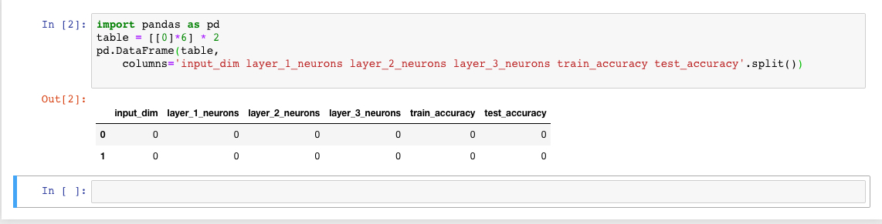
Example Python

