Slide 1


L6: Natural Language Processing
Digital Health
UCSD Extension – Specialization Certificate
Data Science for Healthcare
Hobson Lane, UC San Diego
Instructor

Slide 2
What is
Natural Language Processing?
How can it be used in healthcare?

Slide 3
Agenda
{ 'each': 1
'word': 2
"'s": 3
'meaning': 4 }
Natural language
  Analyze text
  Represent text as numbers
  Meaningful representations
  Word vectors
Applications
  Semantic search
  Summarization
Conversational AI
  Therapy
  First Aid
"each word's meaning"
"COVID-19 is an infectious disease caused ..."
"What is Coronavirus?"

Slide 4
“Natural Language Processing”
Means different things to different people
Psychology
  Human (animal) language understanding
Linguistics
  Natural language structure
Math
  Formal grammars for processing text
Engineering
  Computer algorithms to understand (NLU) and generate (NLG) text

Slide 5
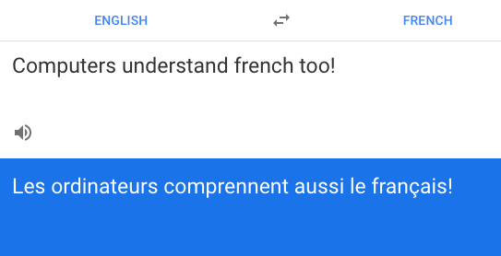
Translation

Slide 6
Text Pieces (Grams)
"Each word's meaning is unique."
Characters:
Tokens:
Word:
['E', 'a', 'c', 'h', ' ', 'w', 'o', ...
['Each', 'word', "'s", 'meaning', ...
['Each', "word's", 'meaning', ...

Slide 7
Character-level N-Grams
"Each word's meaning is unique."
1-grams (unigrams):
2-grams (bigrams):
3-grams (trigrams):
['E', 'a', 'c', 'h', ' ', 'w', 'o', 'r', ...
['Ea', 'ac', 'ch', 'h ', ' w', 'wo', 'or', ...
['Eac', 'ach', 'ch ', 'h w', ' wo', 'wor', ...

Slide 8
Character-level N-Grams
"Each word's meaning is unique."
1-grams (unigrams):
2-grams (bigrams):
3-grams (trigrams):
['E', 'a', 'c', 'h', ' ', 'w', 'o', 'r', ...
['Ea', 'ac', 'ch', 'h ', ' w', 'wo', 'or', ...
['Eac', 'ach', 'ch ', 'h w', ' wo', 'wor', ...

Slide 9
Character-level N-Grams
"Each word's meaning is unique."
1-grams (unigrams):
2-grams (bigrams):
3-grams (trigrams):
['E', 'a', 'c', 'h', ' ', 'w', 'o', 'r', ...
['Ea', 'ac', 'ch', 'h ', ' w', 'wo', 'or', ...
['Eac', 'ach', 'ch ', 'h w', ' wo', 'wor', ...

Slide 10
Character-level N-Grams
"Each word's meaning is unique."
1-grams (unigrams):
2-grams (bigrams):
3-grams (trigrams):
['E', 'a', 'c', 'h', ' ', 'w', 'o', 'r', ...
['Ea', 'ac', 'ch', 'h ', ' w', 'wo', 'or', ...
['Eac', 'ach', 'ch ', 'h w', ' wo', 'wor', ...

Slide 11
Character-level N-Grams
"Each word's meaning is unique."
1-grams (unigrams):
2-grams (bigrams):
3-grams (trigrams):
['E', 'a', 'c', 'h', ' ', 'w', 'o', 'r', ...
['Ea', 'ac', 'ch', 'h ', ' w', 'wo', 'or', ...
['Eac', 'ach', 'ch ', 'h w', ' wo', 'wor', ...

Slide 12
Character-level N-Grams
"Each word's meaning is unique."
1-grams (unigrams):
2-grams (bigrams):
3-grams (trigrams):
['E', 'a', 'c', 'h', ' ', 'w', 'o', 'r', ...
['Ea', 'ac', 'ch', 'h ', ' w', 'wo', 'or', ...
['Eac', 'ach', 'ch ', 'h w', ' wo', 'wor', ...

Slide 13
Character-level N-Grams
"Each word's meaning is unique."
1-grams (unigrams):
2-grams (bigrams):
3-grams (trigrams):
['E', 'a', 'c', 'h', ' ', 'w', 'o', 'r', ...
['Ea', 'ac', 'ch', 'h ', ' w', 'wo', 'or', ...
['Eac', 'ach', 'ch ', 'h w', ' wo', 'wor', ...

Slide 14
Character-level N-Grams
"Each word's meaning is unique."
1-grams (unigrams):
2-grams (bigrams):
3-grams (trigrams):
['E', 'a', 'c', 'h', ' ', 'w', 'o', 'r', ...
['Ea', 'ac', 'ch', 'h ', ' w', 'wo', 'or', ...
['Eac', 'ach', 'ch ', 'h w', ' wo', 'wor', ...

Slide 15
Character-level N-Grams
"Each word's meaning is unique."
1-grams (unigrams):
2-grams (bigrams):
3-grams (trigrams):
['E', 'a', 'c', 'h', ' ', 'w', 'o', 'r', ...
['Ea', 'ac', 'ch', 'h ', ' w', 'wo', 'or', ...
['Eac', 'ach', 'ch ', 'h w', ' wo', 'wor', ...

Slide 16
Character-level N-Grams
"Each word's meaning is unique."
1-grams (unigrams):
2-grams (bigrams):
3-grams (trigrams):
['E', 'a', 'c', 'h', ' ', 'w', 'o', 'r', ...
['Ea', 'ac', 'ch', 'h ', ' w', 'wo', 'or', ...
['Eac', 'ach', 'ch ', 'h w', ' wo', 'wor', ...

Slide 17
Word-level N-Grams
"Each word's meaning is unique."
1-grams (unigrams):
2-grams (bigrams):
3-grams (trigrams):
'Each', "word's", 'meaning', 'is', 'unique.'
('Each', "word's"), ("word's", 'meaning'), ...
('Each', "word's", 'meaning'), ("word's", 'meaning', 'is'

Slide 18
Word-level N-Grams
"Each word's meaning is unique."
1-grams (unigrams):
2-grams (bigrams):
3-grams (trigrams):
'Each', 'word', "'s", 'meaning', 'is', 'unique', '.'
('Each', 'word'), ('word', "'s"), ("'s", 'meaning'), ...
('Each', 'word', "'s"), ('word', "'s", 'meaning'), ...

Slide 19
Python Tokenization
"Each word's meaning is unique."
character-level tokens:

Slide 20
Google Amazon Facebook
know your type
essentially no data privacy

Slide 21
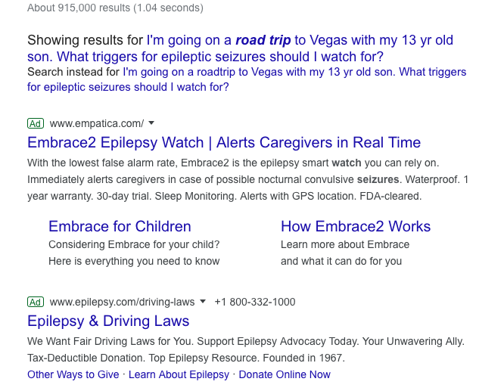
Google answers to your epilepsy needs:

Slide 22
Assistants
knows you
You can teach it
You can trust it

Slide 23
COVID-19 Examples
YOU: What are the symptoms of COVID-19?
qary: hypertension, diabetes and cardiovascular disease
Wikipedia: “Many of those who die of COVID-19 have preexisting conditions, including hypertension, diabetes and cardiovascular disease.”
YOU: What are the symptoms of coronavirus?
qary: respiratory infections
YOU: What is the mortality rate for COVID-19?
qary: 5,833
Notes:
These sorts of questions are better answered with a knowledgebase (knowledge graph inference), rather than a generative bot

Slide 24
COVID-19 Examples
YOU: I am a pregnant mother. Is it possible to transmit coronavirus to my baby?
qary: among close contacts via respiratory droplets generated by sneezing and coughing
YOU: What are the symptoms of coronavirus?
qary: respiratory infections
YOU: How many people have died of COVID-19?
qary: 1.4%

Slide 25
Graphs and Information Extraction
Generate the words for an embedding

Slide 26
Natural Language

Slide 27
Natural Language Documents
“It was a dark and stormy night ...”
“Parlez vous francais?”
“I have a dream ...”

Slide 28
Processing
“Who invented the
perceptron?”
Text
"Google stinks!"
Analysis
[+4.2, +1.1]
[-2.3, +4.2]
[-2.3, +4.2, +1.1]
[+1.1, -2.3, +4.2]
[+9.1, -1.3, +4.5]
[+1.2, -2.4, +4.5]
[-9.0, -0.4, +0.5]
Understanding
Extracting
Generating
Information
“Frank Rosenblatt”

Slide 29
Turn words into numbers

Slide 30
Bag-of-words vector

Slide 31
TF-IDF vector

Slide 32
Language models

Slide 33
Regular expressions

Slide 34
Information extraction
pattern matching
  tokens
  POS
  semantics

Slide 35
NL Generation
Regular expressions/grammars
Markov chains

Slide 36
Predictive text
Autocomplete
Auto reply
Tab completion
TabNine

Slide 37
Math with words

Slide 38
Math with documents

Slide 39
Analogy problems

Slide 40
Reading comprehension problems

Slide 41
Search

Slide 42
Keyword search
Bit vectors
BOW
TF-IDF

Slide 43
Summarization
Natural language
  Turn words into numbers
  Better representations
Applications
  Semantic search
  Summarization
Conversational AI
  Therapy
  First Aid

Slide 44
Semantic search
Embedding vectors
High dimensional vectors
  PCA
  TSNE
LSH?

Slide 45
NL Similarity
Edit distance (Levenshtein)
Metropolis Hastings? Kolmogorov distance?
Word clouds

Slide 46
Application: Research

Slide 47
Application: Diagnosis

Slide 48
Application: Clinical review

Slide 49
Extractive summarization

Slide 50
Abstractive summarization
Encoder-Decoder

Slide 51
Abstractive summarization
Generate the words for an embedding

Slide 53
Numbers from words

Slide 54
Tokens

Slide 55
N-grams

Slide 56
N-grams

Slide 57
Diabetes Severity Multivariate Regression
Combine 3 regressions together?
Better representation of the world (biology)?
Height
Weight
gender
body type
LDL
HDL
BP
vascular
health
diabetes
severity
TCH
GLU
?
thyroid+
pancreas
health

Slide 58
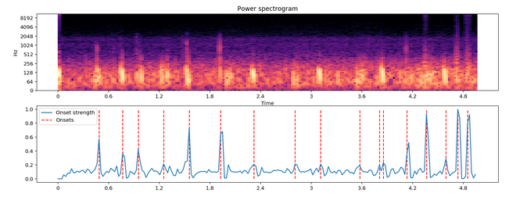
Stethoscope Heartbeat Detection
72% accuracy for deep learning model
LSTM

Slide 59
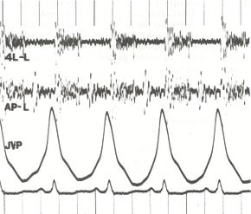
Man vs Machine
Internists: bit.ly/ucsd-stethescope
  Baseline: 40% accuracy: 5 heart murmurs
  Stethescope training app: 80% accuracy
Machines: bit.ly/ucsd-steth-ai
  Normal vs abnormal phonocardiograms
  97% F1 Score (94.8% recall, 99.7% precision)
bit.ly/wiki-phonocardiogram

Slide 60
NLP Application: Summarization
Clinical Medical Records
  Doctor review
  Adjudication
  Insurance Claims
  Retrospective Utilization Review

Slide 61
NLP Application: Search & QA
LiveStrong.com
MayoClinic.com
WebMD.com

Slide 62
What is Deep Learning?
What is AI?
How do they apply to healthcare?

Slide 63
Assignments

Slide 64
Quiz
Why is understanding Baye’s Rule so important?

Slide 65
Homework:
Start your Hyperparameter Log
Create an empty spreadsheet, python list, or paper table with headings: num input dimensions, layer 1 neurons, layer 2 neurons, layer 3 neurons, training set accuracy, test set accuracy (see next slide)
Train two neural networks to predict MNIST hand-written digits and record your hyperparameters (numbers of neurons) and performance (accuracies)
TIP: Start with 0 neurons for layer 2 and layer 3

Slide 66
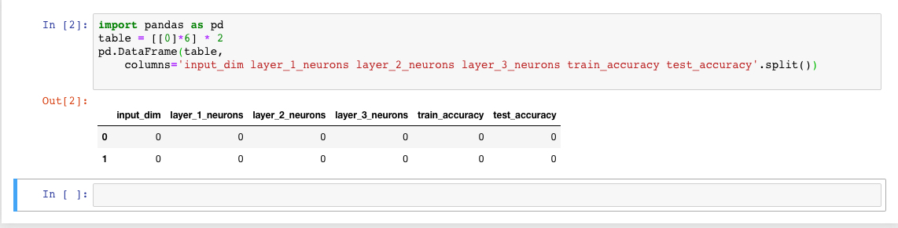
Example Python

Slide 67
Summarization
Natural language
  Turn words into numbers
  Better representations
Applications
  Semantic search
  Summarization
Conversational AI
  Therapy
  First Aid

Slide 68
Semantic search
Embedding vectors
High dimensional vectors
  PCA
  TSNE
LSH?

Slide 69
NL Similarity
Edit distance (Levenshtein)
Metropolis Hastings? Kolmogorov distance?
Word clouds

