Slide 1


Digital Health
UCSD Extension – Specialization Certificate
Data Science for Healthcare
L5: Deep Learning & Artificial Intelligence
Hobson Lane, UC San Diego
Instructor
Notes:
<number>

Slide 2
Agenda
Machine Learning Review
Deep Learning
Layered linear regression
Forward and backward propagation
Making it nonlinear
What it’s good for
Playground
Artificial Intelligence
Intelligence Augmentation

Slide 3
Linear Regression Review: Diabetes
$y=c_{0}+c_{1}⋅x_{1}+c_{2}⋅x_{2}+...$

Slide 4
LinearRegression().fit(X,y).coef_
y = intercept_ + coef_[0]*x[0] + coef_[1]*x[1] + …

Slide 5
Data Flow
y = intercept_ + coef_[0]*x[0] + coef_[1]*x[1] + …
x[3]
x[1]
x₂ (sex)
x[0]
x₁ (age)
x[2]
x₃ (BMI)

Slide 6
Multiplication
y = intercept_ + coef_[0]*x[0] + coef_[1]*x[1] + …
x[3]
x[1]
x₂ (sex)
x[0]
x₁ (age)
x[2]
x₃ (BMI)
-.2* age
-20* sex
+6* bmi
+1* bp

Slide 7
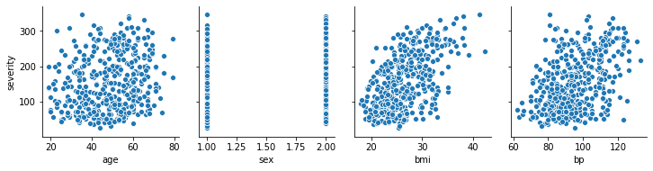
Coefficients as Slopes
y = intercept_ + coef_[0]*x[0] + coef_[1]*x[1] + …
x[3]
x[2]
x₃ (BMI)
x[1]
x₂ (sex)
x[0]
x₁ (age)
-.2* age
-20* sex
+6* bmi
+1* bp

Slide 8
Combine the Nudges
y = intercept_ + coef_[0]*x[0] + coef_[1]*x[1] + …
x[3]
x[2]
x₃ (BMI)
x[1]
x₂ (sex)
x[0]
x₁ (age)
-.2* age
-20* sex
+6* bmi
+1* bp
150*1.0+
+
y (severity)

Slide 9
Network Diagram
age sex BMI
x₁ x₂ x₃
LDL HDL BP
x₄ x₅ x₆
TCH GLU ...
x₇ x₈ ...
-20*x₂
+6*x₃
-.2*x₁
+
y (severity)

Slide 10
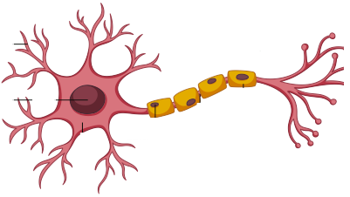
Neuron

Slide 11
Perceptron = Neuron Simulation
age sex BMI
x₁ x₂ x₃
LDL HDL BP
x₄ x₅ x₆
TCH GLU ...
x₇ x₈ ...
+6*x₃
-20*x₂
-.2*x₁
+
y (severity)

Slide 12
More neurons = smarter?
age sex BMI
x₁ x₂ x₃
LDL HDL BP
x₄ x₅ x₆
TCH GLU ...
x₇ x₈ ...

Slide 13
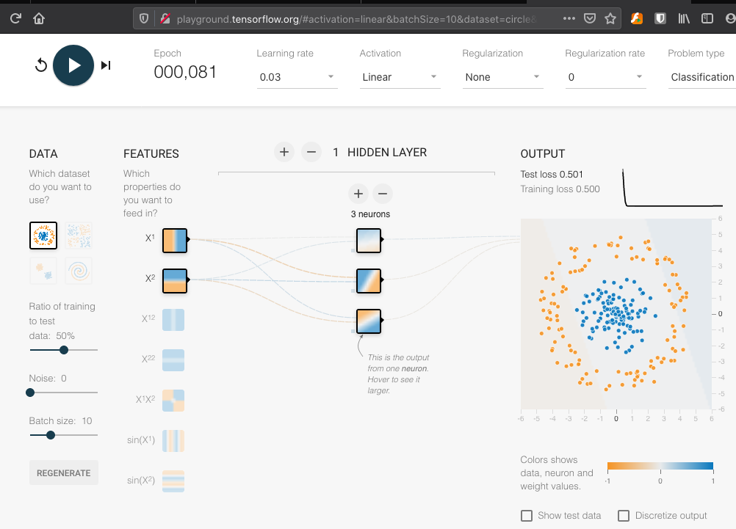
Try it!
bit.ly/ucsd-try-3-neurons

Slide 14
More layers = smarter?
Layer 1
3 neurons
Layer 2
1 neuron

Slide 15
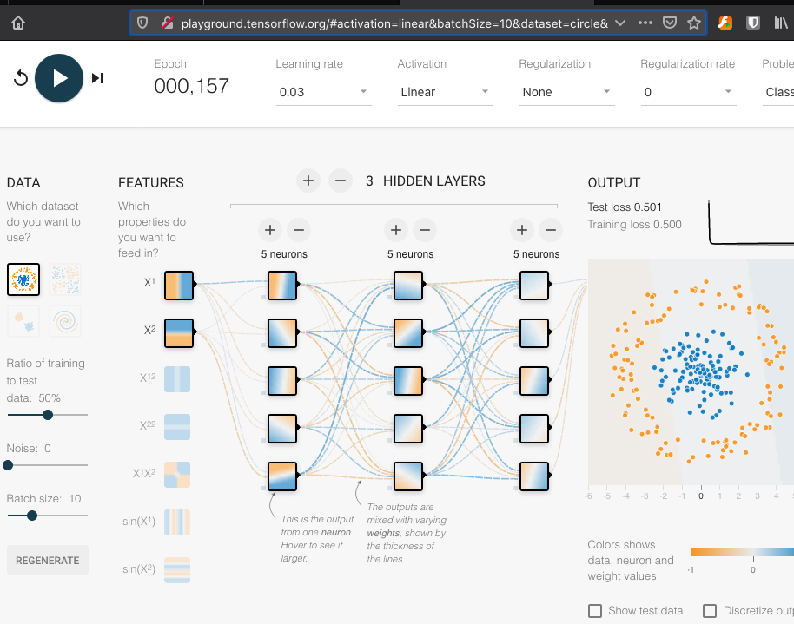
More Power?
bit.ly/ucsd-try-5-5-5-neurons

Slide 16
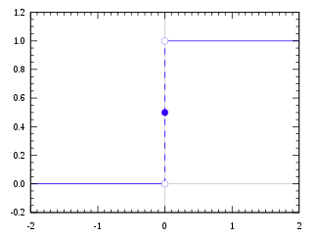
Activation Function
Threshold
(Heaviside)
1.0
z
0.0
x
0.0 (or 0.5)

Slide 17
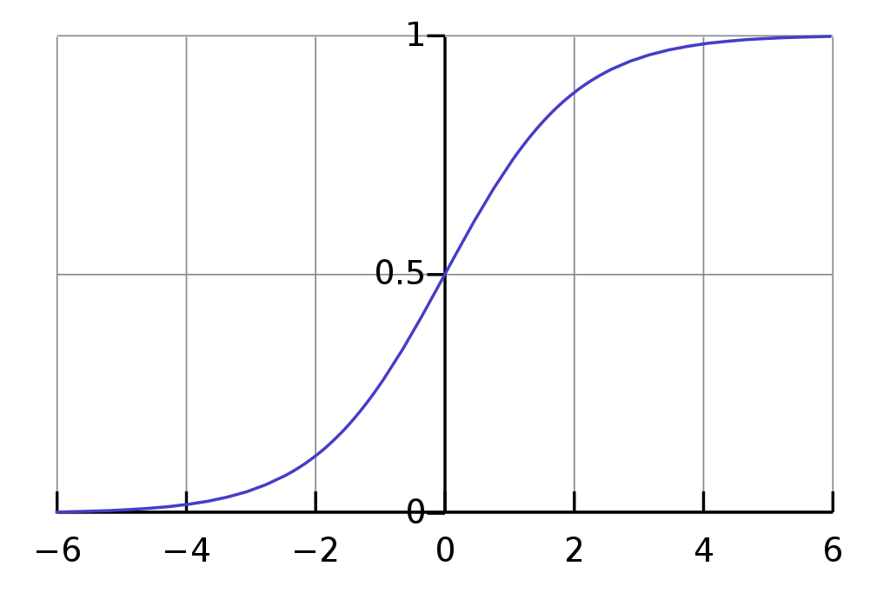
Activation Function
Sigmoid
1.0
z
0.0
x
0.0

Slide 18
Activation Function
ReLU
1.0
z
0.0
x
0.0

Slide 19
Grouping Features Together
age sex BMI
x₁ x₂ x₃
LDL HDL BP
x₄ x₅ x₆
TCH GLU ...
x₇ x₈ ...
?
?
?
?
?
?
?
?
?
?
heart
health
+
+
+
body
health
pancreas?
health
+
y (severity)

Slide 20
Dense (Fully Connect) Network
age sex BMI
x₁ x₂ x₃
LDL HDL BP
x₄ x₅ x₆
TCH GLU ...
x₇ x₈ ...
heart
health
+
+
+
body
health
pancreas?
health
+
y (severity)

Slide 21
Your Network is Dense
Fully Connected
(Dense)

Slide 22
Synapse Activation
Synapse Activation
Function
z
x

Slide 23
Dot Products in Python
age sex BMI
x₀ x₁ x₂
LDL HDL BP
x₃ x₄ x₅
TCH GLU ...
x₆ x₇ ...
z[0,0] = intercept_[0,0] + coef_[0,0,0]*x[0] + coef_[0,0,1]*x[1] + …
z[0,1] = intercept_[0,1] + coef_[0,1,0]*x[0] + coef_[0,1,1]*x[1] + …
z[0,2] = intercept_[0,2] + coef_[0,2,0]*x[0] + coef_[0,2,1]*x[1] + …
+
+
+
y = intercept_[1,0] + coef_[1,0,0]*z[0,0] + coef_[1,0,1]*z[0,1]
+ coef_[1,0,1]*z[0,2]
+
y

Slide 24
Input 1 (age)
age sex BMI
x₀ x₁ x₂
LDL HDL BP
x₃ x₄ x₅
TCH GLU ...
x₆ x₇ ...
z[0,0] = intercept_[0,0] + coef_[0,0,0]*x[0] + coef_[0,0,1]*x[1] + …
z[0,1] = intercept_[0,1] + coef_[0,1,0]*x[0] + coef_[0,1,1]*x[1] + …
z[0,2] = intercept_[0,2] + coef_[0,2,0]*x[0] + coef_[0,2,1]*x[1] + …
+
+
+
y = intercept_[1,0] + coef_[1,0,0]*z[0,0] + coef_[1,0,1]*z[0,1]
+ coef_[1,0,1]*z[0,2]
+
y

Slide 25
Input 2 (sex)
age sex BMI
x₀ x₁ x₂
LDL HDL BP
x₃ x₄ x₅
TCH GLU ...
x₆ x₇ ...
z[0,0] = intercept_[0,0] + coef_[0,0,0]*x[0] + coef_[0,0,1]*x[1] + …
z[0,1] = intercept_[0,1] + coef_[0,1,0]*x[0] + coef_[0,1,1]*x[1] + …
z[0,2] = intercept_[0,2] + coef_[0,2,0]*x[0] + coef_[0,2,1]*x[1] + …
+
+
+
y = intercept_[1,0] + coef_[1,0,0]*z[0,0] + coef_[1,0,1]*z[0,1]
+ coef_[1,0,1]*z[0,2]
+
y

Slide 26
Inputs 3-10
age sex BMI
x₀ x₁ x₂
LDL HDL BP
x₃ x₄ x₅
TCH GLU ...
x₆ x₇ ...
z[0,0] = intercept_[0,0] + coef_[0,0,0]*x[0] + coef_[0,0,1]*x[1] + …
z[0,1] = intercept_[0,1] + coef_[0,1,0]*x[0] + coef_[0,1,1]*x[1] + …
z[0,2] = intercept_[0,2] + coef_[0,2,0]*x[0] + coef_[0,2,1]*x[1] + …
+
+
+
y = intercept_[1,0] + coef_[1,0,0]*z[0,0] + coef_[1,0,1]*z[0,1]
+ coef_[1,0,1]*z[0,2]
+
y

Slide 27
Layer 1, Intercept
age sex BMI
x₀ x₁ x₂
LDL HDL BP
x₃ x₄ x₅
TCH GLU ...
x₆ x₇ ...
z[0,0] = intercept_[0,0] + coef_[0,0,0]*x[0] + coef_[0,0,1]*x[1] + …
z[0,1] = intercept_[0,1] + coef_[0,1,0]*x[0] + coef_[0,1,1]*x[1] + …
z[0,2] = intercept_[0,2] + coef_[0,2,0]*x[0] + coef_[0,2,1]*x[1] + …
+
+
+
z[0,0]
y = intercept_[1,0] + coef_[1,0,0]*z[0,0] + coef_[1,0,1]*z[0,1]
+ coef_[1,0,1]*z[0,2]
+
y

Slide 28
Layer 1, Neuron 1
age sex BMI
x₀ x₁ x₂
LDL HDL BP
x₃ x₄ x₅
TCH GLU ...
x₆ x₇ ...
z[0,0] = intercept_[0,0] + coef_[0,0,0]*x[0] + coef_[0,0,1]*x[1] + …
z[0,1] = intercept_[0,1] + coef_[0,1,0]*x[0] + coef_[0,1,1]*x[1] + …
z[0,2] = intercept_[0,2] + coef_[0,2,0]*x[0] + coef_[0,2,1]*x[1] + …
+
+
+
z[0,0]
y = intercept_[1,0] + coef_[1,0,0]*z[0,0] + coef_[1,0,1]*z[0,1]
+ coef_[1,0,1]*z[0,2]
+
y

Slide 29
Layer 1, Neuron 2
age sex BMI
x₀ x₁ x₂
LDL HDL BP
x₃ x₄ x₅
TCH GLU ...
x₆ x₇ ...
z[0,0] = intercept_[0,0] + coef_[0,0,0]*x[0] + coef_[0,0,1]*x[1] + …
z[0,1] = intercept_[0,1] + coef_[0,1,0]*x[0] + coef_[0,1,1]*x[1] + …
z[0,2] = intercept_[0,2] + coef_[0,2,0]*x[0] + coef_[0,2,1]*x[1] + …
+
+
+
z[0,1]
y = intercept_[1,0] + coef_[1,0,0]*z[0,0] + coef_[1,0,1]*z[0,1]
+ coef_[1,0,1]*z[0,2]
+
y

Slide 30
Layer 1, Neuron 3
age sex BMI
x₀ x₁ x₂
LDL HDL BP
x₃ x₄ x₅
TCH GLU ...
x₆ x₇ ...
z[0,0] = intercept_[0,0] + coef_[0,0,0]*x[0] + coef_[0,0,1]*x[1] + …
z[0,1] = intercept_[0,1] + coef_[0,1,0]*x[0] + coef_[0,1,1]*x[1] + …
z[0,2] = intercept_[0,2] + coef_[0,2,0]*x[0] + coef_[0,2,1]*x[1] + …
+
+
+
z[0,2]
y = intercept_[1,0] + coef_[1,0,0]*z[0,0] + coef_[1,0,1]*z[0,1]
+ coef_[1,0,1]*z[0,2]
+
y

Slide 31
Backpropagation
age sex BMI
LDL HDL BP
TCH GLU ...
[0,2]
[0,4]
[0,5]
[0,6]
[0,7]
...
coef_[0,0]
[0,1]
[0,2]
[0,3]
-
-
-
?
?
[1,2]
?
[1,1]
coef_[1,0]
y_pred
y_true
-
(prediction error)

Slide 32
Backpropagation: Prediction Error Gradients
age sex BMI
LDL HDL BP
TCH GLU ...
[0,2]
[0,4]
[0,5]
[0,6]
[0,7]
...
coef_[0,0]
[0,1]
[0,2]
[0,3]
z[0,0] = intercept_[0,0] + coef_[0,0,0]*x[0] + coef_[0,0,1]*x[1] + …
z[0,1] = intercept_[0,1] + coef_[0,1,0]*x[0] + coef_[0,1,1]*x[1] + …
z[0,2] = intercept_[0,2] + coef_[0,2,0]*x[0] + coef_[0,2,1]*x[1] + …
+
+
+
y = intercept_[1,0] + coef_[1,0,0]*z[0,0] + coef_[1,0,1]*z[0,1]
+ coef_[1,0,1]*z[0,2]
-
y_true
y_pred

