Slide 1


Digital Health
UCSD Extension – Specialization Certificate
Data Science for Healthcare
L3: Assignment
Spreadsheet Linear Modeling
Hobson Lane, UC San Diego
Instructor
Notes:
<number>

Slide 2
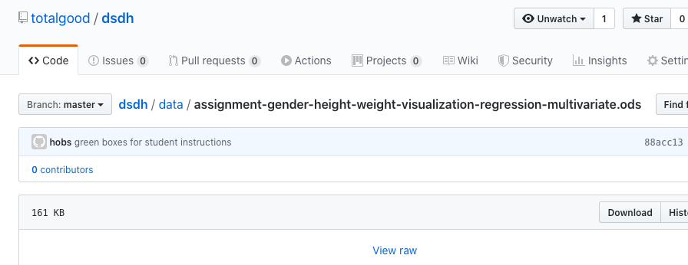
Dataset Spreadsheet: bit.ly/ucsd-spreadsheet

Slide 3
Dataset Spreadsheet: bit.ly/ucsd-spreadsheet
A: Patient ID (integer, but not usable, unique for each)
B: Gender (“Male’/”Female”), text feature
C: Height (in), continuous numerical feature
D: Weight (lbs), continuous numerical target (regression)

Slide 4
Assignment Goal
Descriptive Statistics
Min, Max, Mean, Standard Deviation
Scatter Plot
Linear Regression (by manual trial and error)
Multivariate Linear Regression

Slide 5
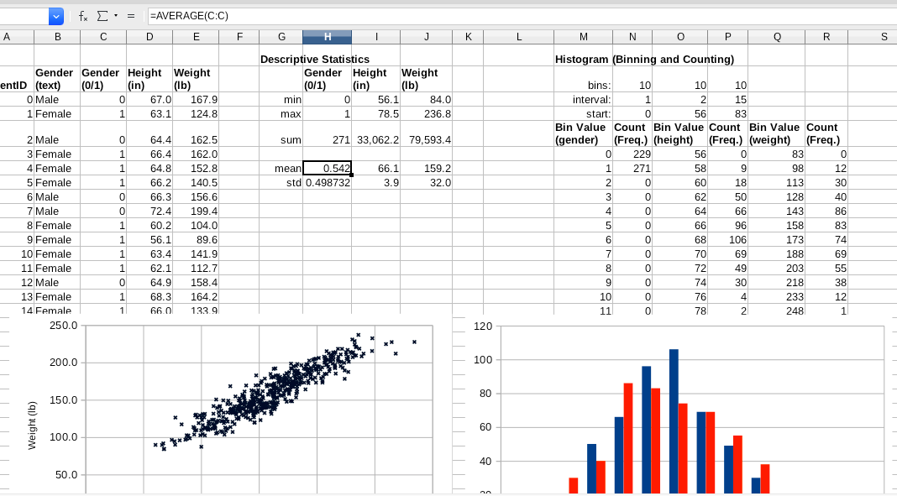
Descriptive Statistics and Scatter Plot

Slide 6
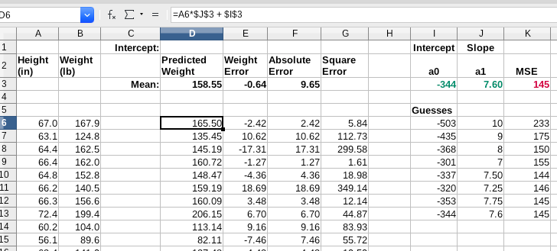
Example Linear Regression

Slide 7
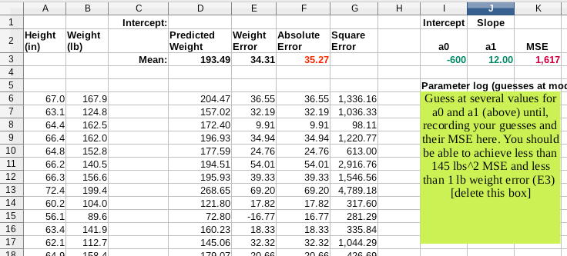
Linear Regression Template

Slide 8
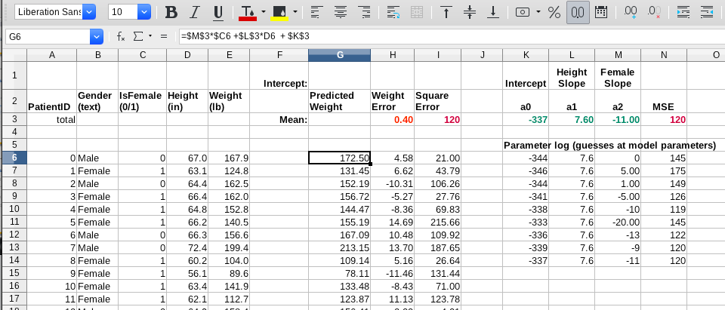
Example Multivariate Linear Regression

Slide 9
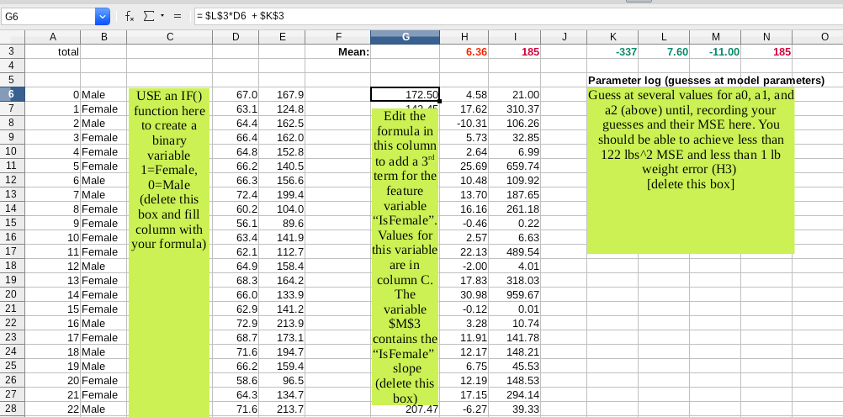
Multivariate Linear Regression Template

