Slide 1


Data Science for Digital Health
UCSD Extension – Specialization Certificate
L2: Spreadsheet Data Science
Hobson Lane, UC San Diego
Instructor
Notes:
<number>

Slide 2
Agenda
Topic | Concepts
Advantages | When to use a spreadsheet
Applications | DIY, Healthcare
Data | Data types
Database | Relational database Graph database (nosql)
Spreadsheet statistics | Sum, mean, standard deviation
Spreadsheet visualization | Scatter plots & histograms
Spreadsheet modeling | Linear regression Classification

Slide 3
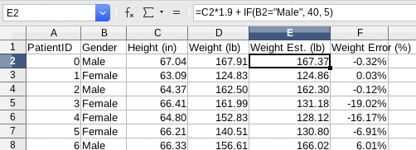
Advantages
Approachable
Universal
Transparent
Automatic variables (“A1”, “B3”)
Data + Code + Graphics
Killer feature: automatic filters

Slide 4
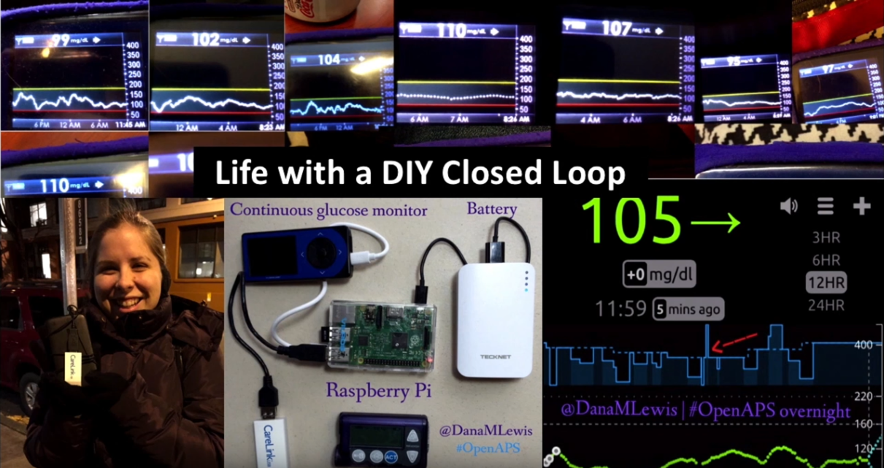
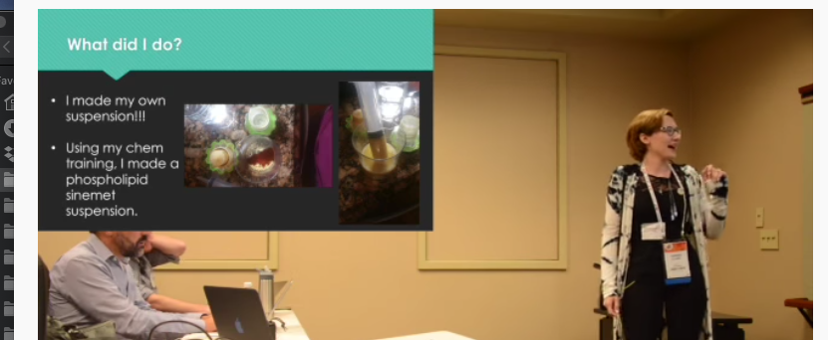
DIY Spreadsheet Data Science
bit.ly/ucsd-lewis
Fitness: step count, heart rate
Psychology: Emotional support
Sleep: CPAP data, smart watch
Heart disease: wearable EKG
DIY CGM + insulin pump
DIY Parkinson’s pharma
bit.ly/ucsd-sturr

Slide 5

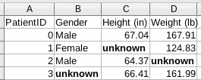
Healthcare Applications
Patient “intake”
Operations management
Insurance actuarial tables
Presentation (visualization)
Cooperative analysis

Slide 6
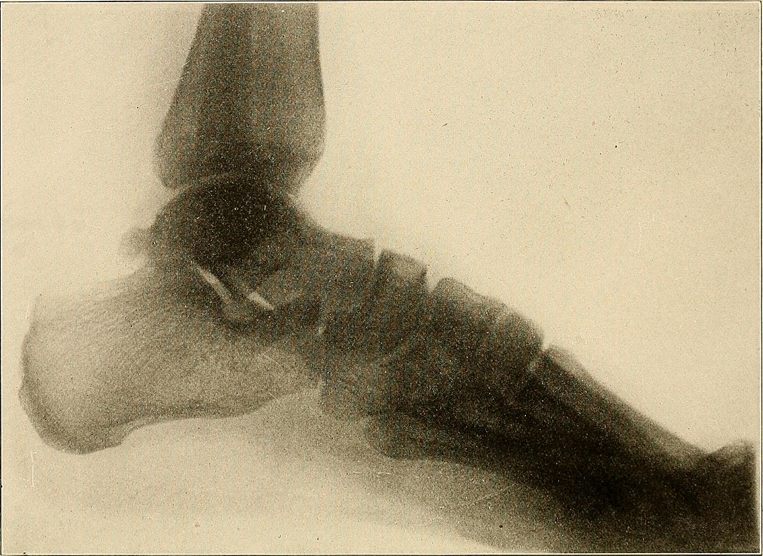
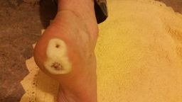
Kinds of Datasets
Tabular data
Relational databases (SQL)
Hospital, insurance, pharma, etc
Images
X-Rays, MRI, CAT, dermatology
Time series
Hospital records, log files, audio
Image time series
Video of patient interviews (Awakenings)
Unstructured data (natural language):
Doctor & nurse notes

Slide 7
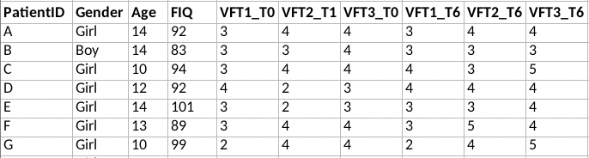
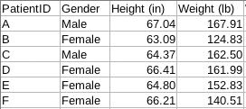

Spreadsheet Tabs vs Relational Database Tables
Relational Database captures relationships
VLOOKUP(A2, $'IQ'.A3:D501, 4)
SELECT FIQ FROM IQ WHERE PatientID = ‘A’
IQ
Patient
PrimaryKey
ForeignKey

Slide 8
NOSQL Database (Graph Database)
Deep, dynamic relationships
Smith
ID=1
Name
BP
test date
BP test date
Jan 1,
2020
125
systolic
weight
Jan 1,
2019
diastolic
120
175
systolic
weight
diastolic
80
170
80

Slide 9
Data Dichotomies
Continuous vs discrete
Categorical vs numerical
High-D, Low-D
Structured (Labeled) vs unstructured
Deterministic vs Chaotic/Random (Noise)
Big (“out of core”) vs small

Slide 10

Data File Formats
Text files (CSV, TSV, JSON, TXT)
Compressed (ZIP, GZ)
Binary files (XLS, PDF)
Images (PNG, JPG, TIF)
Web pages (HTML)
Databases (SQL, NOSQL, HDF)
Hint: check out “Pandas” and the `pandas.read_csv()` function

Slide 11
Data types
Continuous: numerical values like height, weight, blood pressure, temperature
Categorical: gender, eye color, disease names
Natural language: symptom descriptions, medical procedure descriptions
Sequence: genome, DNA, RNA, protein, chemical pathways
Time series: treatment timelines, hospital records, EKG/EEG recordings)
Geographic: epidemiology, maps of clinic locations
Imagery: X-rays, MRI slices, CAT scan slices, photos of skin abnormalities

Slide 12
Geographic Data
Pop Health (Population Health)
Epi (Epidemiology)
Annual flu vaccines around the world
Hepatitis outbreak in southern US
Ebola epidemic in Africa
Examples
Latitude and Longitude
State
Zip Code

Slide 13
Sequence Data
Genomics
Self-service genetic testing (23andme)
Prenatal screening (Counsyl)
Pre-exposure allergy prediction
Asthma anticipation
Resistance to disease (AIDS, Malaria, West Nile, Ebola)

Slide 14
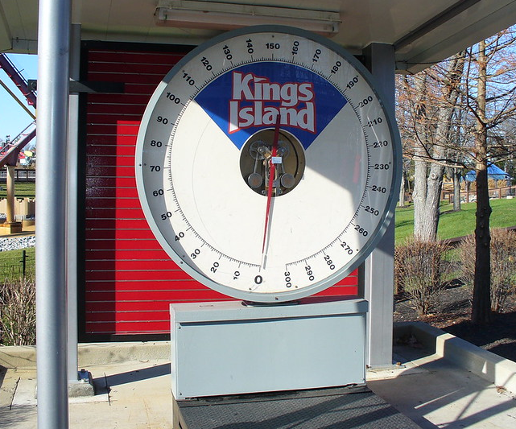
Weight Guesser Example
Weight guessing game
... useful in healthcare for:
Data cleaning
Detecting anomalies (disease)
Body Mass Index (BMI)

Slide 15
Weight Guesser Dataset
PatientID | Gender | Height (in) | Weight (lb)
0 | Male | 67.04 | 167.91
1 | Female | 63.09 | 124.83
2 | Male | 64.37 | 162.50
3 | Female | 66.41 | 161.99
4 | Female | 64.80 | 152.83
5 | Female | 66.21 | 140.51
6 | Male | 66.33 | 156.61
7 | Male | 72.39 | 199.45
8 | Female | 60.15 | 103.98
9 | Female | 56.07 | 89.57
Height
Weight
Gender
Do you notice anything wrong?
Other uses (targets) for this data?
...
...
...
...
9998 | Female | 66.21 | 156.54
9999 | Male | 71.41 | 216.92

Slide 16
Artificial Pancreas Timeline
1973: Wearable insulin pump (Dean Kaman)
2003: Wearable CGM (glucose monitoring)
2013: Dana Lewis adds #DIYPS to #WeAreNotWaiting
2015: Dana Lewis DIYs an artificial pancreas
2017: Medtronic integrates Dana's technology
2018: Medtronic notifed of security vulnerability
2019: FDA recalls MiniMed insulin pumps

