Slide 1


Digital Health
UCSD Extension – Specialization Certificate
Data Science for Healthcare
L4:
Clinical Data Science
Hobson Lane, UC San Diego
Instructor
Notes:
<number>

Slide 2
Agenda
Clinical Data Environments
US (HIPAA):
Europe (GDPR)
PII and Privacy
Developing Countries
Clinical Machine Learning
Tabular data: Diabetes severity
Visualization: Scatterplots
Machine Learning: Linear Regression
Feature engineering

Slide 3
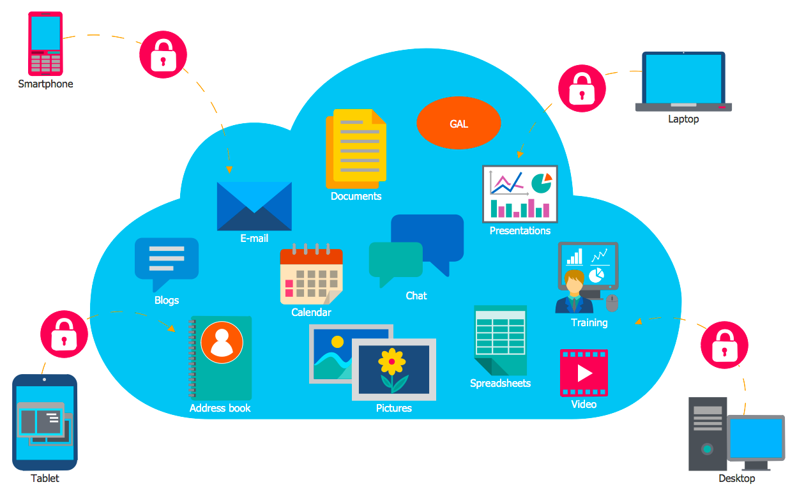
Clinical Data
Accept
Data Quantity
Difficult in the US (HIPAA)
Easier in Europe (GDPR)
Easiest in developing economies
Data Quality
Complete
Correct
Available
Accept
Accept
Accept

Slide 4
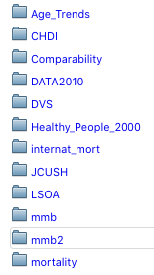
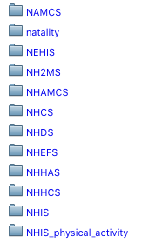
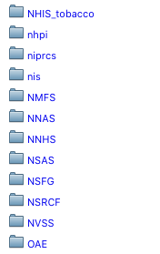
Centralized US Data Resource (CDC)
CDC (Center for Disease Control): bit.ly/ucsd-cdc
data.gov/health
ftp.cdc.gov/pub/Health_Statistics/NCHS/Datasets/
Mortality
Nutrition
Ambulatory care
Insurance stats
Discharge stats
Tobacco use

Slide 5
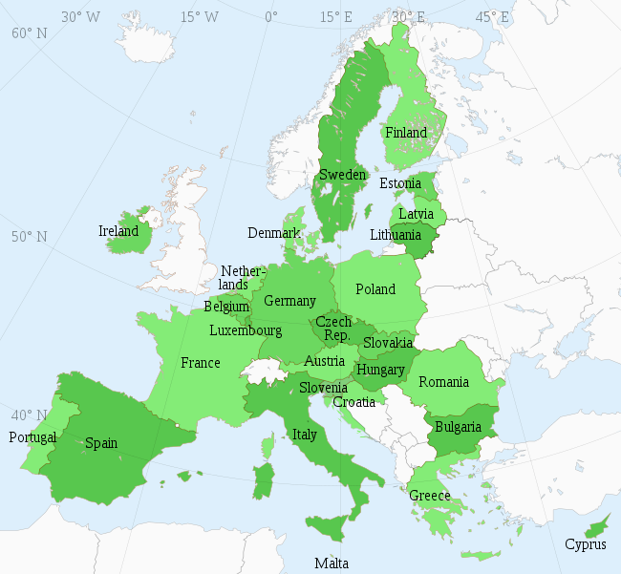

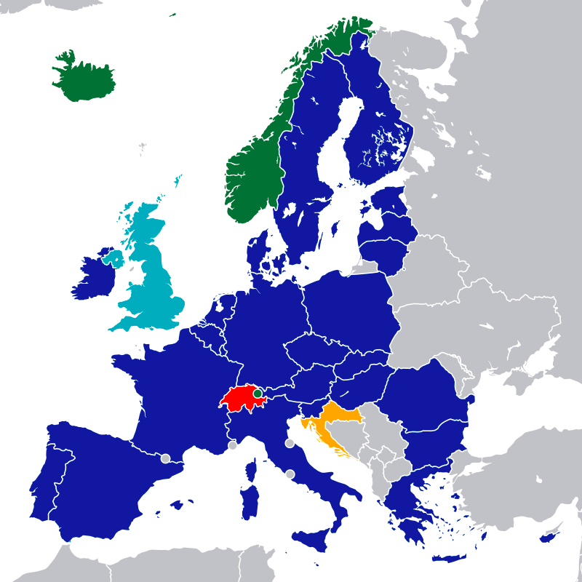
EU (European Union)
EEA (Economic Area)

Slide 6
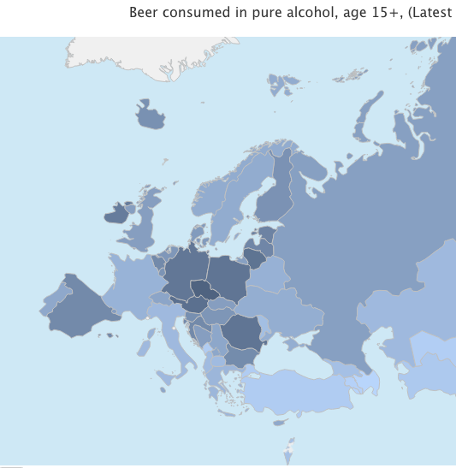
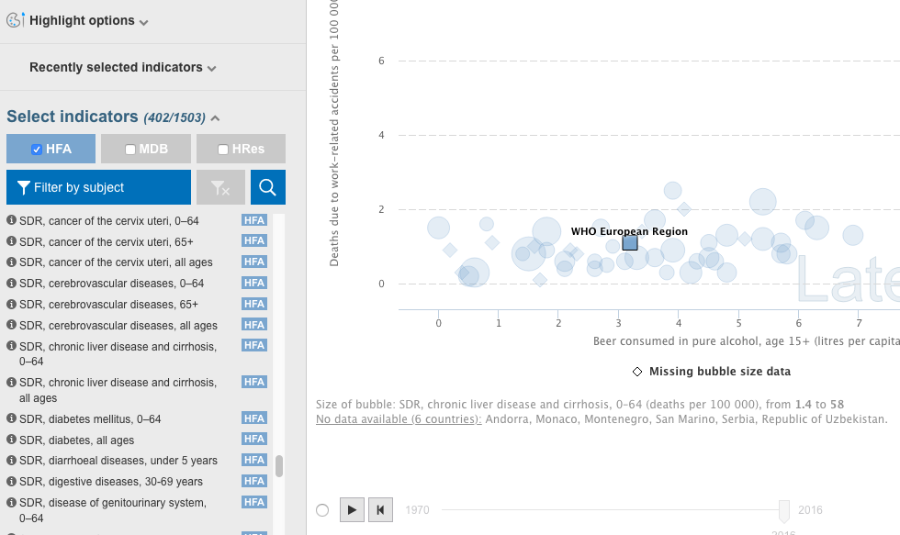
Data in Europe
WHO (World Healthcare Organization):gateway.euro.who.int
bit.ly/ucsd-who-beer

Slide 7
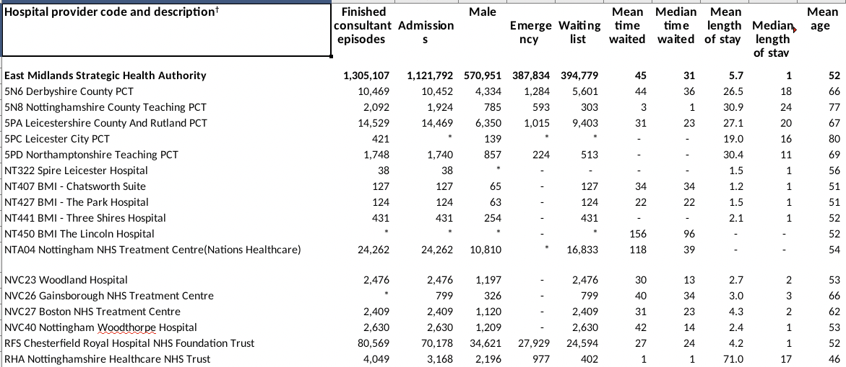
UK Hospital Data (bit.ly/ucsd-hes)

Slide 8
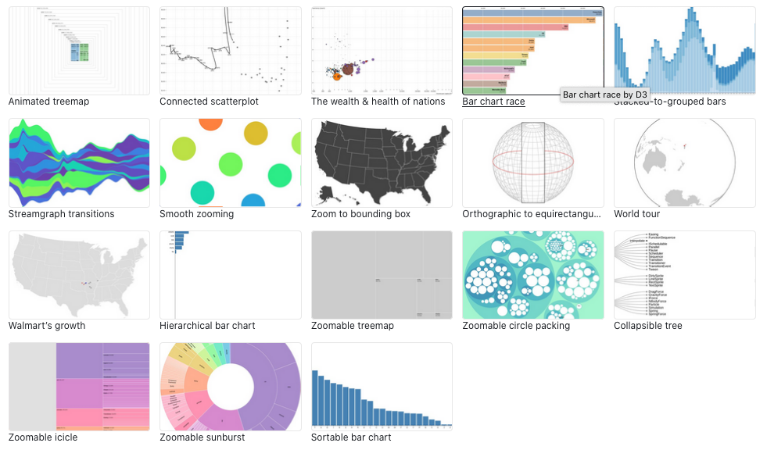
D3.js and Plot.ly
bit.ly/ucsd-d3
plot.ly/python

Slide 9

PII (Personally Identifiable Information)
Full name
ID Number
SSN, Driver’s License
Telephone, Credit Card
Combinations
Birthdate + neighborhood
Hospital + age (if over 80)
Why protected?
Prevent discrimination
Profit, bias, politics

Slide 10

Anonymization
Delete PII columns/fields
Shuffle PII
Add noise to PII
Implement “Differential Privacy”
Wait 50 years after individuals die
Wait until the data is made public
bit.ly/ucsd-deanon
bit.ly/ucsd-netflix

Slide 11
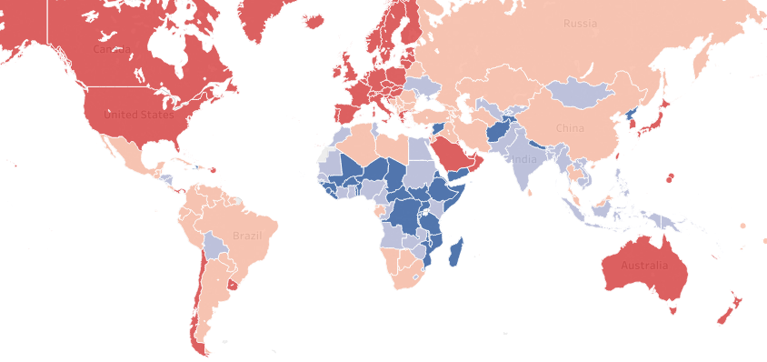
Developing World is Different
Hospital
Clinic
In the field
Dr’s office
Home
Community Health Worker
Mobile app

Slide 12
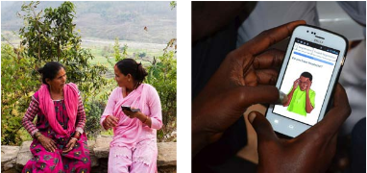
Clinical Data Science in Developing World
Rural
No clinic
Intermittent Wireless
Little Internet (WiFi)
NGOs deliver care
Mobile Apps like CommCare (by Dimagi)

Slide 13
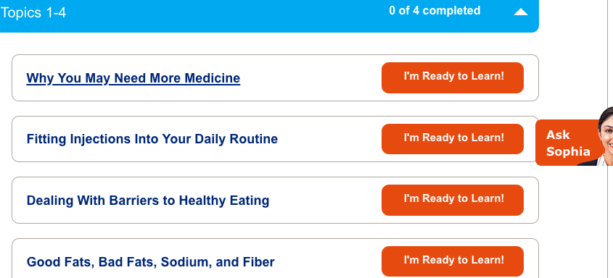

US Pharma Bots
Diabetes coach
Pharma prior:
insulin
medication

Slide 14
Clinical Dataset (Diabetes Severity)
bit.ly/ucsd-diabetes

Slide 15
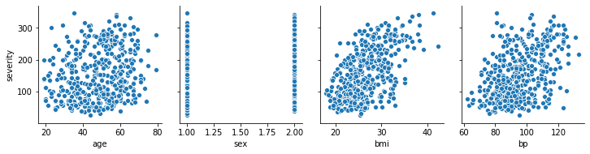
Clinical Dataset (Age, Gender, BMI, BP)

Slide 16
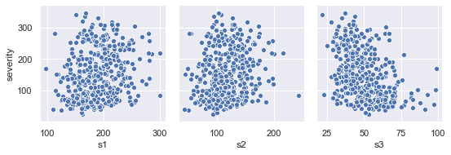
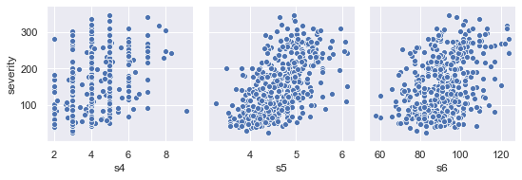
Clinical Dataset (Blood Test Results)

Slide 17
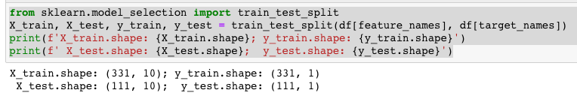
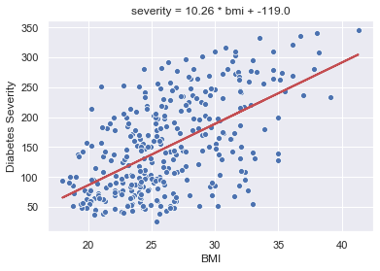


Single-variate Linear Regression (BMI)

Slide 18


Test Set Error Larger than Training Set?
Training Set Error
Unseen Test Set Error
<
Test set error is 5% larger than training set error for this simple model

Slide 19
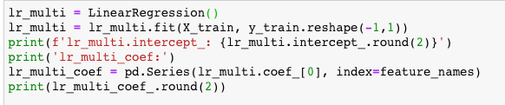
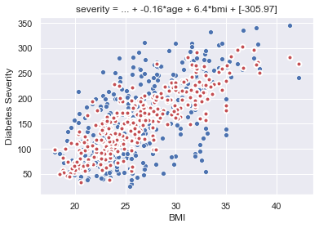
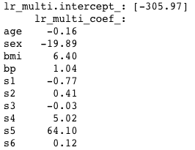
Multivariate Linear Regression (Age, BMI, BP)

Slide 20
Coefficients of Multivariate Model
-0.16*age
-20.89*sex
+6.4*bmi
+1.0*bp

Slide 21
Blood Test Coefficients
-0.77*s1
+0.41*s2
-0.03*s3
+5*s4
64*s5
0.12*s6

Slide 22



Too Many Features (Overfitting)?
Training Set Error
Unseen Test Set Error
<<
Test set error is 7% larger than training set error for this simple model

