Slide 1


Backup (unreleased):
Deep Learning &
Artificial Intelligence
Digital Health
UCSD Extension – Specialization Certificate
Data Science for Healthcare
Hobson Lane, UC San Diego
Instructor

Slide 2
Diabetes Severity Multivariate Regression
Combine 3 regressions together?
Better representation of the world (biology)?
Height
Weight
gender
body type
LDL
HDL
BP
vascular
health
diabetes
severity
TCH
GLU
?
thyroid+
pancreas
health

Slide 3
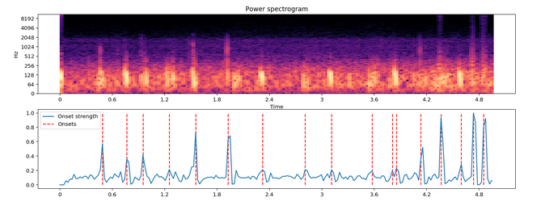
Stethoscope Heartbeat Detection
72% accuracy for deep learning model
LSTM

Slide 4
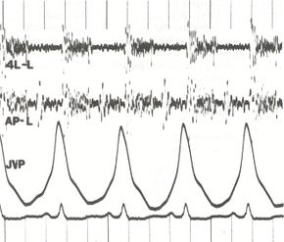
Man vs Machine
Internists: bit.ly/ucsd-stethescope
  Baseline: 40% accuracy: 5 heart murmurs
  Stethescope training app: 80% accuracy
Machines: bit.ly/ucsd-steth-ai
  Normal vs abnormal phonocardiograms
  97% F1 Score (94.8% recall, 99.7% precision)
bit.ly/wiki-phonocardiogram

Slide 5
NLP Application: Summarization
Clinical Medical Records
  Doctor review
  Adjudication
  Insurance Claims
  Retrospective Utilization Review

Slide 6
NLP Application: Search & QA
LiveStrong.com
MayoClinic.com
WebMD.com

Slide 7
What is Deep Learning?
What is AI?
How do they apply to healthcare?

Slide 8
Assignments

Slide 9
Quiz
Why is understanding Baye’s Rule so important?

Slide 10
Homework:
Start your Hyperparameter Log
Create an empty spreadsheet, python list, or paper table with headings: num input dimensions, layer 1 neurons, layer 2 neurons, layer 3 neurons, training set accuracy, test set accuracy (see next slide)
Train two neural networks to predict MNIST hand-written digits and record your hyperparameters (numbers of neurons) and performance (accuracies)
TIP: Start with 0 neurons for layer 2 and layer 3

Slide 11
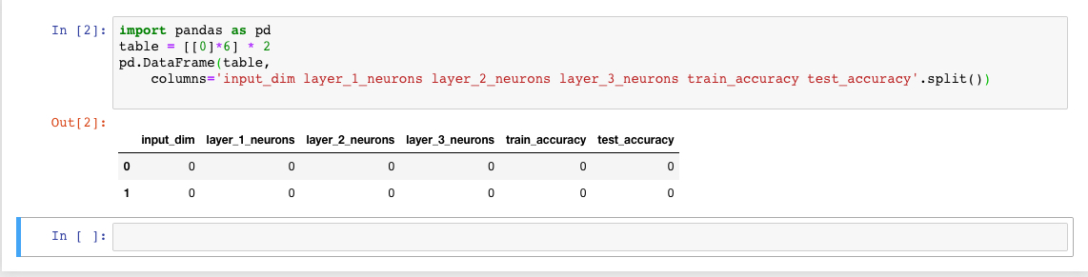
Example Python

