Slide 1


Digital Health
UCSD Extension – Specialization Certificate
Data Science for Healthcare
L2: Statistics
Hobson Lane, UC San Diego
Instructor

Slide 2
Agenda
Example statistics “lies”
Accuracy, Precision, Recall
True positive rate
True_Positive_Count / (True_Positive_Count + False_Positive_Count)

Slide 3
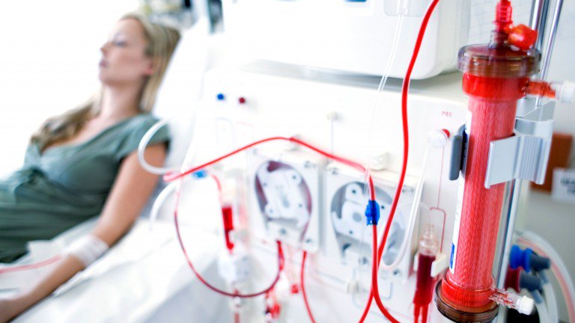
Example Application: Predict Kidney Disease
Clinical records can predict Kidney failure
2 days in advance
55% accuracy for acute problems
90% accuracy for serious issues
Dataset:
100% UK citizens
100% military
90% male
DeepMind (London)

Slide 4
Accuracy
Continuous numerical predictions (regression):
  How close to correct are your predictions?

Slide 5
Accuracy
Categorical predictions (classification):
  What proportion of your predictions were correct?

Slide 6
Precision
Of all the positive results how many were correct?
Positive predictive value
True positive rate
True_Positive_Count / (True_Positive_Count + False_Positive_Count)

Slide 7
Recall
Of all the patients with the disease how many were correctly “recalled” (predicted) by the test?
Sensitivity
True_Positive_Count / (True_Positive_Count + False_Negative_Count)

Slide 8
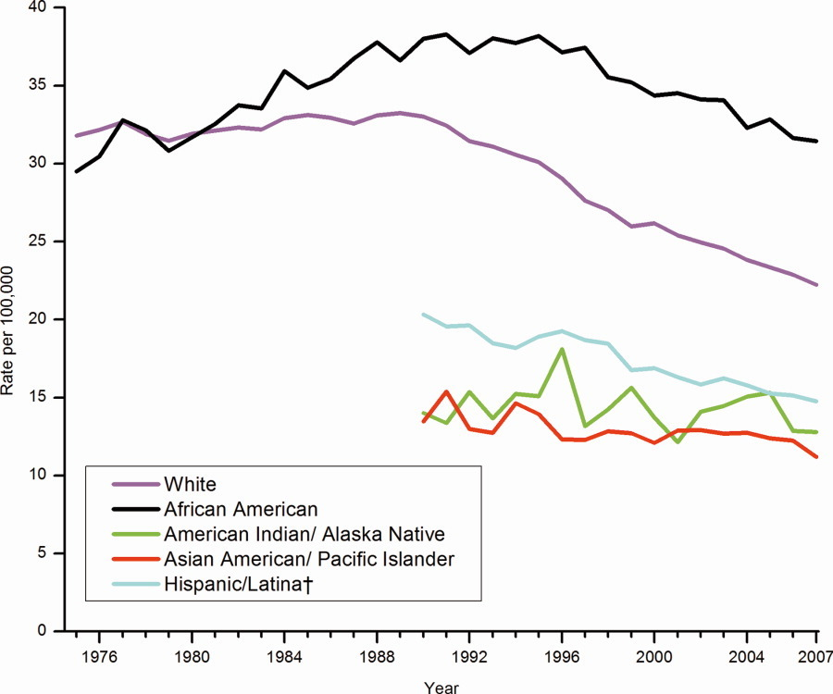
Correlation enables prediction
Breast Cancer Rates 2011: bit.ly/ucsdbreast

Slide 9
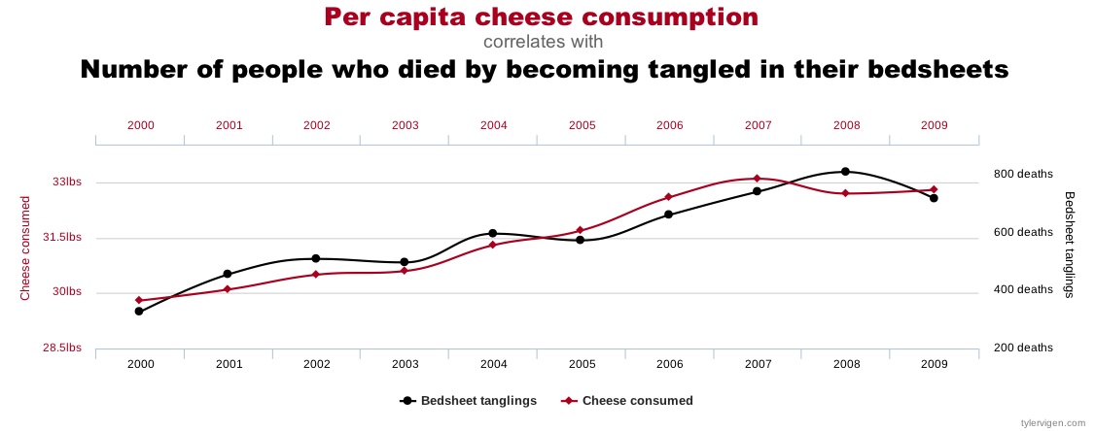
Correlation is not enough
Computers are good at finding patterns
But often those patterns are “spurious correlation”

Slide 10
The “Bradford Hill Criteria”
1. Consistency: multiple studies, datasets, subjects
2. Strength: correlation magnitude
3. Dose-response: increased dose = increased effect
4. Specificity: 1 effect rather than many
5. Temporal relationship: cause before effect
6. Coherence: biological plausibility

Slide 11
Cause or Confounder?
Other?
age
genetics
diet
environment
pregnancy
surgery
drugs
education
urban/rural
Mammogram
frequency
Wealth
Ethnicity
Gender
Cancer
death
rate

Slide 12
Bayes Rule
Updated Probability = Likelihood Ratio x Prior Probability

Slide 13
Bayes Rule Example
Prior | P(D) | Probability of getting breast cancer | 1 in 700 per yr 1 in 70,000 (men)
True Positive Rate (Sensitivity) | P(T|D) | Probability of mammogram detecting cancer | .73
False Positive Rate (False Alarm) | P(T|~D) | Probability of positive mammogram w/o cancer | .12
Positive Rate | P(T) = P(D) * P(T|D) + P(~D) * P(T|~D) | Probability of a positive mammogram among all women | .73 * 1 / 700 + .27 * 699 / 700 = .121

Slide 14
Real Numbers
P(D) | 1/700
P(T|D) | .73
P(T) | .121

Slide 15
What is statistics?
How is statistics used
in healthcare?

Slide 16
Probability

Slide 17
Conditional Probability

Slide 18
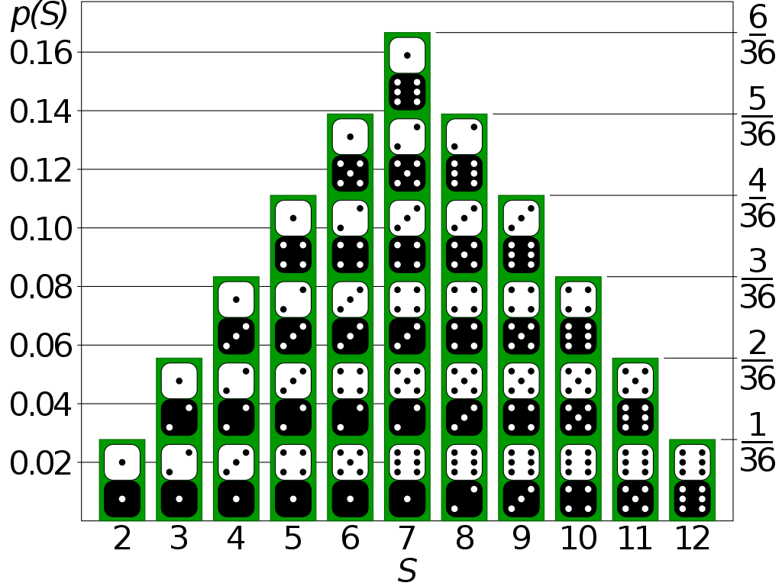
Probability Distribution
Text files (CSV, TSV, JSON, TXT)
Compressed files (ZIP, GZ)
Binary files (XLS, PDF, Images)
Web pages (links to HTML)
Databases

Slide 19
Probability Distribution

Slide 20
PMF: Probability Mass Function (Discrete PDF)

Slide 21
PDF: Probability Density Function

Slide 22
Continuous Probability Distribution

Slide 23
Ethics and Accuracy
Clinical records can predict Kidney failure
2 days in advance
55% accuracy for acute problems
90% accuracy for serious issues
Dataset:
100% UK citizens
100% military
90% male
DeepMind (London)

Slide 24
Berkson’s Paradox
 | General Population |  |  |  | Hospitalization past 6 mo
 | Bone Disease | No Bone Disease | % Bone Disease |  | Bone Disease | No Bone Disease | % Bone Disease
Lung disease | 17 | 207 | 7.6% |  | 5 | 15 | 25.0%
No lung disease | 184 | 2,376 | 7.2% |  | 18 | 219 | 7.6%

Slide 25
Correlation enables prediction
Breast Cancer Rates 2011: bit.ly/ucsdbreast

Slide 26
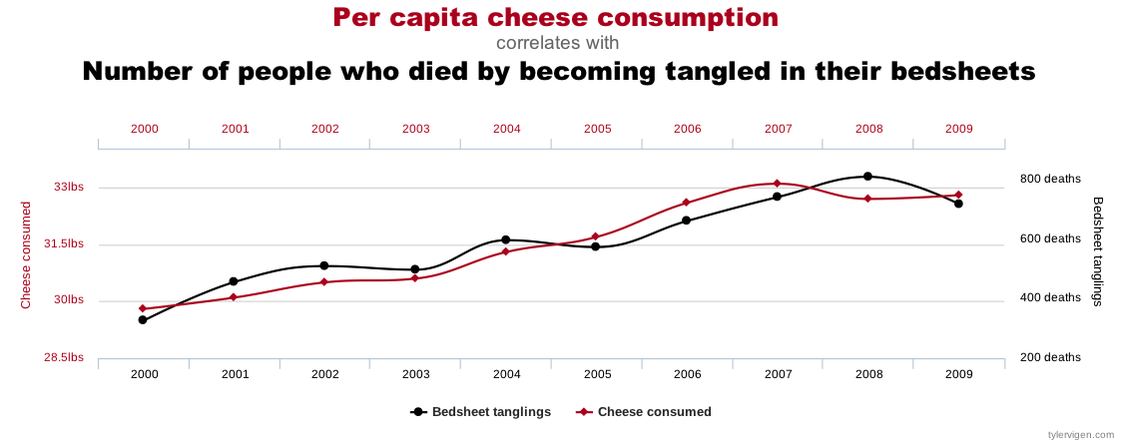
Correlation is not enough
Computers are good at finding patterns
But often those patterns are “spurious correlation”

Slide 27
Bayes Rule
Updated Probability = Likelihood Ratio x Prior Probability

Slide 28
Bayes Rule Example
Prior | P(D) | Probability of getting breast cancer | 1 in 700 per yr 1 in 70,000 (men)
Sensitivity | P(T|D) | Probability of mammogram detecting cancer | .73
False Positive Rate (False Alarm) | P(T|~D) | Probability of positive mammogram w/o cancer | .12
 | P(T) = P(D) * P(T|D) + P(~D) * P(T|~D) | Probability of a positive mammogram among all women | .73 * 1 / 700 + .27 * 699 / 700 = .121

Slide 29
Mammograms can cause harm!
P(D) | 1/700
P(T|D) | .73
P(T) | .121
ACP: biannually after age 50+
previously: annual exams at 40+

Slide 30
Assignments

Slide 31
Quiz
Why is understanding Baye’s Rule so important?

Slide 32
Homework: Create diabetes MLE
Download diabetes dataset: http://totalgood.org/midata/...

Slide 33
Project
Use numpy.random.randint() to simulated rolling a pair of dice.

