Slide 1
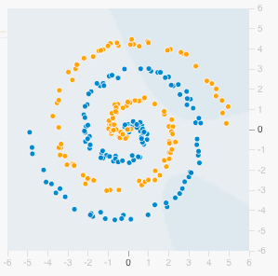
Assignment 1: Play with Neural Nets
Visit playground.tensorflow.org
Select the spiral dataset and add 20% Noise
Add and remove different combinations of features: x1, x2, x1^2, x2^2, x1*x2, sin(x1), sin(x2)
Play around with different numbers of “HIDDEN LAYERS” and neurons per layer.
How many features, hidden layers and total neurons work best for you? Goal: 15% test set loss or less.

Slide 2
Quiz 1: Data Science
Give two applications of Data Science to Healthcare
What is the Iron Triangle of Healthcare?
Will Artificial Intelligence replace doctors?
Why or why not?
If a blood test for a particular disease has a False Positive rate of 10% and a False Negative rate of 30%, what’s the test’s precision (positive predictive value) and recall (sensitivity)?

