Slide 1
Unredact the Mueller Report

Slide 2
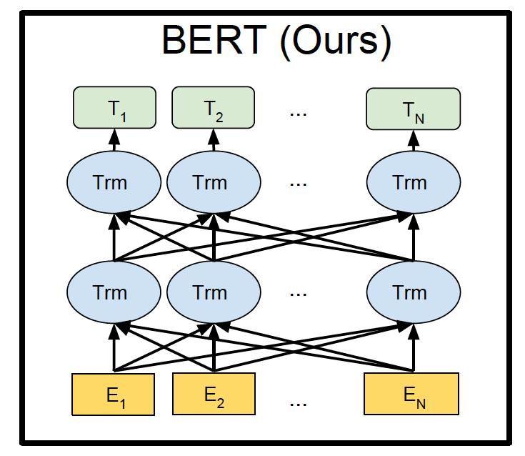
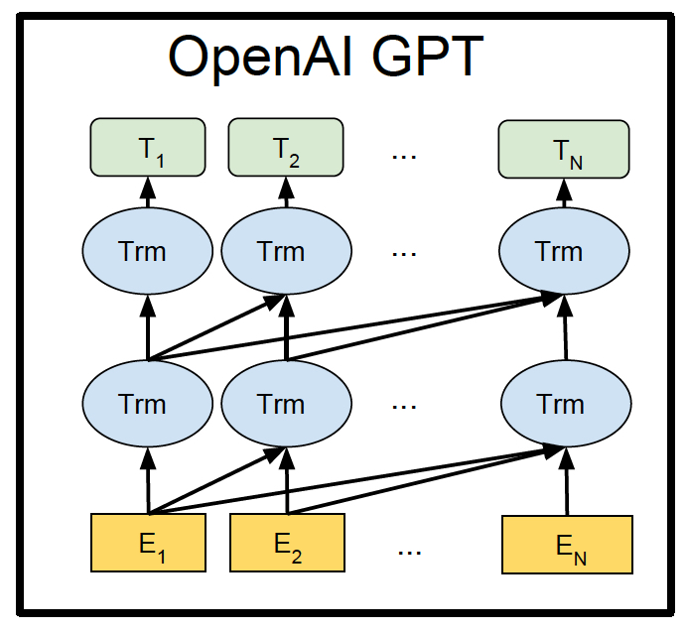
BERT
Bidirectional Encoder Representations from Transformers
Jacob Devlin, Ming-Wei Chang, Kenton Lee, Kristina Toutanova. 2018. BERT: Pre-training of Deep Bidirectional Transformers for Language Understanding. arxiv: 1810.04805.pdf

Slide 3
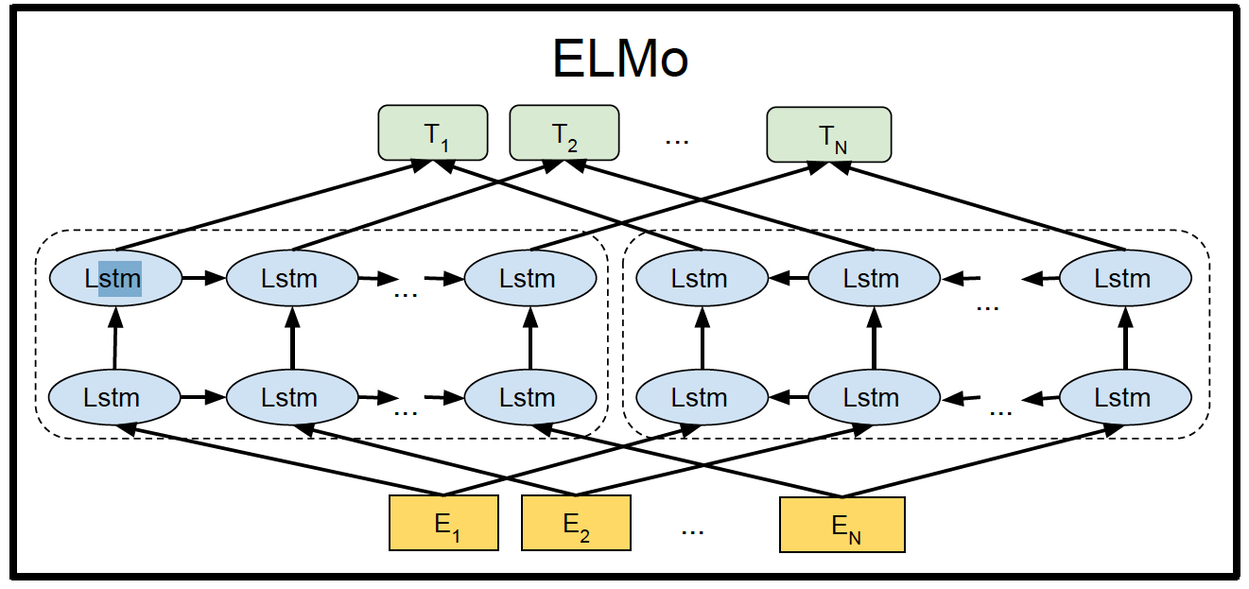
ELMo:
Embeddings from Language Models
Matthew Peters, Mark Neumann, Mohit Iyyer, Matt Gardner, Christopher Clark, Kenton Lee, and Luke Zettlemoyer. 2018. Deep contextualized word representations. arxiv: 1802.05365.pdf

Slide 4
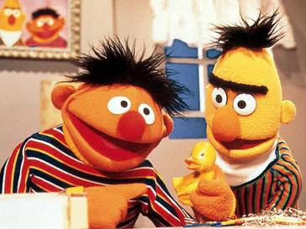
Which one is Bert!

Slide 5
Human Learning
Human’s learn too!
Portlandian:
  Sunlight
  Temperature
  Roses
  Apples/walnuts
  Coyote on Tabor
  Wolf on hood

Slide 6
Californian
Smog level
Email inbox full
Web traffic
Stock price
Freeway jammed
dodgers win

Slide 7
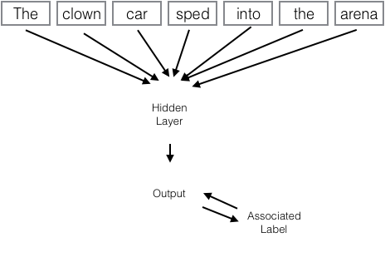
Unredact the Mueller Report

