Slide 1
Unredact the Mueller Report
Notes and Backup Slides

Slide 2
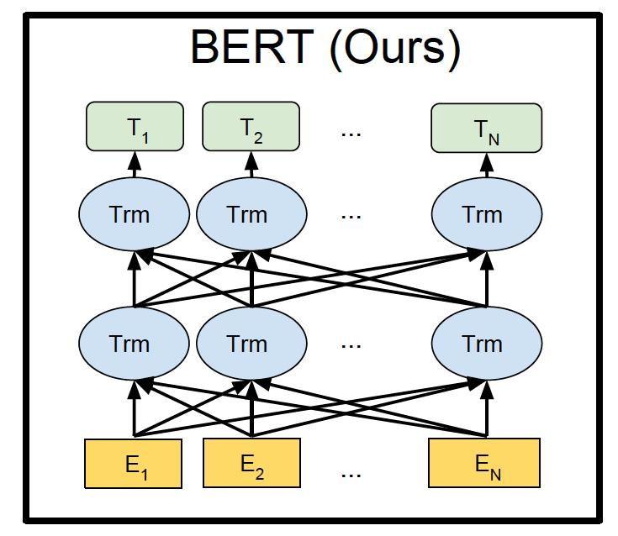
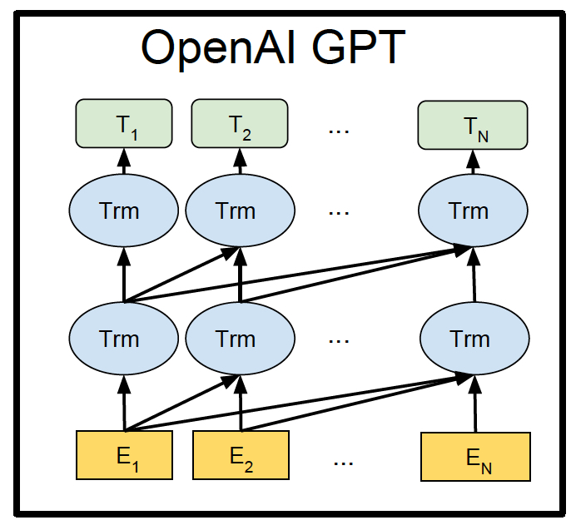
BERT
Bidirectional Encoder Representations from Transformers
Jacob Devlin, Ming-Wei Chang, Kenton Lee, Kristina Toutanova. 2018. BERT: Pre-training of Deep Bidirectional Transformers for Language Understanding. arxiv: 1810.04805.pdf

Slide 3
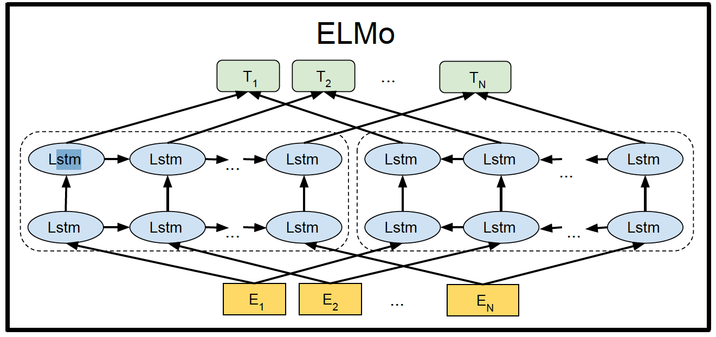
ELMo:
Embeddings from Language Models
Matthew Peters, Mark Neumann, Mohit Iyyer, Matt Gardner, Christopher Clark, Kenton Lee, and Luke Zettlemoyer. 2018. Deep contextualized word representations. arxiv: 1802.05365.pdf

Slide 4
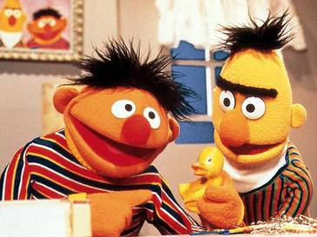
Which one is Bert!

Slide 5
Human Learning
Human’s learn too!
Portlandian:
  Sunlight
  Temperature
  Roses
  Apples/walnuts
  Coyote on Tabor
  Wolf on hood

Slide 6
Californian
Smog level
Email inbox full
Web traffic
Stock price
Freeway jammed
dodgers win

Slide 7
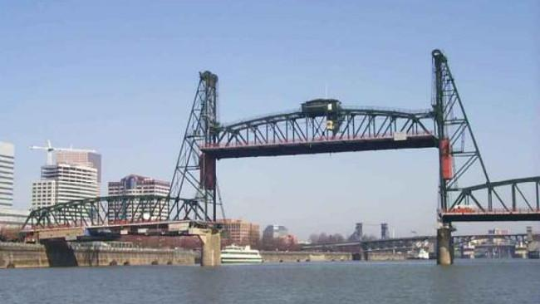
Rain/Sun
Hawthorne Bridge
Cloudy
Traffic
Roses

Slide 8
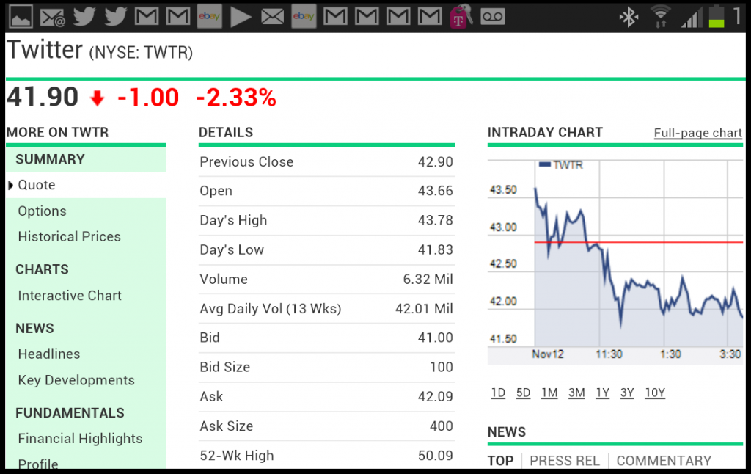
Californian’s Learn Too
Smog
Email inbox
Web traffic
Stock price
Traffic jams
Dodgers

Slide 9
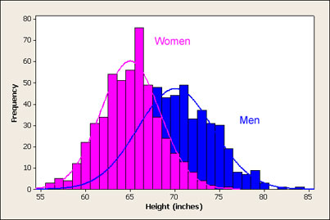
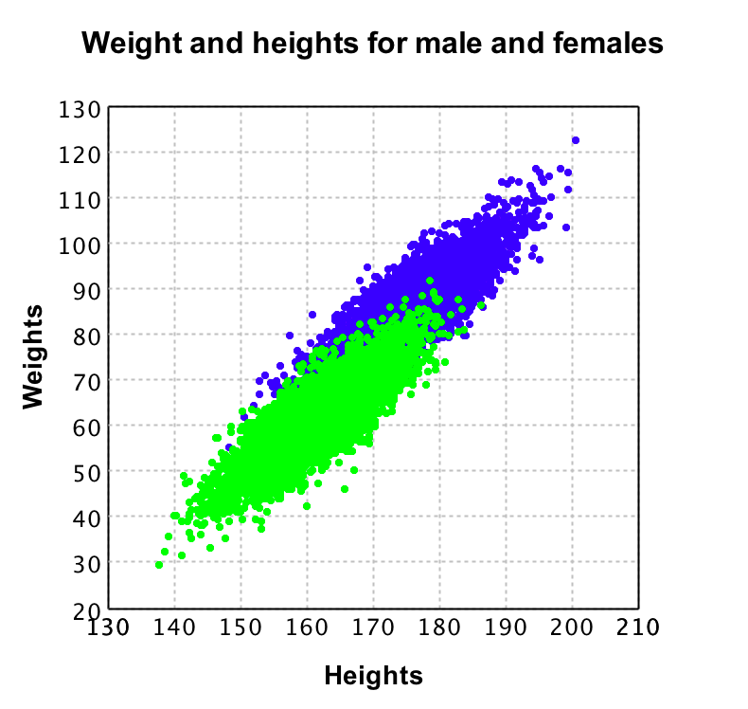
Machine Learning
Average (MLE)
Linear Regression
Moving Average
ARMA
Decision Tree
Many Decision Trees (Forest)
Voting (XGBoost)

Slide 10
Chatbot
“a”
“b”
“Cohen”
“;-)”
“LOL”
“!”

Slide 11
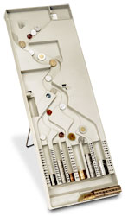
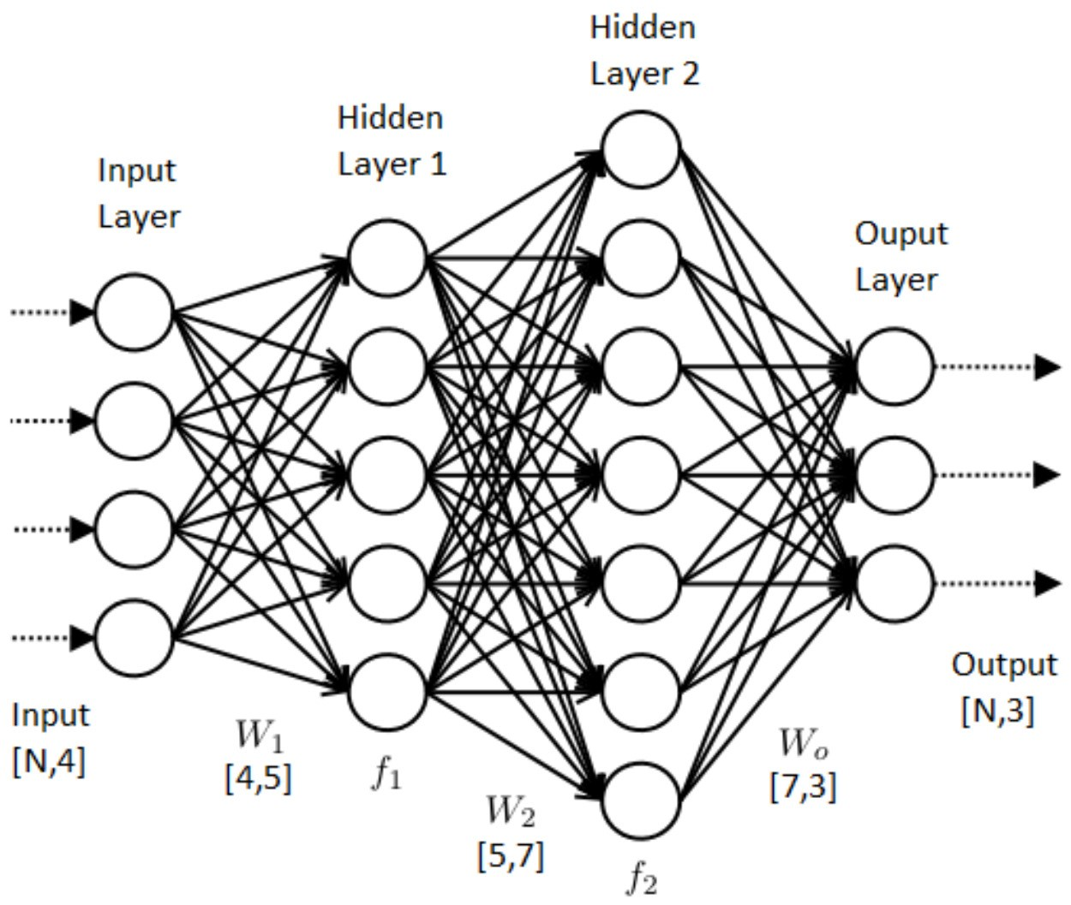
NLP Pipeline
Learning/Training
(back propagation)
“The quick brown ...”
“fox” “jumped” “over” ...
“The” “quick” “brown”
“...”
Prediction (forward propagation)

Slide 12
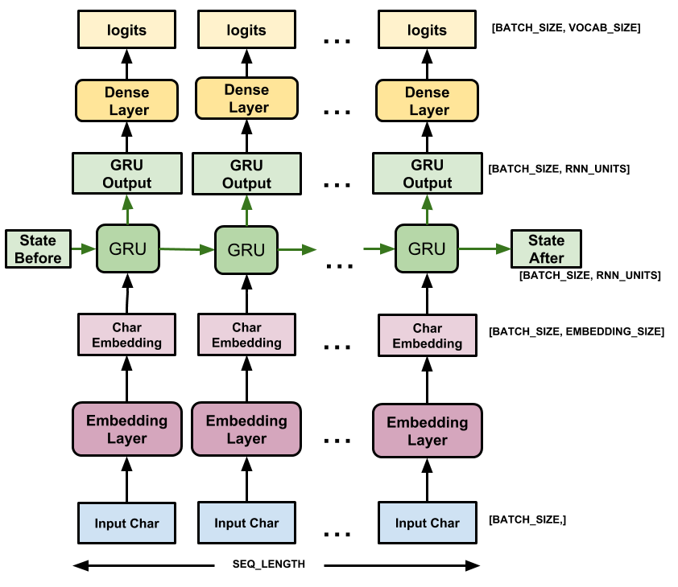
RNN (Recurrence)
Recurrence
1.2
2.0
.25
Gate
.3
.6
“a”

Slide 14
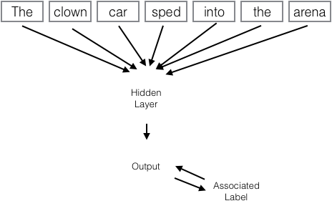
Unredact the Mueller Report

