Slide 1

Adapting SimLingo Vision-Language-Action
Models to New Domains
A Case Study for QCar 2
Garegin Mazmanyan
Master of Science in Computer Science
The University of Arizona
Committee: Chicheng Zhang (Chair) · Hossein Rastgoftar (Co-Chair) · Eduardo Blanco
February 2026

Slide 2
Outline
01
Motivation & Research Questions
02
Background: SimLingo & VLA Driving
03
Methodology: CARLA → QLabs
04
Data Collection & Fine-Tuning
05
Inference Stack & Control
06
Evaluation Design & Baselines
07
Results & Analysis
08
Limitations & Future Work
09
Conclusion
2

Slide 3
Motivation
Vision-Language-Action (VLA) models show promise for autonomous driving
Core Question
SimLingo: winning entry of the CARLA Autonomous Driving Challenge 2024
Can a VLA driving model trained on CARLA transfer to Quanser QLabs via parameter-efficient fine-tuning?
Uses InternVL2-1B multimodal backbone for end-to-end waypoint prediction
Goal: reproducible pipeline for adapting CARLA-trained VLA to QCar 2 in QLabs
CARLA
QLabs
Unreal Engine 4, photorealistic rendering
Full vehicle dynamics (tire, suspension)
Rich sensor suite
Educational platform, simplified rendering
Idealized physics (instant velocity)
Compact fixed-layout environment
3

Slide 4
Background
SimLingo, InternVL2-1B, and VLA Driving Architecture
4

Slide 5
Two-Level Driving Architecture
Upper Level (Learned)
Lower Level (Classical)
VLA model predicts future waypoints
Input: camera image + route intent
Output: WHERE the vehicle should go
Never directly outputs steering or throttle
PID controllers convert waypoints to actuators
Lateral PID: heading error → steering angle
Longitudinal PID: speed error → throttle
Robust, interpretable control layer
Clean separation: learned perception + classical control
Camera Image
Vision Encoder
LLM Decoder
Waypoint Heads
PID Controllers
Vehicle Commands
5

Slide 6
SimLingo & InternVL2-1B Backbone
300M
500M
512
448²
Vision encoder InternViT-300M-448px
Language model Qwen2-0.5B-Instruct
Visual tokens (2 tiles × 256 each)
Tile resolution px per tile
Dynamic tiling: images split into 448×448 tiles, pixel-unshuffle (factor 4) → 256 tokens/tile
Learned projection maps vision features into LLM embedding space
Causal LLM processes visual + text + navigational tokens jointly
Token sequence: [NAV_1, NAV_2] + [VIS_1 ... VIS_512] + [TEXT tokens] → LLM → Waypoint Heads
Target-point mode: 2 GPS-like waypoints fed through WaypointInputAdaptor MLP → 2 navigational embeddings
6

Slide 7
Dual-Head Action Prediction
Speed Waypoints (Temporal)
Route Waypoints (Geometric)
10 learnable speed query vectors
Predict ego-frame coords at 0.25 s intervals
Used for longitudinal PID control
MLP: Linear(H→256) → SiLU → Linear(256→2)
20 learnable route query vectors
Predict ego-frame coords at ~1 m intervals
Used for lateral PID control
MLP: Linear(H→512) → SiLU → ... → Linear(256→2)
Output: waypoint deltas → cumulative sum → absolute ego-frame positions
Training losses: Smooth-L1 (route + speed waypoints) + Cross-entropy (language) — equal weight
WaypointInputAdaptor: Linear(2→256) → ReLU → Linear(256→512) → ReLU → Linear(512→D)
7

Slide 8
CARLA vs. QLabs: Key Differences
Category | CARLA | QLabs
Engine | Unreal Engine 4, photorealistic | Educational, simplified rendering
Physics | Full dynamics (tire, suspension) | Idealized (instant velocity)
Steering sign | Positive = turn left | Opposite sign convention
Control cadence | 20 Hz control, 4 Hz data | 4 Hz control loop
Speed signal | Instantaneous from simulator | Single-frame displacement
Camera | 1024×512, FOV 110° | 820×410, FOV 160°
8

Slide 9
Research Questions
What data and interface adaptations are needed for CARLA → QLabs transfer?
RQ1
Coordinate frames, steering signs, camera configs, speed estimation
Can parameter-efficient fine-tuning (LoRA) achieve domain transfer?
RQ2
Freeze vision encoder, adapt only LLM parameters
What runtime alignment is required for real-time control?
RQ3
Control-loop timing, PID compensation, ego-frame target points
How to build a reproducible evaluation harness?
RQ4
Scenario-driven testing with quantitative metrics
9

Slide 10
Methodology
Adapting CARLA → QLabs
10

Slide 11
Domain Adaptation Pipeline
Starting point: pretrained CARLA checkpoint (epoch 13 of CARLA training)
Stage 1: Data Collection
Stage 2: LoRA Fine-Tuning
Stage 3: Inference Stack
Expert driving in QLabs
Keyboard teleop at 30 Hz
4 Hz data logging
InternVL2-1B backbone
~17.6M adapter params
15 epochs training
Real-time PID controller
Ego-frame target points
4 Hz control loop
Key mismatches addressed: coordinate frames · control rates (20 Hz vs 4 Hz) · camera FOV/resolution · speed estimation
11

Slide 12
Coordinate Frame Alignment
Ego frame: x points forward, y points left
All waypoints converted to ego frame before use
Steering sign: CARLA and QLabs use opposite conventions
World → Ego: pₑ = R(−ψ) · (pʷ − t) where R is 2D rotation matrix, ψ = heading
Steering sign flip: δ = −u · δₘₐₓ (negate for QLabs convention)
12

Slide 13
Control Timing Compensation
CARLA
QLabs
20 Hz control loop
Data saved at 4 Hz (every 5th frame)
PID tuned for 20 Hz feedback
4 Hz control loop directly
Derivative term needs compensation
Without fix: steering oscillation
Derivative compensation: raw_diff / (0.25s / 0.05s) = raw_diff / 5
Normalizes the 4 Hz derivative term to the 20 Hz reference used during CARLA training
13

Slide 14
Camera Configuration
Property | CARLA | QLabs
Mounting position | [−1.5, 0.0, 2.0] | [0.183, 0.0, 0.110]
Resolution | 1024×512 | 820×410
Field of view | 110° | 160°
Max tiles (InternVL2) | 2 | 2
Visual tokens | 512 | 512
14

Slide 15
Speed Estimation & Target-Point Routing
Speed Estimation
Target-Point Routing
Single-frame displacement method
Same in training & inference → consistent
Domain-agnostic (no simulator velocity API)
Trade-off: noisier but portable
85-waypoint roundabout route (JSON config)
Advance along polyline until arc-length > d
Convert target points world → ego frame
Feed to WaypointInputAdaptor MLP
vₜ = ||pₜ − pₜ₋₁|| / Δt where Δt = 0.25 s (at 4 Hz)
15

Slide 16
Data Collection & Training
Dataset, LoRA Fine-Tuning, and Convergence
16

Slide 17
Data Collection Pipeline
Expert driving via keyboard teleoperation at 30 Hz
Data logging at 4 Hz (Δt = 0.25 s), matching runtime controller frequency
Each frame: 1 RGB JPEG + 1 gzip JSON measurement (position, heading, speed)
Route: roundabout navigation with optional single static obstacle
Multi-actor challenge: QLabs API calls are serialized
Shared mutex prevents simultaneous API calls
Actor update rate lowered to 2 Hz, start times staggered 0–99 ms
Container timeout extended to 10 s
17

Slide 18
Dataset Summary
10,495
40 / 15
~470 MiB
5
Total frames across 55 runs
Train / Val runs
On-disk footprint
Obstacle placement positions
Split | Runs | Frames | Run Length Range
Training | 40 | 7,498 | 98 – 301 frames
Validation | 15 | 2,997 | 171 – 234 frames
Each frame: 1 RGB JPEG + 1 gzip-compressed JSON measurement · Obstacle waypoint indices: 25, 35, 50, 65, 75
18

Slide 19
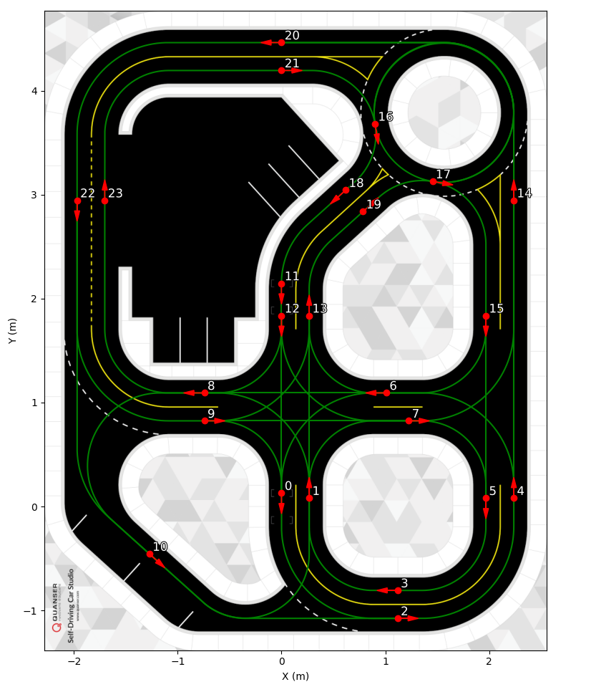
QLabs Roundabout Environment
SDCS road map with numbered waypoint nodes. Roundabout route used for training and evaluation.
19

Slide 20
LoRA Fine-Tuning Strategy
17.6M
r = 32
Frozen
Epoch 13
LoRA adapter parameters
LoRA rank α = 64, dropout = 0.1
300M-param vision encoder (InternViT)
CARLA pretrained starting checkpoint
Applied to all linear layers of Qwen2-0.5B language model
No language/commentary supervision: constant command = 4 (“follow the road”)
Trained exclusively in target-point navigation mode
20

Slide 21
Training Hyperparameters
Parameter | Value
Backbone | InternVL2-1B (OpenGVLab)
Learning rate | 2e-5
Optimizer | AdamW (β = [0.9, 0.999], wd = 0.1)
Batch size | 4 (effective: 16 with grad accum 4)
Max epochs | 15
Precision | 16-mixed
Strategy | DeepSpeed Stage 2
GPU | NVIDIA RTX 5070 Ti (16 GB VRAM)
LR schedule | One-cycle with 5% warmup
Seed | 42
21

Slide 22
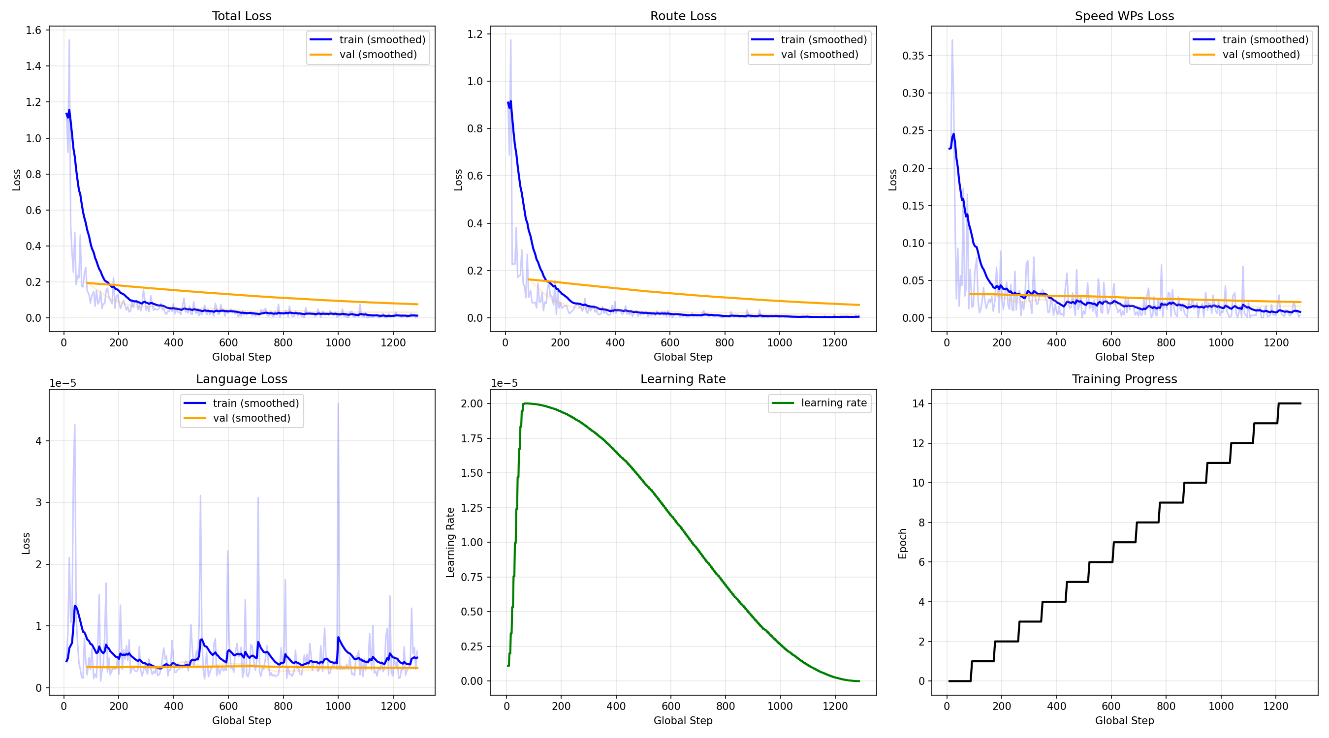
Training Loss Curves
Total, route, speed, and language loss over 15 epochs. Rapid convergence in first 3–5 epochs.
22

Slide 23
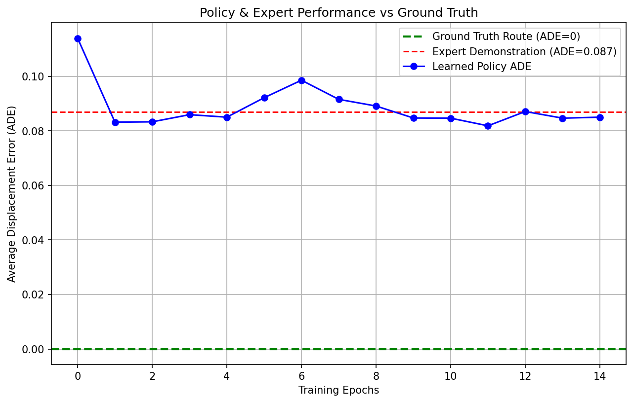
Average Displacement Error (ADE) Convergence
25% ADE reduction: 0.114 m (epoch 0) → 0.085 m (epoch 11). Expert baseline ADE = 0.087 m.
23

Slide 24
Inference Stack
Runtime Pipeline and Control Conversion
24

Slide 25
Runtime Inference Pipeline
1
2
3
4
5
Capture
Ego State
Target Pts
VLA Infer
Commands
Camera frame from CSI
Position, heading speed estimate
Ego-frame from active route
Or reuse cached prediction
Waypoints → QCar 2 cmds
Nominal control rate: 4 Hz (Δt = 0.25 s) · Inference stride configurable · All eval runs: stride = 1
25

Slide 26
Control Conversion: Speed & Steering
Longitudinal (Speed)
Lateral (Steering PID)
Distance between first two speed waypoints / Δt
Clipped to [0, v_max] for safety
Sent directly to QCar 2 velocity interface
Heading error scaled: rad → deg → /90
Derivative: raw_diff / 5 (4 Hz → 20 Hz ref)
Integral: K_I = 0 (currently inactive)
v_des = clip(||s₁ − s₀||/ Δt_model,0,v_max )
δ = −u · δ_max(steering sign flip for QLabs convention)
26

Slide 27
Evaluation
Test Design, Metrics, and Baselines
27

Slide 28
Evaluation Design
15
5 + 10
5
Total test runs per full sweep
Baseline + obstacle runs
Obstacle placement variants
Baseline (no obstacle): 5 repeated runs
Static obstacle variants 1–5: 2 repeated runs each
Placements span: early roundabout, mid, exit, straight, late (curved)
Caveat: test obstacle positions are identical to training positions — this is an in-distribution reliability test, not a generalization test
28

Slide 29
Evaluation Metrics
Lateral Deviation
Route Coverage
Cross-track error: point-to-polyline-segment distance
Reports both mean and max deviation
Waypoint reached within r = 1.5 m
Coverage = reached / total × 100%
Safety
Timeout
Bumper-hit flags from QLabs API
Stop detection at speed < 0.05 m/s
Max step count + forward-progress thresholds
Prevents infinite loops
29

Slide 30
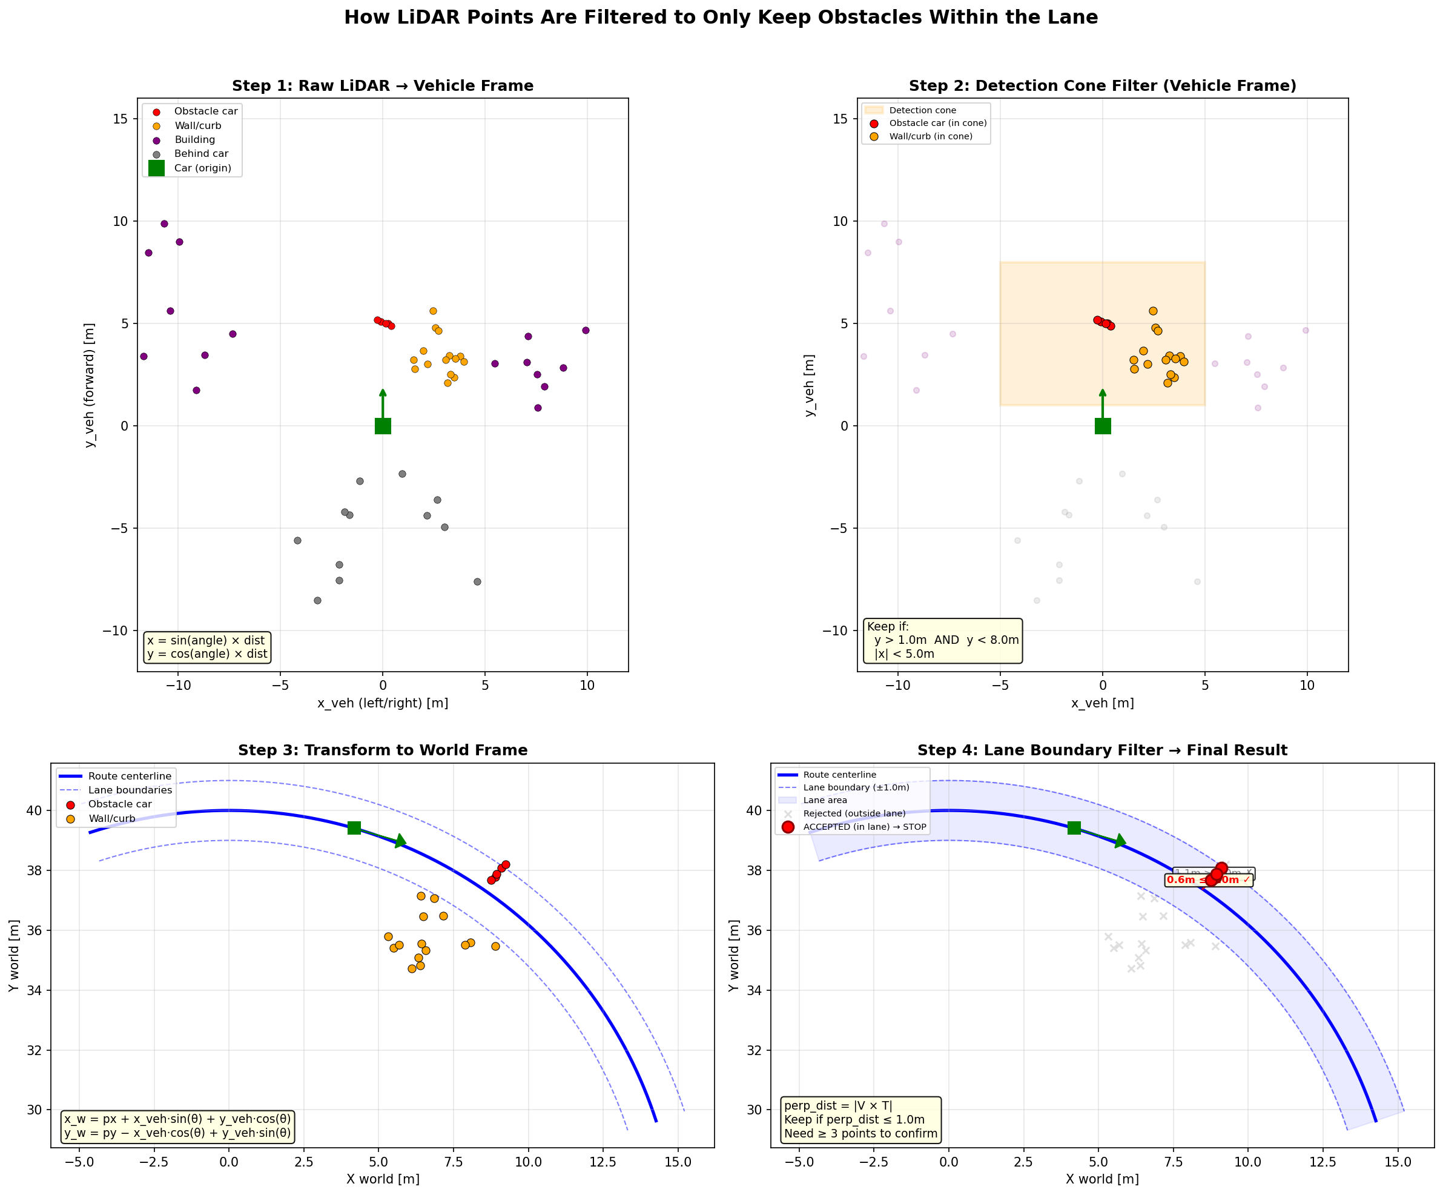
ACC Baseline: LiDAR Filtering Pipeline
4-step LiDAR filter: raw → forward cone → world frame → lane boundary. Pure-pursuit lateral with 4.5 m lookahead.
30

Slide 31
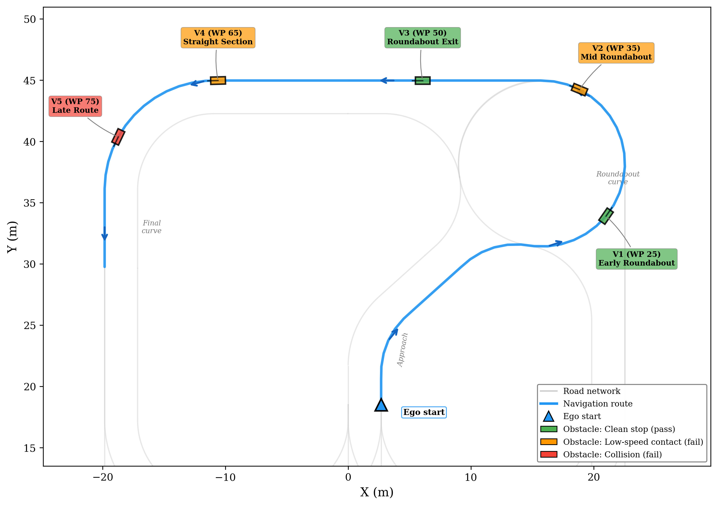
Obstacle Placement Map
5 obstacle variants: green = clean stop, orange = low-speed contact, red = collision.
31

Slide 32
Results
Training Convergence, Route Following, and Obstacle Avoidance
32

Slide 33
Training Results
25%
0.085 m
0.087 m
Ep 14
ADE reduction over 15 epochs
Final ADE (< 9 cm avg deviation)
Expert baseline ADE
Final ckpt used
ADE at epoch 0 (CARLA checkpoint): 0.114 m → epoch 11: 0.085 m
Policy converges to within 2 mm of expert-level accuracy
Losses decrease rapidly in first 3–5 epochs, then plateau
Language loss near zero throughout (no NL supervision)
33

Slide 34
Baseline Route Following (No Obstacles)
Metric | SimLingo | ACC Baseline
Route coverage (%) | 99.1 | 97.6
Avg lateral deviation (m) | 0.056 | 0.261
Max lateral deviation (m) | 0.311 | 0.670
Avg completion time (s) | 68.1 | 42.3
34

Slide 35
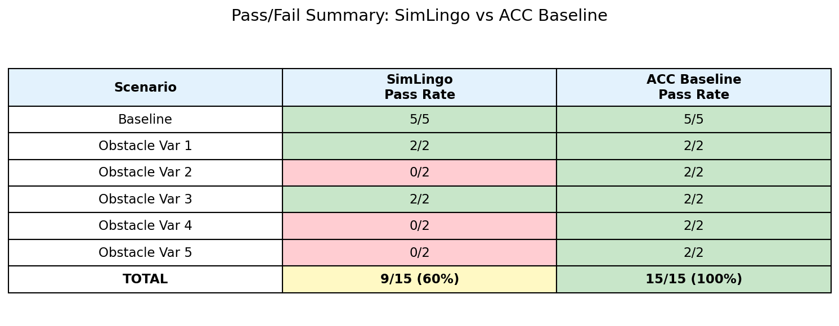
Overall Pass Rates
SimLingo: 60% overall (9/15), 40% obstacle-only (4/10). ACC baseline: 100%.
35

Slide 36
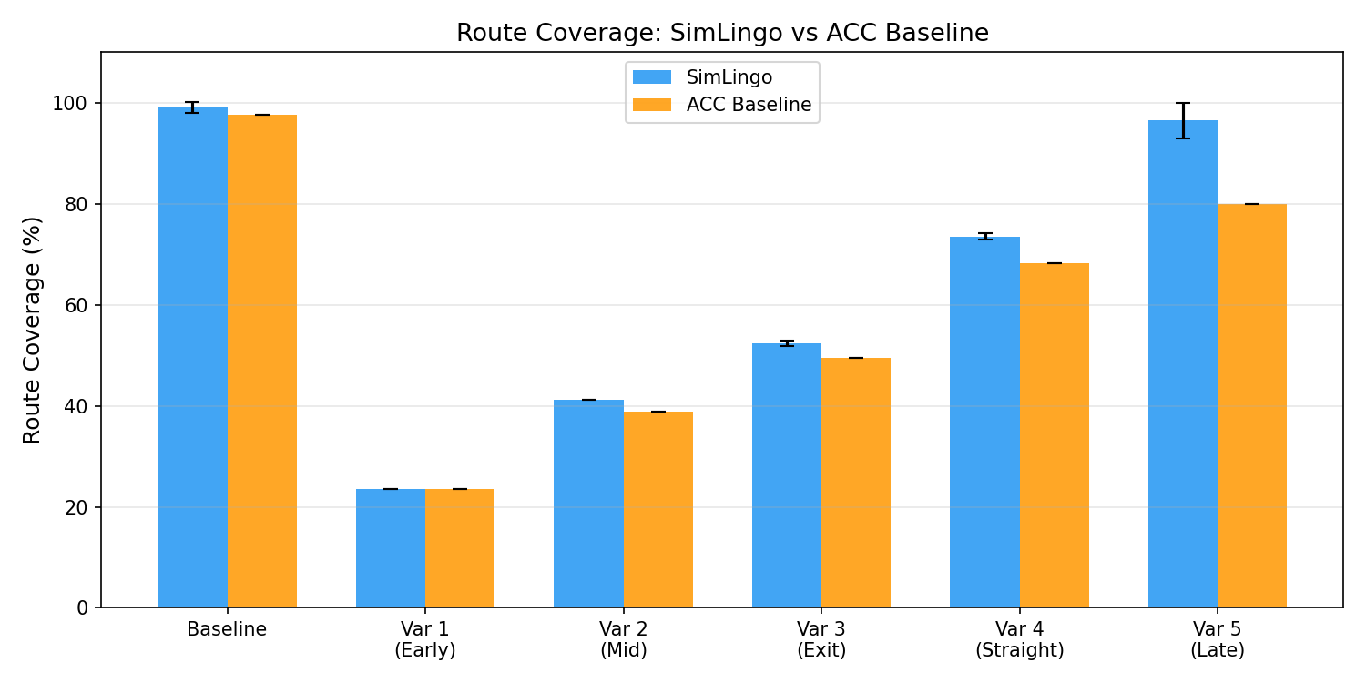
Route Coverage Comparison
Route coverage by scenario. Both controllers achieve >97% on obstacle-free runs.
36

Slide 37
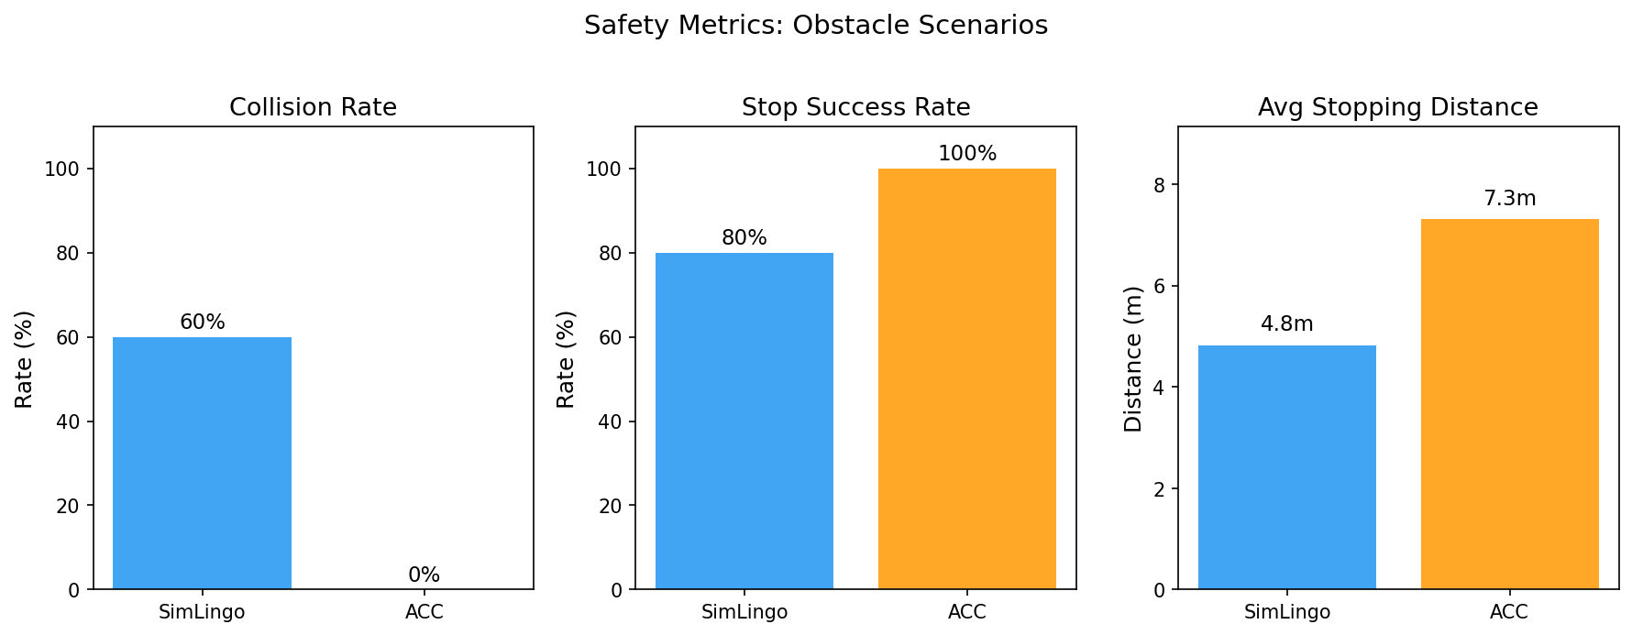
Safety Comparison
Collision rate, stop success rate, and stopping distance across all obstacle variants.
37

Slide 38
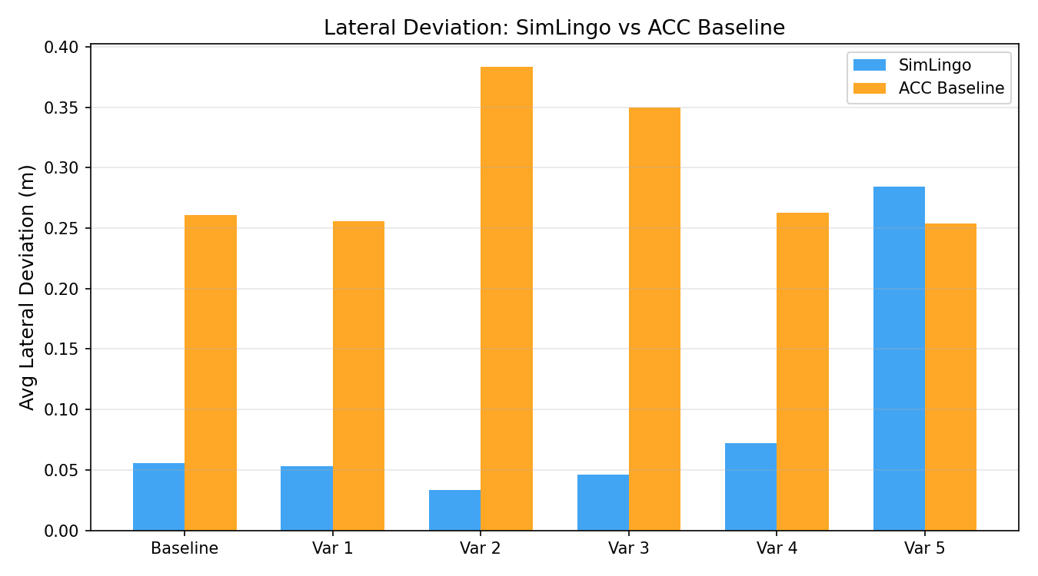
Lateral Deviation Comparison
SimLingo: 0.03–0.09 m on most scenarios. ACC: 0.25–0.38 m (pure-pursuit corner-cutting).
38

Slide 39
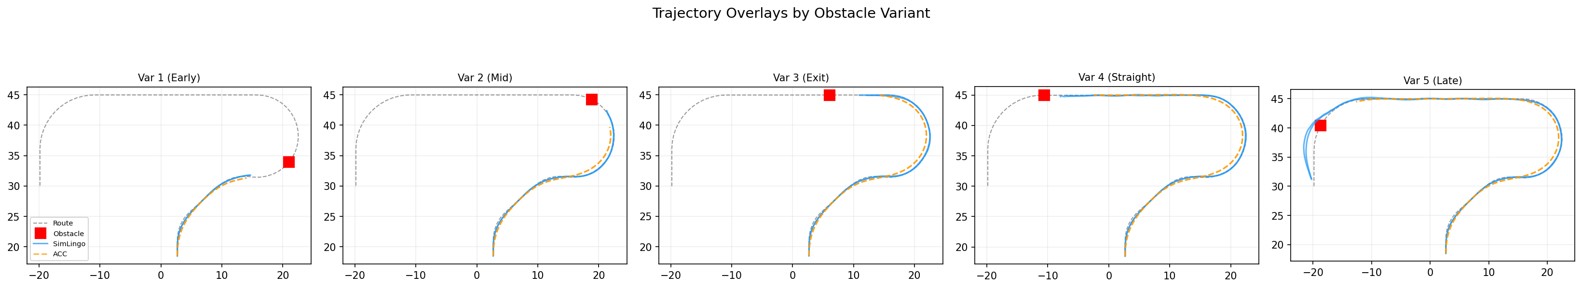
Trajectory Overlays (Bird’s-Eye View)
Bird’s-eye trajectories for all variants. SimLingo (blue) vs ACC (orange) vs route (dashed).
39

Slide 40
Obstacle Avoidance: Detailed Results
Scenario | Controller | Coverage% | Collisions | Stopped | Stop Dist (m) | Avg Lat Dev (m)
Var 1 (Early) | SimLingo | 23.5 | 0/2 | 2/2 | 6.8 | 0.053
Var 1 (Early) | ACC | 23.5 | 0/2 | 2/2 | 7.4 | 0.256
Var 2 (Mid) | SimLingo | 41.2 | 2/2 | 2/2 | 3.2 | 0.033
Var 2 (Mid) | ACC | 38.8 | 0/2 | 2/2 | 5.4 | 0.383
Var 3 (Exit) | SimLingo | 52.4 | 0/2 | 2/2 | 5.7 | 0.046
Var 3 (Exit) | ACC | 49.4 | 0/2 | 2/2 | 8.3 | 0.350
Var 4 (Straight) | SimLingo | 73.5 | 2/2 | 2/2 | 3.6 | 0.072
Var 4 (Straight) | ACC | 68.2 | 0/2 | 2/2 | 8.1 | 0.262
Var 5 (Late) | SimLingo | 96.5 | 2/2 | 0/2 | N/A | 0.284
Var 5 (Late) | ACC | 80.0 | 0/2 | 2/2 | 7.3 | 0.254
40

Slide 41
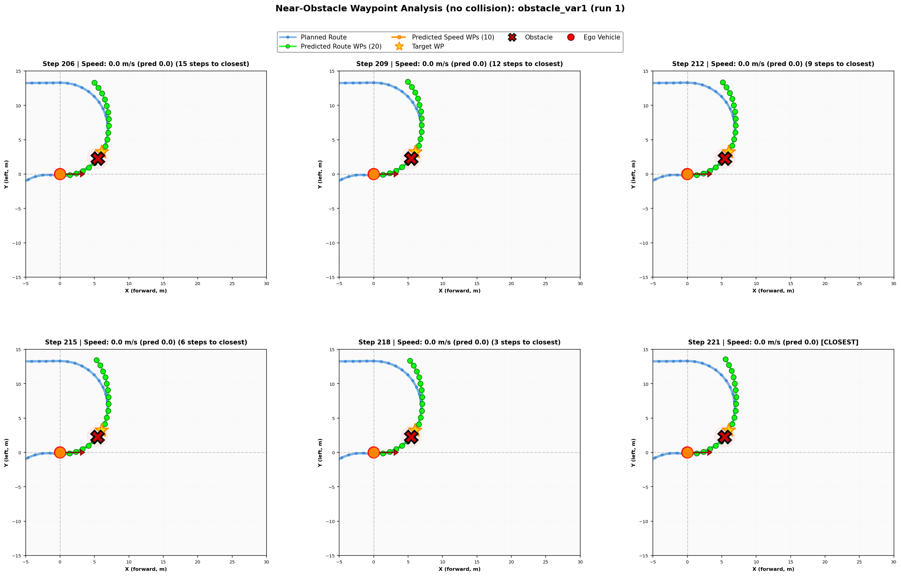
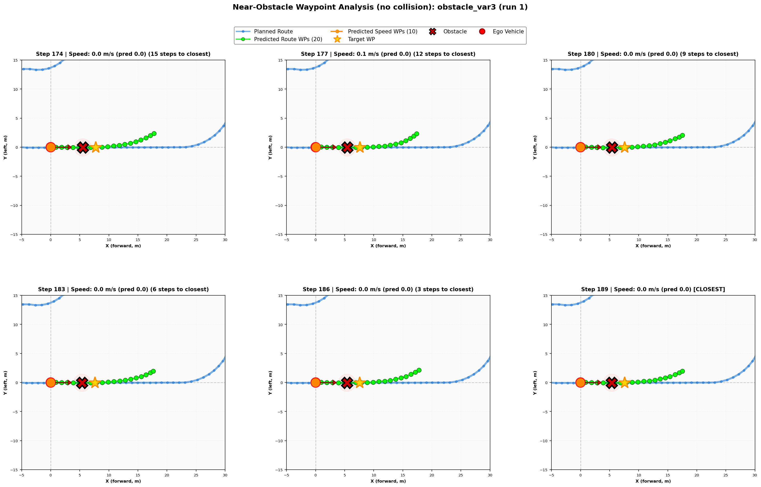
Clean Stops: Variant 1 (Early) & Variant 3 (Exit)
Var 1: Stop at ~6.8 m, speed < 1.5 m/s
Var 3: Stop at ~5.7 m, just exited curve
41

Slide 42
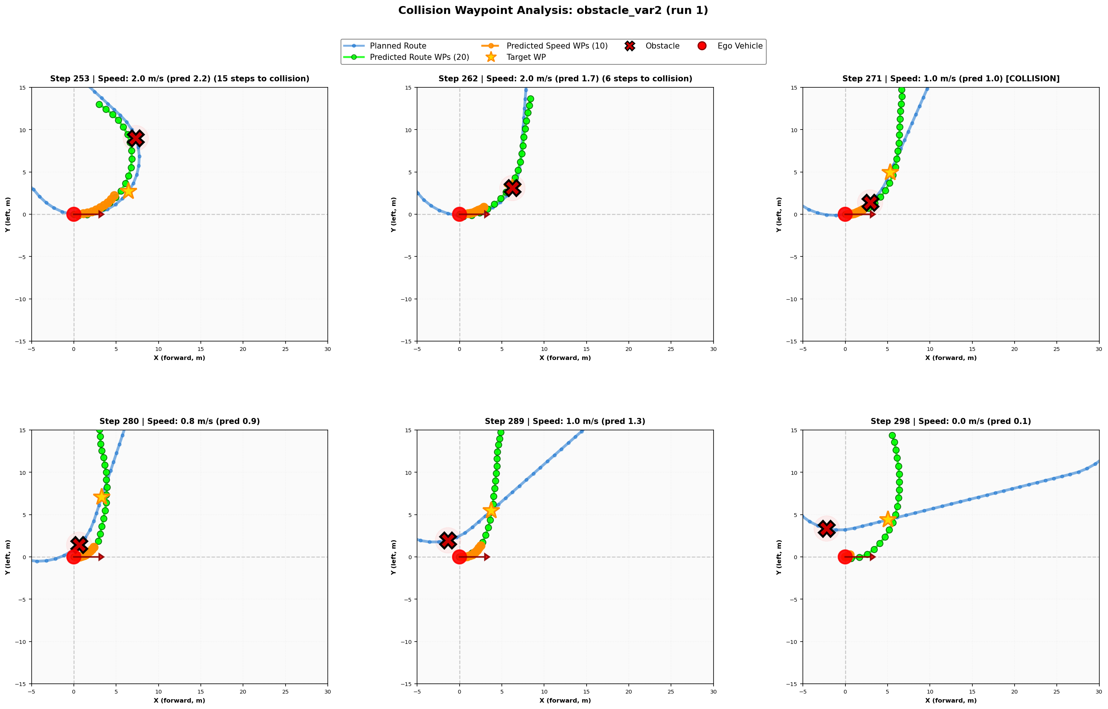
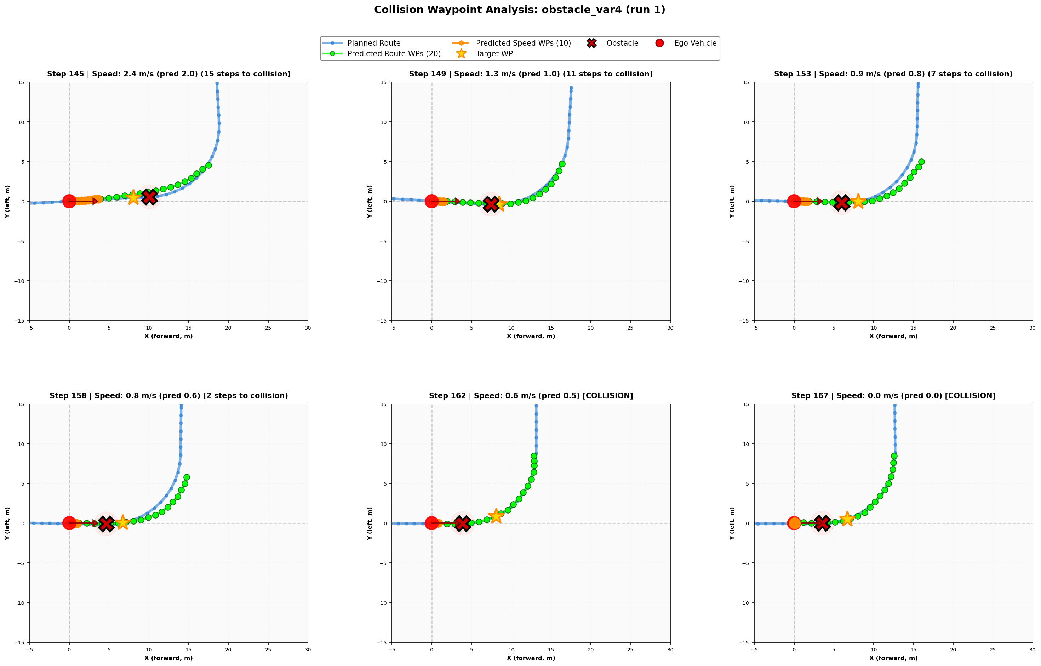
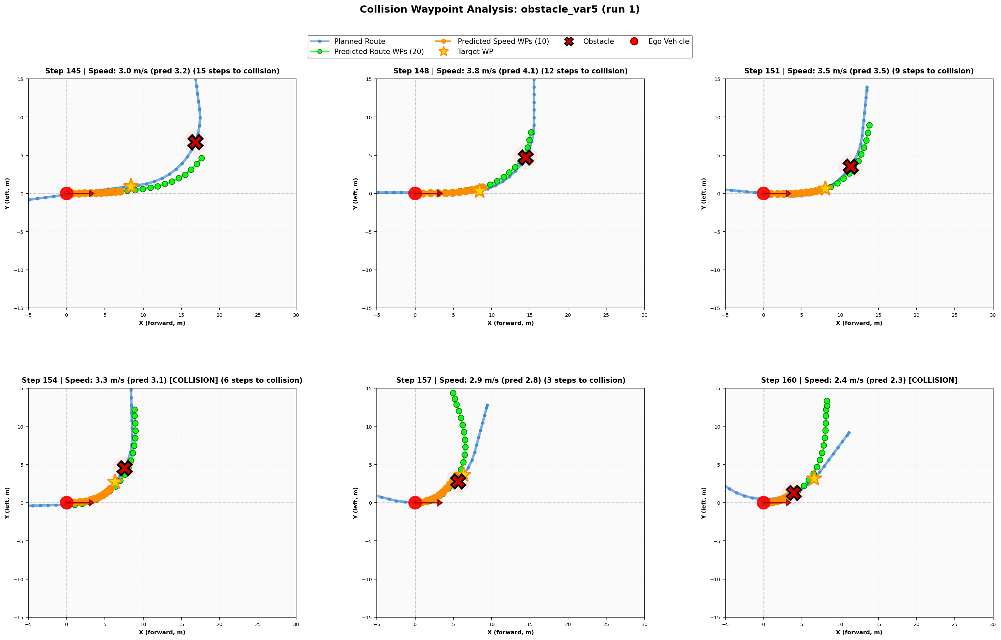
Contact & Failure: Variants 2, 4, and 5
Var 2: Low-speed contact at 3.2 m
Var 4: Contact at 0.6 m/s, stop by step 167
Var 5: No deceleration, 3.4 m/s through
42

Slide 43
Limitations & Future Work
43

Slide 44
Limitations
Sim-to-Sim Gap
Timing Sensitivity
CARLA photorealistic vs QLabs simplified—unclear how much visual grounding transfers
PID derivative factor (1/5) is hand-tuned; speed from single-frame displacement is noisy
Scenario Coverage
Multi-Actor
Limited to roundabout + 5 obstacle positions; no generalization guarantee
Serialized QLabs API limits real-time multi-actor execution
No Language Supervision
In-Distribution Eval
Fine-tuning adapts visual/control but not language-following
Test positions overlap with training—no held-out generalization test
44

Slide 45
Future Work
Broader Scenarios
Multi-Actor
Camera Calibration
Intersections, merges, adverse weather/lighting
Reduce lock contention, async logging
Systematic FOV/resolution matching
PID Robustness
Training Ablations
Language Supervision
Gain tuning sweeps across domains
LoRA rank, learning rate, augmentation
Paired language annotations for commentary
Sim-to-Real
Deploy to physical QCar 2 hardware
Highest priority: broader scenario coverage and sim-to-real transfer to physical QCar 2
45

Slide 46
Conclusion
46

Slide 47
Contributions
1
QLabs Expert Data Collection Pipeline
Keyboard teleop, 4 Hz logging, multi-actor scene management
2
Fine-Tuning Config for InternVL2-1B with LoRA
PyTorch Lightning + DeepSpeed, ~17.6M adapter parameters
3
Real-Time Inference Stack for QCar 2
PID control conversion, timing compensation, ego-frame target points
4
Scenario-Driven Evaluation Harness
15-run test matrix, quantitative metrics, LiDAR ACC baseline comparison
47

Slide 48
Summary of Key Results
25%
60%
4.7×
ADE reduction 0.114 → 0.085 m over 15 epochs
Overall pass rate 9/15 runs (5/5 baseline + 4/10 obstacle)
Lower lateral dev vs ACC on curves (0.056 vs 0.261 m)
Obstacle detection and deceleration in 4 of 5 variants
40% obstacle avoidance pass rate (clean stops) vs ACC baseline 100%
Var 5 (high speed + curved approach): complete failure — model maintains 3–4 m/s
Policy ADE converges to within 2 mm of expert demonstration baseline (0.087 m)
VLA domain transfer via LoRA is feasible with a small dataset — obstacle handling needs further work
48

Slide 49
Thank You
Questions?
Garegin Mazmanyan
The University of Arizona · Department of Computer Science

