Slide 1

LLM Agent-Augmented Visual Analytics
for Semiconductor Wafer Polishing Data
CSC 696D Visual Analytics — Interim Presentation
Garegin Mazmanyan Taoseef Aziz
University of Arizona, Tucson | Spring 2026
1 / 9

Slide 2
Problem & Motivation
Chemical Mechanical Planarization (CMP)
Critical step in semiconductor manufacturing — sensors capture force, temperature, and pressure data during wafer polishing.
The Challenge
Process engineers are domain experts, not data scientists. They must manually select ML models, tune hyperparameters, and interpret diagnostic plots.
Our Solution
An AI agent that combines AutoML with a natural language chat interface — running entirely offline via a local LLM.
~1000 Hz
Sensor sampling rate
15–80
Polishing runs per project
100% Offline
Air-gapped fab compatible
2 / 9

Slide 3
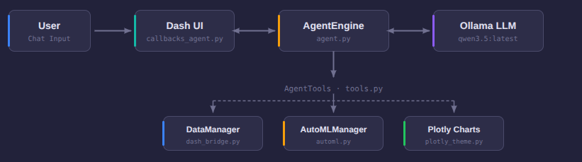
System Architecture
User types in the Dash chat interface. Messages route through callbacks to the AgentEngine, which orchestrates conversations with Ollama (Qwen 3.5). Tool calls dispatch to DataManager, AutoMLManager, or Plotly for chart generation. Results stream back to the UI incrementally.
3 / 9

Slide 4
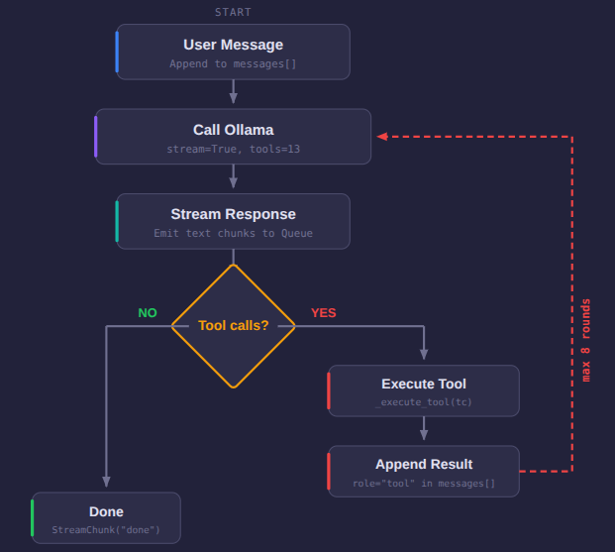
Agent Tool-Calling Loop
How It Works
Background thread
Runs in a daemon thread to avoid blocking the Dash event loop
Streaming via Queue
StreamChunk objects (text, tool_start, tool_end, chart, done) pushed to a thread-safe Queue
Max 8 tool-calling rounds
Safety limit prevents infinite loops — terminates when LLM returns text-only
13 registered tools
Data queries, ML operations, and chart generation tools available each round
4 / 9

Slide 5
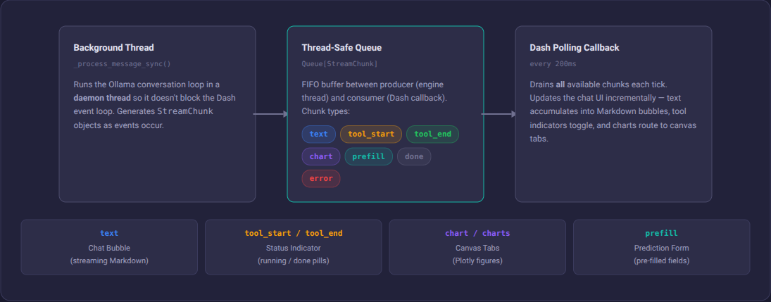
Streaming Pipeline
Engine runs in a daemon thread, pushes StreamChunk objects to a FIFO Queue. A 200ms Dash interval callback drains all chunks and routes them: text to chat bubbles, tool indicators to status pills, charts to canvas tabs, and prefill payloads to the prediction form.
5 / 9

Slide 6
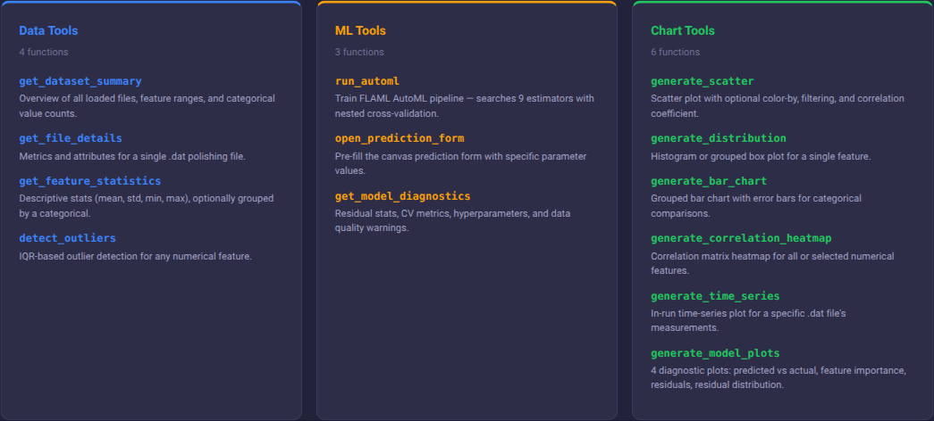
Agent Tools (13 Functions)
6 / 9
All tools are methods on the AgentTools class. Ollama auto-generates JSON schemas from Python type annotations. Chart tools return both a Plotly figure (routed to UI) and a text summary with exact numbers (given to the LLM so it cites real data).

Slide 7
Current Results
13
9
200ms
31
Tools
Implemented
ML Estimators
Searched
Streaming
Interval
Polishing Files
Tested
Implemented Components
Full agent conversation loop with tool calling
AutoML engine (FLAML) with 9 estimators and nested cross-validation
Real-time streaming chat with Markdown rendering
6 chart generation tools (scatter, distribution, bar, heatmap, time-series, model diagnostics)
Tool status indicators (running / done / failed pills)
Context pruning at ~48K chars for long conversations
Prediction form pre-filling from agent conversation
Canvas with tabbed chart history
7 / 9

Slide 8
Remaining Tasks & Challenges
Remaining Tasks
Unsolved Challenges
Add more agent tools
Expand data exploration and comparison capabilities
Simplify existing tool arguments
Reduce parameter complexity with specific argument lists
Evaluation study
Case study with domain expert: task completion, accuracy, user confidence
Write the final report
Document architecture, results, and evaluation
Create final presentation
Polished slide deck with live demo and evaluation results
Ollama lifecycle management
Auto-start/stop Ollama server, health checks, graceful degradation when LLM is unavailable
Tool argument complexity
LLM sometimes struggles with tools that have many optional parameters — need to simplify schemas
Evaluation methodology
Defining fair comparison metrics for agent-assisted vs. manual analytics workflows
Context window limits
Long conversations with large tool results can exceed model context — pruning strategy needs refinement
8 / 9

Slide 9
Feedback Requests
Tool design
Evaluation plan
Are 13 tools the right granularity, or should we consolidate/split further?
Is a single-expert case study sufficient, or should we target multiple users?
AutoML vs. manual
Offline constraint
How should we fairly compare AutoML-selected models against manual baselines?
Does the local-LLM-only approach satisfy the air-gapped requirement, or do we need fallback modes?
Questions?
9 / 9

