Slide 1
UART
(Universal Asynchronous Receiver-Transmitter)
Protocol

Slide 2
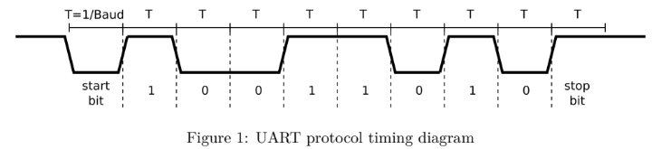
UART
Protocol:
Normally high (‘1’) when not in used.
Serialize a Data (0x59)
Initial Requirements:
Top-level module ports (clk, nrst, tx)
Baud rate of 9600bits/sec

Slide 3
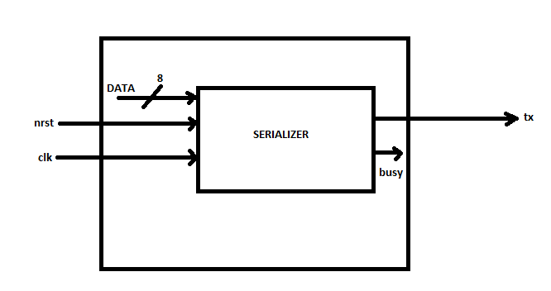
UART
Initial Design Block Diagram:

Slide 4
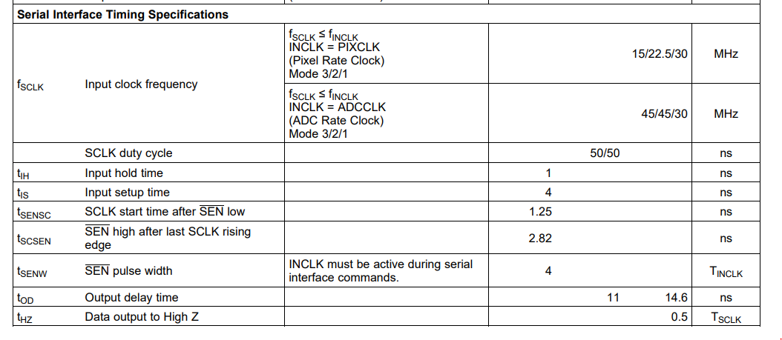
UART
Clock Specification:
(LM98714 Three Channel, 16-Bit, 45 MSPS Analog Front End With LVDS/CMOS Output and Integrated CCD/CIS Sensor Timing Generator)
Input clock frequency of 30Mhz.
https://www.ti.com/lit/ds/symlink/lm98714.pdf?ts=1623995244902&ref_url=https%253A%252F%252Fwww.ti.com%252Fproduct%252FLM98714

Slide 5
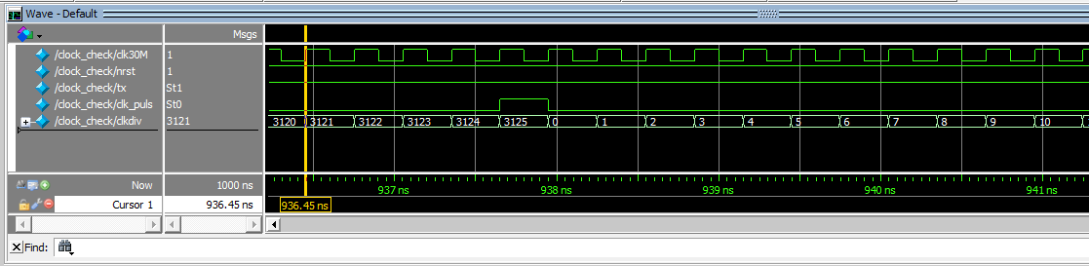
UART
Counter:
Baud = 9600
Clk_freq = 30 000 000 → 0.3ns (in one clock cycle)
(30M)/9600 = 3125 → counts per 1 bit
Log2(3125) = 11.6 ≈ 12 → bits
**Take note: baud rate must be varied so we need to, implement Log2 in the code. But for the initial trial we will pre-set this parameter.

Slide 6
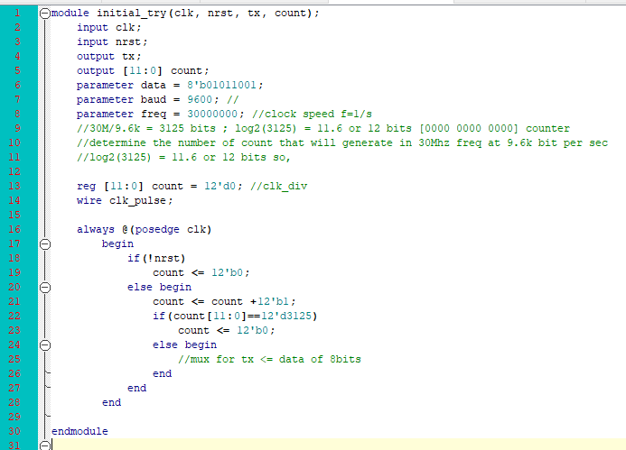
UART
Base module:

