Slide 1
IslaHaven
Mohamed Afnaan Shifau

Slide 2
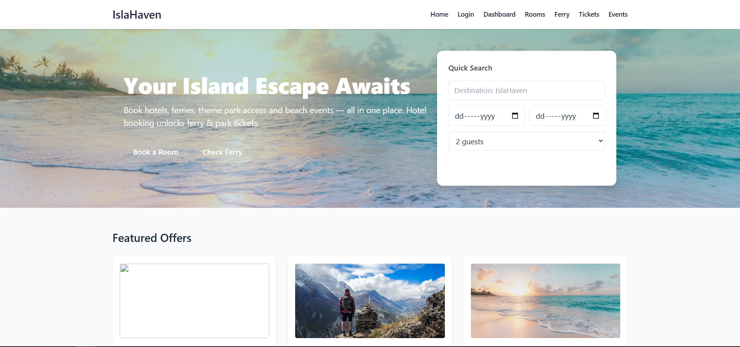
HOMEPAGE

Slide 3
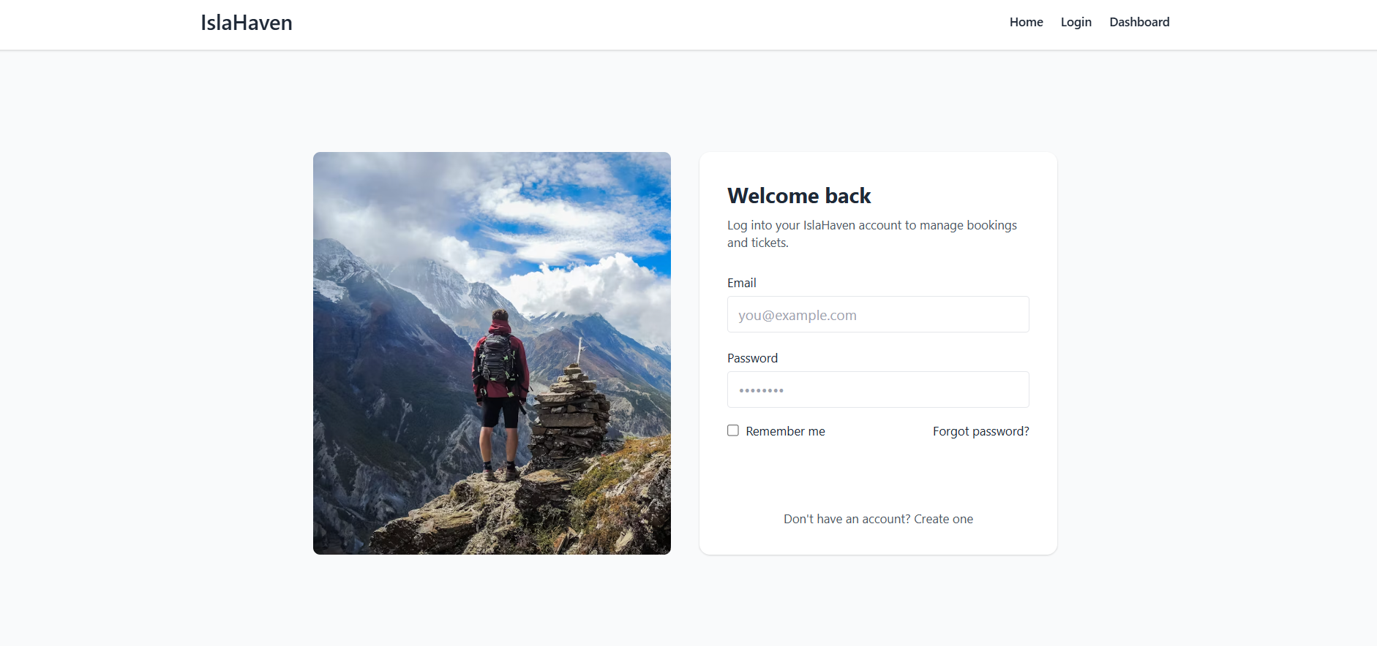
LOGIN PAGE

Slide 4
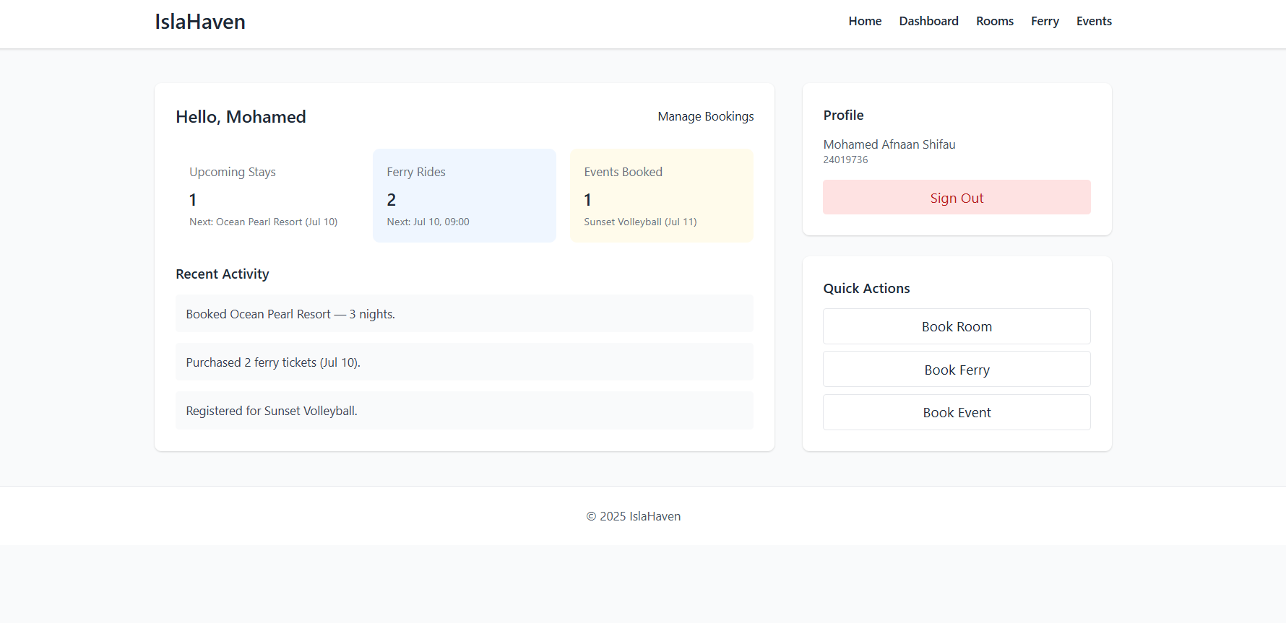
MY BOOKINGS

Slide 5
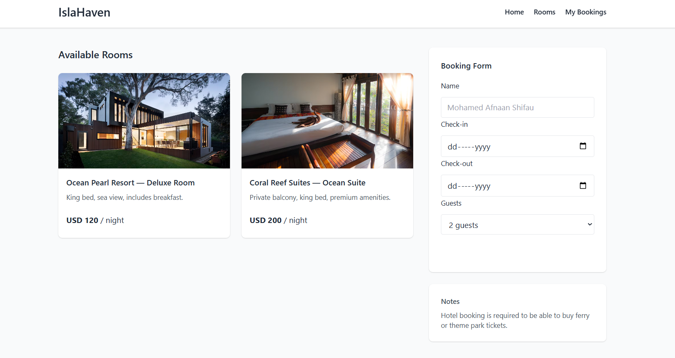
BOOKING FORM PAGE

Slide 6
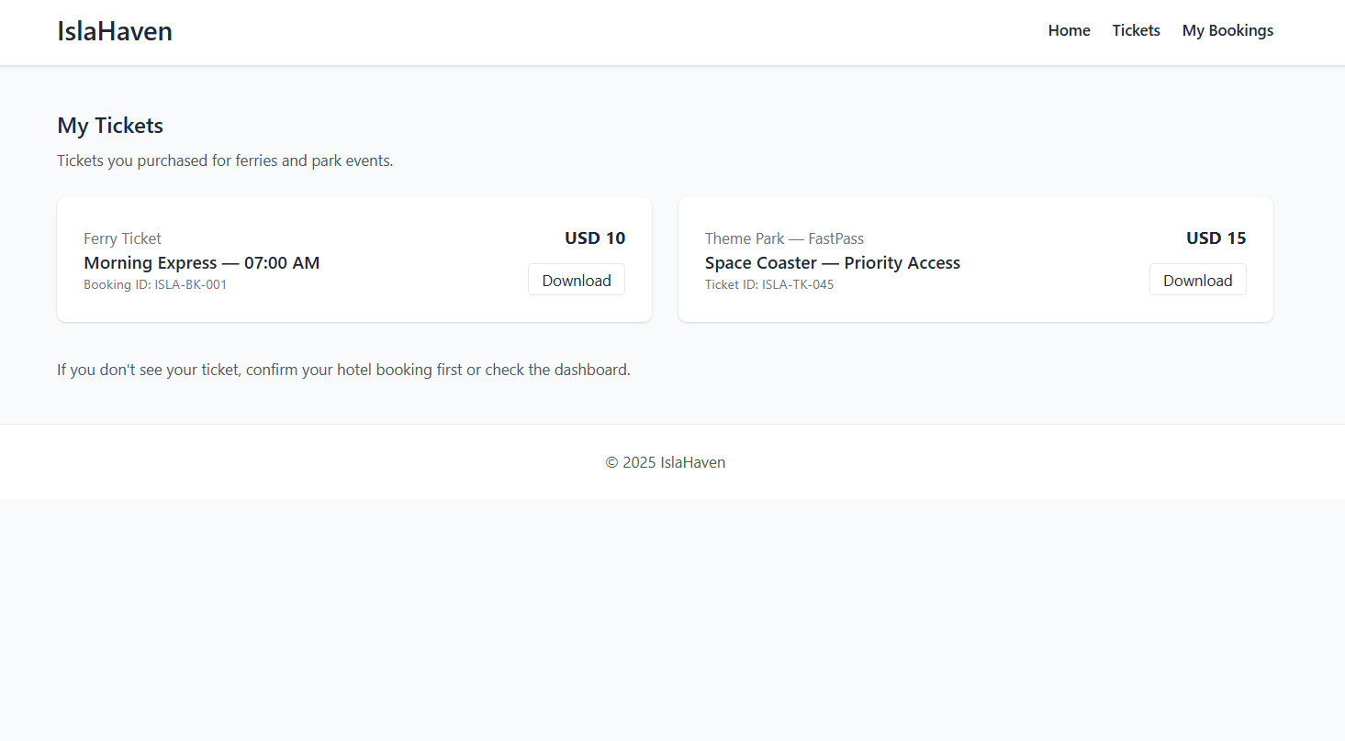
MY TICKETS PAGE

