Slide 1
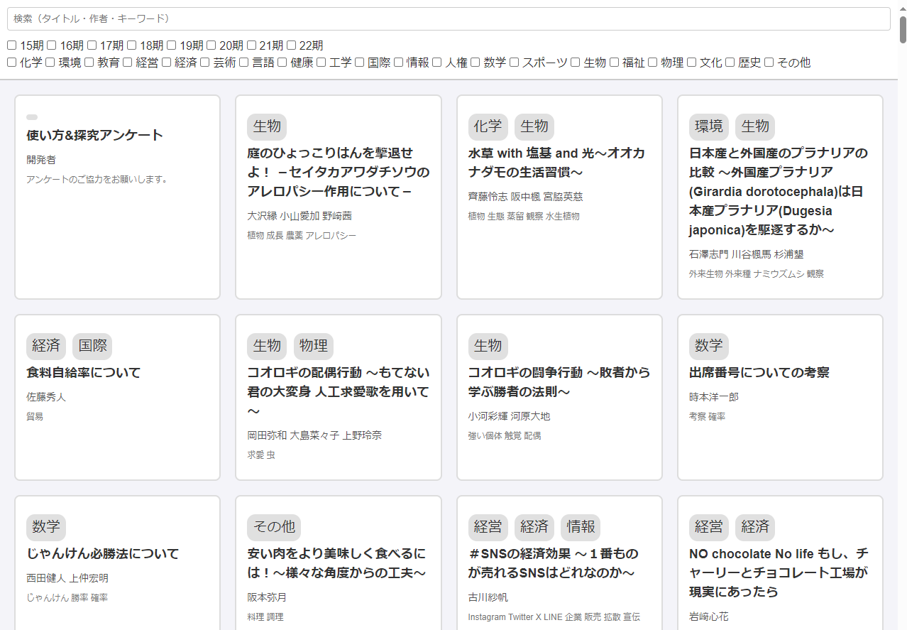
Shoun Poster Finder
<Development of a poster search system to facilitate research activities>
Hyogo Prefectural Sanda Shounkan High School Information team 22nd Minato Kimura, Yuito Kumon
Background
Results
We thought that the reason the poster search system created by the 20th year students was not being used was because the posters were old, the layout was messed up, and it was difficult to use.
So we aimed to make it perfect so that it could be used in classes.
RQ: Will it make inquiry classes easier?
Objective: To facilitate inquiry classes
Hypothesis: If we create system with good UX, classes will run more smoothly.
Although accurate statistics cannot be obtained due to the small number of survey results, the positive response rate for the question of whether the inquiry class was conducted smoothly exceeded 80%, which can be said to have been a success. 90% of people would like to continue using it in the future or would recommend it to their juniors, so it is considered that there is value in continuing development.
71.6%
21.6%
6.6%
Method
Recommend to my juniors
73.3%
20.0%
6.6%
① Organize PDFs.
② Add necessary functions such as search and filtering.
③ Organize the UI (user interface).
④ Publish it on campus and take a survey in the second year.
⑤ Improve and update the unpopular parts.
Our research activities would have been smoother
40.0%
40.0%
20.0%
Want to continue using
86.6%
13.3%
Easy to use
86.6%
13.3%
Yes
Somewhat Yes
Development Environment
Neither
Somewhat No
[Used Languages] [Used Software]
HTML Visual Studio Code
CSS Microsoft Edge
JavaScript Google Chrome
No
Future Outlook
We found that the results were generally well received, so we would like to continue to improve it further in the future. We will also use a form to ask for user feedback to make it easier to use.
The number of responses to this survey was small, so we will look for ways to increase the number next time.
System Overview
·You can view posters made by Shoun students
·You can search by title, author, or keyword
·You can filter by genre and grade
·Supports responsive design
·It's easy to add posters
The foundation of the system was created with HTML, the dynamic parts with JavaScript, and the appearance with CSS. The PDF title, author, keywords, class, and genre are compiled into JSON format and read from JS. JS searches for parts that match the JSON content and displays only the corresponding PDFs. Click to open the PDF in a new tab.
References
Mozilla(2005~).｢MDN Web Docs｣.
https://developer.mozilla.org/ja/ End of August 2024

