Slide 1
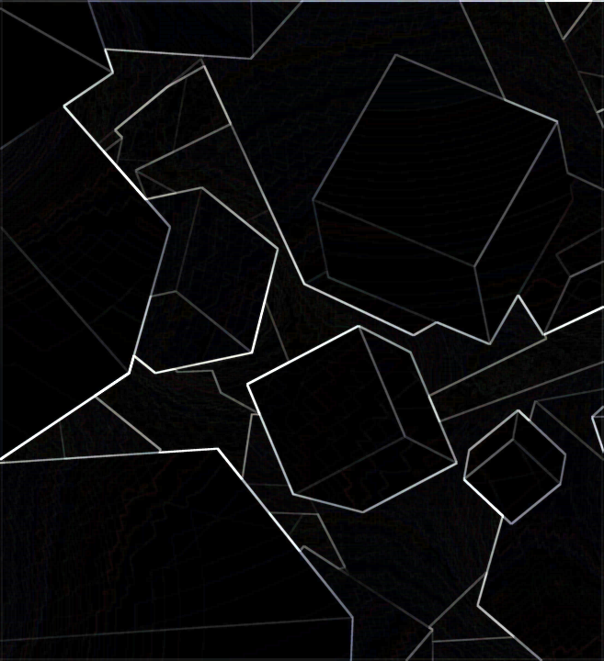
@
Already we have won!!
m.Kimura Y.eto
Notes:
自己紹介
・メンバー紹介
・軽く流れを紹介

Slide 2
Reasons for running
@
m.Kimura Y.eto
Already we have won!!
We can use AI well.
We have very strong mental, we can accept any opinion.
There is a need for AI these days and he has a lot of the knowledge we need.
Now, he recommends class reader.
Notes:
ナゼ立候補したか
・最先端のAIを上手に使える
・強いメンタルを持っていて、どんな意見も受け入れる

Slide 3
What we want to do
@
m.Kimura Y.eto
Already we have won!!
We want to increase class using PCs.
We want to improve quality of BYODs.
We want to increase class of internet literacy.
Notes:
We think this school should use PC more.
I know other school students can’t take a class without PC or tablet.
But our BYOD is too low specs to use in class. You think so too, right?
So, We want improve quality of it.
If we use it more, it’s necessary for us to take literacy class.
I hope you all will be able to create slides like this.

Slide 4
Pros and Cons
@
m.Kimura Y.eto
Already we have won!!
It can lean skills of future society.
It cost more money, so we need to be supported by educational institutions.
Eyesight deteriorates. but we often using smartphone, it’s more problem.
Notes:
Using BYODs in class is lots of merit.
Give the best merit,
We can lean skills you’ll need in the near future by using it.
But there are some demerit .
For example,
It cost more money.
Our eyesight maybe de worse.
BUT!!
We often use smartphone.
Smartphone are worse for your eyesight than BYODs.

Slide 5
r
o
e
n
u
k
n
a
t
h
i
s
y
o
t
f
i
n
g
l

Slide 6
t
h
a
n
k
y
o
u
f
o
r
l
i
s
t
e
n
i
n
g
Notes:
Thank you for listening.

Slide 7
a
g
n
n
f
t
o
i
t
u
e
r
o
n
h
i
l
y
s
k

