Slide 1
Hypothesis testing
Dr. PK

Slide 2

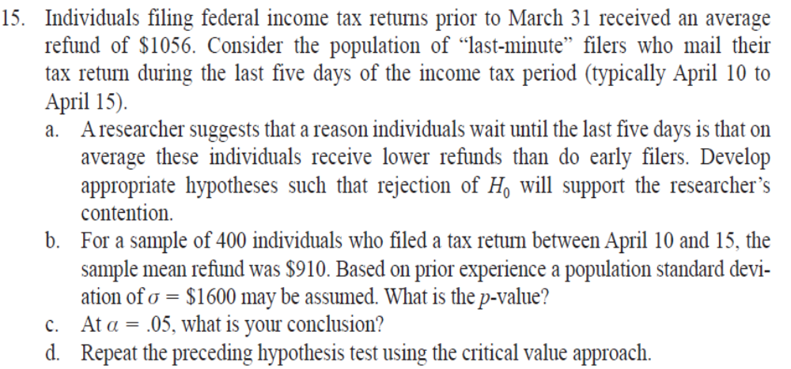
Known

Slide 3
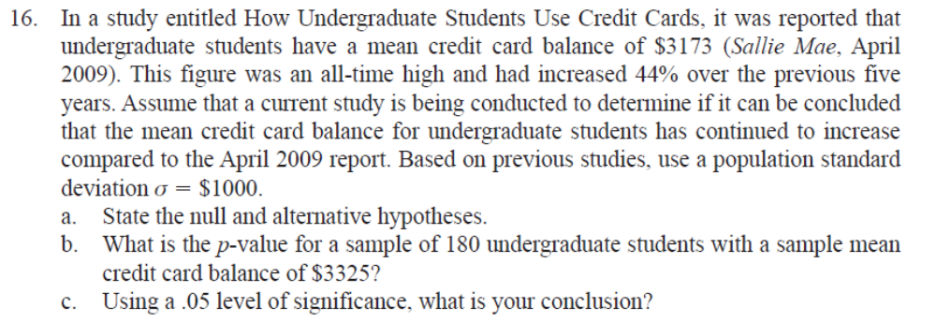

Slide 4
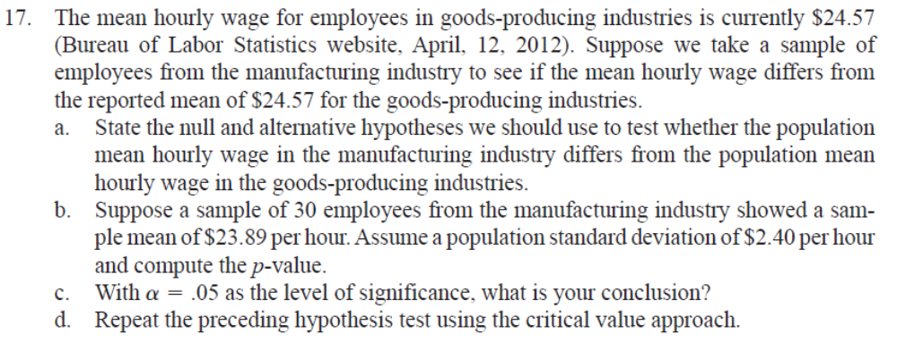

Slide 5
  18. The average annual total return for U.S. Diversified Equity mutual funds from 1999 to 2003 was 4.1% (BusinessWeek, January 26, 2004). A researcher would like to conduct a hypothesis test to see whether the returns for mid-cap growth funds over the same period are significantly different from the average for U.S. Diversified Equity funds.
  a. Formulate the hypotheses that can be used to determine whether the mean annual return for mid-cap growth funds differ from the mean for U.S. Diversified Equity funds.
  b. A sample of 40 mid-cap growth funds provides a mean return of ẍ= 3.4%. Assume the population standard deviation for mid-cap growth funds is known from previous studies to be σ = 2%. Use the sample results to compute the test statistic and p-value for the hypothesis test.
  c. At α= .05, what is your conclusion?

Slide 6
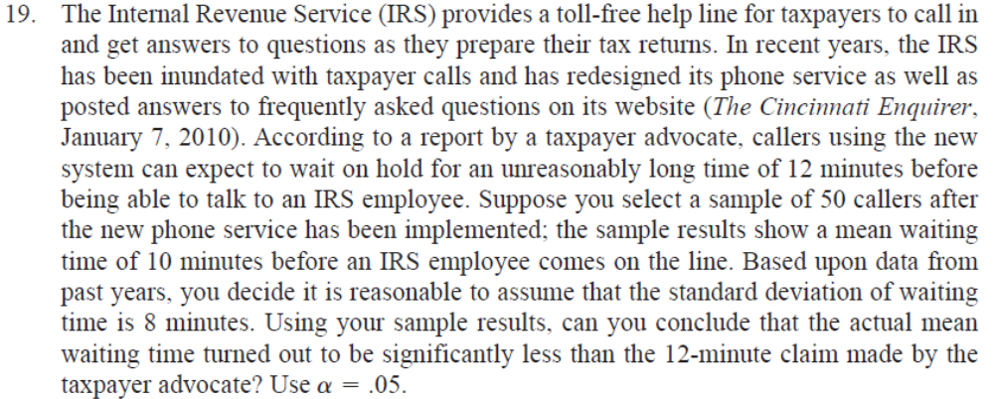

Slide 7
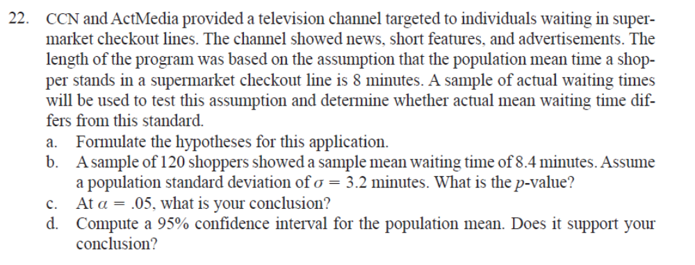

Slide 8
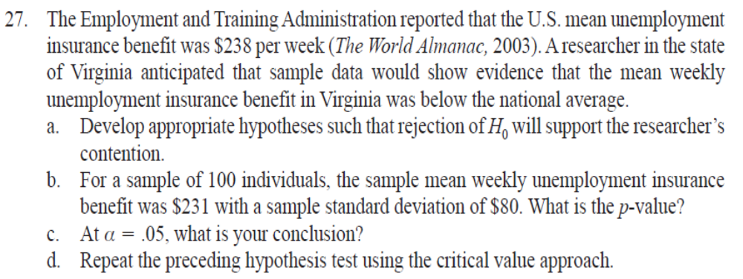
Unknown

Slide 9
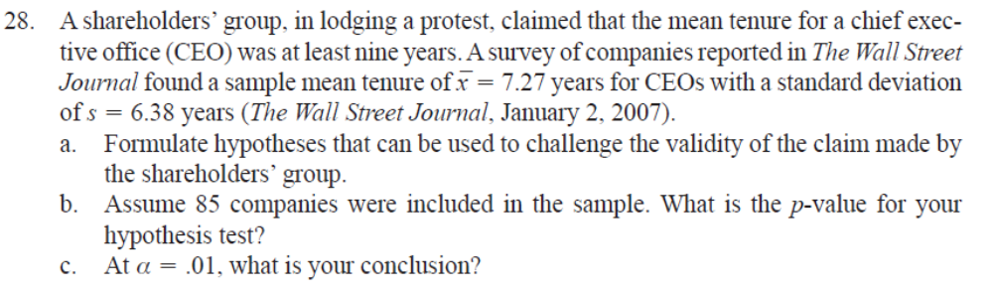

Slide 10
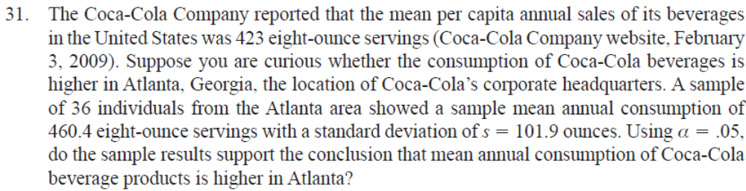

Slide 11
