Slide 1
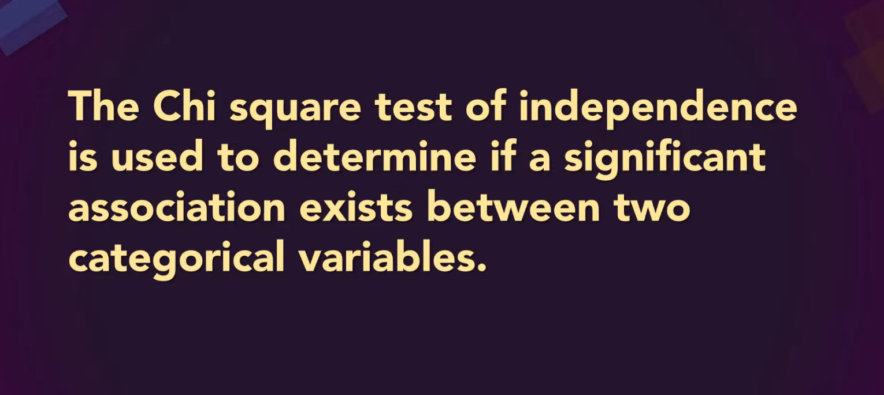
The Chi-Square Test of Independence
MBA BUSINESS STATISTICS
Notes:
Start with a quick show of hands: who used an AI tool this week? Keep that number in mind. The worked example today asks whether AI usage depends on age, using the survey of 1,440 people from the reference video.
The numbers on the right are the real observed counts from that video. By the end, every student should be able to run this test by hand, in Excel, and explain the answer to a manager in one sentence.

Slide 2
Anatomy of a contingency table
FOUNDATIONS
Age group | Uses AI: Yes | Uses AI: No | Total
Under 30 | 312 | 178 | 490
30–49 | 273 | 183 | 456
50 & above | 224 | 270 | 494
Total | 809 | 631 | 1,440
Cell
One observed count, O. Here: 312 under-30s use AI.
Marginal totals
Row and column totals, sitting in the margins.
Grand total, n
Everyone in the sample: 1,440.
Also called a two-way table, cross-classification table or cross-tab
3 × 2 table
r = 3 rows (age), c = 2 columns (AI usage). Rows are always named first.
Notes:
Walk the table piece by piece. Age group runs down the rows and AI usage across the columns. Each inner cell is an observed count.
Totals on the edges are called marginal totals, because they sit in the margins. And the bottom-right number is the grand total, n. In the video this is a 3 by 2 table: rows first, then columns.
A small note for you: the reference video names only the 'Under 30' band on screen, so the labels '30–49' and '50 & above' are our assumption. The counts are exactly the video's.

Slide 3

The question, in plain English
FOUNDATIONS
H₀ · Null hypothesis
H₁ · Alternative hypothesis
Age and AI usage are independent.
Age and AI usage are associated.
The share of AI users is the same in every age group. Any gaps in the sample are just chance.
At least one age group uses AI at a different rate from the others.
Why a manager cares: under H₀, one onboarding campaign fits everyone. Under H₁, the AI-tool budget should be split by age group. Same data, different spending decision.
The test compares what we observed with what we'd expect if H₀ were true.
Notes:
Get students to say H0 in their own words before you reveal it. The usual trap: thinking H0 means 'nobody uses AI' or 'the groups are the same size'. It means the usage pattern is the same in every age group.
Then ask what a marketing head would do differently under each hypothesis. That's the whole reason we test.

Slide 4
The mechanics
02
The reference video's worked example, one step at a time: age group × AI usage, n = 1,440
Notes:
Now the arithmetic, exactly as the reference video does it. Go slowly here. Everything later builds on these five slides.

Slide 5
Expected counts come from the margins
STEP 1 · EXPECTED COUNTS
Age group | Yes | No | Total
Under 30 | ? | 178 | 490
30–49 | 273 | 183 | 456
50 & above | 224 | 270 | 494
Total | 809 | 631 | 1,440
E = (Row total × Column total) ÷ n
The count we'd expect in a cell if H₀ were true
Why this formula? Independence means probabilities multiply: P(row and column) = P(row) × P(column). Multiply by n and you get n × (R/n) × (C/n), which simplifies to R × C ÷ n.
Under 30 × Yes
490 × 809 ÷ 1,440
= 275.28
Notes:
This is the one idea students must own. Expected counts are what we'd see if H0 were true. Independence means you can multiply probabilities: the chance of being under 30 times the chance of using AI.
Multiply by n and the arithmetic collapses to row total times column total over grand total. Have them compute one more cell on their own: 30–49 and Yes. They should get 456 × 809 ÷ 1,440 = 256.18.

Slide 6

Observed vs expected, side by side
STEP 1 · EXPECTED COUNTS
Observed (O)
Expected if independent (E)
Age group | Yes | No | Total
Under 30 | 312 | 178 | 490
30–49 | 273 | 183 | 456
50 & above | 224 | 270 | 494
Total | 809 | 631 | 1,440
Age group | Yes | No | Total
Under 30 | 275.28 | 214.72 | 490
30–49 | 256.18 | 199.82 | 456
50 & above | 277.53 | 216.47 | 494
Total | 809 | 631 | 1,440
Totals match
All E ≥ 5
Expected row and column totals equal the observed ones, give or take rounding. If they don't, recheck the arithmetic.
The smallest expected count is 199.82, far above 5, so the test is valid here.
Notes:
Two quick checks the video mentions. First, the expected totals match the observed totals, give or take rounding. If they don't, someone made an arithmetic slip.
Second, every expected count is at least 5, so the test is valid. The smallest here is 199.82, nowhere near the limit.

Slide 7
Add up the surprises: the χ² statistic
STEP 2 · THE TEST STATISTIC
Cell | O | E | (O − E)² ÷ E
Under 30 · Yes | 312 | 275.28 | 4.90
Under 30 · No | 178 | 214.72 | 6.28
30–49 · Yes | 273 | 256.18 | 1.10
30–49 · No | 183 | 199.82 | 1.42
50 & above · Yes | 224 | 277.53 | 10.33
50 & above · No | 270 | 216.47 | 13.24
Total | 1,440 | 1,440 | χ² = 37.26
χ² = Σ (O − E)² ÷ E
Sum over every cell of the table
Squaring removes the sign, so over and under both count.
Dividing by E scales each gap to the size of its cell.
The 50 & above row supplies 23.6 of the 37.26 total.
Rounded parts add to 37.27, the unrounded total is 37.26. The video quotes both.
Notes:
Each cell's contribution is the squared gap between observed and expected, scaled by the expected count. Squaring removes the sign, so over and under both add to the total. Dividing by E keeps big cells from dominating just because they're big.
Point at the 50-plus row: it supplies about 23.6 of the 37.26. That's a preview of the residual analysis later. The video says 37.27 in one place and 37.26 in another; it's rounding, nothing more.

Slide 8
How many cells are actually free?
STEP 3 · DEGREES OF FREEDOM
Age group | Yes | No | Total
Under 30 | 312 | 490 − 312 | 490
30–49 | 273 | 456 − 273 | 456
50 & above | 809 − 585 | 494 − 224 | 494
Total | 809 | 631 | 1,440
df = (r − 1)(c − 1)
= (3 − 1)(2 − 1) = 2
Table size | df
2 × 2 | 1
3 × 3 | 4
4 × 3 | 6
5 × 4 | 12
Free choice: pick any value
Forced by the totals
Once the margins are fixed, two cells decide the whole table.
Notes:
Degrees of freedom count how many cells you could fill in freely once the totals are fixed. In a 3 by 2 table, pick two counts in the Yes column and everything else is forced by subtraction. Hence df = 2.
Quick drill: ask for the df of a 4 by 3 table. Answer: 6.

Slide 9
Two routes to the same decision
STEP 5 · DECIDE
Critical value route
p-value route
From a χ² table or Excel
From software
Critical value (df = 2, α = .05)
5.99
p = P(χ² ≥ 37.26)
≈ 0.000000008
Our statistic
37.26
Significance level
α = 0.05
Rule
Reject H₀ if χ² > 5.99
Rule
Reject H₀ if p < α
37.26 > 5.99 → Reject H₀
p < 0.05 → Reject H₀
Conclusion in context: age and AI usage are associated. The pattern of AI use differs across age groups, and chance is a poor explanation for a gap this size.
Notes:
Both routes always agree, so use whichever the question gives you. Printed tables give critical values; software gives p-values. Make students write the conclusion in context: 'age and AI usage are associated', not just 'reject H0'.
A manager can't act on 'reject H0'.

Slide 10
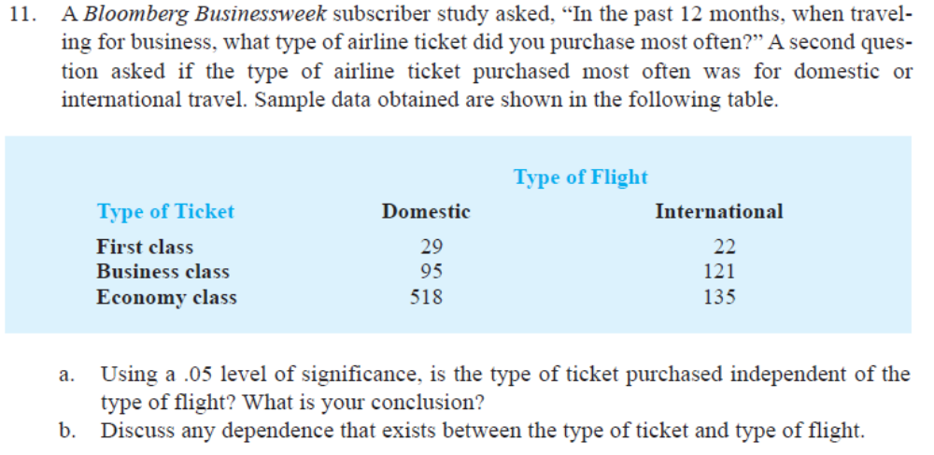

Slide 11
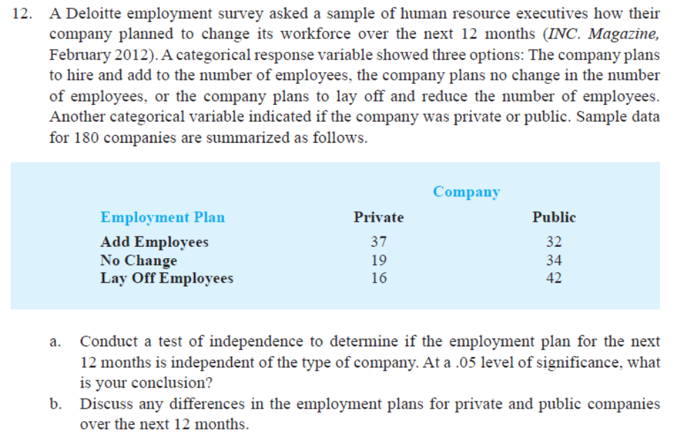

Slide 12
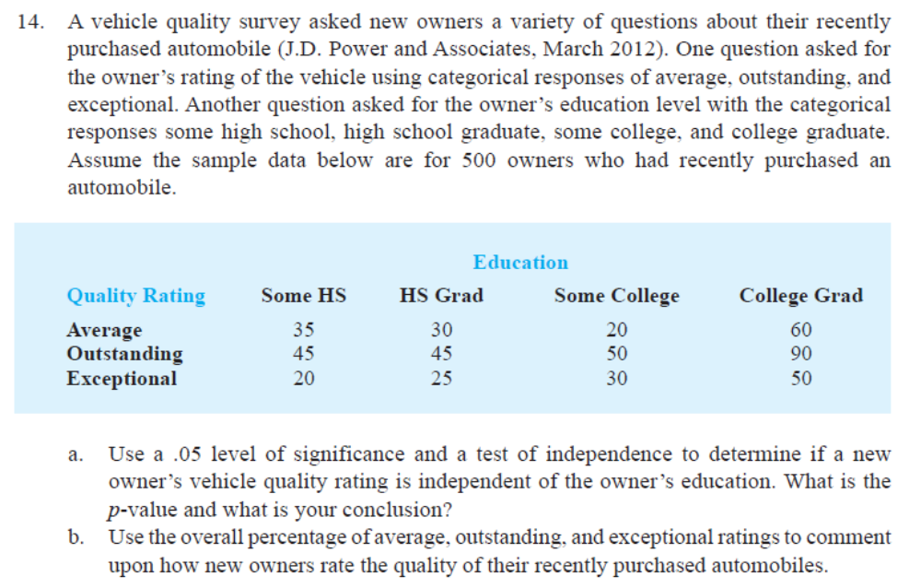

Slide 13
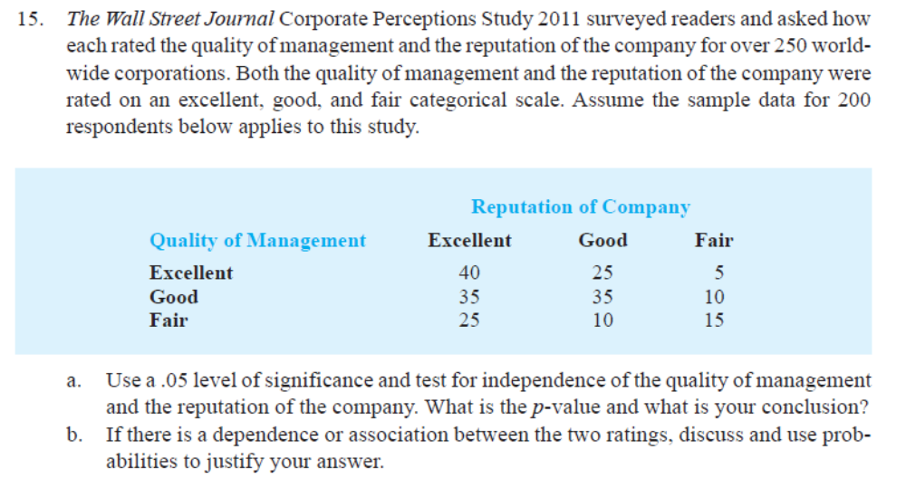

Slide 14
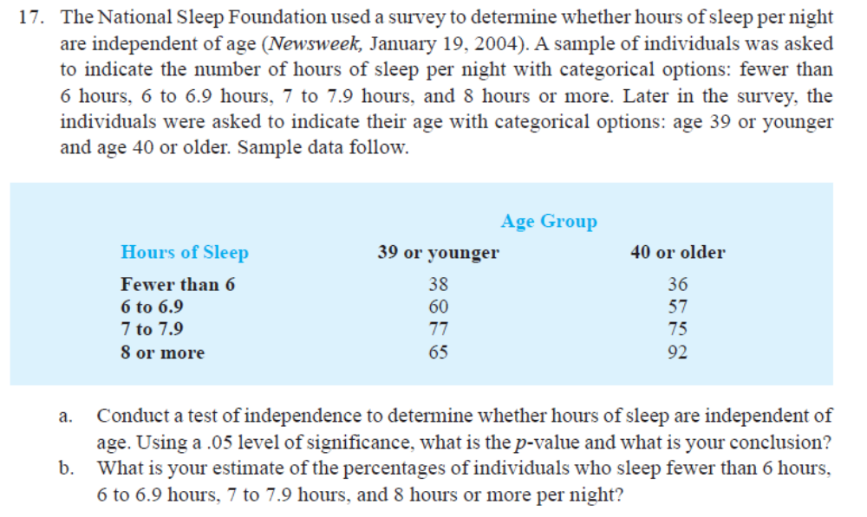

Slide 15


Does specialisation decide placement?
CASE 10 · CAMPUS PLACEMENT
Observed counts
The situation
Specialisation | Placed | Not placed | Total
Marketing | 30 | 5 | 35
Finance | 35 | 5 | 40
HR | 16 | 4 | 20
Business Analytics | 23 | 2 | 25
Total | 104 | 16 | 120
A business school's MBA batch of 120 has finished final placements. The placement office recorded each student's specialisation and outcome.
The question A faculty member argues that specialisation decides placement. Test it, but check the assumptions first.
Illustrative data · α = 0.05
Your task: state H₀ and H₁, check assumptions, compute E and χ², decide at α = 0.05, and name the cells driving the result.
Think about it
Compute the expected 'Not placed' counts before anything else. What do you notice?
Notes:
This case is built to trip people up. Many students will jump straight to χ². Make them compute the expected 'Not placed' column first.

Slide 16
Which chi-square test fits your question?
CHOOSING THE TEST
Goodness of fit
Independence
Homogeneity
One variable against a claimed distribution
One sample, classified on two variables
Separate samples from each group, one variable
Example
Are complaints spread evenly across the week?
Example
Is age linked to AI usage?
Example
Do three cities share the same payment mix?
df = k − 1
df = (r − 1)(c − 1)
df = (r − 1)(c − 1)
Independence and homogeneity use identical arithmetic; they differ in how the sample was drawn. Paired yes/no data on the same people → McNemar's test.
Notes:
Students confuse these constantly. Goodness of fit has one variable. Independence and homogeneity both use two-way tables and the same arithmetic; the difference is the sampling design.
One sample classified two ways is independence. Separate samples drawn from each group is homogeneity. Case 6 is technically homogeneity, since exactly 300 people were sampled per city tier.

Slide 17




Running it in Excel, Python, R and SPSS
SOFTWARE
Excel
Python (SciPy)
=CHISQ.TEST(observed, expected) → p
=CHISQ.INV.RT(0.05, df) → cutoff
=CHISQ.DIST.RT(chi2, df) → p
from scipy.stats import chi2_contingency
chi2, p, dof, exp = chi2_contingency(
table, correction=False)
Build the expected table first with =R*C/n.
correction=False matches hand calculations.
R
SPSS
res <- chisq.test(tbl, correct = FALSE)
res$expected # E table
res$stdres # adjusted residuals
Analyze → Descriptive Statistics →
Crosstabs → Statistics: Chi-square, Phi
and Cramér's V → Cells: Adjusted std.
Yates is on by default for 2 × 2 tables.
One dialog gives the whole expert package.
Notes:
Excel is where most MBA grads will run this. CHISQ.TEST needs both the observed and the expected ranges, so build the expected table first with the row times column over n formula and absolute references. Python and R apply Yates' correction to 2 by 2 tables by default; switch it off to match hand calculations, or leave it on and say so.
SPSS gives the full package, including Cramér's V and adjusted residuals, from one dialog.

