Slide 1
Statistics for Managers
Using Microsoft® Excel
Regression

Slide 2
Learning Objectives
In this chapter, you learn:
To use regression analysis to predict the value of a dependent variable based on an independent variable
The meaning of the regression coefficients b₀ and b₁
To evaluate the assumptions of regression analysis and know what to do if the assumptions are violated
To make inferences about the slope and correlation coefficient
To estimate mean values and predict individual values

Slide 3
Correlation vs. Regression
A scatter plot (or scatter diagram) can be used to show the relationship between two numerical variables
Correlation analysis is used to measure strength of the association (linear relationship) between two variables
  Correlation is only concerned with strength of the relationship
  No causal effect is implied with correlation

Slide 4
Regression Analysis
Regression analysis is used to:
  Predict the value of a dependent variable based on the value of at least one independent variable
  Explain the impact of changes in an independent variable on the dependent variable
Dependent variable: the variable you wish to explain
Independent variable: the variable used to explain the dependent variable

Slide 5
Simple Linear Regression Model
Only one independent variable, X
Relationship between X and Y is described by a linear function
Changes in Y are related to changes in X

Slide 6
Types of Relationships
Linear relationships
Curvilinear relationships
Y
Y
X
X
Y
Y
X
X

Slide 7
Types of Relationships
Strong relationships
Weak relationships
Y
Y
X
X
Y
Y
X
X

Slide 8
Types of Relationships
Y
No relationship
X
Y
X

Slide 9
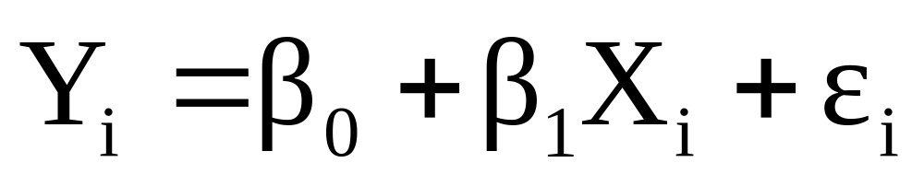
The Linear Regression Model
Population Slope
Coefficient
Random Error term
Population
Y intercept
Independent Variable
Dependent Variable
Linear component
Random Error
component
The population regression model:

Slide 10

The Linear Regression Model
Y
Observed Value of Y for X_{i}
ε_{i}
Slope = β₁
Predicted Value of Y for X_{i}
Random Error for this X_{i} value
Intercept = β₀
X_{i}
X

Slide 11
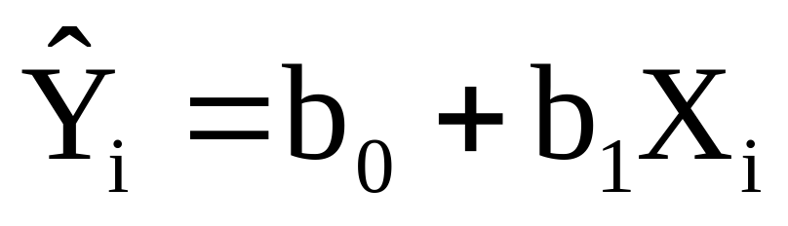
Linear Regression Equation
The simple linear regression equation provides an estimate of the population regression line
Estimated (or predicted) Y value for observation i
Estimate of the regression
intercept
Estimate of the regression slope
Value of X for observation i

Slide 12

The Least Squares Method
b₀ and b₁ are obtained by finding the values of b₀ and b₁ that minimize the sum of the squared differences between Y and :

Slide 13
Finding the Least Squares Equation
The coefficients b₀ and b₁ , and other regression results in this chapter, will be found using Excel
Formulas are shown in the text for those who are interested

Slide 14
Interpretation of the
Intercept and the Slope
b₀ is the estimated mean value of Y when the value of X is zero
b₁ is the estimated change in the mean value of Y for every one-unit change in X

Slide 15
Linear Regression Example
A real estate agent wishes to examine the relationship between the selling price of a home and its size (measured in square feet)
A random sample of 10 houses is selected
  Dependent variable (Y) = house price in $1000s
  Independent variable (X) = square feet

Slide 16
Linear Regression Example
Data
House Price in $1000s (Y) | Square Feet (X)
245 | 1400
312 | 1600
279 | 1700
308 | 1875
199 | 1100
219 | 1550
405 | 2350
324 | 2450
319 | 1425
255 | 1700

Slide 17
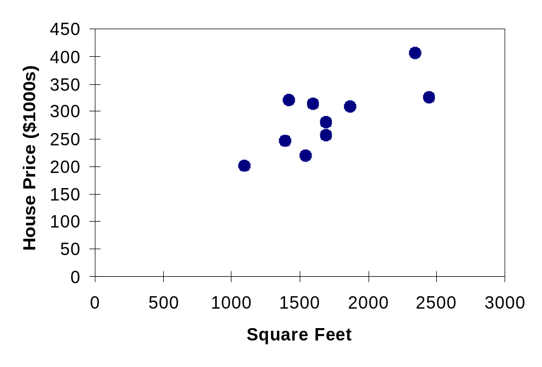
Linear Regression Example
Scatterplot
House price model: scatter plot

Slide 18
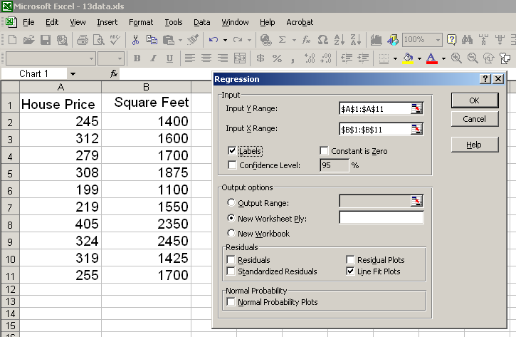
Linear Regression Example
Using Excel
Tools
--------
Data Analysis
--------
Regression

Slide 19
Linear Regression Example
Excel Output
The regression equation is:
Regression Statistics
Multiple R | 0.76211
R Square | 0.58082
Adjusted R Square | 0.52842
Standard Error | 41.33032
Observations | 10
ANOVA | df | SS | MS | F | Significance F
Regression | 1 | 18934.9348 | 18934.9348 | 11.0848 | 0.01039
Residual | 8 | 13665.5652 | 1708.1957
Total | 9 | 32600.5000
 | Coefficients | Standard Error | t Stat | P-value | Lower 95% | Upper 95%
Intercept | 98.24833 | 58.03348 | 1.69296 | 0.12892 | -35.57720 | 232.07386
Square Feet | 0.10977 | 0.03297 | 3.32938 | 0.01039 | 0.03374 | 0.18580

Slide 20
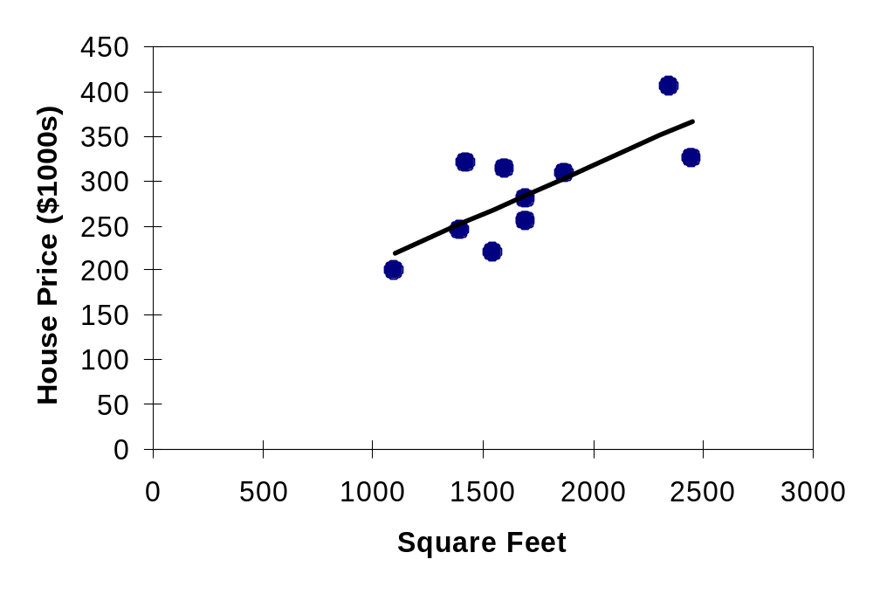
Linear Regression Example
Graphical Representation
House price model: scatter plot and regression line
Slope
= 0.10977
Intercept
= 98.248

Slide 21
Linear Regression Example
Interpretation of b₀
b₀ is the estimated mean value of Y when the value of X is zero (if X = 0 is in the range of observed X values)
Because the square footage of the house cannot be 0, the Y intercept has no practical application.

Slide 22
Linear Regression Example
Interpretation of b₁
b₁ measures the mean change in the average value of Y as a result of a one-unit change in X
Here, b₁ = .10977 tells us that the mean value of a house increases by .10977($1000) = $109.77, on average, for each additional one square foot of size

Slide 23
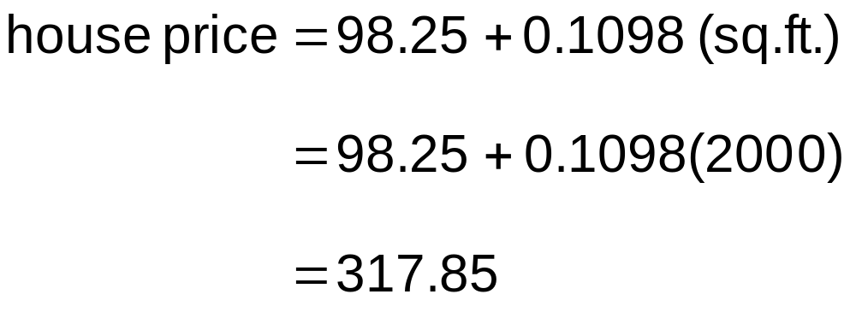
Linear Regression Example
Making Predictions
Predict the price for a house with 2000 square feet:
The predicted price for a house with 2000 square feet is 317.85($1,000s) = $317,850

Slide 24

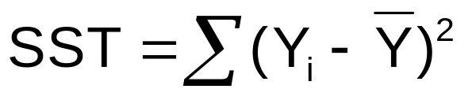
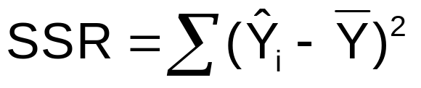
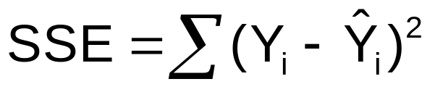

Measures of Variation
Total variation is made up of two parts:
Total Sum of Squares
Regression Sum of Squares
Error Sum of Squares
where:
= Mean value of the dependent variable
Y_{i} = Observed values of the dependent variable
_{i} = Predicted value of Y for the given X_{i} value

Slide 25
Measures of Variation
SST = total sum of squares
  Measures the variation of the Y_{i} values around their mean Y
SSR = regression sum of squares
  Explained variation attributable to the relationship between X and Y
SSE = error sum of squares
  Variation attributable to factors other than the relationship between X and Y

Slide 26
Measures of Variation
Y
Y_{i}
∧
∧
SSE = ∑(Y_{i} - Y_{i} )²
Y
_
SST = ∑(Y_{i} - Y)²
∧
Y
_
∧
_
SSR = ∑(Y_{i} - Y)²
_
Y
Y
X
X_{i}

Slide 27
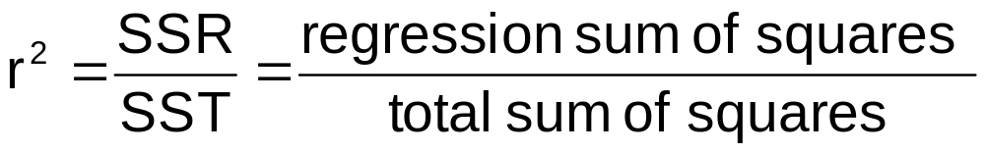
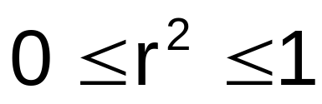
Coefficient of Determination, r²
The coefficient of determination is the portion of the total variation in the dependent variable that is explained by variation in the independent variable
The coefficient of determination is also called r-squared and is denoted as r²

Slide 28
Coefficient of Determination, r²
Y
r² = 1
Perfect linear relationship between X and Y:
100% of the variation in Y is explained by variation in X
X
r² = -1
Y
X
r² = 1

Slide 29
Coefficient of Determination, r²
Y
0 < r² < 1
Weaker linear relationships between X and Y:
Some but not all of the variation in Y is explained by variation in X
X
Y
X

Slide 30
Coefficient of Determination, r²
r² = 0
Y
No linear relationship between X and Y:
The value of Y is not related to X. (None of the variation in Y is explained by variation in X)
X
r² = 0

Slide 31
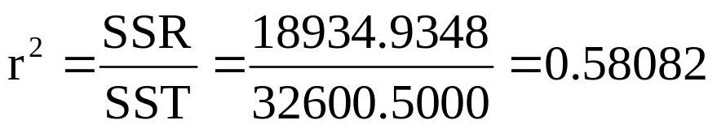
Linear Regression Example
Coefficient of Determination, r²
Regression Statistics
Multiple R | 0.76211
R Square | 0.58082
Adjusted R Square | 0.52842
Standard Error | 41.33032
Observations | 10
ANOVA | df | SS | MS | F | Significance F
Regression | 1 | 18934.9348 | 18934.9348 | 11.0848 | 0.01039
Residual | 8 | 13665.5652 | 1708.1957
Total | 9 | 32600.5000
 | Coefficients | Standard Error | t Stat | P-value | Lower 95% | Upper 95%
Intercept | 98.24833 | 58.03348 | 1.69296 | 0.12892 | -35.57720 | 232.07386
Square Feet | 0.10977 | 0.03297 | 3.32938 | 0.01039 | 0.03374 | 0.18580
58.08% of the variation in house prices is explained by variation in square feet

Slide 32
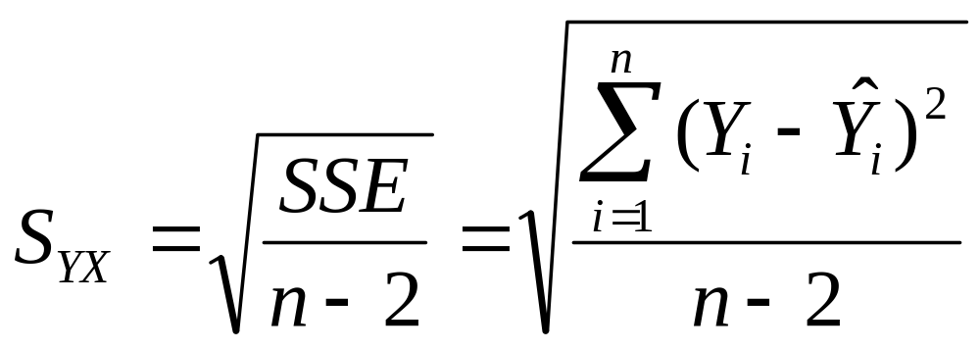
Standard Error of Estimate
The standard deviation of the variation of observations around the regression line is estimated by
Where
SSE = error sum of squares
n = sample size

Slide 33
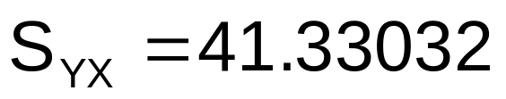
Linear Regression Example
Standard Error of Estimate
Regression Statistics
Multiple R | 0.76211
R Square | 0.58082
Adjusted R Square | 0.52842
Standard Error | 41.33032
Observations | 10
ANOVA | df | SS | MS | F | Significance F
Regression | 1 | 18934.9348 | 18934.9348 | 11.0848 | 0.01039
Residual | 8 | 13665.5652 | 1708.1957
Total | 9 | 32600.5000
 | Coefficients | Standard Error | t Stat | P-value | Lower 95% | Upper 95%
Intercept | 98.24833 | 58.03348 | 1.69296 | 0.12892 | -35.57720 | 232.07386
Square Feet | 0.10977 | 0.03297 | 3.32938 | 0.01039 | 0.03374 | 0.18580

Slide 34
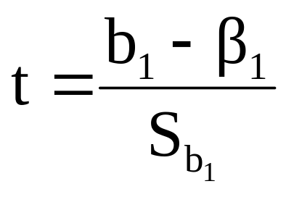

Inferences About the Slope: t Test
t test for a population slope
  Is there a linear relationship between X and Y?
Null and alternative hypotheses
  H₀: β₁ = 0 (no linear relationship)
  H₁: β₁ ≠ 0 (linear relationship does exist)
Test statistic
where:
b₁ = regression slope
coefficient
β₁ = hypothesized slope
S_{b1} = standard
error of the slope

Slide 35
Inferences About the Slope: t Test Example
Estimated Regression Equation:
House Price in $1000s (y) | Square Feet (x)
245 | 1400
312 | 1600
279 | 1700
308 | 1875
199 | 1100
219 | 1550
405 | 2350
324 | 2450
319 | 1425
255 | 1700
The slope of this model is 0.1098
Is there a relationship between the square footage of the house and its sales price?

Slide 36
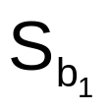
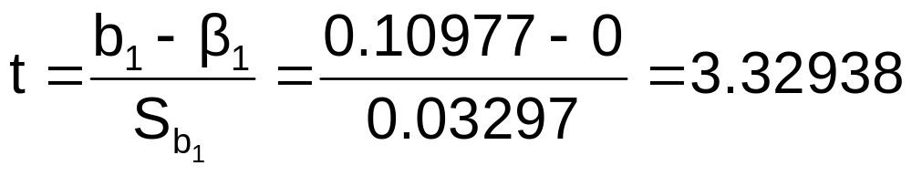
Inferences About the Slope: t Test Example
b₁
H₀: β₁ = 0
H₁: β₁ ≠ 0
From Excel output:
 | Coefficients | Standard Error | t Stat | P-value
Intercept | 98.24833 | 58.03348 | 1.69296 | 0.12892
Square Feet | 0.10977 | 0.03297 | 3.32938 | 0.01039
t

Slide 37
Inferences About the Slope: t Test Example
Test Statistic: t = 3.329
H₀: β₁ = 0
H₁: β₁ ≠ 0
d.f. = 10- 2 = 8
Decision: Reject H₀
α/2=.025
α/2=.025
There is sufficient evidence that square footage affects house price
Reject H₀
Do not reject H₀
Reject H₀
-t_{α/2}
t_{α/2}
0
-2.3060
2.3060
3.329

Slide 38
Inferences About the Slope: t Test Example
P-Value
From Excel output:
 | Coefficients | Standard Error | t Stat | P-value
Intercept | 98.24833 | 58.03348 | 1.69296 | 0.12892
Square Feet | 0.10977 | 0.03297 | 3.32938 | 0.01039
H₀: β₁ = 0
H₁: β₁ ≠ 0
Decision: Reject H₀, since p-value < α
There is sufficient evidence that square footage affects house price.

Slide 39
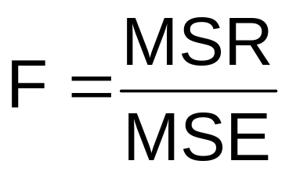
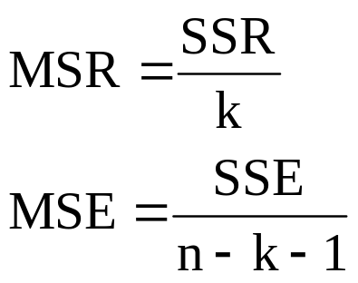
F-Test for Significance
F Test statistic:
where
where F follows an F distribution with k numerator degrees of freedom and (n - k - 1) denominator degrees of freedom
(k = the number of independent variables in the regression model)

Slide 40
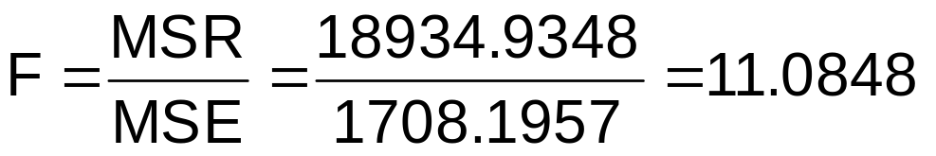
F-Test for Significance
Excel Output
Regression Statistics
Multiple R | 0.76211
R Square | 0.58082
Adjusted R Square | 0.52842
Standard Error | 41.33032
Observations | 10
ANOVA | df | SS | MS | F | Significance F
Regression | 1 | 18934.9348 | 18934.9348 | 11.0848 | 0.01039
Residual | 8 | 13665.5652 | 1708.1957
Total | 9 | 32600.5000
With 1 and 8 degrees of freedom
P-value for the F-Test

Slide 41
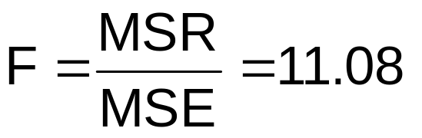
F-Test for Significance
H₀: β₁ = 0
H₁: β₁ ≠ 0
α = .05
df₁= 1 df₂ = 8
Test Statistic:
Decision:
Conclusion:
Reject H₀ at α = 0.05
Critical Value:
F_{α} = 5.32
α = .05
There is sufficient evidence that house size affects selling price
0
F
Do not
reject H₀
Reject H₀
F_{.05} = 5.32

Slide 42
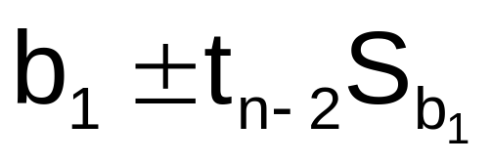
Confidence Interval Estimate for the Slope
Confidence Interval Estimate of the Slope:
d.f. = n - 2
Excel Printout for House Prices:
 | Coefficients | Standard Error | t Stat | P-value | Lower 95% | Upper 95%
Intercept | 98.24833 | 58.03348 | 1.69296 | 0.12892 | -35.57720 | 232.07386
Square Feet | 0.10977 | 0.03297 | 3.32938 | 0.01039 | 0.03374 | 0.18580
At the 95% level of confidence, the confidence interval for the slope is (0.0337, 0.1858)

Slide 43
Confidence Interval Estimate for the Slope
 | Coefficients | Standard Error | t Stat | P-value | Lower 95% | Upper 95%
Intercept | 98.24833 | 58.03348 | 1.69296 | 0.12892 | -35.57720 | 232.07386
Square Feet | 0.10977 | 0.03297 | 3.32938 | 0.01039 | 0.03374 | 0.18580
Since the units of the house price variable is $1000s, you are 95% confident that the mean change in sales price is between $33.74 and $185.80 per square foot of house size
This 95% confidence interval does not include 0.
Conclusion: There is a significant relationship between house price and square feet at the .05 level of significance

Slide 44
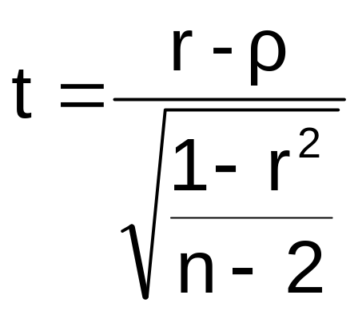
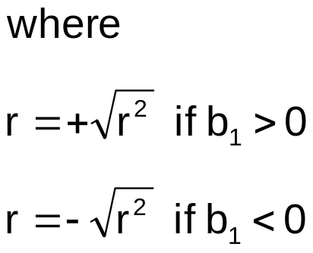
t Test for a Correlation Coefficient
Hypotheses
  H₀: ρ = 0 (no correlation between X and Y)
  H₁: ρ ≠ 0 (correlation exists)
Test statistic
  (with n – 2 degrees of freedom)

Slide 45
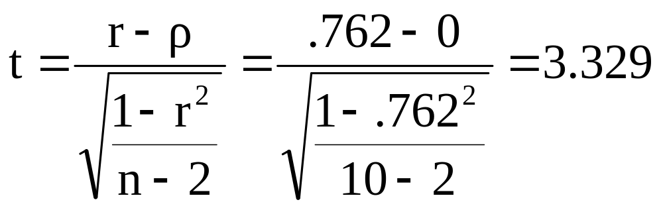
t Test for a Correlation Coefficient
Is there evidence of a linear relationship between square feet and house price at the .05 level of significance?
H₀: ρ = 0 (No correlation)
H₁: ρ ≠ 0 (correlation exists)
α =.05 , df = 10 - 2 = 8

Slide 46
t Test for a Correlation Coefficient
Decision:
Reject H₀
d.f. = 10- 2 = 8
α/2=.025
α/2=.025
Conclusion:
There is evidence of a linear association at the 5% level of significance
Reject H₀
-t_{α/2}
Do not reject H₀
t_{α/2}
Reject H₀
0
-2.3060
2.3060
3.329

Slide 47
The Multiple Regression Model
Idea: Examine the linear relationship between 1 dependent (Y) & 2 or more independent variables (X_{i}).
Multiple Regression Model with k Independent Variables:
Y-intercept
Population slopes
Random Error

Slide 48
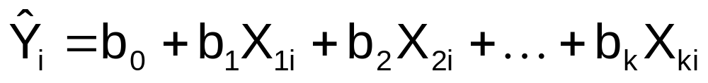
Multiple Regression Equation
The coefficients of the multiple regression model are estimated using sample data
Multiple regression equation with k independent variables:
Estimated
(or predicted)
value of Y
Estimated
intercept
Estimated slope coefficients
In this chapter we will always use Excel to obtain the regression slope coefficients and other regression summary measures.

Slide 49
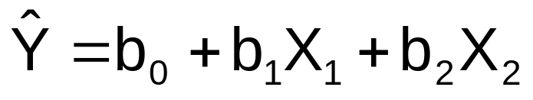
Multiple Regression Equation
Example with two independent variables
Y
Slope for variable X₁
X₂
Slope for variable X₂
X₁

Slide 50
Multiple Regression Equation
2 Variable Example
A distributor of frozen dessert pies wants to evaluate factors thought to influence demand
  Dependent variable: Pie sales (units per week)
  Independent variables: Price (in $)
  Advertising ($100’s)
Data are collected for 15 weeks

Slide 51
Multiple Regression Equation
2 Variable Example
Week | Pie Sales | Price ($) | Advertising ($100s)
1 | 350 | 5.50 | 3.3
2 | 460 | 7.50 | 3.3
3 | 350 | 8.00 | 3.0
4 | 430 | 8.00 | 4.5
5 | 350 | 6.80 | 3.0
6 | 380 | 7.50 | 4.0
7 | 430 | 4.50 | 3.0
8 | 470 | 6.40 | 3.7
9 | 450 | 7.00 | 3.5
10 | 490 | 5.00 | 4.0
11 | 340 | 7.20 | 3.5
12 | 300 | 7.90 | 3.2
13 | 440 | 5.90 | 4.0
14 | 450 | 5.00 | 3.5
15 | 300 | 7.00 | 2.7
Multiple regression equation:
Sales = b₀ + b₁ (Price) + b₂ (Advertising)
Sales = b₀ +b₁X₁ + b₂X₂
Where X₁ = Price
X₂ = Advertising

Slide 52
Multiple Regression Equation
2 Variable Example, Excel
Regression Statistics
Multiple R | 0.72213
R Square | 0.52148
Adjusted R Square | 0.44172
Standard Error | 47.46341
Observations | 15
ANOVA | df | SS | MS | F | Significance F
Regression | 2 | 29460.027 | 14730.013 | 6.53861 | 0.01201
Residual | 12 | 27033.306 | 2252.776
Total | 14 | 56493.333
 | Coefficients | Standard Error | t Stat | P-value | Lower 95% | Upper 95%
Intercept | 306.52619 | 114.25389 | 2.68285 | 0.01993 | 57.58835 | 555.46404
Price | -24.97509 | 10.83213 | -2.30565 | 0.03979 | -48.57626 | -1.37392
Advertising | 74.13096 | 25.96732 | 2.85478 | 0.01449 | 17.55303 | 130.70888

Slide 53
Multiple Regression Equation
2 Variable Example
where
Sales is in number of pies per week
Price is in $
Advertising is in $100’s.
b₁ = -24.975: sales will decrease, on average, by 24.975 pies per week for each $1 increase in selling price, net of the effects of changes due to advertising
b₂ = 74.131: sales will increase, on average, by 74.131 pies per week for each $100 increase in advertising, net of the effects of changes due to price

Slide 54
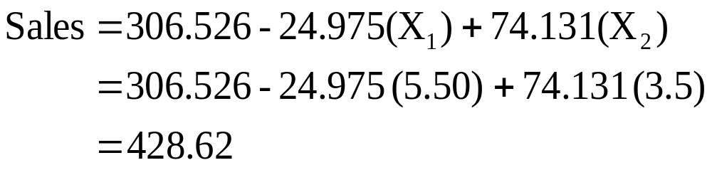
Multiple Regression Equation
2 Variable Example
Predict sales for a week in which the selling price is $5.50 and advertising is $350:
Note that Advertising is in $100’s, so $350 means that X₂ = 3.5
Predicted sales is 428.62 pies

Slide 55
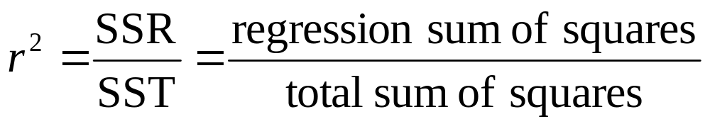
Coefficient of
Multiple Determination
Reports the proportion of total variation in Y explained by all X variables taken together

Slide 56
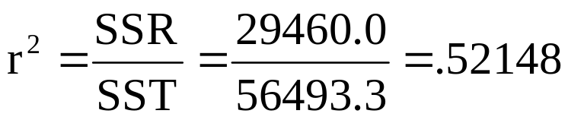
Coefficient of
Multiple Determination (Excel)
Regression Statistics
Multiple R | 0.72213
R Square | 0.52148
Adjusted R Square | 0.44172
Standard Error | 47.46341
Observations | 15
ANOVA | df | SS | MS | F | Significance F
Regression | 2 | 29460.027 | 14730.013 | 6.53861 | 0.01201
Residual | 12 | 27033.306 | 2252.776
Total | 14 | 56493.333
 | Coefficients | Standard Error | t Stat | P-value | Lower 95% | Upper 95%
Intercept | 306.52619 | 114.25389 | 2.68285 | 0.01993 | 57.58835 | 555.46404
Price | -24.97509 | 10.83213 | -2.30565 | 0.03979 | -48.57626 | -1.37392
Advertising | 74.13096 | 25.96732 | 2.85478 | 0.01449 | 17.55303 | 130.70888
52.1% of the variation in pie sales is explained by the variation in price and advertising

Slide 57
Adjusted r²
r² never decreases when a new X variable is added to the model
  This can be a disadvantage when comparing models
What is the net effect of adding a new variable?
  We lose a degree of freedom when a new X variable is added
  Did the new X variable add enough independent power to offset the loss of one degree of freedom?

Slide 58
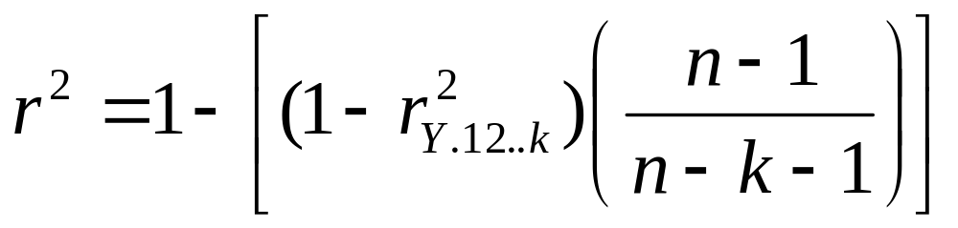
Adjusted r²
Shows the proportion of variation in Y explained by all X variables adjusted for the number of X variables used
  (where n = sample size, k = number of independent variables)
  Penalizes excessive use of unimportant independent variables
  Smaller than r²
  Useful in comparing models

Slide 59
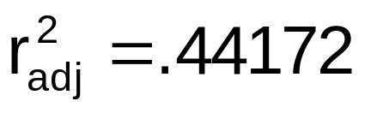
Adjusted r²
Regression Statistics
Multiple R | 0.72213
R Square | 0.52148
Adjusted R Square | 0.44172
Standard Error | 47.46341
Observations | 15
ANOVA | df | SS | MS | F | Significance F
Regression | 2 | 29460.027 | 14730.013 | 6.53861 | 0.01201
Residual | 12 | 27033.306 | 2252.776
Total | 14 | 56493.333
 | Coefficients | Standard Error | t Stat | P-value | Lower 95% | Upper 95%
Intercept | 306.52619 | 114.25389 | 2.68285 | 0.01993 | 57.58835 | 555.46404
Price | -24.97509 | 10.83213 | -2.30565 | 0.03979 | -48.57626 | -1.37392
Advertising | 74.13096 | 25.96732 | 2.85478 | 0.01449 | 17.55303 | 130.70888
44.2% of the variation in pie sales is explained by the variation in price and advertising, taking into account the sample size and number of independent variables

Slide 60
F-Test for Overall Significance
F-Test for Overall Significance of the Model
  Shows if there is a linear relationship between all of the X variables considered together and Y
Use F test statistic
  Hypotheses:
    H₀: β₁ = β₂ = … = β_{k} = 0 (no linear relationship)
    H₁: at least one β_{i} ≠ 0 (at least one independent variable affects Y)

Slide 61
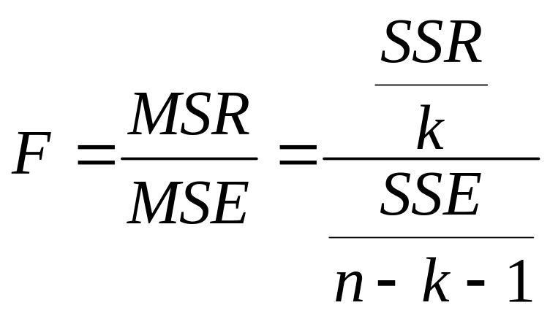
F-Test for Overall Significance
Test statistic:
where F has (numerator) = k and
(denominator) = (n - k - 1)
degrees of freedom

Slide 62
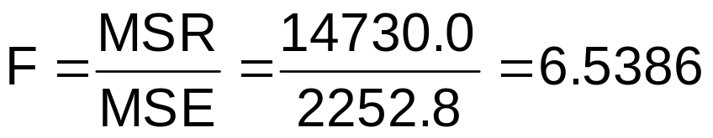
F-Test for Overall Significance
Regression Statistics
Multiple R | 0.72213
R Square | 0.52148
Adjusted R Square | 0.44172
Standard Error | 47.46341
Observations | 15
ANOVA | df | SS | MS | F | Significance F
Regression | 2 | 29460.027 | 14730.013 | 6.53861 | 0.01201
Residual | 12 | 27033.306 | 2252.776
Total | 14 | 56493.333
 | Coefficients | Standard Error | t Stat | P-value | Lower 95% | Upper 95%
Intercept | 306.52619 | 114.25389 | 2.68285 | 0.01993 | 57.58835 | 555.46404
Price | -24.97509 | 10.83213 | -2.30565 | 0.03979 | -48.57626 | -1.37392
Advertising | 74.13096 | 25.96732 | 2.85478 | 0.01449 | 17.55303 | 130.70888
P-value for the F-Test

Slide 63
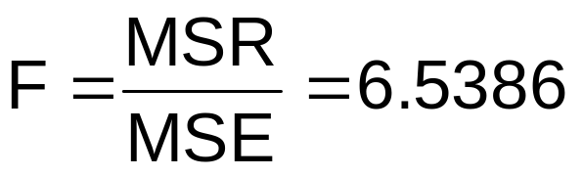
F-Test for Overall Significance
H₀: β₁ = β₂ = 0
H₁: β₁ and β₂ not both zero
α = .05
df₁= 2 df₂ = 12
Test Statistic:
Decision:
Conclusion:
Critical Value:
F_{α} = 3.885
Since F test statistic is in the rejection region (p-value < .05), reject H₀
α = .05
0
F
There is evidence that at least one independent variable affects Y
Do not
reject H₀
Reject H₀
F_{.05} = 3.89

Slide 64
Individual Variables
Tests of Hypothesis
Use t-tests of individual variable slopes
Shows if there is a linear relationship between the variable X_{i} and Y
Hypotheses:
  H₀: β_{i} = 0 (no linear relationship)
  H₁: β_{i} ≠ 0 (linear relationship does exist
  between X_{i} and Y)

Slide 65
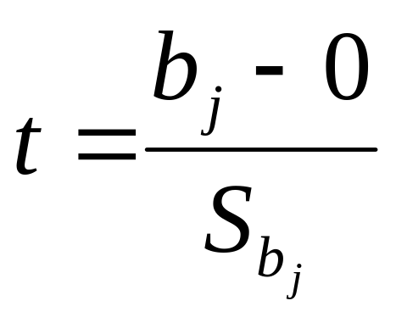
Individual Variables
Tests of Hypothesis
  H₀: β_{j} = 0 (no linear relationship)
  H₁: β_{j} ≠ 0 (linear relationship does exist between X_{i} and Y)
  Test Statistic:
  (df = n – k – 1)

Slide 66
Individual Variables
Tests of Hypothesis
Regression Statistics
Multiple R | 0.72213
R Square | 0.52148
Adjusted R Square | 0.44172
Standard Error | 47.46341
Observations | 15
ANOVA | df | SS | MS | F | Significance F
Regression | 2 | 29460.027 | 14730.013 | 6.53861 | 0.01201
Residual | 12 | 27033.306 | 2252.776
Total | 14 | 56493.333
 | Coefficients | Standard Error | t Stat | P-value | Lower 95% | Upper 95%
Intercept | 306.52619 | 114.25389 | 2.68285 | 0.01993 | 57.58835 | 555.46404
Price | -24.97509 | 10.83213 | -2.30565 | 0.03979 | -48.57626 | -1.37392
Advertising | 74.13096 | 25.96732 | 2.85478 | 0.01449 | 17.55303 | 130.70888
t-value for Price is t = -2.306, with p-value .0398
t-value for Advertising is t = 2.855, with p-value .0145

Slide 67
Individual Variables
Tests of Hypothesis
H₀: β_{j} = 0
H₁: β_{j} ≠ 0
 | Coefficients | Standard Error | t Stat | P-value
Price | -24.97509 | 10.83213 | -2.30565 | 0.03979
Advertising | 74.13096 | 25.96732 | 2.85478 | 0.01449
d.f. = 15 - 2 - 1 = 12
= .05
t_{α/2} = 2.1788
The test statistic for each variable falls in the rejection region (p-values < .05)
Decision:
Conclusion:
α/2=.025
α/2=.025
Reject H₀ for each variable
There is evidence that both Price and Advertising affect pie sales at α = .05
Reject H₀
Do not reject H₀
Reject H₀
-t_{α/2}
t_{α/2}
0

Slide 68
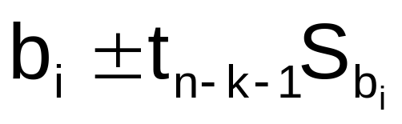
Confidence Interval Estimate for the Slope
Confidence interval for the population slope β_{i}
where t has
(n – k – 1) d.f.
 | Coefficients | Standard Error
Intercept | 306.52619 | 114.25389
Price | -24.97509 | 10.83213
Advertising | 74.13096 | 25.96732
Here, t has
(15 – 2 – 1) = 12 d.f.
Example: Form a 95% confidence interval for the effect of changes in price (X₁) on pie sales, holding constant the effects of advertising:
-24.975 ± (2.1788)(10.832): So the interval is (-48.576, -1.374)

Slide 69
Confidence Interval Estimate for the Slope
Confidence interval for the population slope β_{i}
 | Coefficients | Standard Error | … | Lower 95% | Upper 95%
Intercept | 306.52619 | 114.25389 | … | 57.58835 | 555.46404
Price | -24.97509 | 10.83213 | … | -48.57626 | -1.37392
Advertising | 74.13096 | 25.96732 | … | 17.55303 | 130.70888
Example: Excel output also reports these interval endpoints:
Weekly sales are estimated to be reduced by between 1.37 to 48.58 pies for each increase of $1 in the selling price, holding constant the effects of advertising.

Slide 70
Using Dummy Variables
A dummy variable is a categorical independent variable with two levels:
  yes or no, on or off, male or female
  coded as 0 or 1
Assumes equal slopes for other variables
If more than two levels, the number of dummy variables needed is (number of levels - 1)

Slide 71
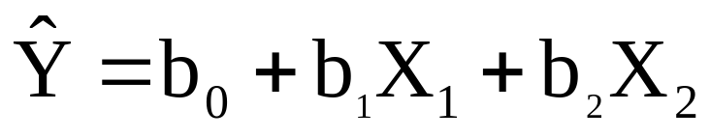
Dummy Variable Example
Let:
Y = pie sales
X₁ = price
X₂ = holiday (X₂ = 1 if a holiday occurred during the week) (X₂ = 0 if there was no holiday that week)

Slide 72
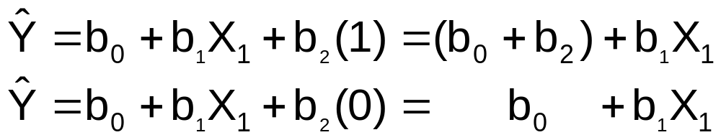
Dummy Variable Example
Holiday
No Holiday
Y (sales)
Different intercept
Same slope
b₀ + b₂
If H₀: β₂ = 0 is rejected, then
“Holiday” has a significant effect on pie sales
b₀
Holiday (X₂ = 1)
No Holiday (X₂ = 0)
X₁ (Price)

Slide 73
Dummy Variable Example
Sales: number of pies sold per week
Price: pie price in $
Holiday:
1 If a holiday occurred during the week
0 If no holiday occurred
b₂ = 15: on average, sales were 15 pies greater in weeks with a holiday than in weeks without a holiday, given the same price

