Slide 1

Online Learning
& Assignment Submission System
Name: Oveshek Kundu Toton ID: 200154
Session: 2020-21
Supervised By:Dr. Md. Alam Hossain, PhD Professor, Department of Computer Science and Engineering

Slide 2
INTRODUCTION
Flexibility
Efficiency
Engagement

Slide 3
PROBLEM STATEMENT
High Manual Workflow
Lack of Real-time Monitoring & Communication
No Automated Performance & Certification System
Disconnected Learning Workflow

Slide 4
OBJECTIVES
ROLE-BASED SYSTEM COURSE
ENROLLMENT
INSTRUCTOR CLASS REQUESTS
LIVE CLASSES & GROUP MANAGEMENT
ASSIGNMENT AND CERTIFICATION SYSTEM

Slide 5
FEATURES
USER ROLES & MANAGEMENT
COURSE & CLASS MANAGEMENT
ENROLLMENT
STUDENT GROUPING
ASSIGNMENTS & MARKING
COURSE-WISE PASS FAIL AUTO PDF GENERATE
TEACHER-WISE PASS FAIL REPORT
LIVE NOTIFICATIONS & COMMUNICATION
CERTIFICATION SYSTEM

Slide 6
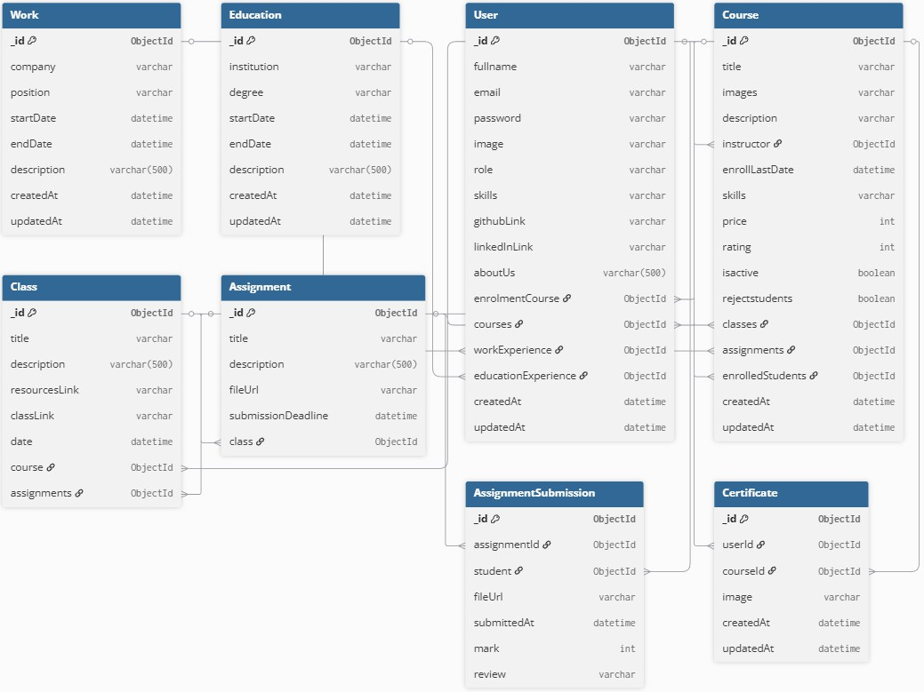
SCHEMA DIAGRAM

Slide 7
TECHNOLOGY
Frontend
React.js
Tailwind CSS
Backend
Node.js
Express.js
Database
MongoDB

Slide 8

HOME PAGE

Slide 9

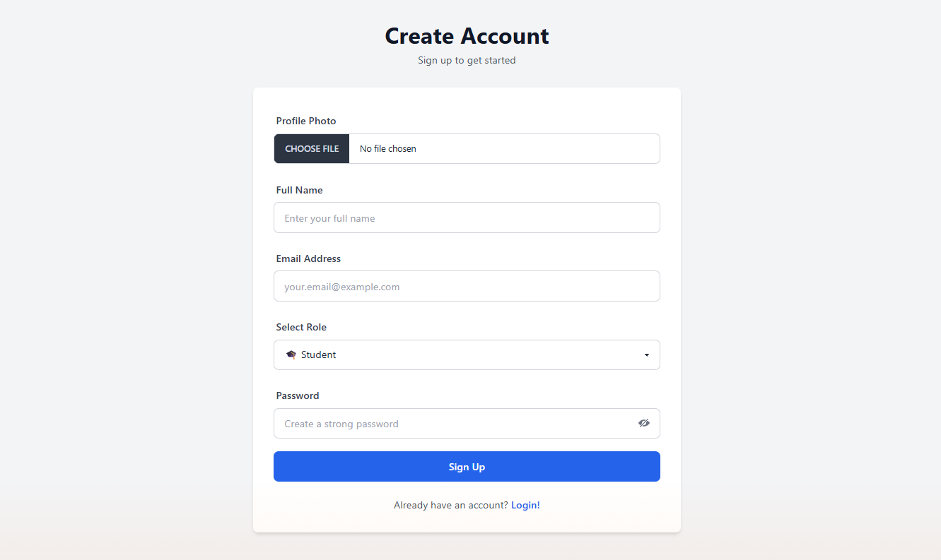
SIGN UP!

Slide 10
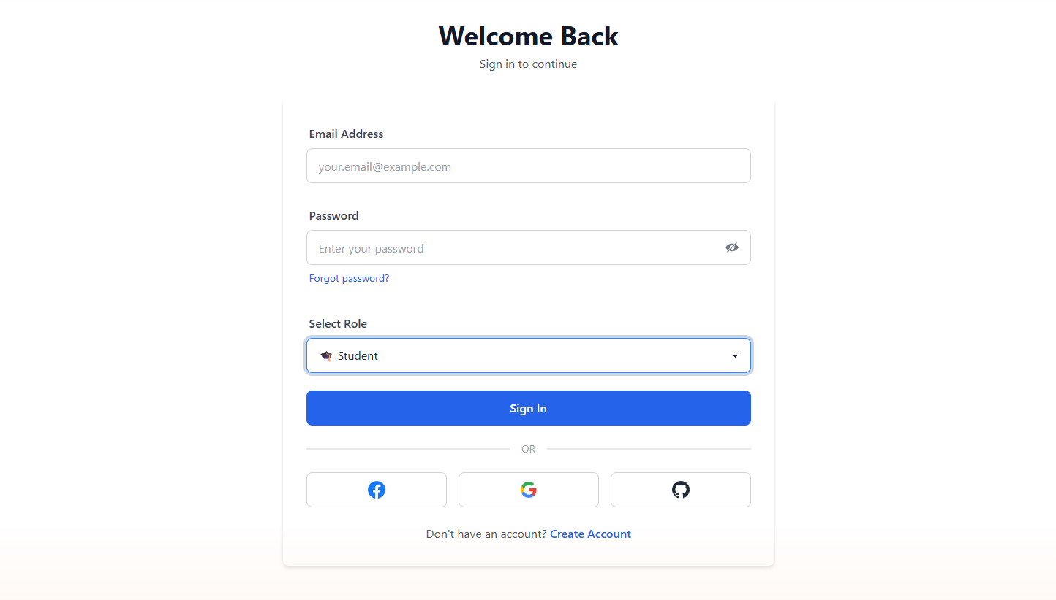
Login!

Slide 11
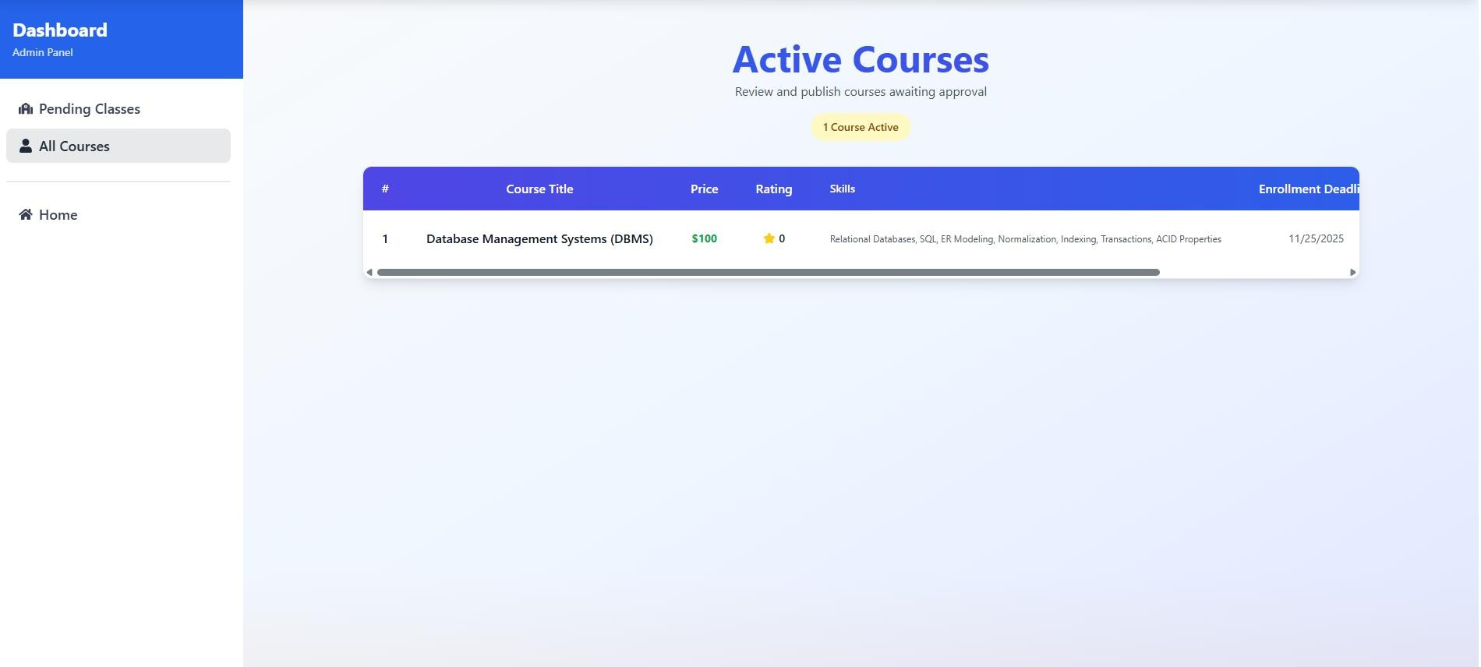
ADMIN DASHBOARD

Slide 12
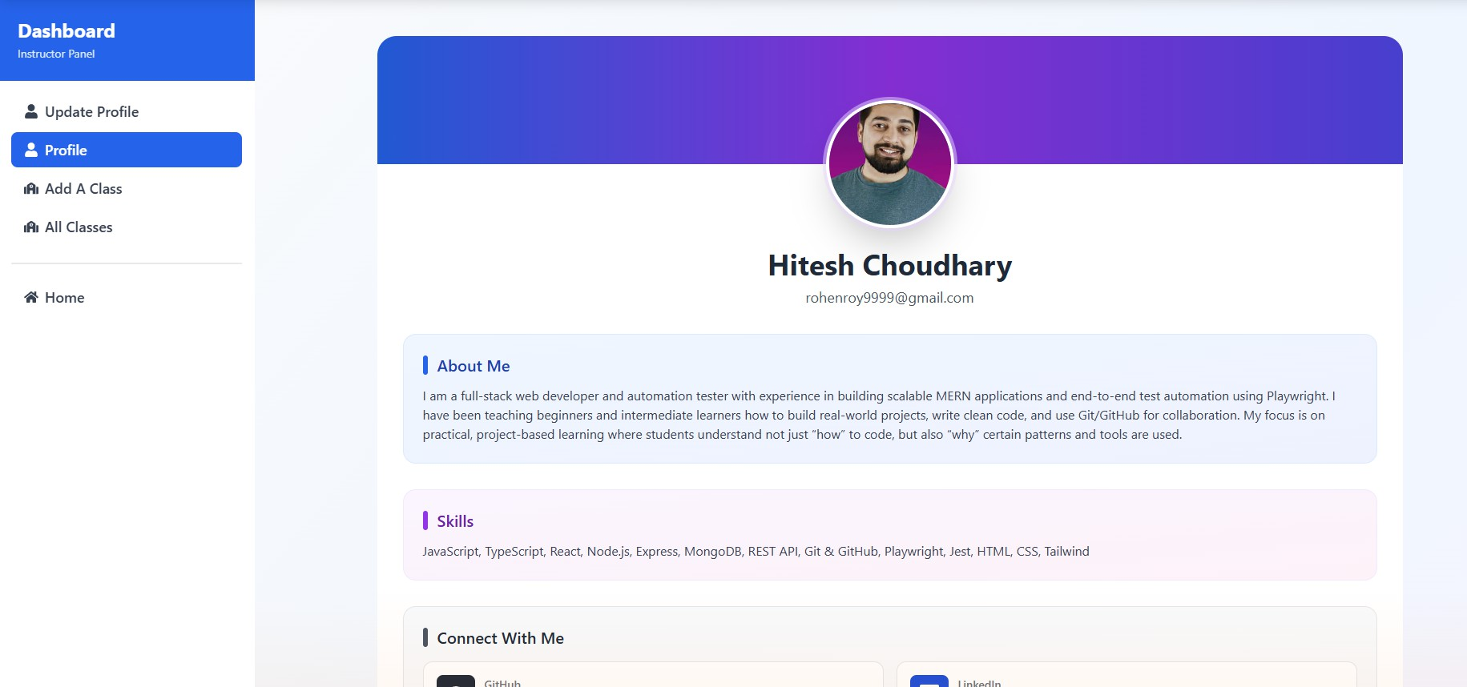
TEACHER DASHBOARD

Slide 13
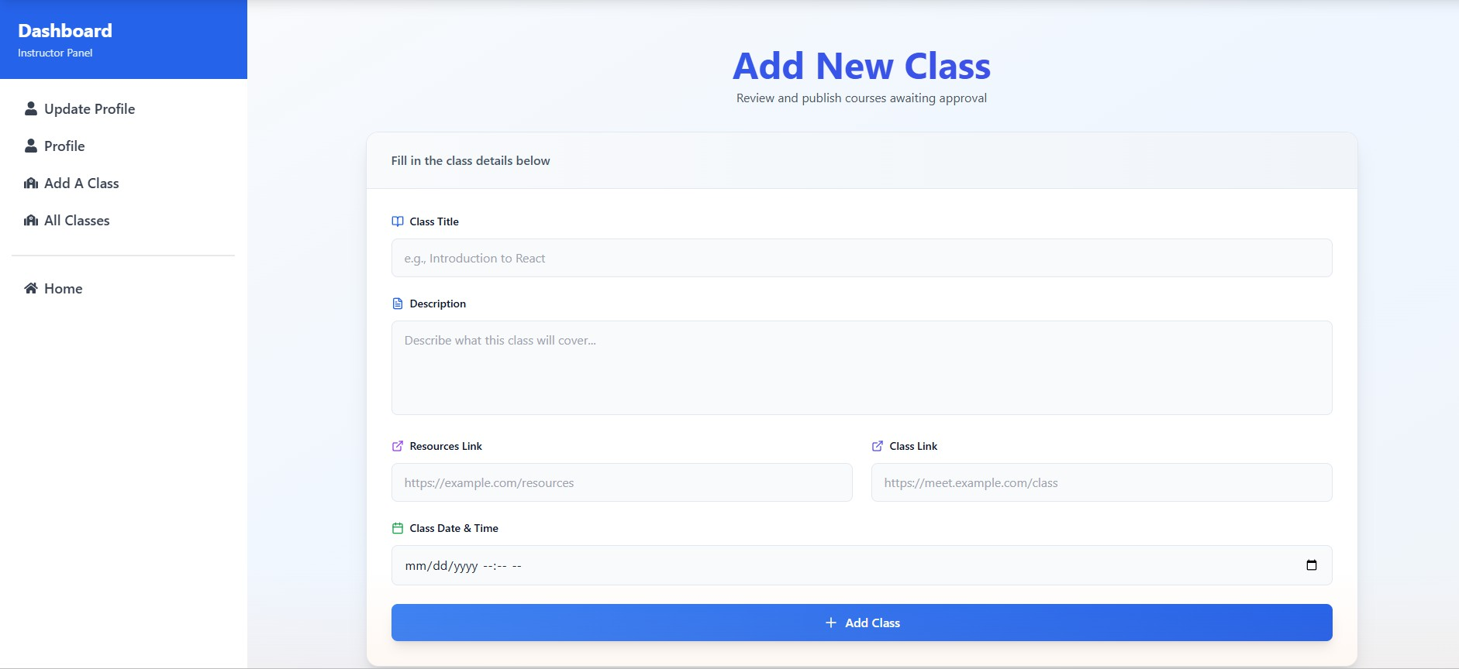
ADD CLASS

Slide 14
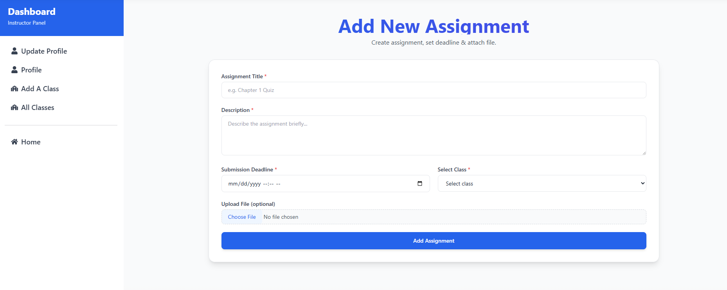
ADD ASSIGNMENT

Slide 15
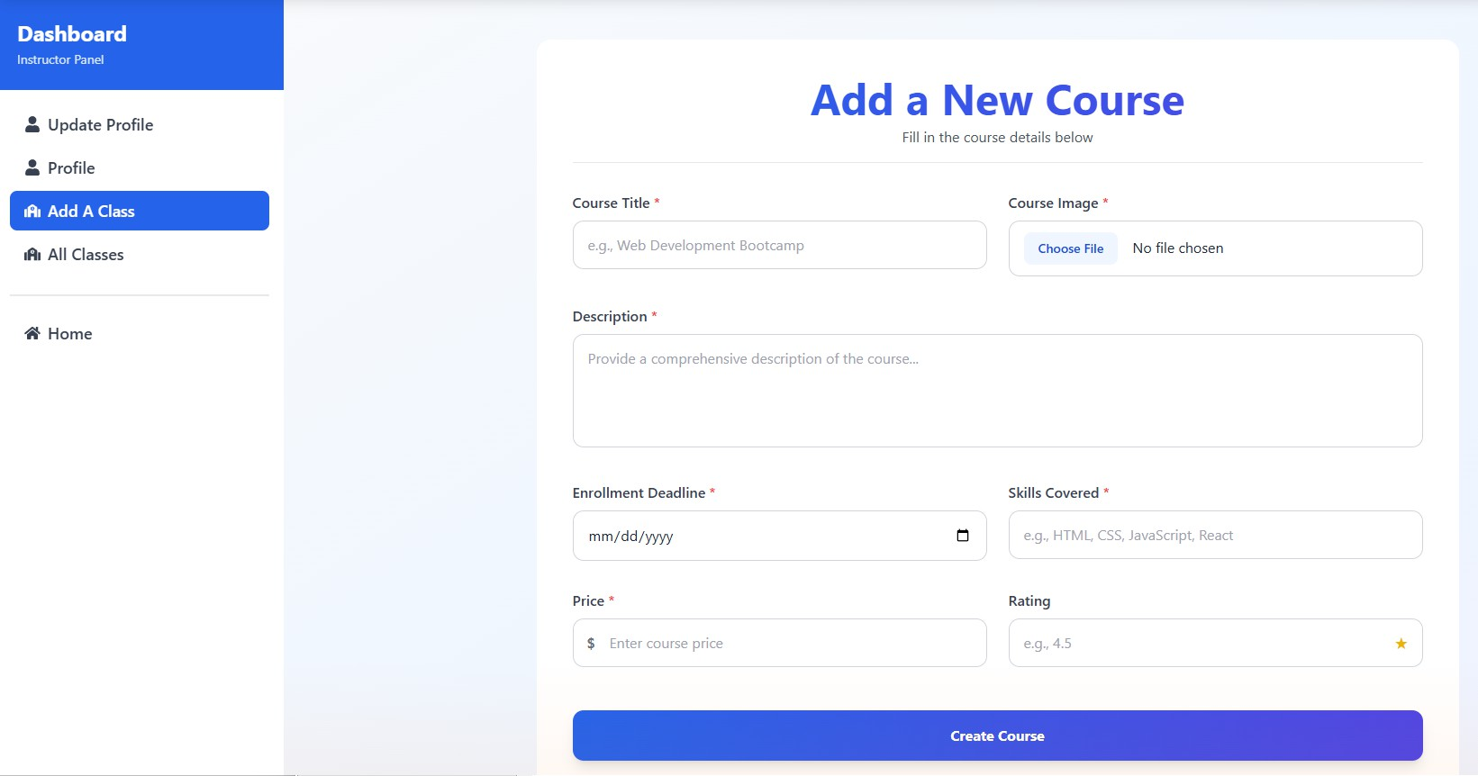
ADD COURSE

Slide 16
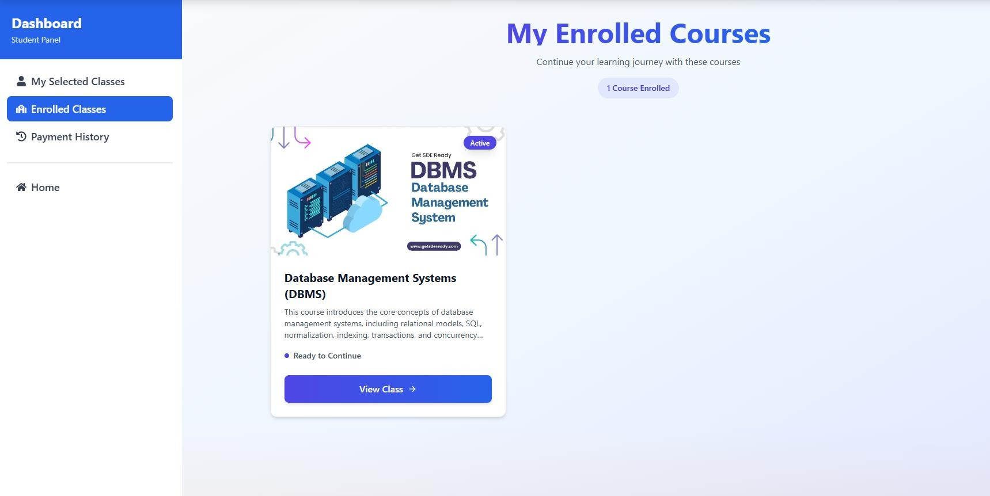
STUDENT DASHBOARD

Slide 17
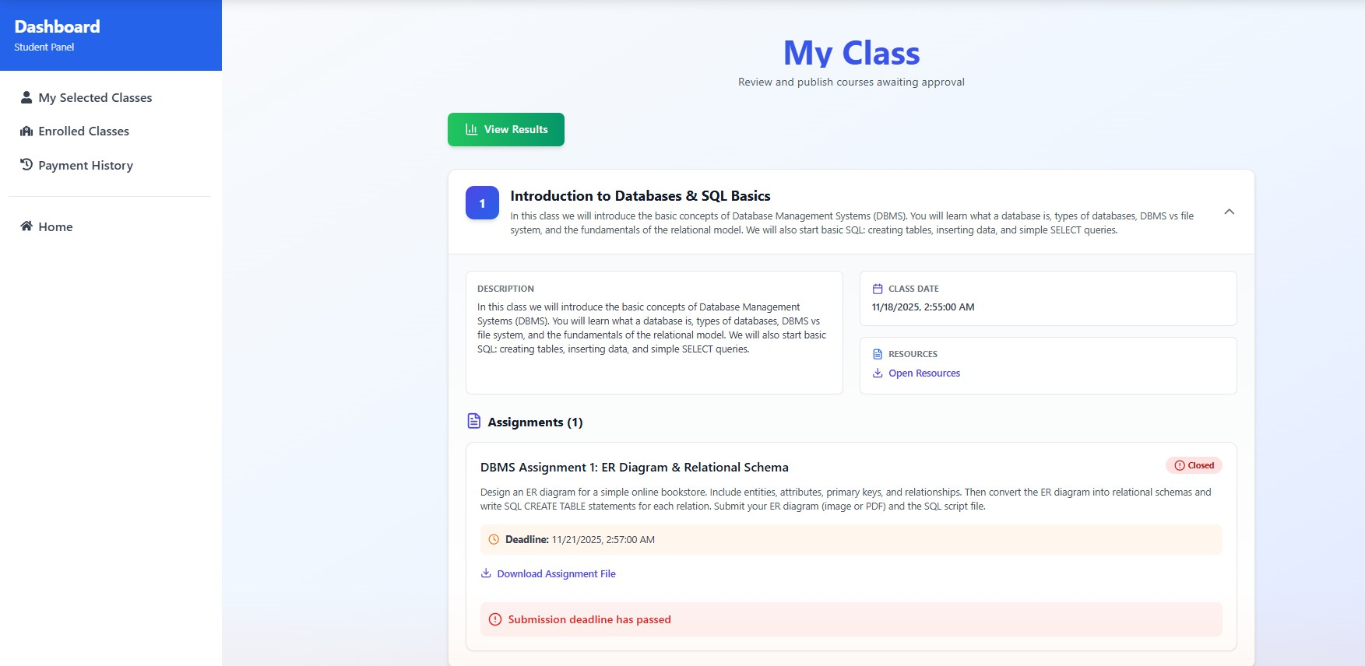
STUDENT CLASS

Slide 18
FUTURE WORK
COURSE-WISE PASS FAIL AUTO PDF GENERATE
TEACHER-WISE PASS FAIL REPORT
LIVE NOTIFICATIONS & COMMUNICATION
CERTIFICATION SYSTEM
SECURITY & AUTH (email verification,password recovery)

Slide 19
THANK YOU

