Slide 1
Skilled-based Online Marketplace
Presented By :
Oveshek kundu Toton
Student ID : 200154
Supervised by : Dr. Md. Alam Hossain Professor,
Computer Science and Engineering
Jashore University of Science and Technology

Slide 2

Skills
Safety
Trust
Transparency
INTRODUCTION

Slide 3

User Registration & Role Assignment
Job Categorization & Skill Filtering
Availability Management
Rating & Feedback System
Advanced Search & Filtering
Subscription Options
Key Features

Slide 4

Notification System
Payment Gateway
Bidding System
Analytics Dashboard
Real-Time Chat
Key Features

Slide 5
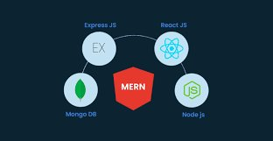
References
This chapter will list all the references and resources used during the development of the project. Possible references include:
MERN Stack Documentation: MongoDB, Express, React, and Node.js official docs.
Payment Integration: SSLCommerz
Live Chatting Web Socket: For real-time communication between users.
Technology

Slide 6

MAJOR MILSTONE
 | 4-5 | 6-7 | 8-9 | 10-11 | 12
Basic Knowledge Gathering
Frontend Design
Backend Development
Database Integration
Admin Dashboard, Payment Gateway
Testing, Bug Fixing and Deployment
WORK PLAN

Slide 7
THANK YOU

