Slide 1

Lex A Lexical Analyzer Generator
Spring 2015

Slide 2
The Goal of CS340400
Writing a C compiler
that generates Andes assembly code.

Slide 3
What compilers do?
Read the source program
Discover its structure
Process this structure
e.g. generate the target program

Slide 4
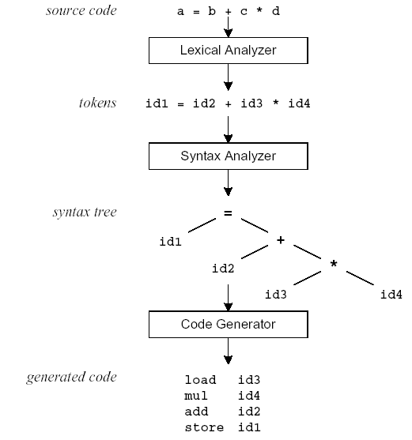
Compilation flow
Project 1 (lex)
Project 2 (yacc)
Project 3 (yacc)

Slide 5
Lex with Yacc
Project 1
Project 2
Lex source
(Lexical Rules)
Yacc source
(Grammar Rules)
Lex
Yacc
lex.yy.c
y.tab.c
call
yylex()
yyparse()
Parsed
Input
Input
return token

Slide 6
What is Lex?
Lex is an utility to help you rapidly generate your lexical analyzer, without writing complicated C program.
The main job of a lexical analyzer (scanner) is to break up an input stream into more usable elements (tokens)
a = b + c * d;
ID ASSIGN ID PLUS ID MULT ID SEMI

Slide 7
Lex – Lexical Analyzer
Lexical analyzers tokenize input streams
Tokens are the terminals of a language
English
verbs, nouns, punctuation marks, …
Programming language
identifiers, operators, keywords, …
Regular expressions define tokens
[a-zA-Z]+ => a word

Slide 8
Lex Source Program
Lex source is a table of
regular expressions
corresponding program fragments
digit [0-9]
letter [a-zA-Z]
%%
{letter}({letter}|{digit})* prinft(“id: %s\n”, yytext);
\n printf(“new line\n”);
%%
main() {
yylex();
}

Slide 9
Lex Source to C Program
The table is translated into a C program (lex.yy.c), which
reads an input stream
partitions the input into strings which match the given expressions and
copies it to an output stream if necessary

Slide 10
An overview of Lex
$ flex lex.l
Lex source program
“lex.l”
Lex
“lex.yy.c”
$ gcc lex.yy.c -lfl
“lex.yy.c”
C compiler
“a.out”
$ ./a.out < test.c
input file “test.c”
a.out
tokens

Slide 11
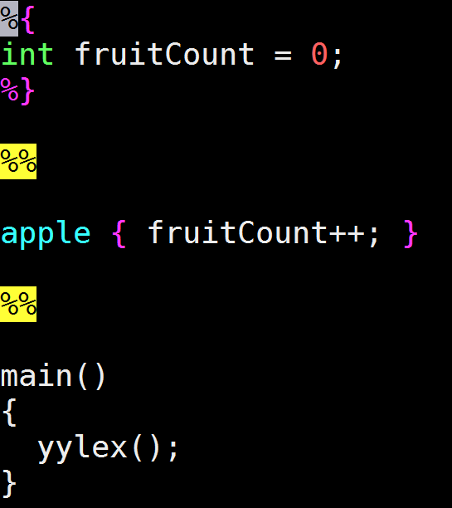
How to write lex file?
The format of Lex source is
{definitions}
%%
{transition rules}
%%
{user subroutines}

Slide 12
How to write lex file? (Definition part)
Definition part:
format: %{ your declaration code(C language)%}
Ex
%{ //to record the number and lines of the parser input file
int num_char = 0;
int num_line = 0;
%}
%%
\n {num_line++;}
. {num_char;}
Notes:
definition：使用者自己定義的變數，都放在這個地方 rules：parser對token match的規則 user code：最後產生的lex.yy.c最底下會有一模一樣的code

Slide 13
How to write lex file? (Definition part)
Definition part :
We can also declare variables for the rule part…
format: name definition
Ex
number [0-9]+
identifier [a-zA-Z_][a-zA-Z_0-9]*
%%
{number} printf(“%s this token is a number\n”, yytext);
{identifier} printf(“%s this token is a identifier\n”, yytext);
the code above equals to…
{[0-9]+} printf(“%s this token is a number\n”, yytext);
{[a-zA-Z_][a-zA-Z_0-9]*} printf(“%s this token is a identifier\n”, yytext);

Slide 14
How to write lex file? (Definition part)
%%
[a-zA-Z_]([a-zA-Z_]|[0-9])* ECHO;
. |
\n ;
Equivalent!!
letter [a-zA-Z_]
digit [0-9]
%%
{letter}({letter}|{digit})* ECHO;
. |
\n ;

Slide 15

How to write lex file? (Rules part)
Rules part :
Write the tokens’ rule you want
format: regexp action (C code);
format: regexp { actions (C code); }
E.g

Slide 16
Transition Rules : For Rule Part
Unmatched patterns will perform a default action, which copies the input to the output
Null statement ; will ignore the input (no actions)
E.g：Ignore blank, tab (\t), newline (\n)
[ \t\n] ;
Causes the three spacing characters to be ignored
a = b + c;
d = b * c;
↓ ↓
a=b+c;d=b*c;
Notes:
A null statement : 只有一個分號，沒有敘述

Slide 17
Transition Rules (cont’d)
Four special options for actions: |, ECHO, REJECT, and BEGIN
| indicates that the action for this rule is from the action for the next rule
[ \t\n] ;
“ “ |
“\t” |
“\n” ;
ECHO copies the matched string to the output
An unmatched token uses the default action, ECHO
When more than one expression can match the current input,
The rule given first is preferred
Notes:
| 這個符號一樣是 or

Slide 18
Lex Predefined Variables
yytext -- a string containing the lexeme
yyleng -- the length of the lexeme
yyin -- the input stream pointer
the default input of default main() is stdin
yyout -- the output stream pointer
the default output of default main() is stdout.
E.g.
[a-z]+ printf(“%s”, yytext);
[a-z]+ ECHO;
[a-zA-Z]+ {words++; chars += yyleng;}
Notes:
Yytext 該TOKEN的內容會存在YYTEXT字串中
Yyleng 該TOKEN的長度會存在YYLENG中
yyin
yyout

Slide 19
Review of Lex Predefined Variables
Name | Function
char *yytext | pointer to matched string
int yyleng | length of matched string
FILE *yyin | input stream pointer
FILE *yyout | output stream pointer
int yylex(void) | call to invoke lexer, returns token
char* yymore(void) | return the next token
int yyless(int n) | retain all token except the first n characters in yytext
int yywrap(void) | wrapup, return 1 if done, 0 if not done
ECHO | write matched string
REJECT | go to the next alternative rule
BEGIN | condition switch start condition

Slide 20
The Use of Start Conditions
Lex allows the user to explicitly declare multiple states (in definition section)
%Start name1 name2 …
The word Start may be abbreviated to s or S.
i.e. %Start name
= %S name
= %s name

Slide 21
The Use of Start Conditions (cont’d)
Consider the following problem:
copy the input to the output,
changing the word magic to first on every line which began with the letter a,
changing the word magic to second on every line which began with the letter b,
changing the word magic to third on every line which began with the letter c
Notes:
當一行以a為開頭 就把該行中的magic代換成first

Slide 22
The Use of Start Conditions (cont’d)
The default state is <INITIAL> or 0
int flag;
%%
^a {flag=‘a’; ECHO;}
^b {flag=‘b’; ECHO;}
^c {flag=‘c’; ECHO;}
\n {flag=0; ECHO;}
magic { switch(flag) {
case ‘a’: printf(“first”); break;
case ‘b’: printf(“second”); break;
case ‘c’: printf(“third”); break;
default: ECHO;
}
}
%Start AA BB CC
%%
^a {ECHO; BEGIN AA;}
^b {ECHO; BEGIN BB;}
^c {ECHO; BEGIN CC;}
\n {ECHO; BEGIN 0;}
<AA>magic printf(“first”);
<BB>magic printf(“second”);
<CC>magic printf(“third”);
magic ECHO;
Equivalent!!

Slide 23
The Use of Start Conditions (cont’d)
The default state is <INITIAL> or 0
%Start COMMENT
%%
<INITIAL>. ECHO;
<INITIAL>”/*” BEGIN COMMENT;
<COMMENT>. ;
<COMMENT>”*/” BEGIN INITIAL;
/* comments */
a = b + c; /* another comment */
↓ ↓
a = b + c;
Notes:
用於COMMENT，當抓到 “/*”時，看COMMENT(此時不做任何動作)，直到 “*/”再從INITIAL開始(原本/最初始的狀態 INITIAL)(淺灰色表示忽略)

Slide 24
User Subroutines Section
You can use your Lex routines in the same ways you use routines in other programming languages.
%{
void foo();
%}
letter [a-zA-Z]
%%
{letter}+ foo();
%%
…
void foo() {
…
}
Definitions
Rules
Routines

Slide 25
User Subroutines Section (cont’d)
The section where main() is placed
%{
int counter = 0;
%}
letter [a-zA-Z]
%%
{letter}+ {printf(“a word\n”); counter++;}
%%
main() {
yylex();
printf(“There are total %d words\n”, counter);
}

Slide 26
Default Rules and Actions
The first and second section must exist, but may be empty, the third section and the second %% are optional.
If the third section dose not contain a main(), -lfl will link a default main() which calls yylex() then exits.
Unmatched patterns will perform a default action, which copies the input to the output

Slide 27
Lex Regular Expressions (Extended Regular Expressions)
A regular expression matches a set of strings
Extended regular expression
Operators
Character classes
Arbitrary character
Optional expressions
Alternation and grouping
Context sensitivity
Repetitions and definitions

Slide 28
Operators
“ \ [ ] ^ - ? . * + | ( ) $ / { } % < >
“xyz” = xyz
If they are to be used as text characters, an escape should be used
\$ = “$”
\\ = “\”
xyz“++” = “xyz++” = xyz\+\+
Every character but blank, tab (\t), newline (\n) and the list above is always a text character
Notes:
Operators 有其代表不同意思:
如果想要代表該符號，就要用 “\”來包起來

Slide 29
Character Classes []
[abc] matches a single character, which may be a, b, or c
Every operator meaning is ignored except \, - and ^
e.g.
[ab] => a or b
[a-z] => a or b or c or … or z
[-+0-9] => all the digits and the two signs
[^a-zA-Z] => any character which is not a letter

Slide 30
Arbitrary Character .
To match almost character, the operator character . is the class of all characters except newline.

Slide 31
Optional & Repeated Expressions
a? => zero or one instance of a
a* => zero or more instances of a
a+ => one or more instances of a
Ex
ab?c => ac or abc
[a-z]+ => all strings of lower case letters
[a-zA-Z][a-zA-Z0-9]* => all alphanumeric strings with a leading alphabetic character

Slide 32
Context Sensitivity ^ $ /
^ab matches the string ab, and only if ab is at the beginning of a line
(if ^ is the first character of an expression)
ab$ matches the string ab, and only if ab is at the end of a line
(if $ is the last character of an expression)
ab/cd matches the string ab, but only if followed by cd
ab$ = ab/\n are the same rule

Slide 33
Repetitions and Definitions {}
The operators {} specify either
repetitions (if they enclose numbers)
definition expansion (if they enclose a name)
E.g.
a{1,5} => 1 to 5 occurrences of a
{digit} => a predefined string named digit

Slide 34
Lex Example
%{
int icount = 0;
%}
%%
int { printf(“double”); icount++;}
%%
int main() {
yylex();
printf(“Change %d int to double\n”, icount);
return 0;
}
Notes:
看到 “int”就印出 “double”

Slide 35
A lex example
To recognize “integers” and “real numbers”
%%
0 |
[1-9][0-9]* {
printf("a integer\n");
}
(0|[1-9][0-9]*)\.[0-9]* {
printf("a real number\n");
}
. {
printf("others\n");
}
%%
Result:
> 012 34.56 789 0.1
a integer
a integer
others
a real number
others
a integer
others
a real number
Notes:
0 =>integer, 12=>integer, space=> others, 34.56 => real number, space=>others, 789=>integer, space=>others, 0.1=>real number

Slide 36
CS340400 Compiler Design HW1

Slide 37
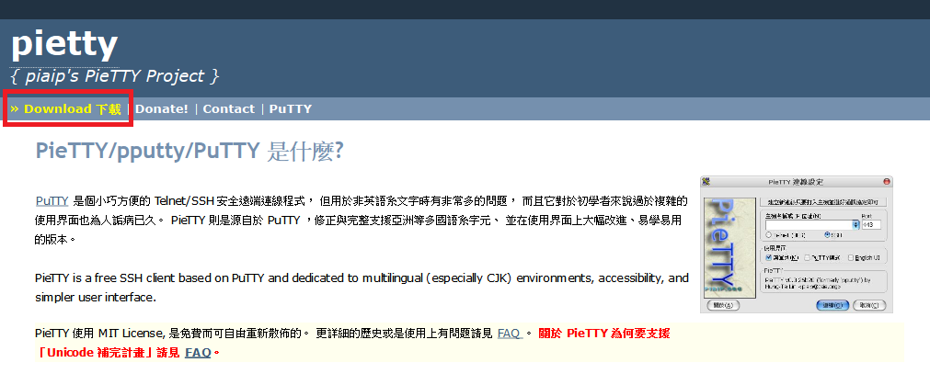
連線到工作站
作業需要在工作站上面撰寫，請同學下載 PieTTY 遠端連線至工作站
PieTTY 網頁：http://ntu.csie.org/~piaip/pietty/
點選左上方的 Download 下載 PieTTY

Slide 38
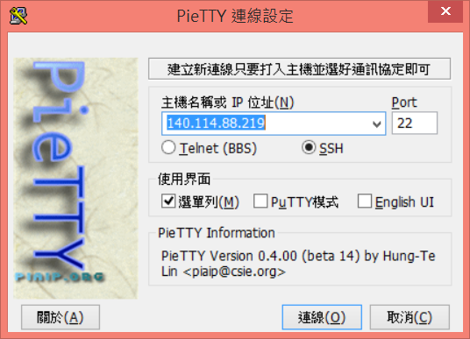
連線到工作站
PieTTY 連線方法
工作站IP：140.114.88.219 Port：22
連線方式選擇 SSH

Slide 39
連線到工作站
帳號為學號，英文字母部分為小寫，密碼跟帳號相同
初次登入系統，工作站會要求更改密碼，更改後再次連至工作站即可
更改密碼步驟：
輸入舊密碼
輸入新密碼
再輸入一次新密碼
如果之後又想修改密碼，請輸入指令 $ passwd
請在自己的家目錄下建立Assignment1資料夾
$ mkdir Assignment1
$ cd Assignment1

Slide 40
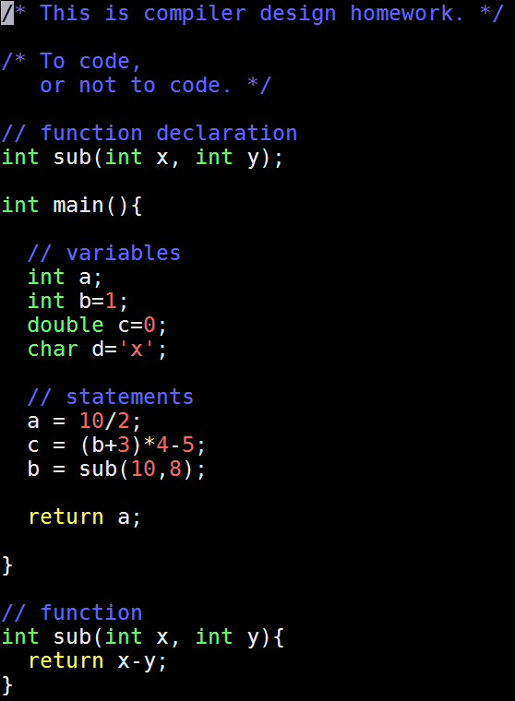
範例
三次作業都是使用這個testfile.c範例來做編譯

Slide 41
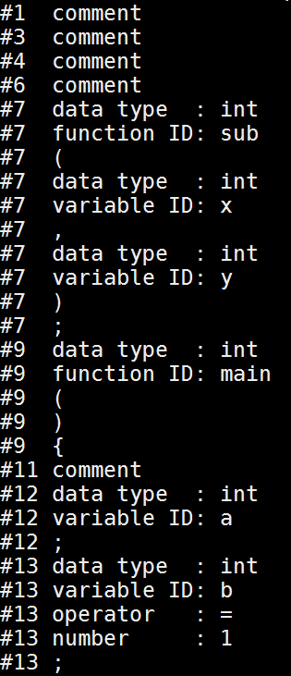
範例結果片段
用flex寫出的編譯器去分析範例程式，必須能輸出跟右圖一樣的結果
每一行分別是
[#行數 token類別 (:值)]
全部的token類別共有
comment character ,
data type (
function ID )
variable ID {
operator }
number ;

Slide 42
作業編譯流程
flex hw1.l
Lex source program
Lex
lex.yy.c
“hw1.l”
gcc lex.yy.c –lfl –o hw1.out
lex.yy.c
C compiler
hw1.out
./hw1.out < testfile.c
input
a.out
tokens

Slide 43
作業編譯流程
flex：全名為 fast lex，為一個開放原始碼的 lex
gcc：compiler 編譯器，一樣為開放原始碼
gcc 的編譯參數 –lfl：代表程式會連結到 flex 的函式庫，使用 flex 已經寫好的函式
./hw1.out：執行 a.out 這個檔案
./hw1.out < test.c： ”<“ 符號表示把 test.c 這個檔案當作執行檔 hw1.out 的輸入

Slide 44
配分
Basic
Variable declaration/initialization 25%
int 7%
double 7%
char 11%
Simple statement 25%
Function 25%
Comment 25%
// 10%
/**/ 15%
Basic :100%
Bonus：最高10%

Slide 45
上傳檔案至 Assignment1 資料夾底下
(flex原始碼檔案) 學號_hw1.l
(執行檔) 學號_hw1.out
(未完成hw1的同學) 請繳交說明文件，命名為 Readme.txt
請撰寫內容：
1.能夠拆解哪些 token
2.為何不能解析剩餘 token
3.嘗試過的方法或語法
(完成Bonus的同學) 請繳交文件及範例C程式碼，命名為 Bonus.txt 跟 bonus.c
文件內容請附上新增可以拆解哪些 token 的功能，並附上範例C程式碼供測試
Bonus 一項加5分，至多10分

Slide 46
Deadline:
April 13th, Monday, 2015
23:59 移除工作站網路線

Slide 47
Contact us
FaceBook社團
你的問題就是大家的問題…
cgcheng@pllab.cs.nthu.edu.tw
yhchien@pllab.cs.nthu.edu.tw

Slide 48
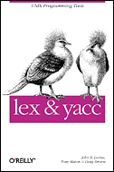
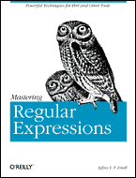
Reference Books
lex & yacc, 2nd Edition
by John R.Levine, Tony Mason & Doug Brown
O’Reilly
ISBN: 1-56592-000-7
Mastering Regular Expressions
by Jeffrey E.F. Friedl
O’Reilly
ISBN: 1-56592-257-3

